Slide 1


Educational Psychology Service
Critical Incident Response
Suzy Francis
Principal EP/Head of Service
Emotional Wellbeing & Mental Health
Neurodiversity
www.enfield.gov.uk/educationalpsychologyservice

Slide 2
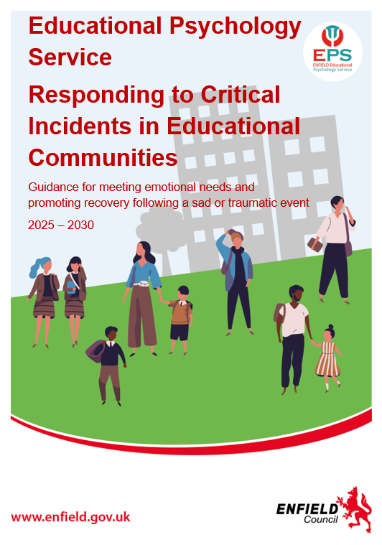
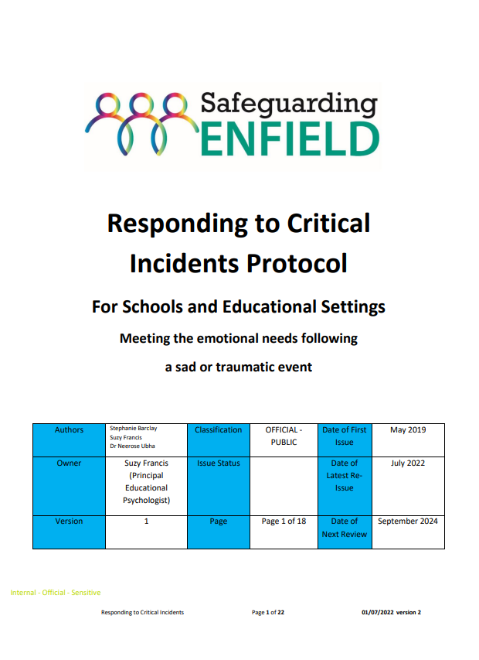
Critical Incident Response: a practical refresh
From safeguarding protocol to a coordinated, psychologically informed response
PROTOCOL
PRACTICE
https://www.enfield.gov.uk/educationalpsychologyservice/educational-psychology-support-for-critical-incidents
02

Slide 3
Critical incidents: what the EPS log tells us
APR 2023 – SEP 2026
Service reach, patterns of concern and the role of Educational Psychology
49 logged situations
Typical service volume
10
2023/24 school year
14
2024/25
7
since 1 April 2026
The EPS typically responds to 10–15 critical incidents each year.
Where support has been provided
The EPS role: leading co-ordination across the network
The service has supported:
Types of concern
The EPS helps schools establish a calm, coherent and proportionate response by:
Primary schools
Most entries relate to:
Linking school leaders with safeguarding, families and relevant partner agencies.
1
Co-ordinating the professional network
Secondary schools
•
Bereavement
•
Sudden or expected death
2
Supporting clear communication
Helping schools agree factual, age-appropriate messages for staff, pupils and families.
Special schools
Community services
•
Serious harm or violence
3
Mapping impact and vulnerability
Identifying close peers, siblings, vulnerable pupils and directly affected staff.
•
Suicide or attempted suicide
Providing consultation and follow-up
Offering resources, reflective spaces, targeted sessions and review as needs emerge.
4
A containing response that normalises varied grief and stress reactions without pathologising them.
03
Notes:
[Sources]
- User-provided EPS Critical Incident Response log and user-supplied annual figures.
[/Sources]

Slide 4
A critical incident overwhelms usual coping systems
The defining feature is not the event alone, but its impact on people and the organisation
01
HARM
Physical, emotional, psychological or social harm.
02
DISRUPTION
Sudden death, local disaster or violence can disrupt everyday life and established routines.
03
SYSTEM IMPACT
Pupils, staff and families may experience distress and grief - requiring a coordinated, sensitive response.
04

Slide 5
The EPS helps schools move from shock to a contained response
01
02
03
CREATE SAFETY
MAKE SENSE
ACT COHERENTLY
Psychological safety
Critical thinking
Implementation science
OUTCOME
Leadership teams can make decisions and provide clear information, support and containment to the school community.
Aim: facilitate a return to normality while assessing the need for further referral.
05

Slide 6
Four myths that can weaken an early response
Replace certainty and urgency with factual communication, familiar support and graduated care
MYTH 01
MYTH 02
“We should protect children from difficult and upsetting information.”
“The sooner we provide specialist counselling, the quicker everyone will recover.”
Give simple, factual information. Be honest about what is known and unknown; silence and speculation can be more damaging.
Use a graduated response. Normal reactions need community, space and routine; some people will need added support over time.
MYTH 03
MYTH 04
“Critical incidents should be dealt with by specialist mental health professionals.”
“Young people who talk about wanting to end their lives don’t kill themselves.”
Trusted school staff are often best placed to communicate and support. EPS and partners can prepare and contain staff.
Take every mention seriously and follow safeguarding and suicide-prevention pathways.
Source pathway: Suicide Prevention Strategy / Board / Papyrus
RESPONDING WELL
06

Slide 7
Three frameworks shape a coherent EPS response
Each contributes a distinct lens for immediate support, relational recovery and system change
01
Hobfoll’s Five Essential Elements
Immediate and mid-term mass trauma intervention
Hobfoll et al. (2007), Psychiatry, 70(4), 283–369
02
ARC: Attachment, Regulation, Competency
Resilience through attachment, self-regulation and competency
Blaustein & Kinniburgh (2010), Guilford Press
03
iThrive Framework for System Change
Needs-led, person-centred support across the system
Wolpert et al. (2019), implementingthrive.org
FRAMEWORKS
07

Slide 8

Hobfoll: five conditions support community recovery
Five Essential Elements of Immediate and Mid-Term Mass Trauma Intervention · Hobfoll et al., 2007
01
Physical and psychological safety
02
Calm
03
Self and community efficacy
04
Connectedness
05
Hope
08

Slide 9
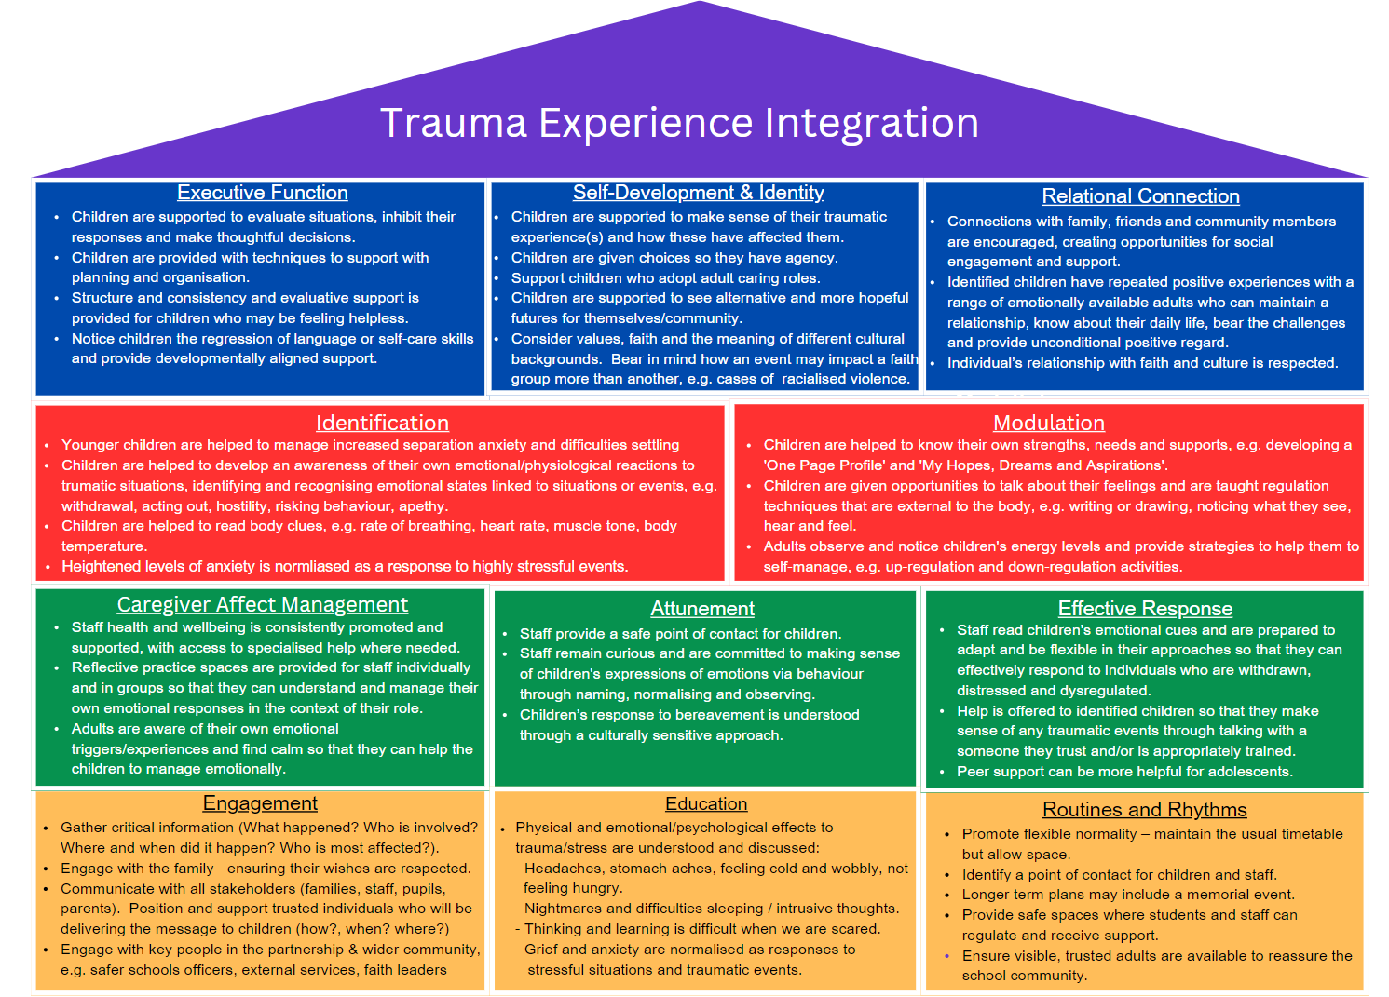
ARC integrates attachment, regulation and competency
Blaustein & Kinniburgh, 2015 · a developmental framework for trauma-informed support
09

Slide 10
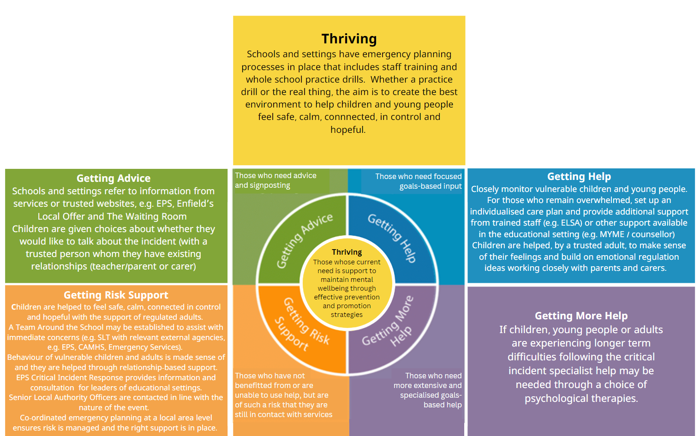
iThrive: support is needs-led and person-centred
THRIVE Framework for System Change · Wolpert et al., 2019
Needs-led,
person-centred
emotional support.
Match the response to need—not simply to diagnosis or service thresholds.
10

Slide 11
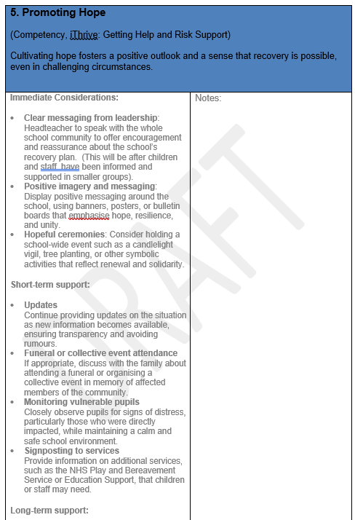
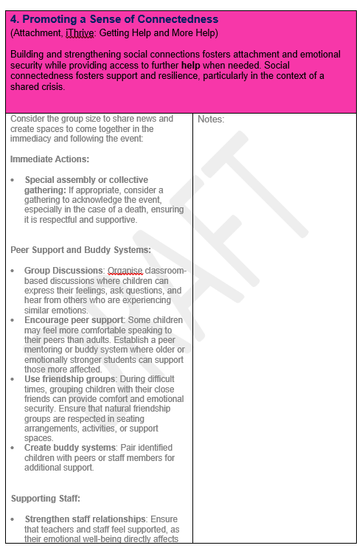
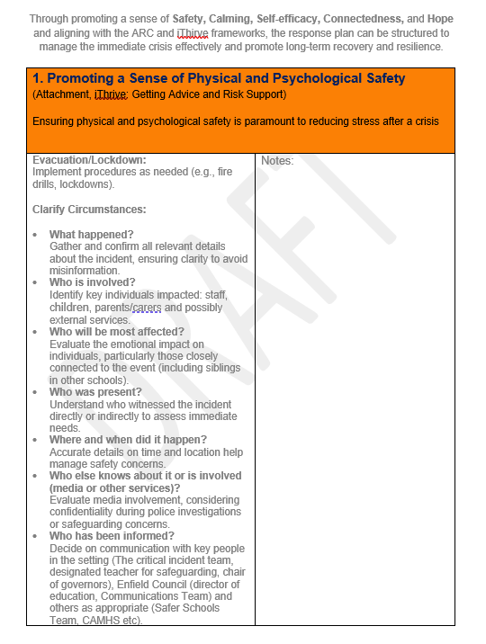
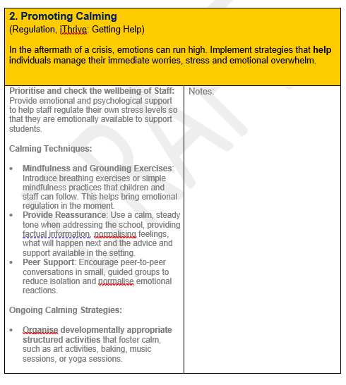
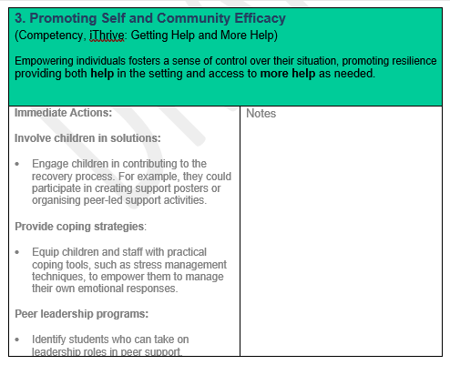
Framework reference sheets
Detailed source materials for facilitation and follow-up reading
REFERENCE
11

Slide 12
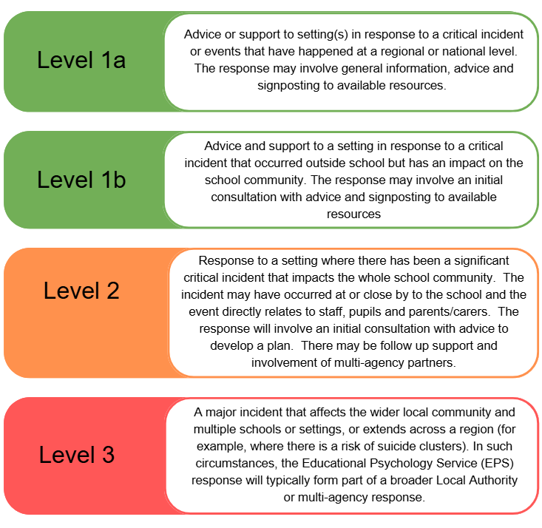
EPS response scales with context and impact
Levels provide a shared language for proportionate advice, consultation and intervention
LOWER
INTENSITY
HIGHER
INTENSITY
RESPONSE LEVELS
12

Slide 13
Levels 1–2: match support to context and need
Examples are illustrative; EPS involvement is proportionate to impact, vulnerability and the wider system
LEVEL
TYPICAL CONTEXT
EPS RESPONSE
Level 1a | When a major head of state dies World or national events, Covid, Earthquakes in Turkey Covid-19 | EPS frequently provide advice and signposting guidance for schools to share with parents, staff and children depending on the situation.
Level 1b | Parent dies whilst the child is at school Stabbings in a ward in Enfield | EPS provided consultation for the HT and staff / signposting. EPS responded and provided a CIR to several schools in the area
Level 2 | Deaths of children (fatal stabbings; suicide; accidents; and death following life-limiting conditions) Parent takes own life after murdering preschool child /sibling of child at school Serious illness or death of staff members Serious incidents between parents in school community (e.g. stabbing; long term feuds) Serious incidents linked to the school by rumour (e.g. murder of school staff family member) Serious within-family incidents which cause distress to staff Peer on peer abuse occurring within school Permanent school closures Death of Council team members Support for Council services following traumatic professional events | EPS provides consultation and guidance, training, intervention and contributes to research on this area. EPS worked with Barnet BICS to support SLT and staff group to manage communications, support child transition back to school in the autumn. Additional MH support was provided There is often co-ordination with other services, such as CAMHS and MYME This can be at a school and LA level, e.g., Suicide Prevention Strategy, school closure
13

Slide 14
Level 3 incidents require sustained system-wide coordination
National and community events demand multi-level support, leadership containment and long-term recovery planning
LEVEL
ILLUSTRATIVE INCIDENTS
EPS CONTRIBUTION
Level 3 | Covid-19 Pandemic (2020 - ) Grenfell Tower Fire (London 2017) On 14 June 2017, a fire at Grenfell Tower claimed 72 lives, including 18 children. The tragedy had a profound impact on the local community, including nearby schools. Manchester Arena Bombing (2017) On 22 May 2017, a suicide bombing at the Manchester Arena killed 22 people, many of them children and young people attending a concert. Southport Attack (Southport, 2024) On 29 July 2024, a violent incident in Southport led to the deaths of two children connected to Churchtown Primary School. | EPS was central to providing a critical incident response at multiple levels, supporting schools and families and the whole partnership, e.g., Wellbeing for Education Return, Enfield Thrives Together, parent and community workshops focussing on children’s mental health, supervision for headteachers and social workers, develop a film with children and young people in partnership with the Youth Parliament. Children and Young Peoples signposting document, liaised nationally with EP services to share the work. The Educational Psychology Service coordinated a school-based response to support pupils, staff, and families. UCL’s review of the response highlighted the importance of emotional containment, communication, and trauma-informed care. Enfield EPS later adopted the Hobfoll framework (Safety, Calming, Efficacy, Connectedness, Hope) after learning from a trainee EP who had worked with Grenfell-affected schools. This was the framework for the response to the pandemic. EPs provided immediate and ongoing support to schools across Manchester. There was a national offer of support from the National Association of Principal EPs. The Manchester Resilience Hub was established to screen and refer affected individuals, including 877 children and young people. Coaching and leadership psychology played a key role in the school’s recovery. The EPS provided trauma-informed support to staff and pupils, including reflective ceremonies, peer support, and long-term wellbeing planning. The approach mirrored recovery work done after Grenfell, emphasising hope, community resilience, and psychological safety.
CASE REFERENCES
14

