Slide 1
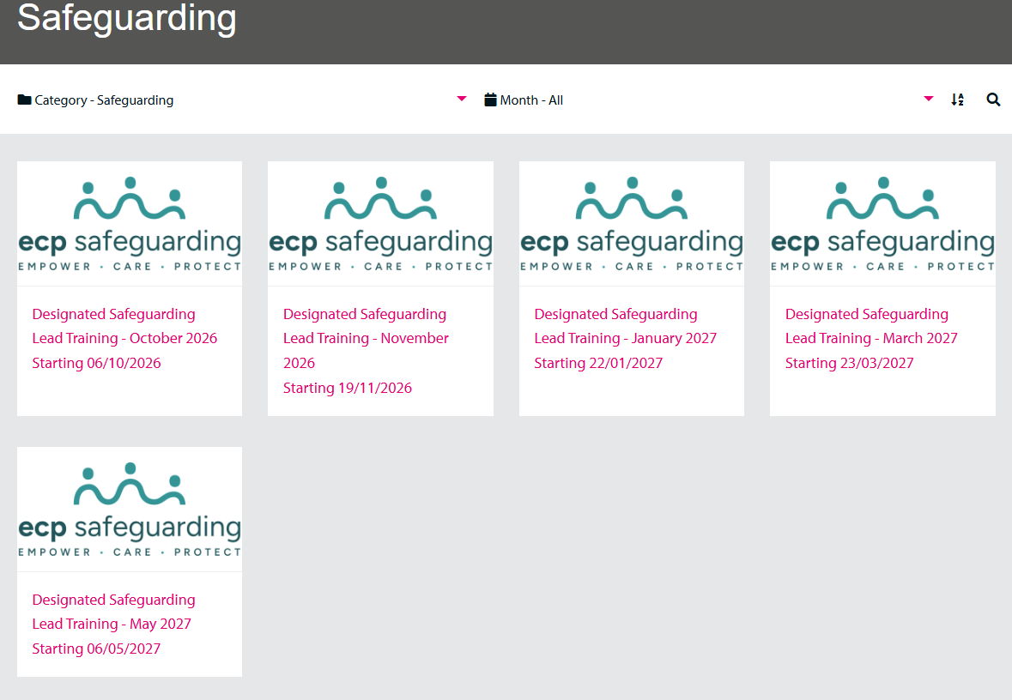
Professional Learning
Designated Safeguarding Leads Training - £80
To book – click here
Professional.learning@enfield.gov.uk

