Slide 1
6th October 2026

Slide 2
AGENDA
Welcome and updates
Policing update
Inclusion & Attendance
Price update
Information sharing duty
ECASS Conference
Health – Flu, Asthma
Inclusive Employment Board
AV1 Bots
Advantage Talking Tactics (Tottenham)
AOB

Slide 3


Experts at Hand and Stability Grant
Building on government consultation, the beginning of the reforms, through the EaH offer, are to:
Support workforce development
Build confidence for both settings and parents
Meet needs early, locally , fairly, effectively and shared across the partnership
SEND Reform Plan accepted by DfE – Stability grant to be provided
October 2026
Notes:
[Sources]
SEND Reform Programme Summary Report, sections 3, 4 and 14. User-provided progress update, 5 October 2026.
Visual on this slide was generated with Microsoft Copilot.

Slide 4




SEND Reforms Experts at Hand LA budget
£2,869,304
£573,861
£2,295,443
Admin & LA Reform
S&L Therapist Lead
Practitioner
Experts at Hand
Alternative Provision
10% Admin
£286,930
10% LA Reform
£286,930
Circa £100,000 – establish new S&L therapist advanced practitioners in every ICB geographical area
Advice, Guidance and Strategic Support
Building on the APST model

Slide 5
04 | 2026–27 LOCAL DELIVERY PLAN
Eight workstreams strengthen early SEND support and inclusion
Measurable outcomes for mainstream settings across the local system.
1
Speech & Language
2
Inclusive Pedagogy – workforce development
Outcome: develop mainstream SLCN offer without the need for an EHCP
Outcome: Recruit specialist teachers x 3 to support Primary and Secondary to support adaptation of the curriculum to meet a range of needs.
3
Post-16 Inclusion
4
Primary Alternative Provision
Outcome: Develop more responsive curriculum to meet the need of young people to increase their employment options.
Outcome:: support inclusion at primary.
5
Secondary AP Taskforce
6
Early Years Inclusion
Outcome: Increase opportunities to target more young people with AP needs.
Outcome: Increase Area SENCOs ( x 4) and BSIPS (x 4) to meet the needs of children in Family Hubs and Nursery/PVIs.
7
Local Inclusion Support Offer (LISO)
8
PINS Neurodiversity
Outcome: To continue supporting schools to holistically meet the needs of children and young people by improving workforce confidence.
Outcome: Increased staff and parent confidence, belonging and wellbeing; fewer dysregulation incidents.
Headteacher focus: identify need early • release staff for support and training • share impact data • engage families
• embed inclusive practice

Slide 6
PRIMARY INCLUSION TEAM
UPDATES
OCTOBER 2026
Mark Maidens

Slide 7
HEADLINES:
PRICE training offer to schools
Alternative Provision developments
New guidance on restrictive interventions
PRICE training offer from Primary Inclusion Team

Slide 8
PRICE TRAINING OFFER TO SCHOOLS (delivered by the Primary Inclusion Team)

Slide 9
PRIMARY INCLUSION TEAM TRAINING OFFER:
OPEN courses
CLOSED courses

Slide 10
OPEN COURSE:
Individuals from all mainstream schools. £95 per delegate (includes certificate and registration with PRICE)
Senior staff attendance is preferable but not essential. There will need to be a minimum delegate number of 9 to make the course viable
Ideally, we would ask that a local school host, we would offer a couple of gratis delegate places
1 trainer per 15 delegates

Slide 11
CLOSED COURSE:
Minimum 15 delegates per school
Maximum 30 delegates per school.
Ideally, includes senior staff and other staff to be decided by the school.
School to host training.

Slide 12
CLOSED COURSE:
COST: Cost of training is £1,150 + VAT per 15 delegates. Individual delegates above 15 will be £95 per delegate
Bookings can be made through EPIT@enfield.gov.uk

Slide 13
OTHER TRAINING OPTIONS
Schools have their own PRICE trainer who attends PRICE “train the trainer” training alongside Annual refreshers. The school and trainer would have a formal agreement with PRICE .
PRICE Training run a 5 day “Train the Trainer” course. The cost of this would be £1695+VAT per delegate.
Annual 2 day refresher @ £745+VAT per delegate.

Slide 14
Schools can contact PRICE directly through enquiries@pricetraining.co.uk. If schools take this route, they will receive an email offering a meeting with a PRICE representative to talk through their specific needs, content of course etc

Slide 15
POST-COURSE SUPPORT
All post course materials (eg certificates) to be supplied by PRICE.
Post training support can be provided by PRICE . PRICE training can offer face to face consultancy sessions , workshops etc this will be charged at the standard daily rate of £1150+ VAT. If a school is a commissioning partner of PRICE training they can also access team via telephone and/or Teams, there is no charge for this ongoing support. Schools can contact PRICE directly through enquiries@pricetraining.co.uk.

Slide 16
POST-COURSE SUPPORT
Primary Inclusion Team will continue to offer:
Support regarding latest Restrictive Intervention guidance
Support with risk assessments and regulation plans
De-escalation and Restorative Processes training
Consultations and trauma-informed Coaching for school staff
Enquire at EPIT@enfield.gov.uk

Slide 17
PRIMARY ALTERNATIVE PROVISION
Updates
Funded by Experts at Hand funding
Part of a graduated response
Clear entry and exit criteria
Both KS1 and KS2

Slide 18
PRIMARY ALTERNATIVE PROVISION
Time limited part-time programme which will include:
* direct work with pupils
* regular consultation with schools
* family work
* multi-disciplinary involvement
Both KS1 and KS2

Slide 19
PRIMARY ALTERNATIVE PROVISION
Three phase programme:
1. Primary Inclusion Team involvement within school
2. Direct work with pupil and school staff in Alternative Provision
3. Reintegration support when returning to school
Both KS1 and KS2

Slide 20
PRIMARY ALTERNATIVE PROVISION
Actions being undertaken:
Recruitment (Alternative provision Co-Ordinator and a teacher)
Trauma-informed psycho-education curriculum being developed
Relationships with partner services being explored and consolidated

Slide 21
PRIMARY ALTERNATIVE PROVISION
Actions in being undertaken:
Clear commissioning, delivery and monitoring processes being drafted
Multi-disciplinary involvement
Thinking around sustainability and ongoing financial viability

Slide 22
STRATEGIC OVERVIEW
Education,
Inclusion & Wellbeing Panel
A new borough-wide Strategy
Ian Hewison
Head of Admissions, Attendance and Traded Services
Children’s Wellbeing and Schools Act 2026 | Inclusion, attendance, alternative provision and children not in school

Slide 23
CHILDREN’S WELLBEING & SCHOOLS ACT
The Act creates a statutory register for children not in school
Section 38 gives local authorities a clear legal framework for identifying children not in school.
1
Duty to maintain a CNiS register
Wellbeing Bill
2026
The local authority must maintain a register of every child who meets the Act’s eligibility conditions.
2
Ensure eligibility
Part 2: Schools
Section 38
new section 436B
The child lives in the area, is of compulsory school age, and meets the statutory school-status condition.
3
The Panel makes the decision binding
Royal Assent
29 April 2026
One borough-wide view supports identification, safeguarding, coordinated support and suitable education pathways.
Act in practice
Every eligible child is known, their education is understood, and action is timely.

Slide 24
STRATEGIC CONTEXT
A single meeting for all inclusion and wellbeing concerns (non DM-FAP)
The Panel links statutory oversight with operational decision-making across education pathways.
Every decision should move a child closer to suitable, inclusive and stable education.
Leadership
+ oversight
+ decisions
The Panel provides borough-wide leadership for Enfield, supporting strengthened local authority duties under the Children’s Wellbeing and Schools Act 2026.
Inclusion
Attendance
Alternative provision
CNiS oversight
Tries to remove barriers to suitable, high-quality education.
Target persistent absence and risk of missing education.
Discuss other quality-assured pathways.
Identify, safeguard and monitor.

Slide 25
RATIONALE FOR A SINGLE EAIW PANEL
Consolidating other meetings to improve transparency, consistency and time use
A fortnightly panel brings related decisions into one visible, accountable process.
CURRENT FORUMS
ASU / Medical Panel
2 hours monthly
At Risk / Intervention Panel
1 hour fortnightly
Fortnightly
Panel
In-Year Fair Access Panel
30 minutes fortnightly
Primary Fair Access Panel
2 hours monthly
Emergency MAC Meetings
many hours weekly
Clearer governance
Consistent thresholds
Faster coordination
Shared accountability
School-based decisions
AP moves, timetables, referrals
EHE requests (S47)
ratification route

Slide 26
REFERRAL CRITERIA
Referral criteria: absence and placement risk
Refer where one or more criteria indicate that coordinated Panel oversight is needed – not limited to the below
1
Severe or persistent absence
2
School interventions exhausted
– Attendance below 50%; no education in place; or severe absence despite support
– Interventions have not improved attendance or hours of education
– Graduated response implemented and reviewed: assess–plan–do–review
– Internal strategies, behaviour plans, reduced timetables and external referrals tried
– School considering referral to alternative provision
3
Health, complex or multiple barriers
4
Placement breakdown risk
– Health needs, including undiagnosed or unmet needs
– SEMH, trauma-related or challenging behaviour
– Family or contextual factors impacting engagement
– Child at risk of permanent exclusion
– Reintegrating from alternative provision
– Directed move has failed or is at risk of failing

Slide 27
REFERRAL CRITERIA
Referral criteria: reduced access, SEND and resources
The criteria help prioritise cases where school-level action needs system coordination.
5
Missing education or reduced access
6
SEND-related difficulties
– Extended reduced timetables or no school place secured
– Fair Access issues, leavers or alternative provision not leading to sustainable improvement
– Pupils returning to school via the EHE route
– EHCNA is ongoing and current provision is no longer meeting need
– Parental challenge resulting in the child being out of school
7
Parental non-engagement with SA attendance
8
Coordination or resources
– Parents have been offered help but decline or disengage
– Case unsuitable for statutory attendance prosecution at that stage
– Child known to multiple services or requiring coordinated support
– Request for short-term or bespoke provision to stabilise placement

Slide 28
EVIDENCE REQUIRED
Evidence required for referral and decision-making
A consistent evidence pack helps the Panel assess need, risk, impact and proposed support.
A
Core referral evidence
B
AP & EHE referrals – PTTT requests
– Parent/carer consent and pupil views
– Attendance and exclusion data
– Behaviour plans and intervention history
– Medical, social, YJS or other reports/advice
– Multi-agency involvement summary
– Request for EHE (LA to confirm?)
– Proposed support and anticipated duration
– Completed application form
Quality check before Panel
Evidence should show what has already been tried, what impact it had, and why Panel-level coordination or resources are now required.

Slide 29
MEMBERSHIP AND MEETING STRUCTURE
Membership and meeting structure
A standing multi-agency group provides consistent decisions, with school presentation at the centre.
CHAIR
01
Frequency
Local Authority senior leader (TBC)
Fortnightly panel; Circa 2 hours allocated for secondary and 45 minutes for primary, subject to confirmation.
STANDING SERVICES
02
Format
– Admissions, & Attendance, Inclusion teams – Secondary & Primary
– YJS, SEND, EPS and Health
– Orchardside, AP’s (?)
– CSC: Virtual School and Early Help
– Rotating Enfield Headteachers: 2 per week from secondary and primary
Cases presented by the referring school; panel discusses needs, interventions and proposed solutions.
03
Decision outcomes
Approved; approved with amendments; rejected with feedback; time-limited placement; AP or other recommendation.
Membership may expand by case need; the core principle is the right services in the room to agree an education pathway.

Slide 30
STRATEGIC PRIORITIES
Three priorities for system-wide improvement
The strategy shifts the system from reactive placement to planned, inclusive support.
01
02
03
Strengthen early intervention
Assure high-quality, equitable AP
Embed pupil voice and family engagement
Support schools to develop strong internal AP models. Enable primary schools to identify needs early and access support quickly.
Quality assure all external, medical and bespoke provision. Prioritise school-led or OFSTED-registered routes.
Agree AP referrals with pupils and families wherever possible. Use transparent communication and shared planning.
Embed best practice in behaviour, wellbeing, trauma-informed approaches and SEND support.
Create clear pathways for post-16 progression and employability.
Build trust so plans are understood, owned and reviewed.

Slide 31
BOARD STRATEGY
What success should look like
A coherent panel should reduce system fragmentation and strengthen outcomes for children.
Expected outcomes
Board focus
Reduced exclusion
Earlier support and clearer thresholds.
Agree fortnightly Panel model
Confirm remit, membership, escalation and decision rights.
Lower persistent absence
Joined-up monitoring and intervention.
Set the assurance rhythm
Fewer children missing education
Active oversight of CNiS pathways.
Use data to review CNiS, attendance, AP quality and outcomes.
Align with AP Strategy delivery
Improved wellbeing and long-term outcomes
Provision matched to need and progression.
Ensure provision quality, progression and family engagement are tracked.
The strategic test: every child is known, every pathway is purposeful, and every decision is anchored in inclusion and wellbeing.

Slide 32
IMPLEMENTATION CAPACITY
A dedicated coordinator will anchor delivery
Recruitment is underway for an Attendance and Wellbeing Coordinator.
01
02
03
Organise the panel
Connect teams
Oversee the register
Coordinate referrals, agendas, papers, attendance, decisions and follow-up.
Act as the conduit between schools, Attendance, Inclusion, SEND, Health and safeguarding partners.
Maintain a complete, accurate CNiS register; coordinate updates and flag gaps or emerging risk.
Create a consistent operating rhythm with clear actions and accountability.
Keep information moving, clarify ownership and unblock hand-offs.
Support timely action and clear statutory assurance.

Slide 33

The Education Welfare Service
April 2027 fully traded service
Ian Hewison
Head of Admissions, Attendance and Traded Services
www.enfield.gov.uk

Slide 34
Funding the service
CSSB, via DSG, centrally funds basic statutory services for all schools and academies.
EWO team receives funding to provide:
Service | What the LA must provide | Source
Communication & Advice | Area-wide meetings, duty-line advice and network updates to share guidance, messages and best practice. | Working together to improve school attendance (2026): “School Attendance Support Team”.
Targeting Support Meetings | Data-led termly conversations to identify at-risk pupils and agree targeted actions.
Strategic attendance data | Track local attendance data to prioritise pupils, cohorts and schools for support, and focus effort on area-wide barriers.
Multi-disciplinary Support | Access to early help and whole-family workers to remove attendance barriers.
Legal Intervention | Penalty notices and prosecutions where voluntary support is refused or unsuccessful.

Slide 35
Additional statutory & central support
Provision | Definition & scope | Local authority function | Funding route
Children Missing Education (CME) | Compulsory-school-age children not on roll and not receiving suitable alternative education. | Identify, track and coordinate action to secure suitable education. | CSSB / DSG
Child Employment & Entertainment | Employment from age 13 to school-leaving age, plus performance licences for entertainment or modelling. | Administer permissions, safeguarding checks and compliance. | General Fund (Non-DSG)
Virtual School attendance support | Children with a social worker whose attendance requires monitoring and improvement. | Monitor attendance and coordinate improvement activity through the Virtual School. | Virtual School

Slide 36
Why now?
Historically funding has narrowed Devolved budgets shifted Education Welfare funding toward statutory duties. Support became traded Councils increasingly use a cost-recovery model for early intervention, attendance support and family casework. Historic undercharging The LA has not charged maintained schools when they should have. From April 2027 School-based EWO casework will be a separate traded service outside the statutory offer for ALL schools.

Slide 37
DFE - Attendance Baseline Improvement Expectations from Sept 2026
ABIEs will set each mainstream school's minimum improvement expectation using its own data.
What schools get | Based on | Used to
Individual ABIE | Attendance history, local context and pupil need | Set the minimum improvement benchmark
Peer comparison | Similar schools, including stronger performers | Challenge plans and share practice
Targeted support | Progress and local context | Review data, intervene early and seek support
Local implication: Diagnose gaps, target intervention and review progress regularly.
EWO support is available.
Source: Department for Education, 6th July 2026.

Slide 38
OFSTED - Below-benchmark attendance raises the bar for a ‘strong’ grade
National comparisons inform the grade; they do not create an automatic ceiling.
What inspectors review | Evidence they expect | What it means
Attendance position | National and contextual data, including pupil groups | Lower figures prompt closer scrutiny
Leadership response | Accurate diagnosis and effective strategies | Expected standard requires issues to be tackled
Evidence of impact | Sustained improvement in attendance and behaviour | Strong standard needs more than plans
Local implication: Below-benchmark schools need a clear improvement trajectory and evidence of impact.
The number matters — but so do context, action and improvement.
Sources: Ofsted school inspection toolkit, June 2026; IDSR guide, July 2026; “Improving school attendance”, Nov 2023.

Slide 39
DfE term 1 2025/26 Absence statistics
Autumn term 2025/26 • All figures are percentages
Higher attendance is better • lower PA/SA is better
National
London
Enfield
ATTENDANCE
PERSISTENT ABSENCE (PA)
SEVERE ABSENCE (SA)
%
% of pupils
% of pupils

Slide 40
Core weekly packages
Costs for academic year (38 weeks)
Support package | Activity included | Cost
Half day per week on site | School consultation; family outreach after pre-referral action; attendance clinics, letters and agency liaison; Fast Track. | £6,000 per year
1 day per week on site | Half-day activity, plus TAF lead for cases; professional, CP and inclusion meetings; coffee mornings and assemblies; policy/systems advice; Fast Track. | £11,000 per year

Slide 41
Sessional support
Per-session support
Half-day and full-day options for targeted attendance intervention planning and practice support.
Support package | Typical use | Cost
Single half day session | One half-day per half-term | £325 per session
Single full day | One full-day per half-term | £600 per session
Activity area | Included in both half-day and full-day sessions
Sessional EWO support | Data analysis; staged intervention planning; CME process support; early-intervention strategies including clinics; telephone and email advice.
Three types of SLA’s
1 2 3 | Prevention and early support Intensive casework intervention Early Intervention + Direct Referral Casework

Slide 42
Additional EWO support
Additional capacity or project work is scoped separately where support is needed beyond standard packages.
Support option | How it is positioned | Pricing
Data project | Scoped attendance-data analysis or agreed project support. | Price on request
Senior support | Senior attendance advice, escalation support or oversight for complex matters. | Price on request
EWO support | Additional EWO capacity beyond the core or sessional offer. | Price on request
Schools that choose not to trade will receive statutory services only

Slide 43







Enfield Speech, Language and Communication CONFERENCE 2026
12th November 2026
Time: 9:00am - 3:45pm
The Dugdale Arts Centre, 39 London Road, EN2 6DS
Keynote Audience: Headteacher and SENCO
Workshop Audience: Middle Leader or Class Teacher

Slide 44


Every Classroom. Every Conversation. Every Child.
Enfield Speech, Language and Communication
CONFERENCE
12th November 2026
Join us for a practical and inspiring conference exploring how language and communication can be embedded at the heart of teaching, learning and inclusion.
Featuring keynote presentations from Tom Sherrington and Marie Gascoigne, alongside contributions from the ECASS and NHS Speech and Language Therapy teams, the day will share evidence-informed approaches in improving outcomes for children and young people.
The conference will also showcase Enfield's Better Communication journey and explore how a Balanced System approach can help schools measure what matters most for children and young people.
TOM SHERRINGTON
Known for translating evidence-informed practice into practical classroom strategies that improve outcomes for all learners. Tom’s keynote, Systematic Inclusion: Principles and Practice will explore how schools can create inclusive environments where every pupil can succeed.
MARIE GASCOIGNE
As a key partner in Enfield's Better Communication journey, Marie will share how schools and services can use a Balanced System approach to measure meaningful outcomes and demonstrate impact for children and young people.
WORKSHOPS
A choice of workshops designed to support the key principles of inclusive practice and high quality teaching through evidence-informed programmes.

Slide 45




Every Classroom. Every Conversation. Every Child.
Enfield Speech, Language and Communication
CONFERENCE
12th November 2026
WORKSHOP 1
Tom Sherrington’s Primary and Secondary School Workshops: Systematic Inclusion - ensuring high success for every learner
(AM) Primary and (PM) Secondary
WORKSHOP 2
The Hidden Curriculum of Language: Supporting thinking, behaviour and emotional regulation in every classroom (Primary and Secondary)
WORKSHOP 3
An Introduction to Concept Cat: for non-pilot primary schools
WORKSHOP 4
Mind the Language Gap! The importance of structured language learning for pupils who need it the most
(Primary and Secondary)

Slide 46




School Flu Vaccination Programme
Enfield Vaccination Team
Headteachers Meeting
October 2026
Protecting pupils this winter I 2026/2027
Notes:
Good morning and thank you for giving us a few minutes today.
I want to briefly explain why the school flu programme matters, what our School Aged Immunisation Team provides, what is changing with MAVIS, and—most importantly—how schools can help us make vaccination sessions run smoothly.
Our shared aim is simple: protect as many children as possible before flu circulates widely.

Slide 47

Enfield Vaccination Team
Why flu vaccination matters
Protecting children, families and the wider school community
PROTECTS CHILDREN
REDUCES SPREAD
REDUCES DISRUPTION
Flu can be much more than a bad cold.
Children can become seriously unwell
and may need hospital care.
Children can catch and spread flu easily.
Vaccinating them helps reduce
transmission in schools, families and
communities.
Fewer flu infections can mean fewer
pupils and staff absent, helping protect
learning and school operations.
School-aged children from Reception to Year 11 are offered flu vaccination at school.
Notes:
Flu vaccination is not simply about preventing an unpleasant illness.
Children can become seriously unwell with flu, and children are also effective spreaders of infection.
For schools, there is an additional benefit: reducing flu can help minimise avoidable absence and disruption during the winter term.
Most school-aged children from Reception through Year 11 are offered flu vaccination through the school programme, making schools a key partner in protecting children.

Slide 48
What our team does
We bring the NHS vaccination service into the school setting
PLAN
INVITE
CONSENT
Agree dates, session requirements
and practical arrangements.
Communicate with families and provide
clear vaccination information.
Collect and review consent and identify
children needing follow-up.
VACCINATE
FOLLOW UP
Deliver vaccination safely in school with
trained immunisation staff.
Record outcomes and support
appropriate follow-up for children who
miss the session.
Notes:
Our role is to make the vaccination pathway as straightforward as possible for schools and families.
We plan the session with the school, support communication and consent, deliver vaccination safely, record outcomes and provide follow-up arrangements for children who miss the school session.
The biggest opportunity is when the school and immunisation team work as one team, with clear communication and a named contact on both sides.

Slide 49


MAVIS: a more joined-up digital journey
Manage Vaccinations in Schools
DIGITAL CONSENT
BETTER DATA
END-TO-END WORKFLOW
Digital consent requests and automated
reminders help families respond more
easily.
Automated consent requests and
Reminders reduce the need for schools to
repeatedly chase parents
Clearer and more accessible communication
makes the consent process much easier for parents
Improved record matching and data
capture can reduce manual entry and
help us work more efficiently.
Schools and the immunisation team have
clearer information about consent
responses to ensure schools can plan
More efficiently for the vaccination session
Supports cohort management, consent, clinical review, vaccination recording and reporting.
Creates a more consistent communication patheway between school, parents and the immunisation team.
Digital information reduces manual data entry and the risk of transcription errors.
For schools: clearer communication • less administration • better visibility
Notes:
One of the key changes this year is MAVIS—Manage Vaccinations in Schools.
MAVIS is designed to support the end-to-end delivery of school-age vaccination programmes.
For parents, it makes consent simpler through digital requests and reminders.
For our team, it reduces fragmented processes, improves data capture and helps us manage vaccination activity more efficiently.
For schools, the important point is that it should make the overall process clearer and reduce some of the administrative chasing that schools have historically had to support.

Slide 50
What we need from schools
Your support makes a direct difference to uptake and smooth delivery
1
PROMOTE
Encourage families to respond to the flu vaccination invitation.
2
SHARE
Use normal school communication channels to reinforce key messages and deadlines.
3
PREPARE
Provide accurate pupil information and a clear school contact.
4
SUPPORT
Agree a suitable space, timetable and staff contact for vaccination day.
5
CATCH UP
Help us reach children who were absent or missed vaccination.
Notes:
This is where we really need your partnership.
Please actively promote the programme and encourage parents to respond to the MAVIS consent request.
Please share our communications promptly and provide accurate pupil information and a clear school contact.
On vaccination day, an agreed space, timetable and member of staff available makes the session more efficient and reduces disruption.
Finally, if children miss the session, please help us communicate follow-up arrangements so they still have an opportunity to be protected.

Slide 51

Working together to protect pupils this winter
Three things we are asking every school to do
PROMOTE
PREPARE
PARTNER
Encourage families to respond to the vaccination invitation.
Work with our team early on practical arrangements.
Help us reach children who miss vaccination and support catch-up.
Our shared goal: make vaccination easier for families and protect more children before winter.
Notes:
To close, there are three things we are asking from every school: promote, prepare and partner.
Promote the programme and encourage families to respond.
Prepare with us so vaccination sessions are well organised and cause as little disruption as possible.
And partner with us to make sure children who miss their school session are not missed from the programme altogether.
Our shared goal is straightforward: make it easy for families to access vaccination and protect as many children as possible before flu has the opportunity to spread widely.
Thank you. I’m happy to take questions or hear about practical issues schools would like us to address.

Slide 52

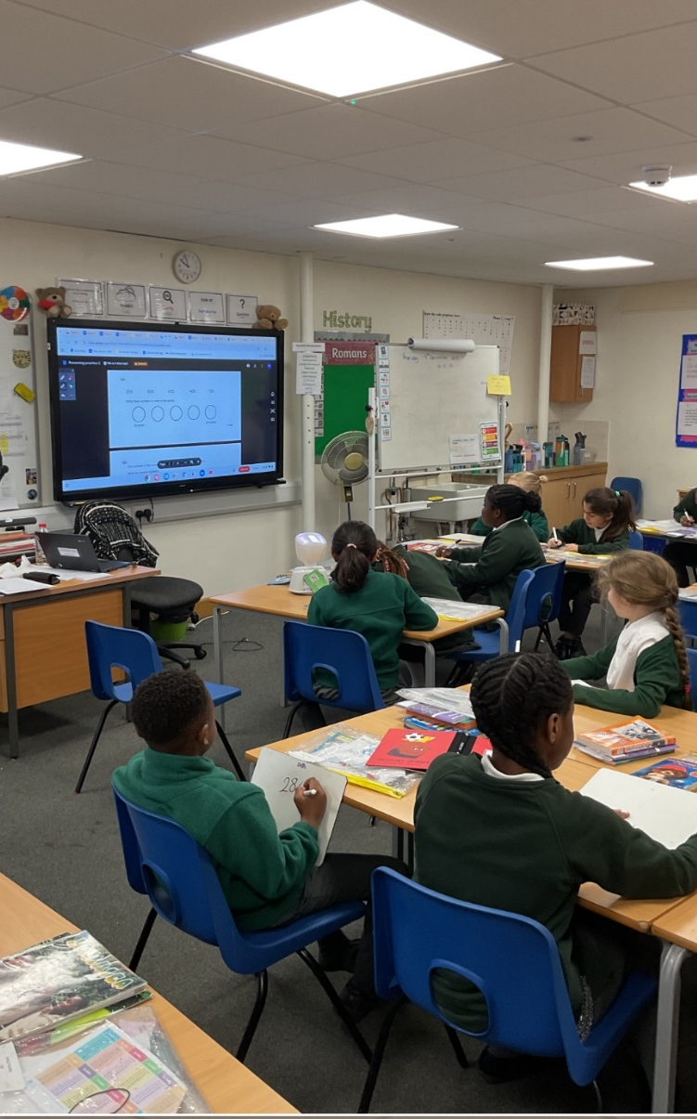
AV1 BOT OFFER – ENFIELD
Keeping CYP connected to learning, social connections and school life
LEARNING • BELONGING • CONNECTION
Headteachers Briefing
6 October 2026
Enfield Council | No Isolation

Slide 53
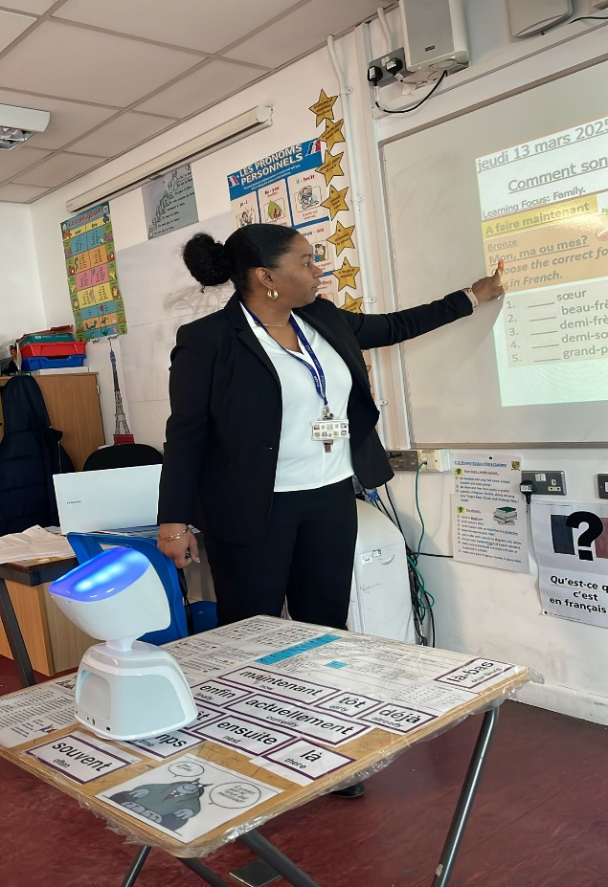
One bot. Three ways to keep a CYP connected
Medical needs
EBSNA
Within school
Access from home or hospital when physical attendance is not possible.
A lower-pressure bridge to learning, trusted adults and peers.
A planned quieter space, while maintaining access to the lesson.
AV1 Bots help children and young people stay connected when they cannot access the classroom.
Connection to learning, people and place

Slide 54
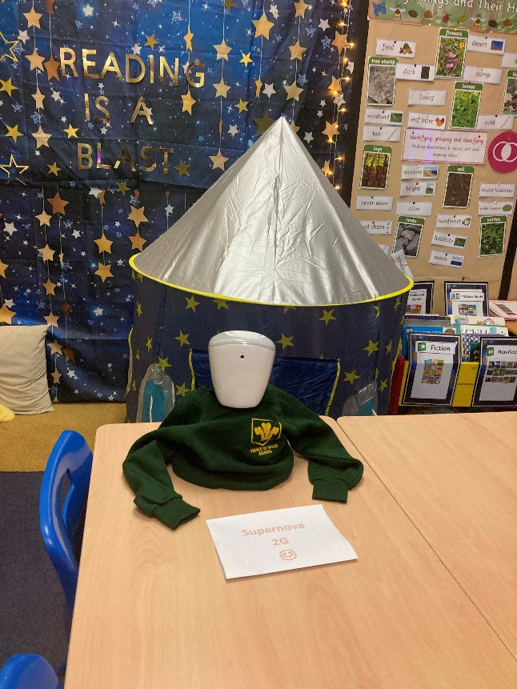








AV1 Bot – No Isolation support offer
Robot
App
Admin
4
Fleet of AV1 units managed and deployed flexibly across education settings
Secure, student-controlled livestream via iOS and Android
Portal for coordinators to allocate, track and report AV1 fleet with ease
Customer Success
Academy
Warranty
No Isolation contact details
Expert guidance from our CS team to ensure effective onboarding, training, and long-term impact
Library of practical resources and trainings to empower schools and families
Accidental damage protection and repair cover provided as part of the LA’s contract with No Isolation

Slide 55
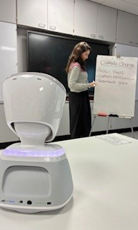
Further information – contact details
Enfield Council – Olivia.bray@enfield.gov.uk
No Isolation – nolan@noisolation.com

Slide 56



ADVANTAGE Mentoring
Talking Tactics
6-month mentoring programme for young people with mild to moderate mental health concerns
Referrals are open in Barnet, Enfield and Haringey
Tottenham Hotspur Foundation + NHS partnership

Slide 57
THE PROGRAMME
What is Advantage Talking Tactics?
A 6-month mentoring programme for young people with mild to moderate mental health concerns.
It is designed for young people who may not meet the CAMHS threshold or who want an alternative to a typical NHS intervention.
The programme combines individual mentoring with mental health support through an innovative partnership between Tottenham Hotspur Foundation and the NHS.
Individual mentoring + mental health support

Slide 58
WHAT PARTICIPANTS RECEIVE
How does Advantage work?
1
Weekly 1-to-1 mentoring
2
Goals for wellbeing
3
Wider opportunities
Participants receive weekly 1-to-1 mentoring with their personal mentor, for up to 6 months maximum.
Mentors work with participants to set goals that help build wellbeing and self-esteem.
Participants can access other Tottenham Hotspur Foundation programmes alongside mentoring.
A consistent relationship with a trusted mentor helps young people connect their interests to positive development.

Slide 59
BEYOND MENTORING
More opportunities through the Foundation
SPORTS
EDUCATION
EMPLOYABILITY
MORE
Sports participation
Education
Employability
And more
Participants can take part in other programmes offered by Tottenham Hotspur Foundation while receiving mentoring support.

Slide 60

Referrals are currently open
Barnet
Enfield
Haringey
Limited spaces are available on the programme.
Reach out today to find out more or discuss a referral.

Slide 61
FIND OUT MORE
Discuss a referral
Jadon Anderson
jadon.anderson@tottenhamhotspur.com
Tottenham Hotspur Foundation
Advantage Talking Tactics
Barnet • Enfield • Haringey

