Slide 1
Our starting point:
A mix of tech savvy and less confident teachers
Good Computing Leads and a Technician
Teachers that were used to having to make learning interactive and engaging and trying something new
Hard to reach parents
Weekly PDF timetable uploaded to the school website with links to White Rose, Purple Mash, Literacy Shed, phonics play, BBC bitesize etc..
Children completing work on paper and some taking photos to send to the school email address.
Ambition & Aspiration Kind Inclusive of Others Honest Community Spirit Imaginative & Creative

Slide 2
Our starting point:
A mix of tech savvy and reluctant teachers
Good Computing Leads and a Technician
Teachers that were used to having to make learning interactive and engaging and trying something new
Hard to reach parents
Weekly PDF timetable uploaded to the school website with links to White Rose, Purple Mash, Literacy Shed, phonics play, BBC bitesize etc..
Children completing work on paper and some taking photos to send to the school email address.
Ambition & Aspiration Kind Inclusive of Others Honest Community Spirit Imaginative & Creative

Slide 3
What we’ve put in place:
An online chat with staff about what we would like our online learning to look like (from the children’s point of view)
Online training – both through Google’s own training and as groups of staff online.
‘How to’ videos created by staff members for teachers and children
Lot of calls to parents trying to get them to help their child sign up to Google Classroom
Some discussions with staff around union guidelines and how this fits in and concerns around workload
Distributing iPads to nearly 40 families to support children accessing online learning.
Ambition & Aspiration Kind Inclusive of Others Honest Community Spirit Imaginative & Creative

Slide 4
What we’ve put in place:
An online chat with staff about what we would like our online learning to look like (from the children’s point of view)
Online training – both through Google’s own training and as groups of staff online.
‘How to’ videos created by staff members for teachers and children
Lot of calls to parents trying to get them to help theiur child sign up to Google Classroom
Some discussions with staff around union guidelines and how this fits in and concerns around workload
Distributing iPads to nearly 40 families to support children accessing online learning.
Ambition & Aspiration Kind Inclusive of Others Honest Community Spirit Imaginative & Creative

Slide 5
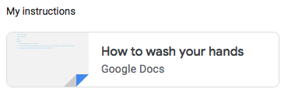
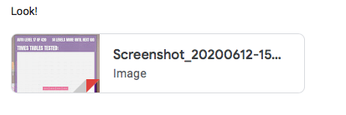
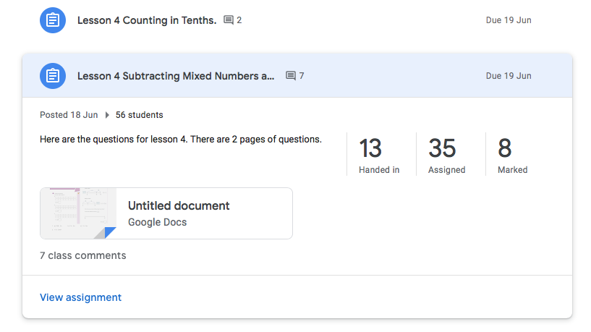
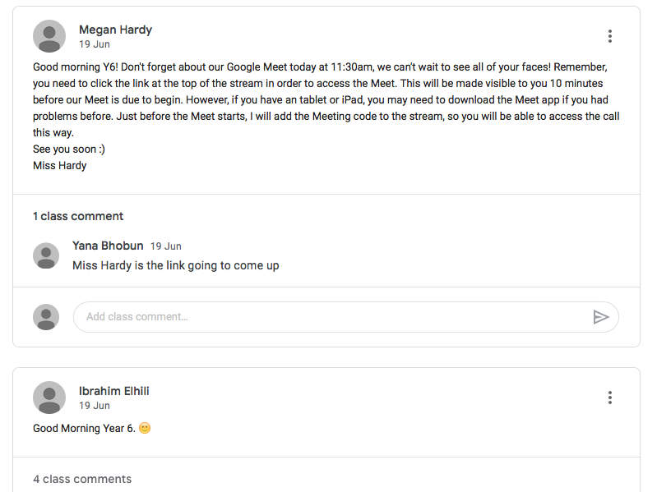
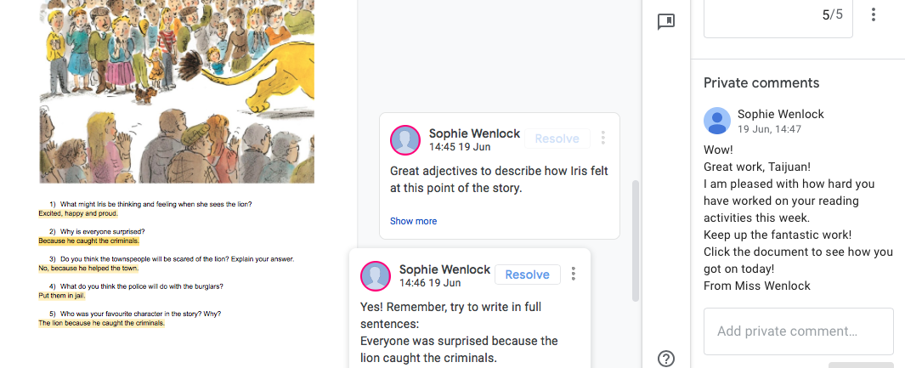
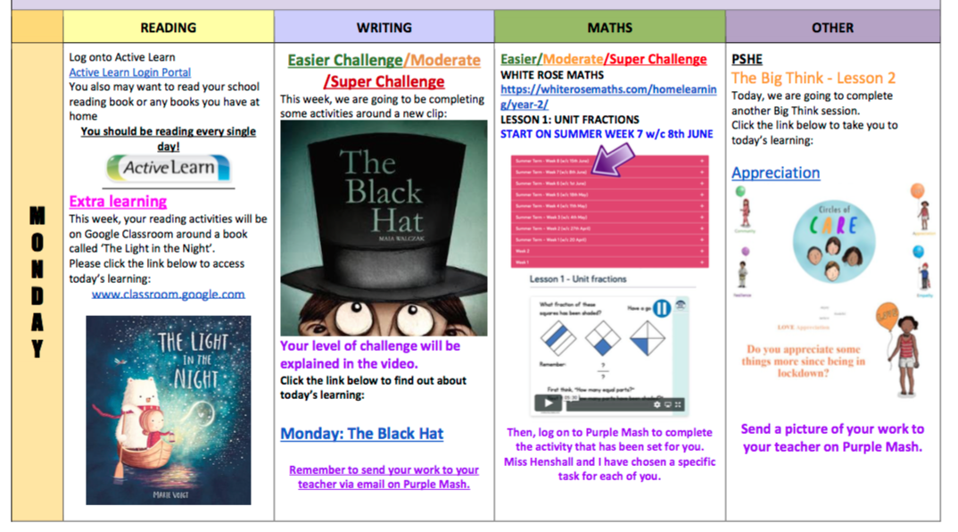
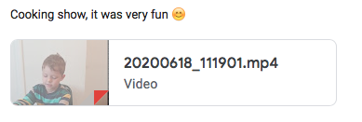
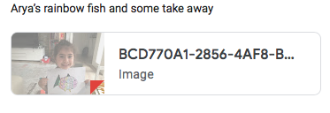
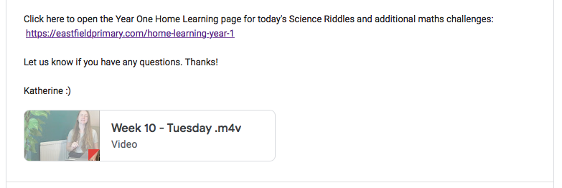
What we have now:
A classroom for each year group as their own learning environment
A year group stream where all children can post messages to each other and the teachers
Daily videos embedded in the stream with one year group teacher per day explaining that day’s learning
The weekly timetable embedded into the stream
Voiceover explanations by teachers on videos (e.g. using White Rose materials with younger classes, but teachers explaining – motivating for children)
A weekly Google Meet for every year group - wellbeing focussed/encouraging more children to sign up
Stories read by teachers
More work being completed and submitted through Google Classroom – therefore easier to monitor and offer feedback
Children sharing their work in a variety of ways
Ambition & Aspiration Kind Inclusive of Others Honest Community Spirit Imaginative & Creative

Slide 6
What we have now:
A classroom for each year group as their own learning environment
A year group stream where all children can post messages to each other and the teachers
Daily videos embedded in the stream with one year group teacher per day explaining that day’s learning
The weekly timetable embedded into the stream
Voiceover explanations by teachers on videos (e.g. using White Rose materials with younger classes, but teachers explaining – motivating for children)
A weekly Google Meet for every year group - wellbeing focussed/encouraging more children to sign up
Stories read by teachers
More work being completed and submitted through Google Classroom – therefore easier to monitor and offer feedback
Children sharing their work in a variety of ways
Ambition & Aspiration Kind Inclusive of Others Honest Community Spirit Imaginative & Creative

Slide 7
What next:
Continue to develop teachers’ skills
Encourage more children to sign up
Begin planning to use Google Classroom for when we are back at school (homework, group work in class, interventions…)
Look at our technology provision and plan for the future
Ambition & Aspiration Kind Inclusive of Others Honest Community Spirit Imaginative & Creative

Slide 8
What next:
Continue to develop teachers’ skills
Encourage more children to sign up
Begin planning to use Google Classroom for when we are back at school (homework, group work in class, interventions…)
Look at our technology provision and plan for the future
Ambition & Aspiration Kind Inclusive of Others Honest Community Spirit Imaginative & Creative

