Slide 1



Enfield COVID19 Dashboard
View in Power BI
Last data refresh:
09/10/2020 15:35:19 GMT Standard Time
Downloaded at:
09/10/2020 15:47:25 GMT Standard Time

Slide 2
Table: Weekly COVID-19 infection rate* between 4th and 10th October for selected local authorities/ regions and England
*Number of new cases in the seven days ending on 10th October 2020
Data source: NHS dashboard- Data available- https://digital.nhs.uk/dashboards/progression-full-width
Accessed on 13th October 2020 at 8:25 am

Slide 3
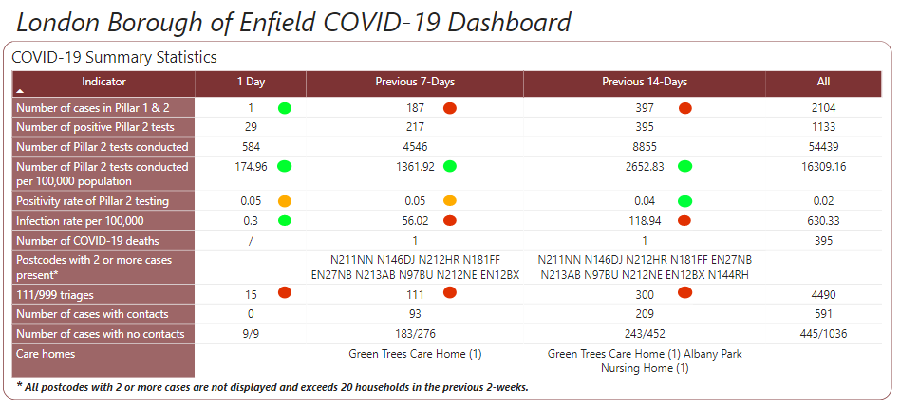


Slide 4
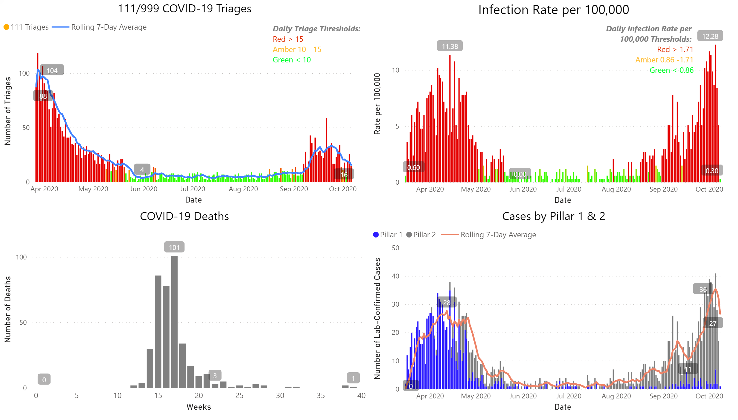

Slide 5

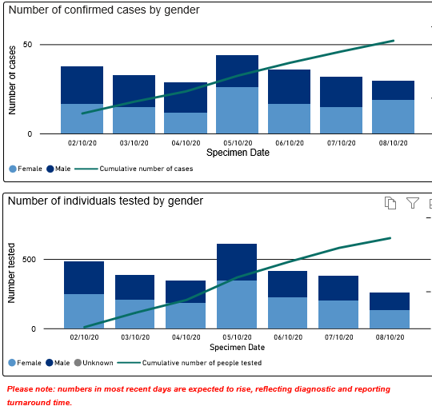
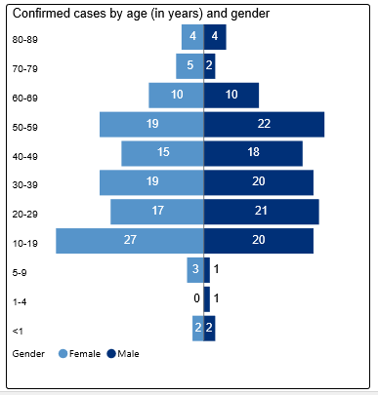
COVID-19 cases and tests by age and gender as at 7th Oct 2020

Slide 6
Number of people tested for COVID-19 per 100,000 residents
Low rates of COVID-19 testing in Enfield compared with average London rate and North of England rates.

Slide 7
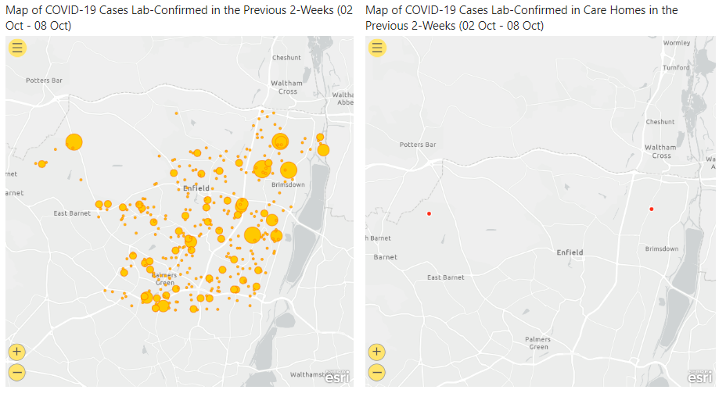

Slide 8
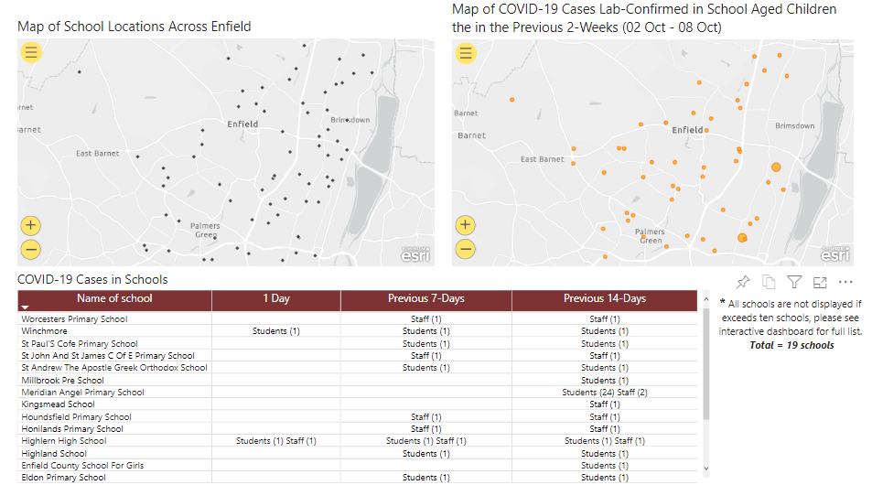

Slide 9
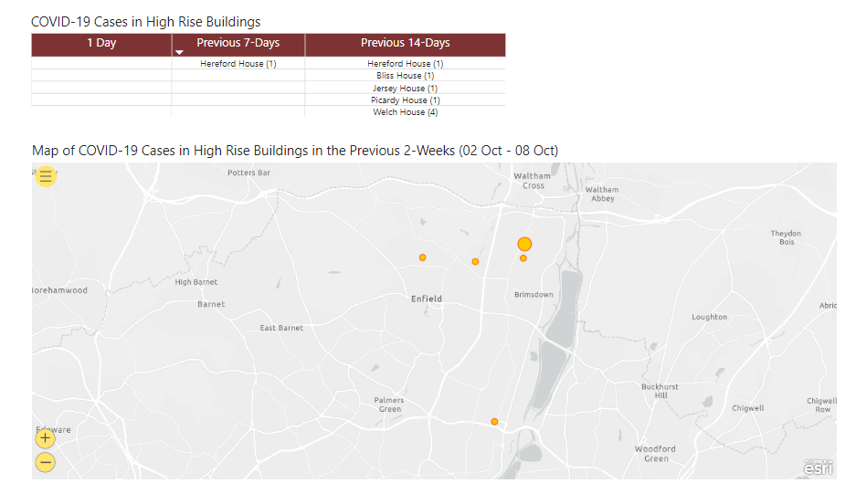

Slide 10
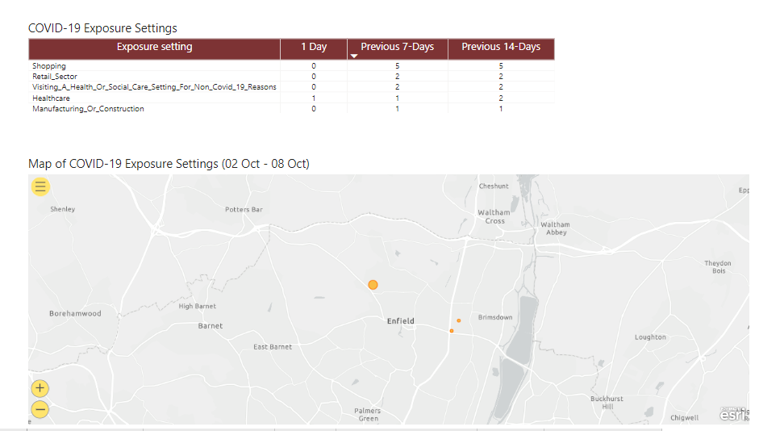

Slide 11
Enfield Schools update
Enfield Care homes with at least one positive resident or staff as at 12th Oct
Local information updated 12th Oct:
20 schools have one or more open cases
15 of these cases are staff
10 of these cases are students
Other impacted: 15 staff and 712 students
  Figures do not include a whole nursery being closed down
  also recently 4 schools/colleges where we have yet to receive data of those impacted
Albany Park
Anastasia Lodge
Avon Lodge
Elizabeth Lodge
Green Tress
Hugh Myddleton
Murrayfields
Parkview

Slide 12
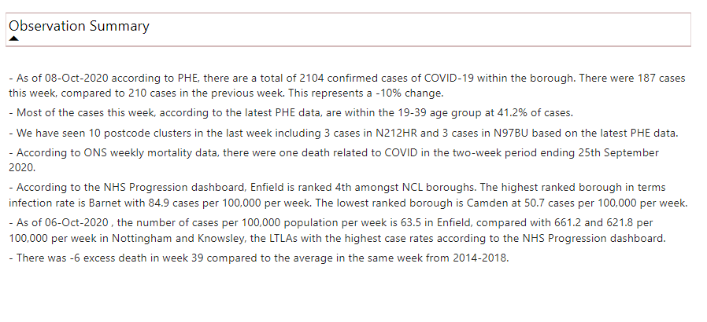

Slide 13
