Slide 1
Enfield COVID19 Dashboard
View in Power BI
Last data refresh:
13/01/2021 13:03:47 GMT Standard Time
Downloaded at:
13/01/2021 14:08:10 GMT Standard Time

Slide 2
ENFIELD COVID-19 DATA
TOTALS
(04 – 10 Jan 21*)
06 Mar 20- 10 Jan 21
TOTAL CASES
23,040
NEW CASES*
3,391
TESTS*
5,751
VACCINATIONS
3,217 1ST DOSES
INFECTION RATE PER 100,000*
1,016
AGE GROUP
0-29 30-59 60+
INFECTION RATE RANK*
NCL# = 1
LON= 4; Eng= 10
per 100,000
(PCR = 12,436 tests, lateral flow = 6,762 tests
CT LFT total – 6,962 tests)
TESTING RATE RANK
NCL# = 1
LON=5; Eng= 22
786
1,256
971
06 Mar – 25 Dec
06 Jan
05 Jan /12 Jan update
11 Jan update
TOTAL DEATHS
485
RECENT COVID DEATHS*
13
SCHOOLS AFFECTED
34
WARDS WITH MOST CASES* (TOP THREE)
Enfield Lock (225)
Edmonton Green (210)
Enfield Highway (208)
CARE HOMES AFFECTED
34
No of deaths= 3
Staff = 72 cases
Residents = 71 cases
Staff = 66 cases
Students = 38 cases
DOM CARE AFFECTED
33
Care Staff = 62 cases
Clients = 31 cases
#North Central London includes Camden, Barnet, Enfield, Haringey & Islington
Change since last week of data

Slide 3
Observation Summary

Slide 4
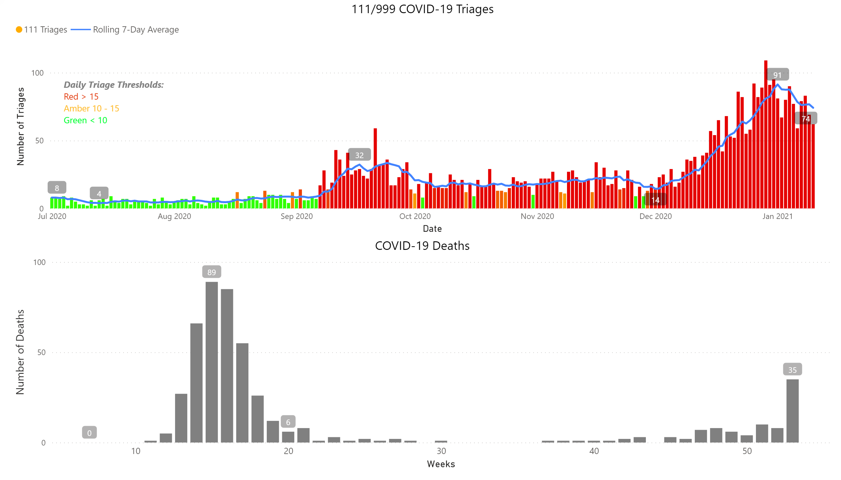
Charts

Slide 5
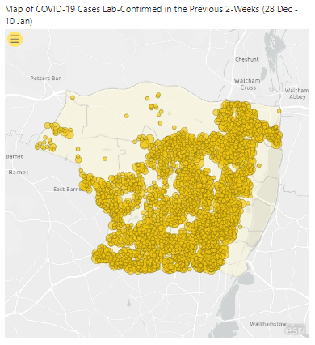
Maps

Slide 6
Weekly Age Stratified Infection Rates
Age | 28-Days |  |  | 14-Days |  |  | 7-Days
 | Number of Cases | % of Total | Weekly Infection Rate per 100,000 | Number of Cases | % of Total | Weekly Infection Rate per 100,000 | Number of Cases | % of Total | Weekly Infection Rate per 100,000
0-29 | 4548 | 32.16% | 847 | 2332 | 31% | 869 | 1055 | 31% | 786
30-59 | 7505 | 53.07% | 1345 | 4029 | 53% | 1444 | 1753 | 52% | 1256
60 & Over | 2089 | 14.77% | 870 | 1230 | 16% | 1024 | 583 | 17% | 971
Total | 14142 |  | 1059 | 7591 |  | 1137 | 3391 |  | 1016

Slide 7
Weekly Age Stratified Infection Rates – 5-Year Age Brackets
 | Average weekly infection rate (last week) | Average weekly infection rate (last two weeks)
0-4 years | 314.24 | 374.99
5-9 years | 295.89 | 354.67
10-14 years | 461.97 | 496.19
15-19 years | 846.94 | 984.69
20-24 years | 1,619.35 | 1,744.53
25-29 years | 1,373.41 | 1,469.42
30-34 years | 1,356.35 | 1,503.77
35-39 years | 1,343.66 | 1,456.29
40-44 years | 1,293.42 | 1,525.02
45-49 years | 1,291.73 | 1,549.18
50-54 years | 1,029.00 | 1,272.14
55-59 years | 1,199.02 | 1,339.07
60-64 years | 1,300.89 | 1,372.08
65-69 years | 1,020.74 | 1,077.45
70-74 years | 741.69 | 888.20
75-79 years | 789.16 | 824.50
80-84 years | 657.69 | 665.34
85-89 years | 807.27 | 794.65
90+ years | 1,430.43 | 1,213.70

Slide 8
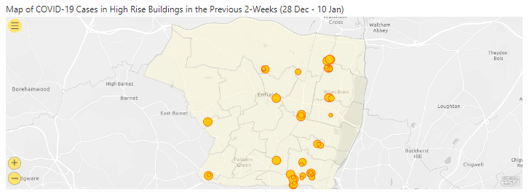
High Rise Buildings & Sheltered Housing

Slide 9
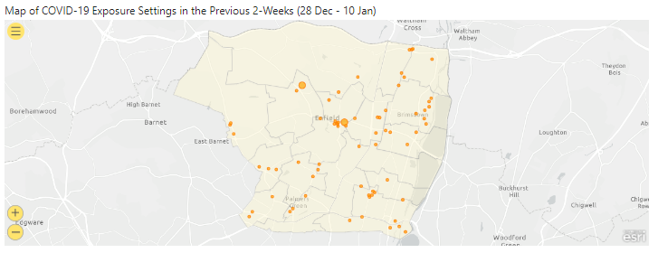
Exposure Settings

Slide 10
Community Mass Testing Number of residents obtaining a confirmatory PCR test
Results include data for Brigadier Hall, Southgate Library, Kempe Hall, Klinger Hall & Green Towers
(20th Dec- 10th Jan)
This analysis covers the 12,524 tests at the community testing centres conducted on Enfield residents only. Total number of tests conducted in this period = 18,731
Of which, 66% remain positive
Of 12,524 Enfield residents tested with lateral flow testing from the 20th to the 10th , 1055 tested positive. Residents are then encouraged to undergo a confirmatory PCR test - 45% were retested via PCR.

Slide 11
Community Mass Testing Demographics
Results include data for Brigadier Hall, Southgate Library, Kempe Hall, Klinger Hall & Green Towers
(20th Dec - 10th Jan)
This analysis covers the 12,524 tests at the community testing centres conducted on Enfield residents only. Total number of tests conducted in this period = 18,731
Number of tests
Males have highest positivity rate but lower testing rates
Positivity rates highest in 0-29, testing rate lowest in younger age groups
 | Male | Female
Positivity rate | 213.0 | 212.6
Testing rate | 2075.8 | 2621.0
0-29 | 30-59 | 60 & Over |  | School aged children
181.0 | 290.2 | 156.6 |  | 123.0
1950.8 | 3116.7 | 2060.6 |  | 1407.4

Slide 12
Asymptomatic Tests (03-Nov-20 – 11-Jan-21)

Slide 13
Age
Gender

Slide 14
Hospitalisation Data
 | Site
 | North Middlesex University Hospital NHS Trust | Royal Free London NHS Foundation Trust
All discharges in past 24 hours | 28 (28) | 16 (16)
Confirmed COVID-19 patients occupying beds and not on any form of oxygen supply at 08:00 | 80 (80) | 80 (80)
Confirmed COVID-19 patients occupying beds and on oxygen supply (MV, NIV or O2) at 08:00 | 205 (205) | 116 (116)
Inpatients diagnosed with COVID-19 in past 24 hours | 32 (32) | 2 (2)
New admissions with COVID-19 in past 24 hours | 5 (5) | 17 (17)
Confirmed COVID-19 patients
0-5 | 1 (1) | 0 (0)
6-17 | 0 (0) | 0 (0)
18-24 | 0 (0) | 2 (2)
25-34 | 7 (7) | 4 (4)
35-44 | 20 (20) | 14 (14)
45-54 | 46 (46) | 28 (28)
55-64 | 40 (40) | 26 (26)
65-74 | 56 (56) | 39 (39)
75-84 | 68 (68) | 44 (44)
85+ | 47 (47) | 39 (39)

Slide 15
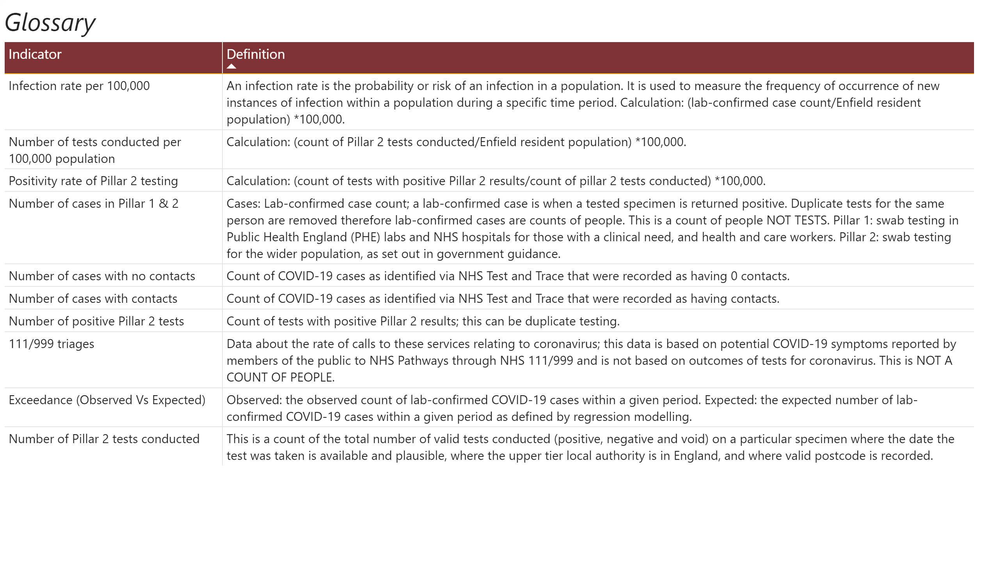
Glossary

