Slide 1



Enfield COVID19 Dashboard
View in Power BI
Last data refresh:
1/22/2021 2:04:54 PM GMT Standard Time
Downloaded at:
1/22/2021 2:29:14 PM GMT Standard Time

Slide 2
Table: Weekly COVID-19 infection rate* between 16th- 22nd Jan 2021 for selected local authorities/ regions and England
*Number of new cases in the seven days ending on 15th Jan 2021
Data source: NHS dashboard- Data available- https://digital.nhs.uk/dashboards/progression-full-width
Accessed on 18th Jan 2021 at 07:15 am

Slide 3



ENFIELD COVID-19 DATA
TOTALS
(16 – 22 Jan 21)
Cases = 06 Mar 20 - 22 Jan 21
22 Jan
13- 19 Jan
COVID- TOTAL
CASES = 26,695
DEATHS = 544
(508 excess#)
NEW CASES*
1,594
INFECTION RATE PER 100,000*
478
AGE GROUP
0-29 30-59 60+
INFECTION RATE RANK*
NCL# = 2
LON= 15; Eng= 34
RECENT COVID DEATHS*
42
Average age= 78y
Age range= 50- 99
Born outside UK= 24
TESTING RATE RANK
NCL# = 1
LON=15; Eng= 81
365
701
432
13- 19 Jan
12- 18 Jan
22 Jan update
18 Jan update
TESTS*
4,981
VACCINATIONS
17,203 1st DOSES
(excluding care home)
1,069 1st DOSES
(care home residents and staff)
SCHOOLS AFFECTED
37
WARDS WITH MOST CASES* (TOP THREE)
Enfield Highway (162)
Upper Edmonton (151)
Edmonton Green (146)
CARE HOMES AFFECTED
24
No of deaths= 5
Staff = 30 cases
Residents = 43 cases
per 100,000
(PCR = 8,201 tests, lateral flow = 8,425 tests)
Staff = 63 cases
Students = 40 cases
DOM CARE AFFECTED
40
Care Staff = 87 cases (-7)
Clients = 44 cases (+5)
#According to ONS weekly mortality analysis.
#North Central London includes Camden, Barnet, Enfield, Haringey & Islington
Change since last week of data
Notes:
Cases – down significantly to 582 per 100,000 or 1941 cases,, R rate london 0.7-1.2 and falling, ranked 11th in London down on 6th
Tests – Increase to 5126 per 100,000,
Deaths - increase to 45 deaths, aged 47 to 95, excess deaths in the latest period 8th Jan are 45, peaked at 89 deaths per week
Schools – 22 primary 1 secondary, 2 special and 10 early years schools
Bridgewood House – 9 staff positive – tested with LFTs. Before they return to work they will be required to do a PCR test. 8 residents positive – previously 9, 1 resident has now finished self-isolation. Extra cleaning and handwashing audits in place. CCTV will be in place from next week to monitor infection prevention & control practice. Keeping same staff in each unit. Home states they have sufficient PPE and staff cover for the time being.
Albany Park – 4 staff positive - staff tested positive one had the a temperature - the other had no symptoms and had the vaccine previously. 12 residents positive – results received 07/11/2020. All currently asymptomatic & are isolating in their rooms.
5 deaths -Elizabeth Lodge, Springview Wellington Park

Slide 4
Weekly Age Stratified Infection Rates
Age | 28-Days |  |  | 14-Days |  |  | 7-Days
 | Number of Cases | % of Total | Weekly Infection Rate per 100,000 | Number of Cases | % of Total | Weekly Infection Rate per 100,000 | Number of Cases | % of Total | Weekly Infection Rate per 100,000
0-29 | 4061 | 31.15% | 756 | 1475 | 30% | 549 | 596 | 31% | 444
30-59 | 6915 | 53.05% | 1239 | 2550 | 52% | 914 | 1038 | 53% | 744
60 & Over | 2060 | 15.80% | 858 | 833 | 17% | 694 | 307 | 16% | 511
Total | 13036 |  | 976 | 4858 |  | 728 | 1941 |  | 581

Slide 5

Weekly Age Stratified Infection Rates – 5 Year Brackets
 | Average weekly infection rate (last week) | Average weekly infection rate (last two weeks)
0-4 years | 171.79 | 234.63
5-9 years | 186.45 | 202.67
10-14 years | 218.15 | 286.59
15-19 years | 484.69 | 586.73
20-24 years | 958.82 | 1118.63
25-29 years | 759.76 | 989.36
30-34 years | 735.18 | 982.86
35-39 years | 699.49 | 875.36
40-44 years | 834.61 | 952.59
45-49 years | 767.93 | 936.61
50-54 years | 742.45 | 844.48
55-59 years | 683.05 | 884.52
60-64 years | 679.57 | 948.16
65-69 years | 558.98 | 741.25
70-74 years | 421.21 | 553.98
75-79 years | 318.02 | 494.70
80-84 years | 443.56 | 466.50
85-89 years | 353.18 | 542.38
90+ years | 736.89 | 1040.31

Slide 6
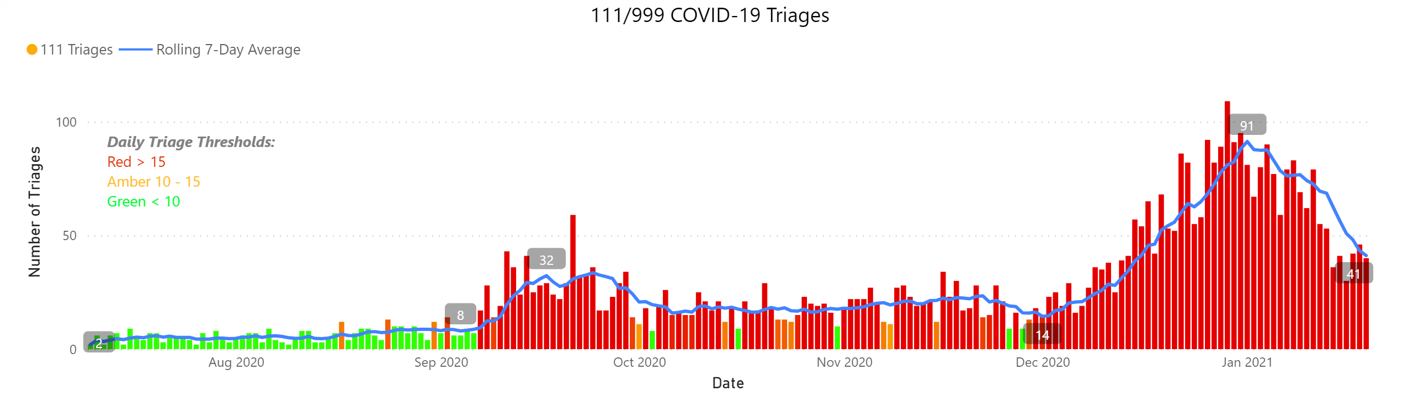
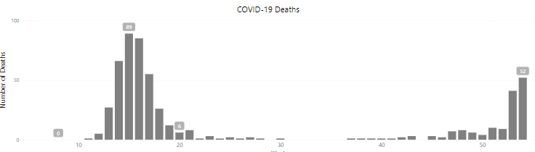
Charts
Notes:
111/999 COVID-19 Triages
No alt text provided.
COVID-19 Deaths
No alt text provided.
textbox
No alt text provided.

Slide 7
Hospital admissions due to COVID-19
Last updated: 22nd Jan 2021
 | Site
 | North Middlesex University Hospital NHS Trust (230) | Royal Free London NHS Foundation Trust (186)
Confirmed COVID-19 patients occupying beds and not on any form of oxygen supply at 08:00 | 79 (+14) | 91 (-1)
Confirmed COVID-19 patients occupying beds and on oxygen supply (MV, NIV or O2) at 08:00 | 151 (-50) | 95 (-15)
Confirmed COVID-19 patients
0- 34 | 11 (-3) | 4 (-2)
35- 44 | 9 (-5) | 11 (-3)
45- 64 | 68 (-12) | 52 (-1)
65- 84 | 99 (-20) | 77 (-13)
85+ | 43 (+4) | 42 (+3)
Update (22nd Jan)
NMUH: Opel 3. No ambulance wait to enter ED; Number of extra bed dropped from 125 to 50. seeing reduction in Covid positive numbers although attendances and admissions remain high
Barnet: seeing Covid proportion fall to ~40% of admissions. Converted 1 ward to non-covid yesterday (21st Jan)
Camden and Islington: older adult wards closed for Covid.

Slide 8
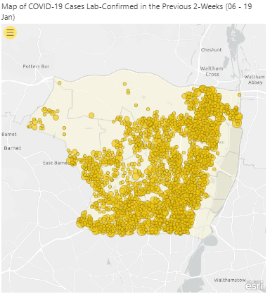
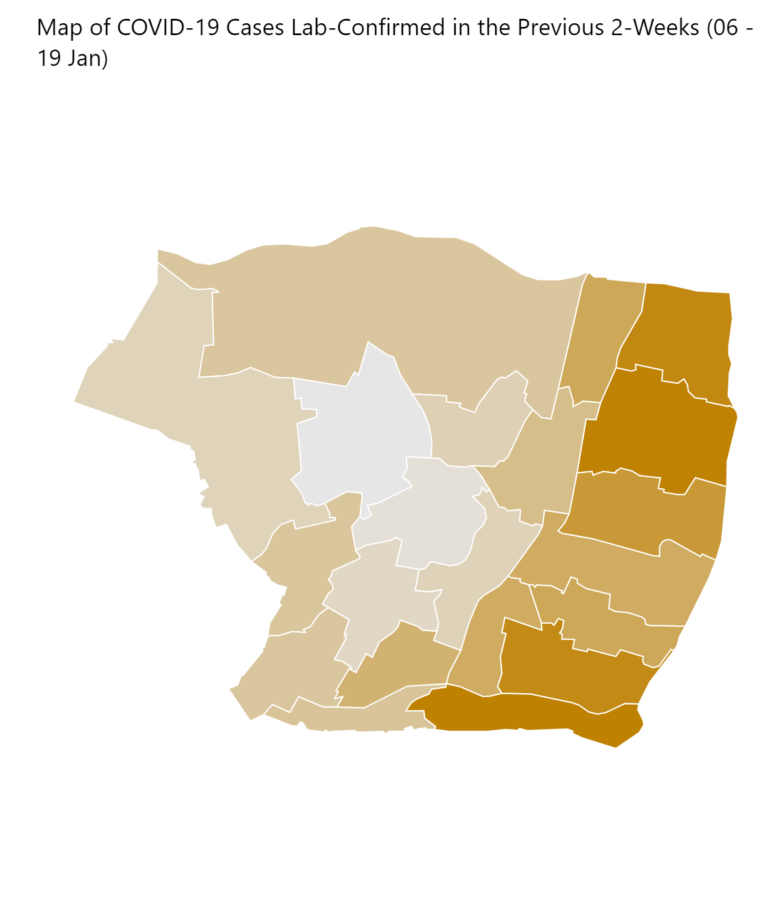
Maps (1)
Notes:
Map of COVID-19 Cases Lab-Confirmed in the Previous 2-Weeks (06 - 19 Jan)
No alt text provided.
Map of COVID-19 Cases Lab-Confirmed in the Previous 2-Weeks (06 - 19 Jan)
No alt text provided.

Slide 9
Enfield Care homes update (Local sources as of 22nd Jan)
• Albany Park – 4 staff positive. 13 residents positive – All currently asymptomatic & are isolating in their rooms.
• Avon Lodge – 5 staff positive.
• Bridgewood House – 1 staff positive – tested with LFTs. Before they return to work they will be required to do a PCR test. 1 residents suspected COVID positive death – 1 resident who was suspected as having COVID has passed away.
• Camden Lodge – 1 staff positive – 1 staff remains in self-isolation. 2 residents positive
• Hugh Myddleton House – 2 staff positive. 2 residents positive.
• Keevan Lodge – 1 staff positive . 3 residents positive.
•Roland residential – 3 residents positive.
• Springview – 1 staff positive. 4 residents positive.
• Stamford Care Home – 3 staff positive – all self-isolating and asymptomatic. 8 residents positive.
• Waterfall House – 1 staff positive- Self-isolating at home. 5 residents positive.
• Wellington Park – 1 new death – sadly one resident who had tested positive for COVID passed away on 20/01/2021.
24 care homes with at least one case (34 care homes last week)
30 members of staff tested positive. (last week 49)
43 residents tested positive in the last 5 days. (62 last week)

Slide 10
Enfield Schools update (updated 18th Jan)
Primary
Number of schools with one or more open cases: 22
Positive cases: Staff 43, Students 34
Contacts currently having to isolate: Staff 57, Students 265
Secondary
Number of schools with one or more open cases: 4
Positive cases: Staff 7, Students 2
Contacts currently having to isolate: Staff 0, Students 2
Special
Number of schools with one or more open cases: 1
Positive cases: Staff 2, Students 0
Contacts currently having to isolate: Staff 4, Students 1
Early Years
Number of settings with one or more open cases: 10
Positive cases: Staff 11, Students 6
Contacts currently having to isolate: Staff 28, Students 79
Closure: 1 nursery
Number of schools/ nurseries affected: 37
Positive cases: Staff: 63; Students: 42

Slide 11
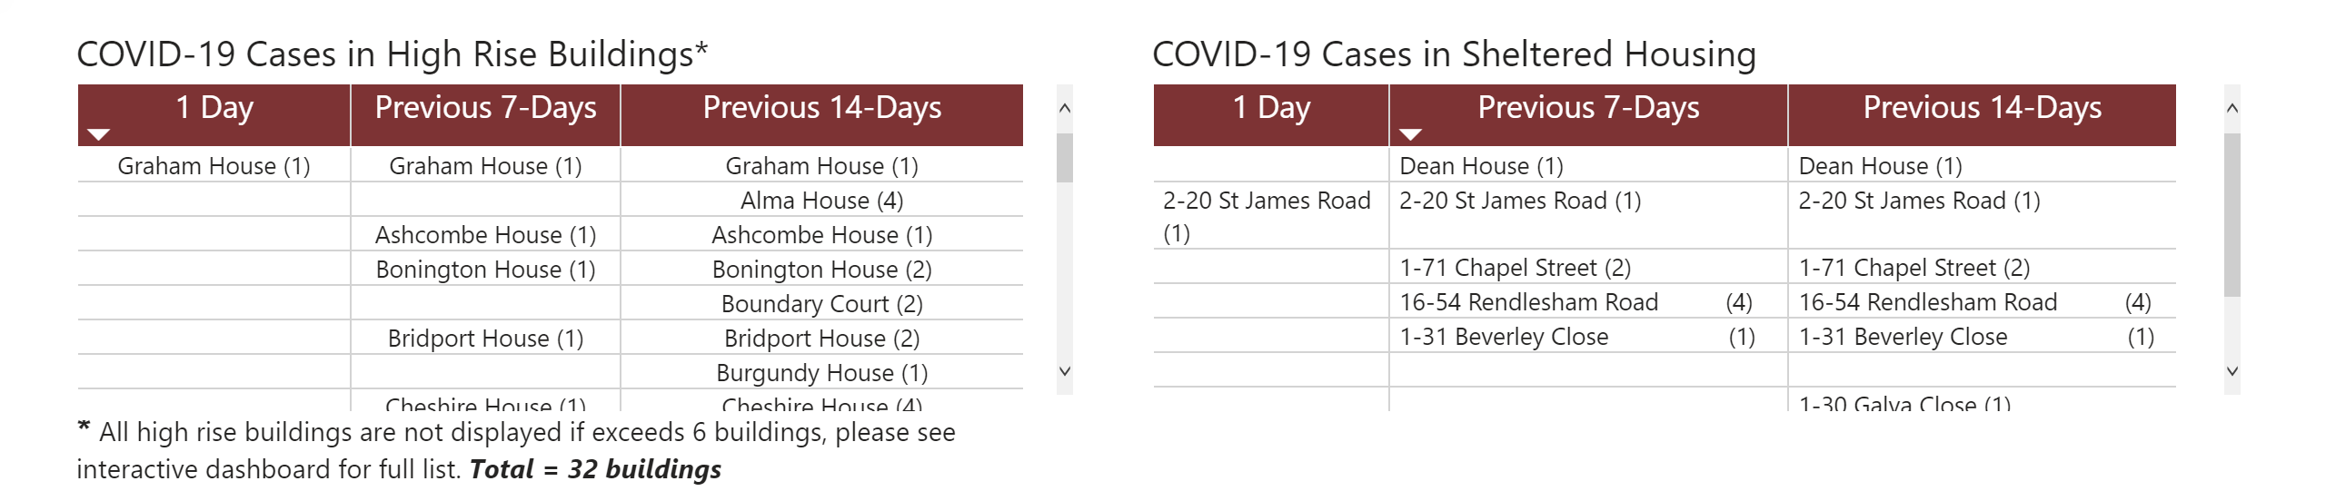
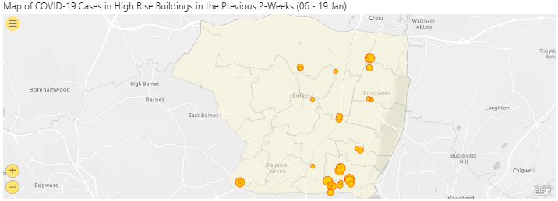
High Rise Buildings & Sheltered Housing
Notes:
Map of COVID-19 Cases in High Rise Buildings in the Previous 2-Weeks (06 - 19 Jan)
No alt text provided.
COVID-19 Cases in Sheltered Housing
No alt text provided.
textbox
No alt text provided.
COVID-19 Cases in High Rise Buildings*
No alt text provided.

Slide 12
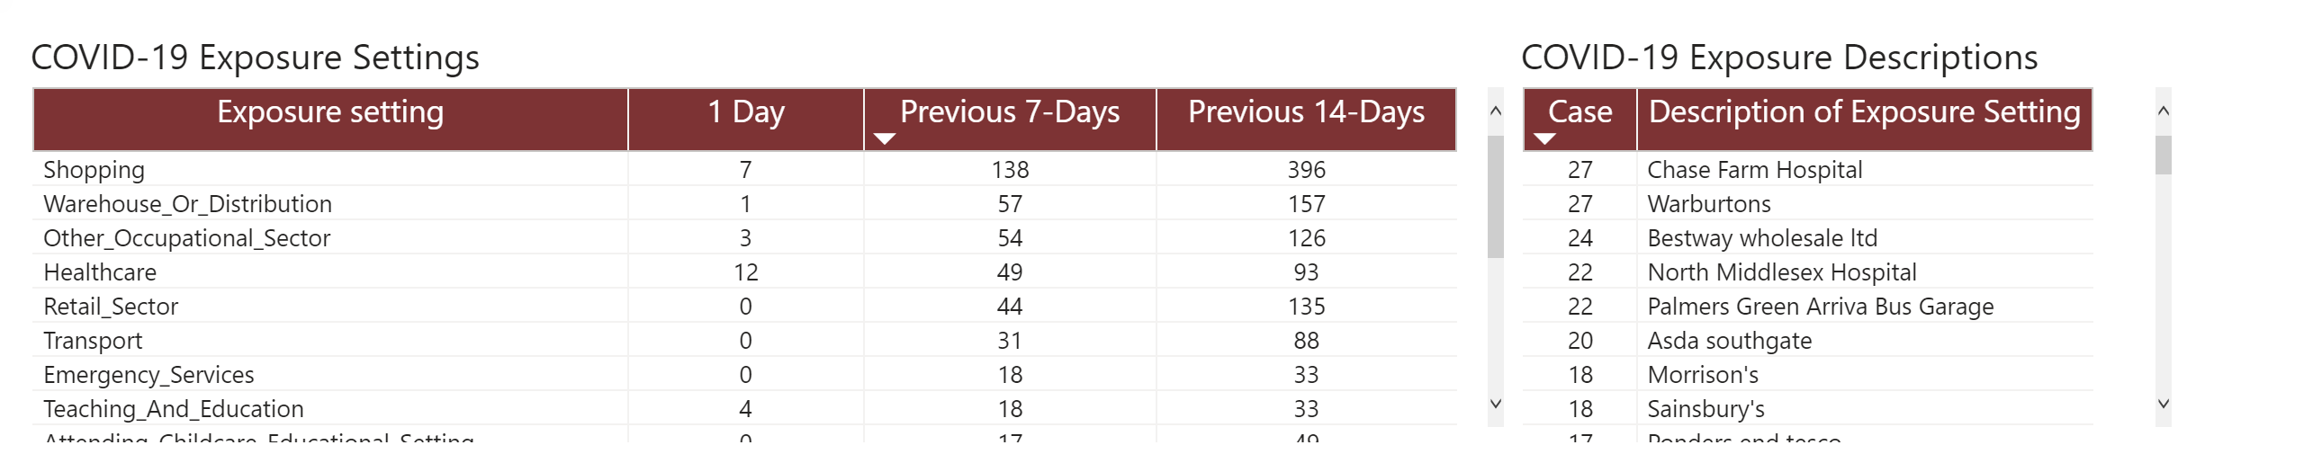
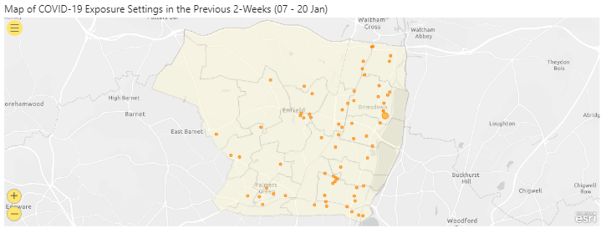
Exposure Settings
Notes:
Map of COVID-19 Exposure Settings in the Previous 2-Weeks (07 - 20 Jan)
No alt text provided.
COVID-19 Exposure Settings
No alt text provided.
COVID-19 Exposure Descriptions
No alt text provided.

Slide 13
COVID-19 Vaccine Uptake : Enfield as at 21.01.21
Number of Vaccine decliners as at 21st Jan= 193
Mostly;
Black
Turkish/ Cypriot residents.
Data source: NCL HealtheAnalytics COVID-19 vaccinations dashboard EMIS refresh 21st Jn 2021.
Updated on 23rd Jan 2021 at 8.45 pm.

Slide 14
COVID-19 Vaccine Declined 1st Dose Demographics
Total declines = 193
% of age-gender group declined first vaccine
%of ethnicity declined first vaccine

Slide 15
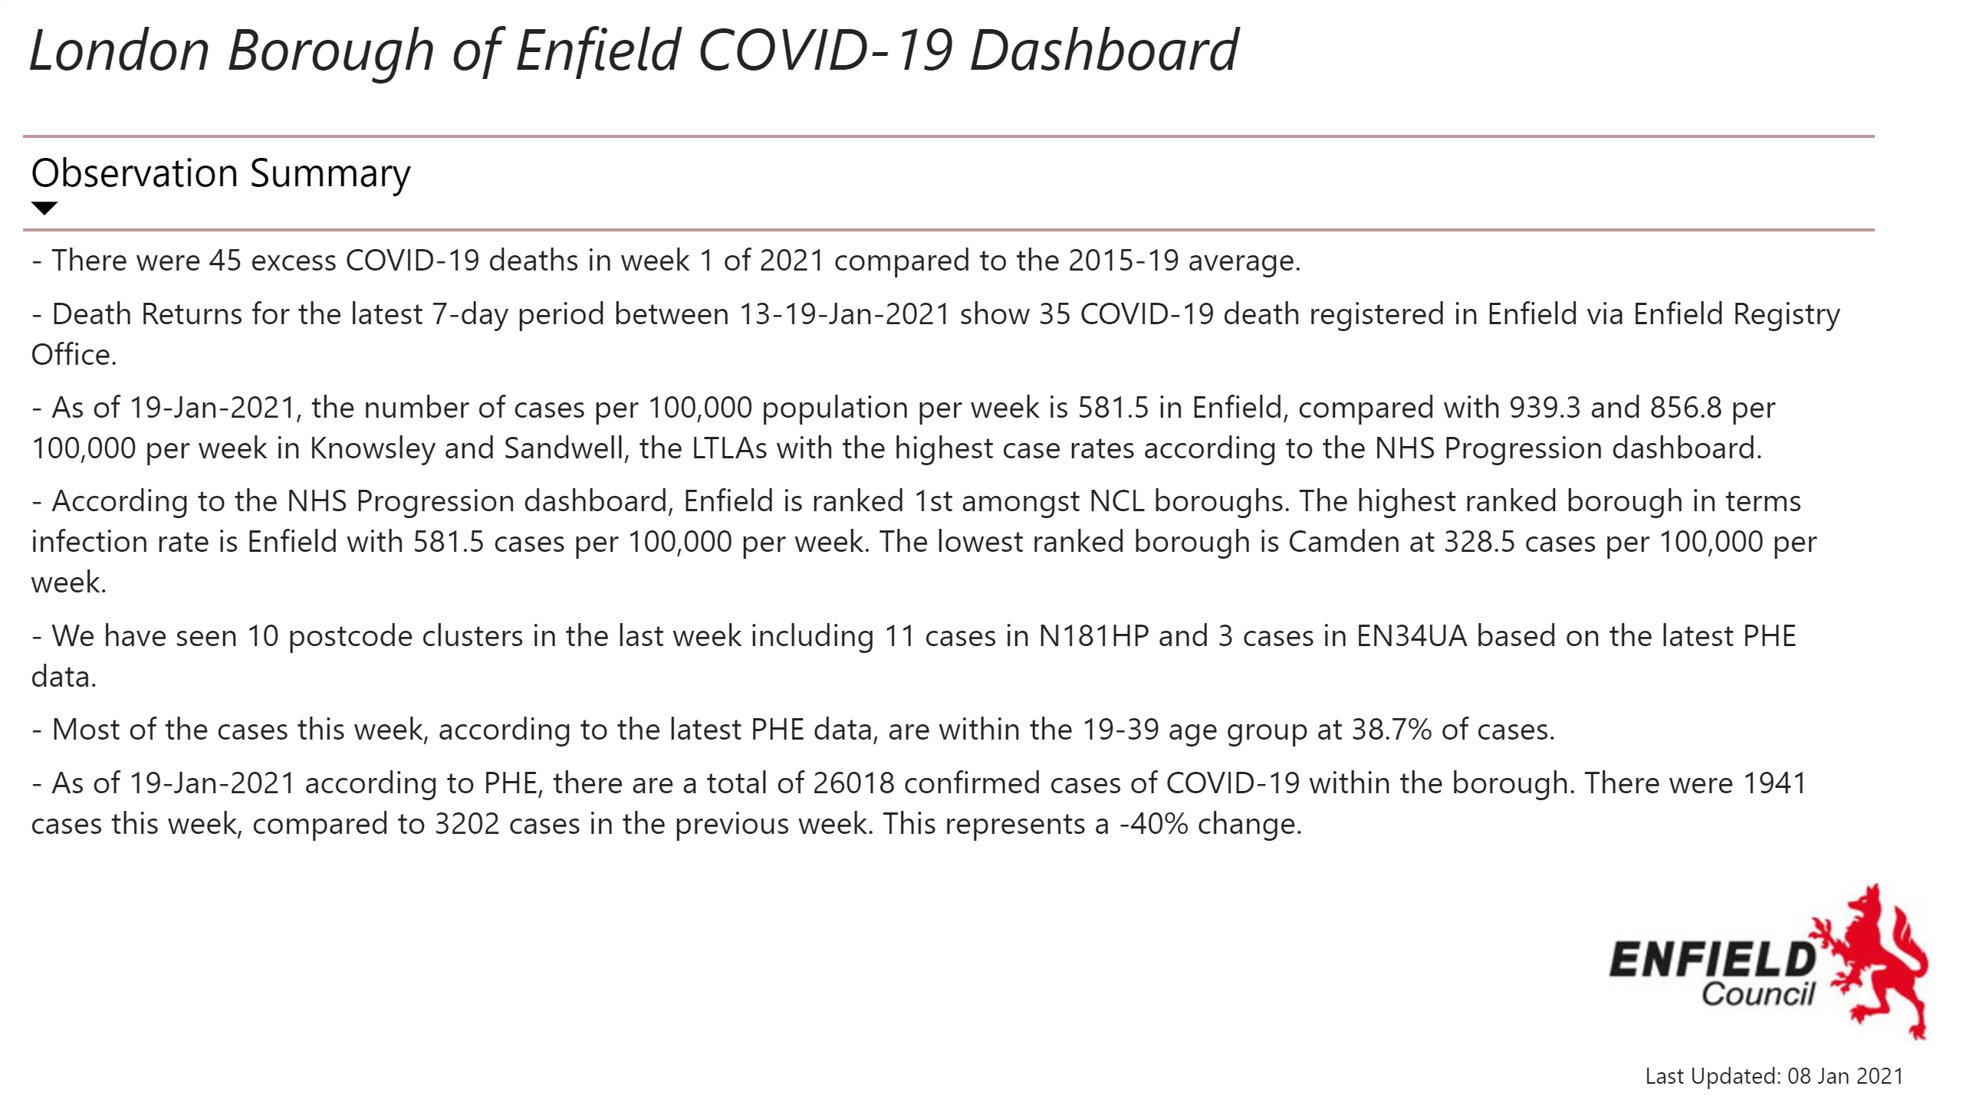
Observation Summary
24,976
Notes:
tableEx
No alt text provided.
textbox
No alt text provided.
textbox
No alt text provided.
image
No alt text provided.

Slide 16
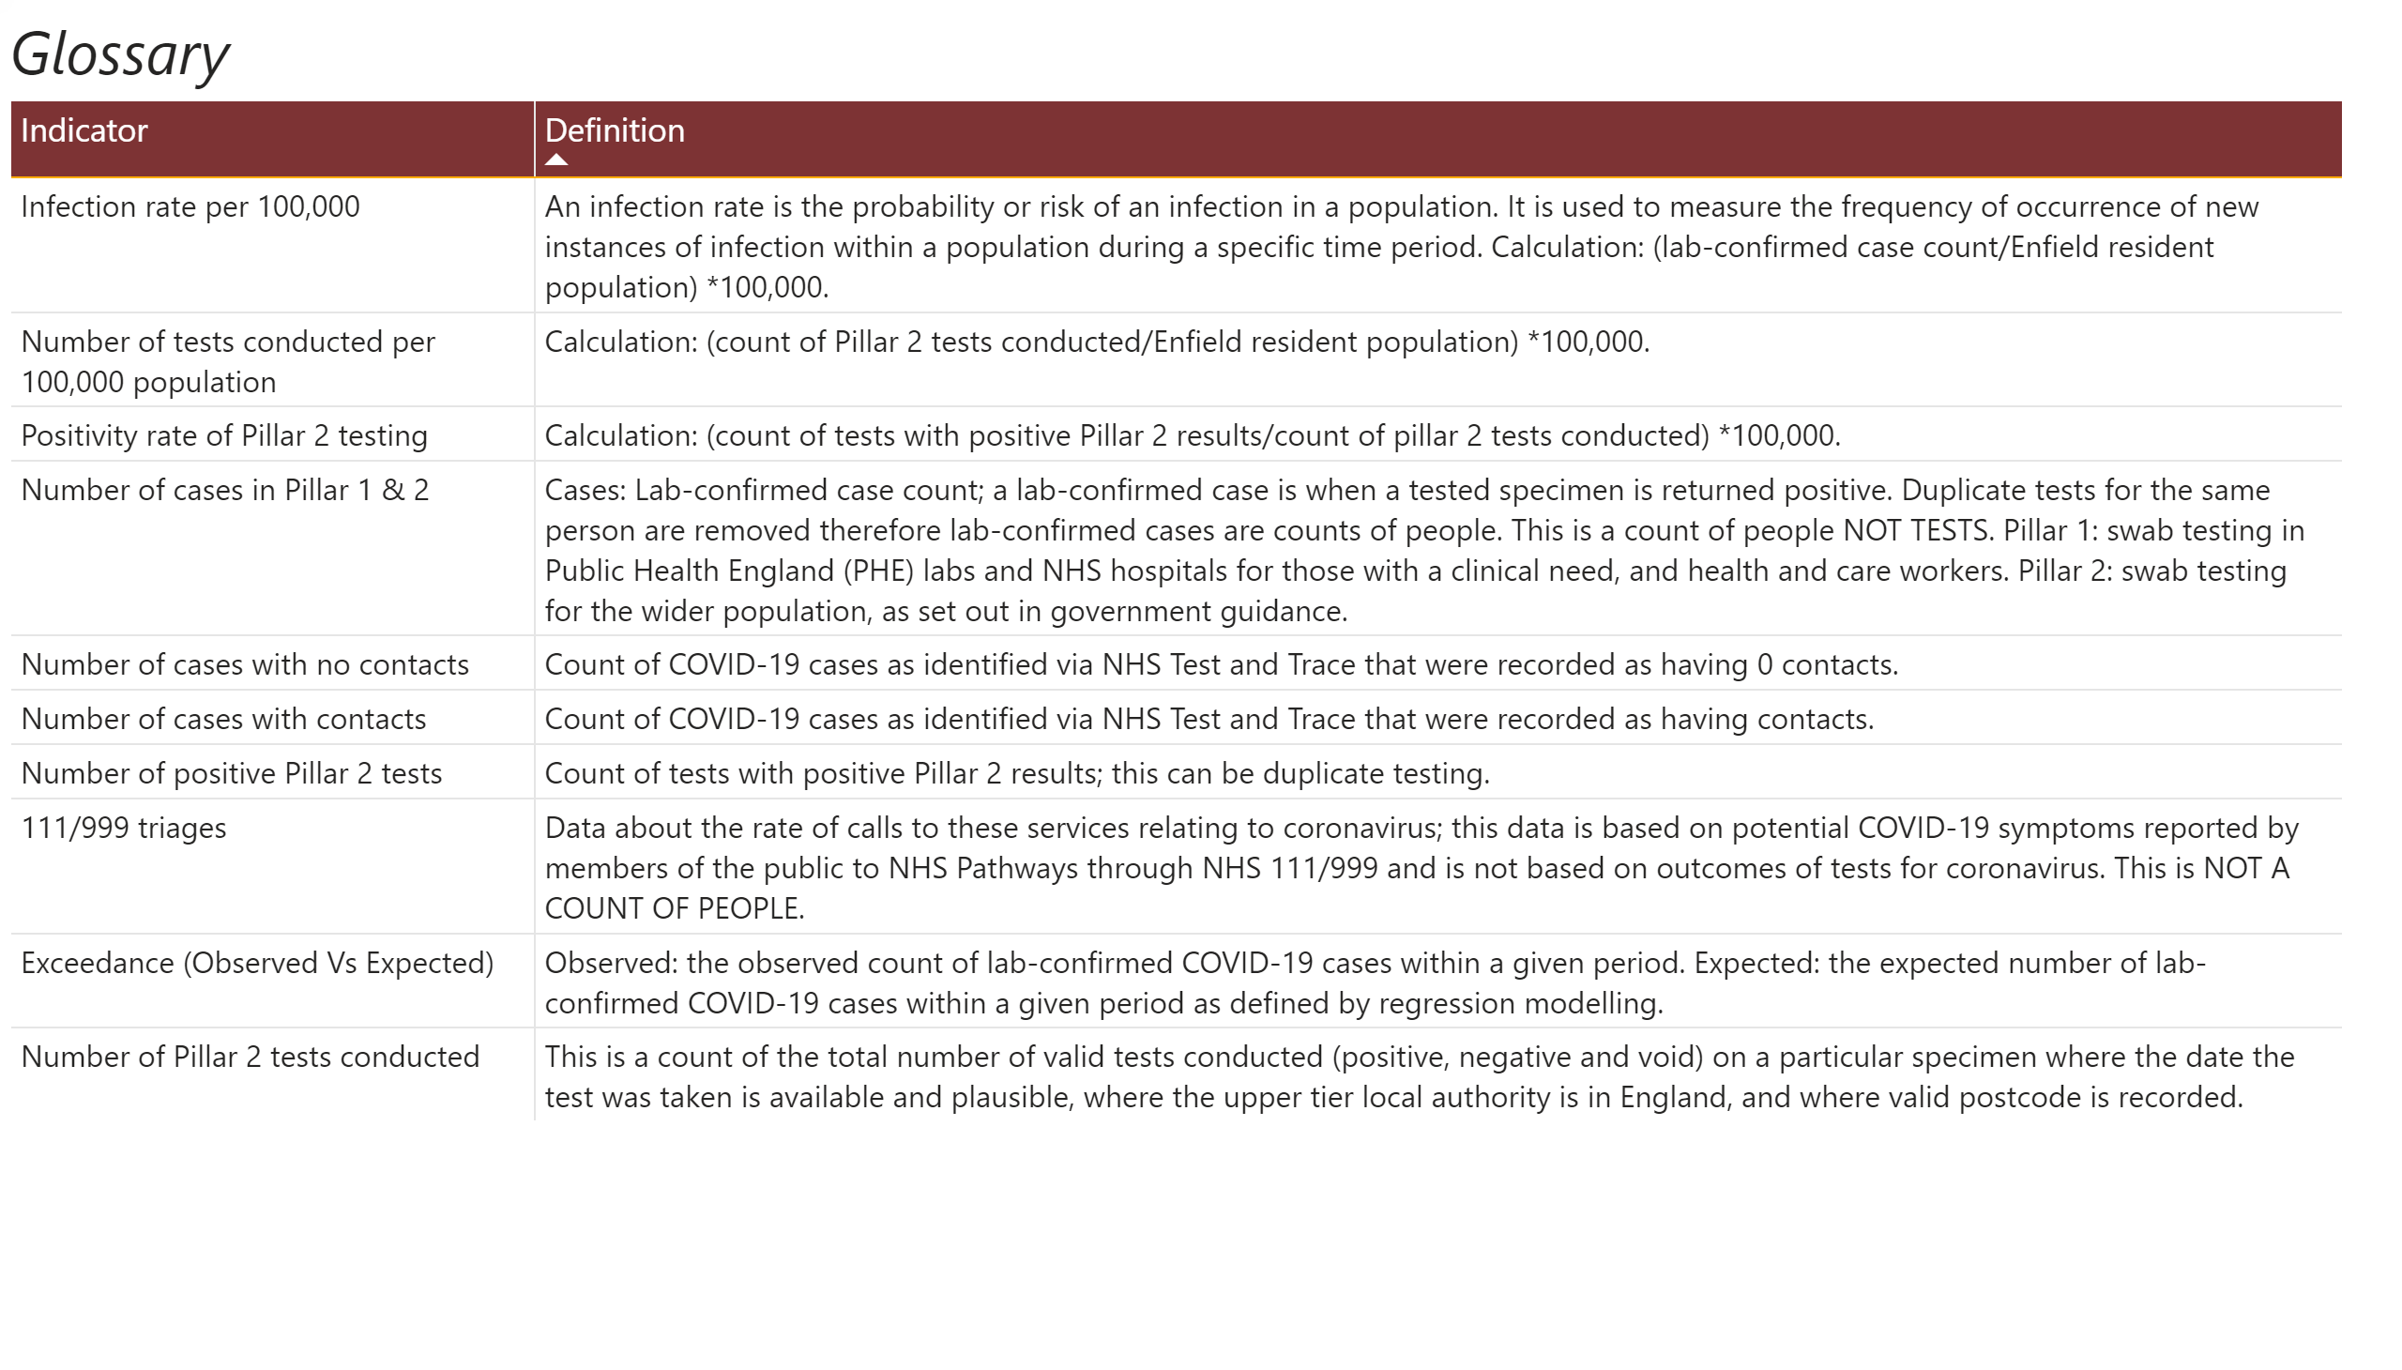
Glossary
Notes:
textbox
No alt text provided.
tableEx
No alt text provided.

