Slide 1
Enfield COVID19 Dashboard
View in Power BI
Last data refresh:
03/03/2021 13:32:59 GMT Standard Time
Downloaded at:
03/03/2021 13:35:31 GMT Standard Time

Slide 2
Observation Summary
Notes:
tableEx
No alt text provided.
textbox
No alt text provided.
image
No alt text provided.

Slide 3
Data Summary
Notes:
TOTAL
No alt text provided.
NEW CASES
No alt text provided.
RECENT DEATHS
No alt text provided.
INFECTION RATE PER 100,000
No alt text provided.
RANKS
No alt text provided.
textbox
No alt text provided.
TESTING RATE PER 100,000
No alt text provided.
VACCINATIONS
No alt text provided.
CARE SETTINGS
No alt text provided.
SCHOOLS
No alt text provided.
WARDS WITH HIGHEST INFECTION RATE
No alt text provided.
textbox
No alt text provided.
basicShape
No alt text provided.
basicShape
No alt text provided.
basicShape
No alt text provided.
basicShape
No alt text provided.
basicShape
No alt text provided.
basicShape
No alt text provided.
basicShape
No alt text provided.
basicShape
No alt text provided.
textbox
No alt text provided.
textbox
No alt text provided.
textbox
No alt text provided.
basicShape
No alt text provided.
basicShape
No alt text provided.
textbox
No alt text provided.
textbox
No alt text provided.
textbox
No alt text provided.

Slide 4
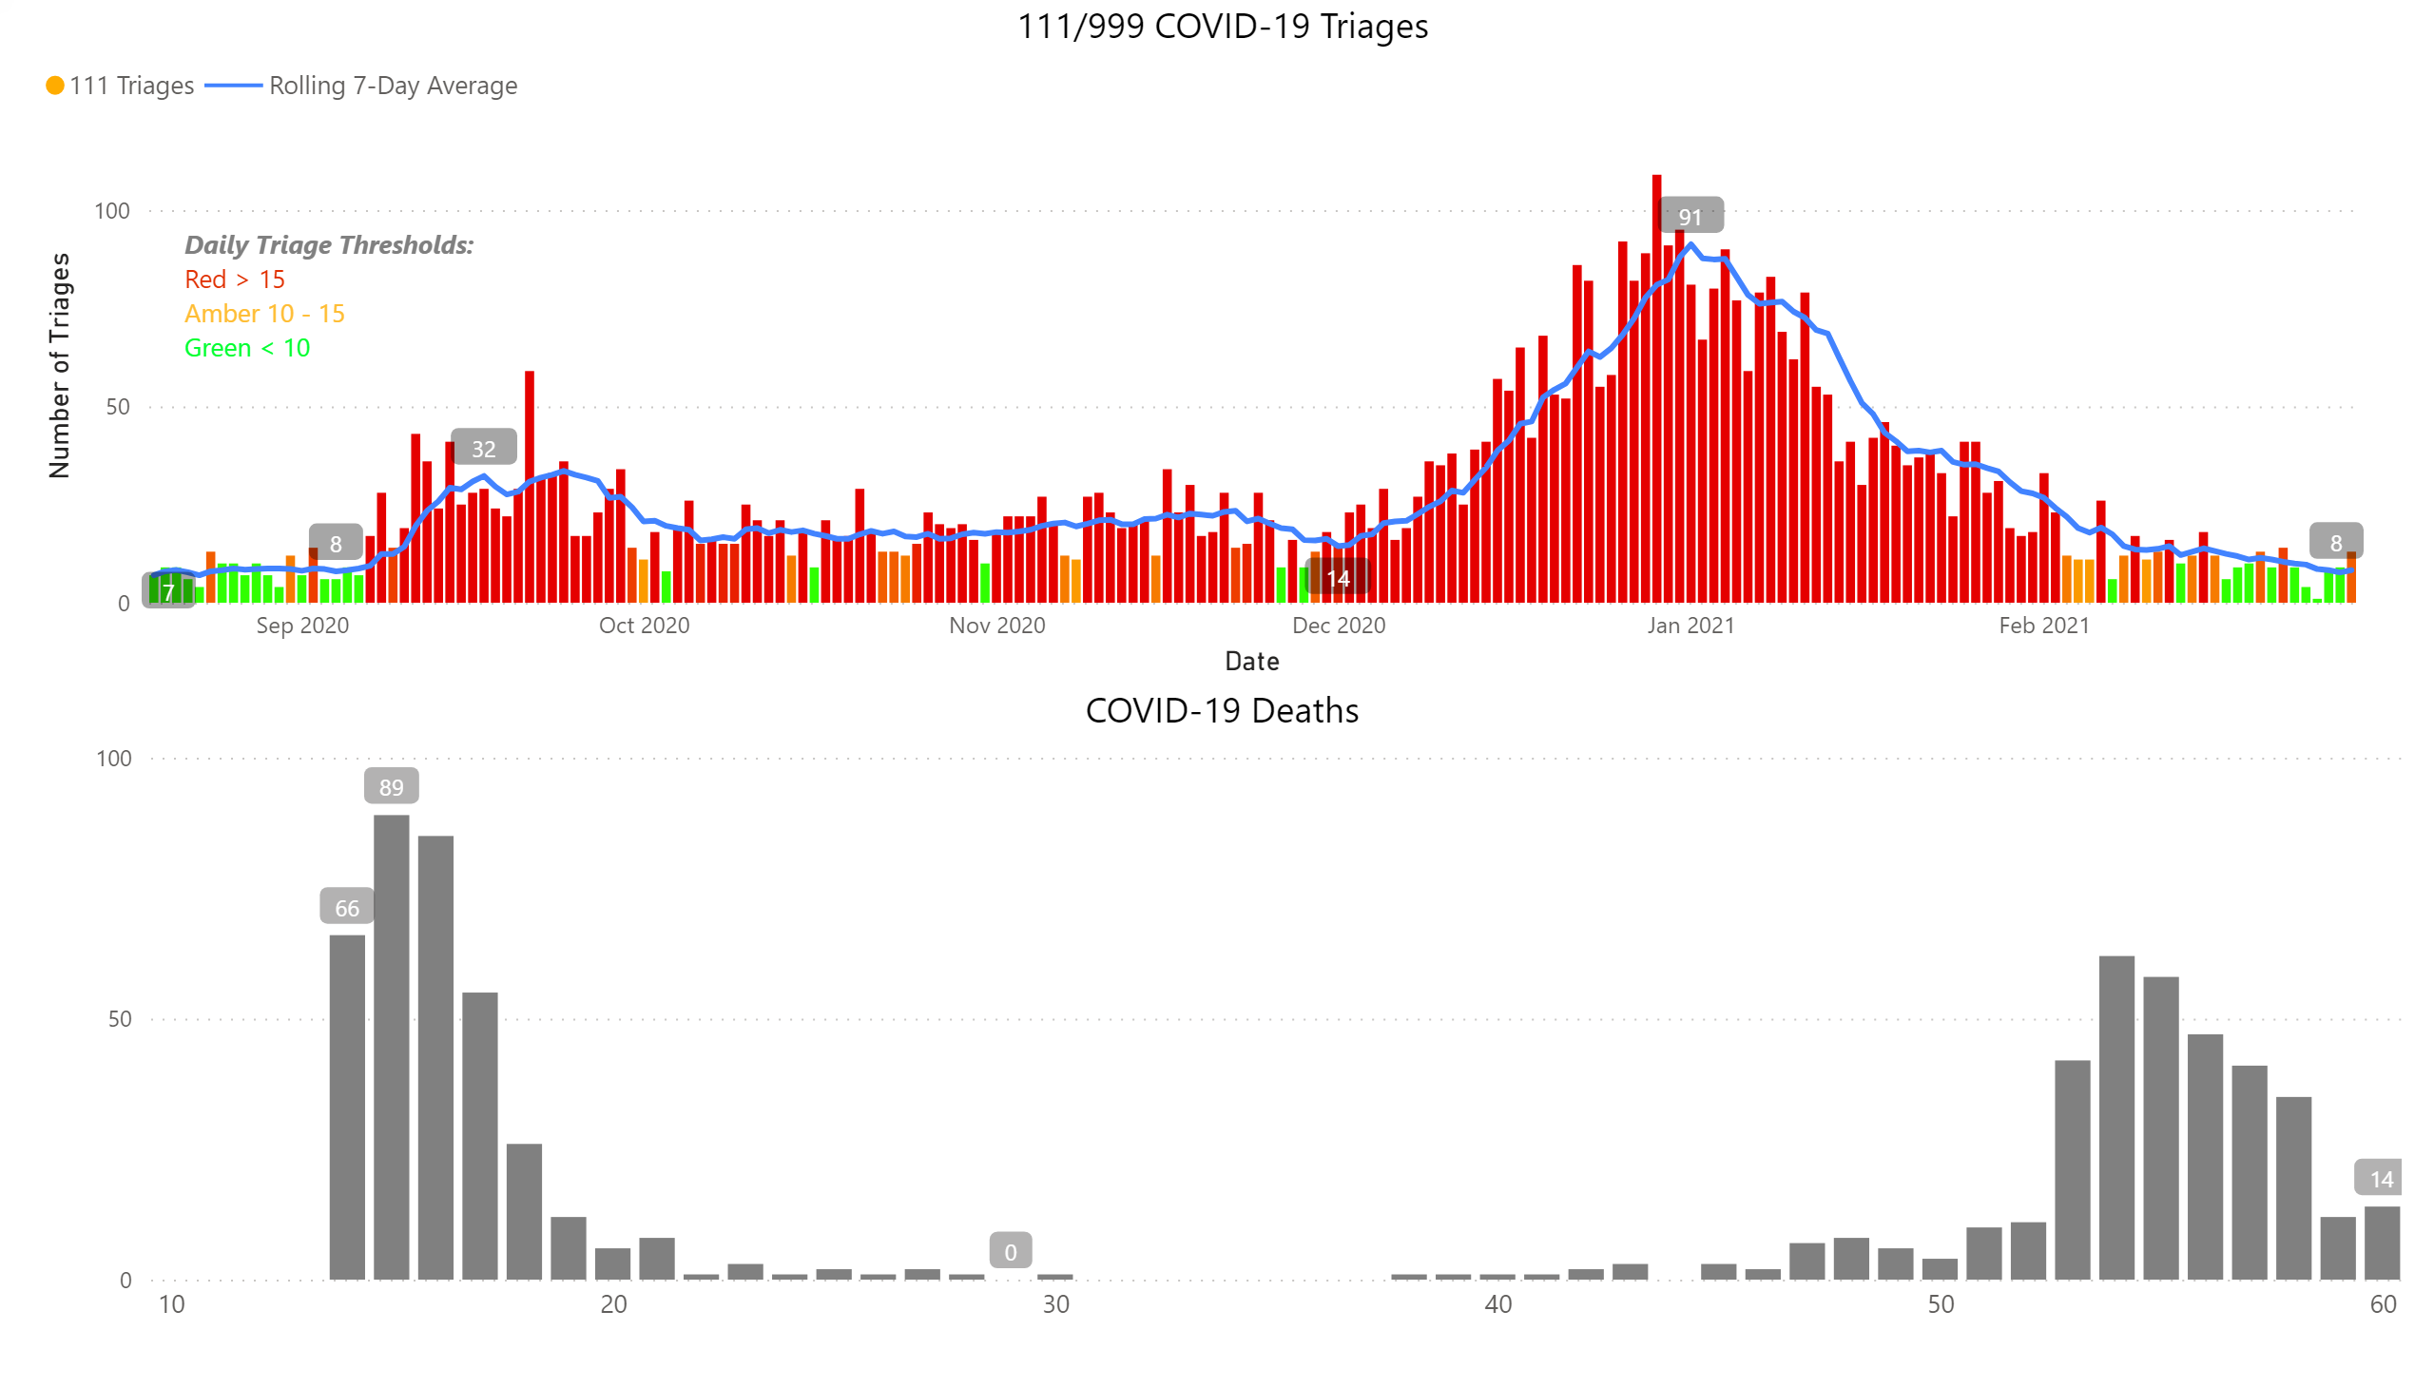
Charts
Notes:
111/999 COVID-19 Triages
No alt text provided.
COVID-19 Deaths
No alt text provided.
textbox
No alt text provided.

Slide 5
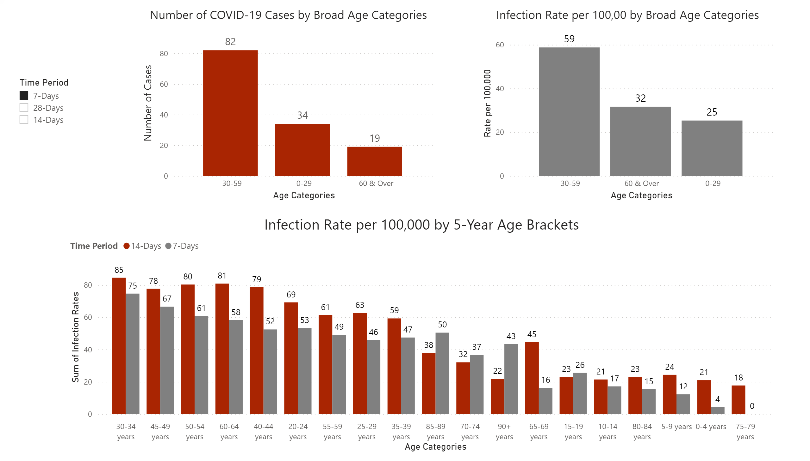
Age Stratified Infection Rates
Notes:
Number of COVID-19 Cases by Broad Age Categories
No alt text provided.
Infection Rate per 100,00 by Broad Age Categories
No alt text provided.
Infection Rate per 100,000 by 5-Year Age Brackets
No alt text provided.
slicer
No alt text provided.

Slide 6
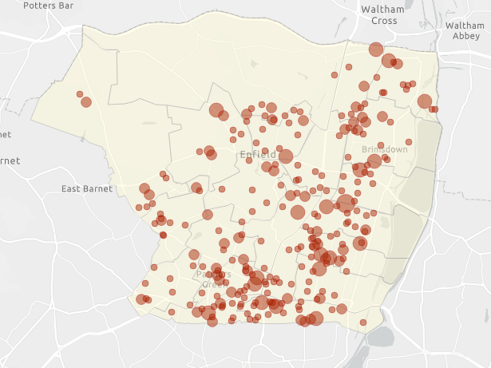
Maps (1)
COVID-19 Cases Lab-Confirmed in the Previous 2-Weeks (15 – 28 Feb)
Previous Week Average Weekly COVID-19 Infection Rate per 100,000 by Ward (22 – 28 Feb)
Notes:
COVID-19 Cases Lab-Confirmed in the Previous 2-Weeks (15 - 28 Feb)
No alt text provided.
COVID-19 Cases Lab-Confirmed in the Previous 2-Weeks (22 - 28 Feb)
No alt text provided.

Slide 7
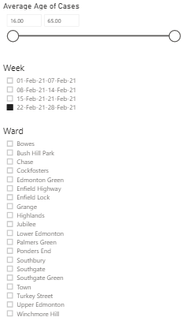
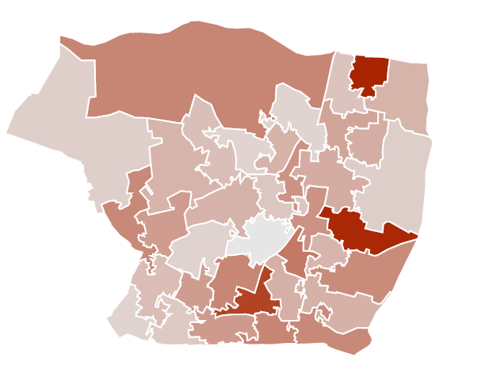
Map (2)
Weekly COVID-19 infection rate by MSOA (22 – 28 Feb)
Notes:
Weekly Infection Rate by MSOA
No alt text provided.
Week
No alt text provided.
Ward
No alt text provided.
Average Age of Cases
No alt text provided.

Slide 8
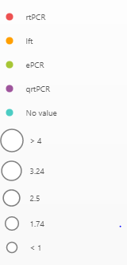
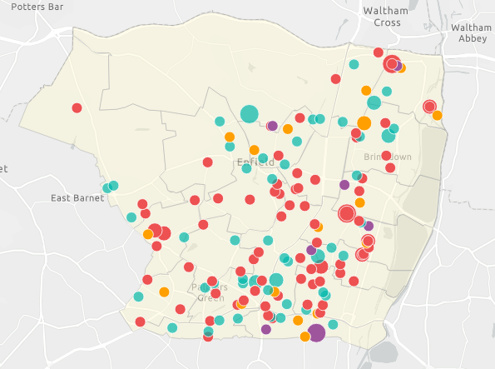
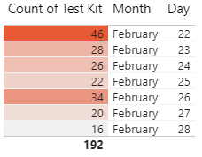
Map (3)
Map of COVID-19 Positive Tests in the Previous Week (22 – 28 Feb)
Notes:
Map of COVID-19 Positive Tests in the Previous Week (22 - 28 Feb)
No alt text provided.
slicer
No alt text provided.
slicer
No alt text provided.
slicer
No alt text provided.
slicer
No alt text provided.
slicer
No alt text provided.
slicer
No alt text provided.
tableEx
No alt text provided.

Slide 9
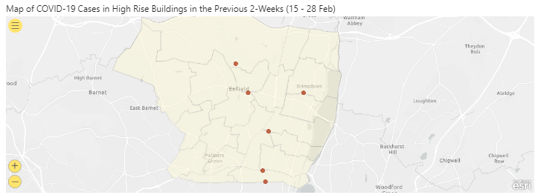
High Rise Buildings & Sheltered Housing
Notes:
Map of COVID-19 Cases in High Rise Buildings in the Previous 2-Weeks (15 - 28 Feb)
No alt text provided.
COVID-19 Cases in Sheltered Housing
No alt text provided.
textbox
No alt text provided.
COVID-19 Cases in High Rise Buildings*
No alt text provided.

Slide 10
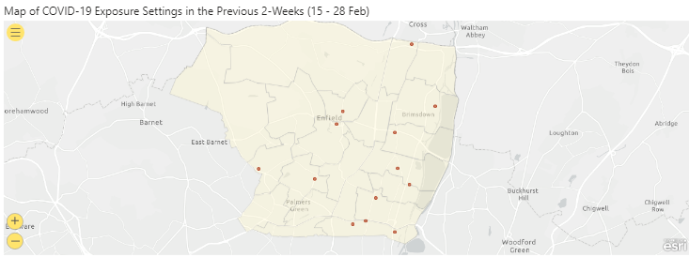
Exposure Settings
Household
Notes:
Map of COVID-19 Exposure Settings in the Previous 2-Weeks (15 - 28 Feb)
No alt text provided.
COVID-19 Exposure Settings
No alt text provided.
COVID-19 Exposure Descriptions
No alt text provided.

Slide 11
Hospital Data
Notes:
Hospital Data as of 02 Mar 21
No alt text provided.

Slide 12
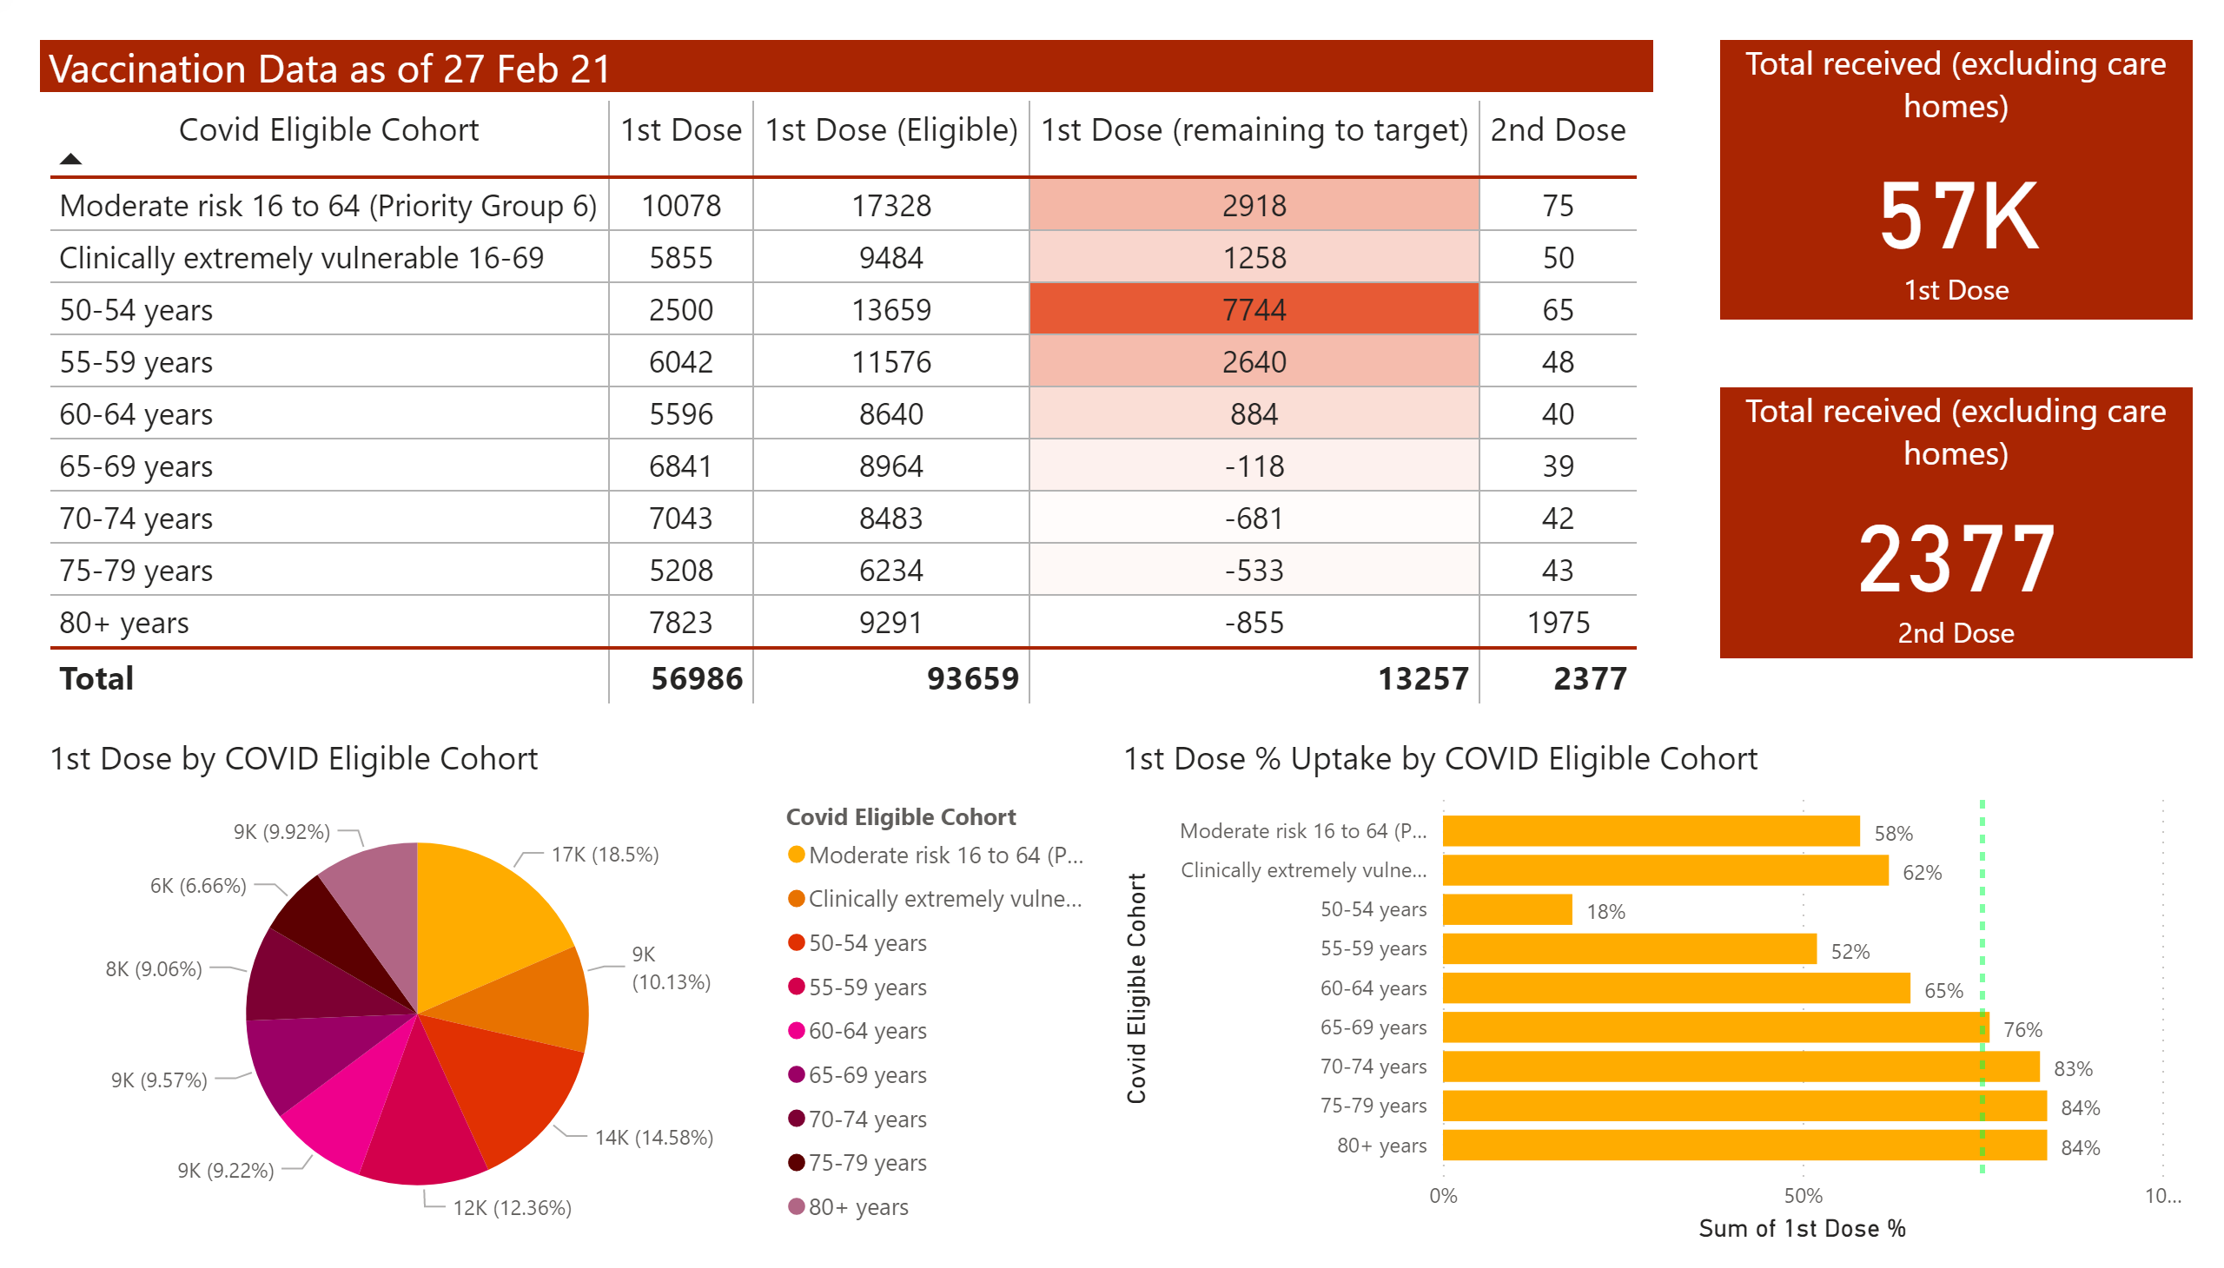
Vaccination Data
Notes:
Vaccination Data as of 27 Feb 21
No alt text provided.
1st Dose by COVID Eligible Cohort
No alt text provided.
Total received (excluding care homes)
No alt text provided.
Total received (excluding care homes)
No alt text provided.
1st Dose % Uptake by COVID Eligible Cohort
No alt text provided.

Slide 13
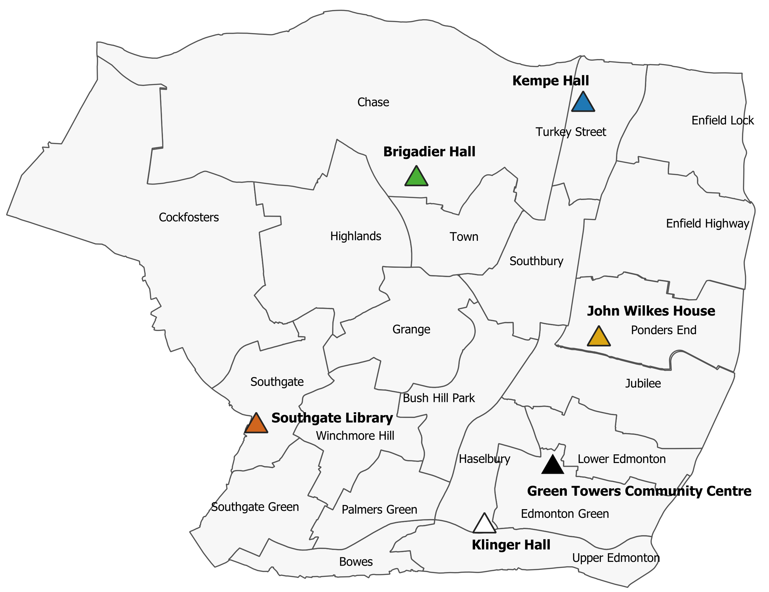
Community Mass Testing Demographics – Confirmatory Re-Test (Cumulative)
Results include data for Brigadier Hall, Southgate Library, Kempe Hall, Klinger Hall & Green Towers
Data as of 28 Feb 21
 | BCCS | KUTM | GTCC | SUHF | JWHG
 | Brigadier Hall | Kempe Hall | Green Towers Community Centre | Southgate Library | John Wilkes House
Total tests | 7,107 | 3,433 | 1,434 | 3,053 | 8,317
Positive | 417 | 331 | 178 | 130 | 438
% of total | 6% | 10% | 12% | 4% | 5%

Slide 14
Community Mass Testing Demographics
Results include data for Brigadier Hall, Southgate Library, Kempe Hall, Klinger Hall & Green Towers
(01 - 28 Feb 21)
Number of tests
Males have highest positivity rate but lower testing rates
Positivity rates highest in 0-29, testing rate lowest in younger age groups
Testing Rate per 100,000
School aged | 0-29 | 30-59 | 60 & Over
67649 | 134,250 | 139,540 | 60,030
1131 | 1896 | 3828 | 1959

Slide 15
School LFT Testing – as of 01 Feb 21
21 total positive LFT tests between 05 Jan – 01 Feb across Schools.
List of positive testing sites:
Negative/Void LFT
School | Enfield (Yes/No)
Oaktree School | Y
Hailey Hall School | N
Enfield County School for Girls | Y
Goffs Academy | N
St Ignatius College | Y
Chace Community School | Y
Oasis Academy Hadley | Y
Capital City College Group | N
Ambitious College | N
Edmonton County School | Y
Kingsmead School | Y
West Lea School | Y
Enfield Grammar School | Y
AIM Academy North London | Y
Treehouse School | N
Bridge Short Stay School | N
Fern House School | Y
Week beginning | School | SS | FE | Independent | Other | PRU | New Academy | Weekly total | Cumulative total
23-Feb-21 | 1019 | 530 | 61 | 52 | 26 | 7 | 0 | 1695 | 9698
16-Feb-21 | 434 | 115 | 9 | 30 | 8 | 0 | 0 | 596 | 8003
09-Feb-21 | 624 | 264 | 30 | 33 | 7 | 7 | 1 | 966 | 7407
02-Feb-21 | 992 | 444 | 43 | 45 | 15 | 6 | 2 | 1547 | 6441
Positive LFT
Week beginning | School | SS | FE | Independent | Other | PRU | New Academy | Weekly total | Cumulative total | Weekly % Total
23-Feb-21 | 0 | 2 | 0 | 0 | 0 | 0 | 0 | 2 | 21 | 0.1
16-Feb-21 | 0 | 0 | 0 | 0 | 0 | 0 | 0 | 0 | 19 | 0.0
09-Feb-21 | 0 | 0 | 0 | 0 | 0 | 0 | 0 | 0 | 19 | 0.0
02-Feb-21 | 0 | 0 | 0 | 0 | 0 | 0 | 0 | 0 | 19 | 0.0
FE, Further Education; SS, Secondary School; PRU, Pupil Referral Unit.

Slide 16
% Uptake by Ward

Slide 17
% Decline by Ward

Slide 18
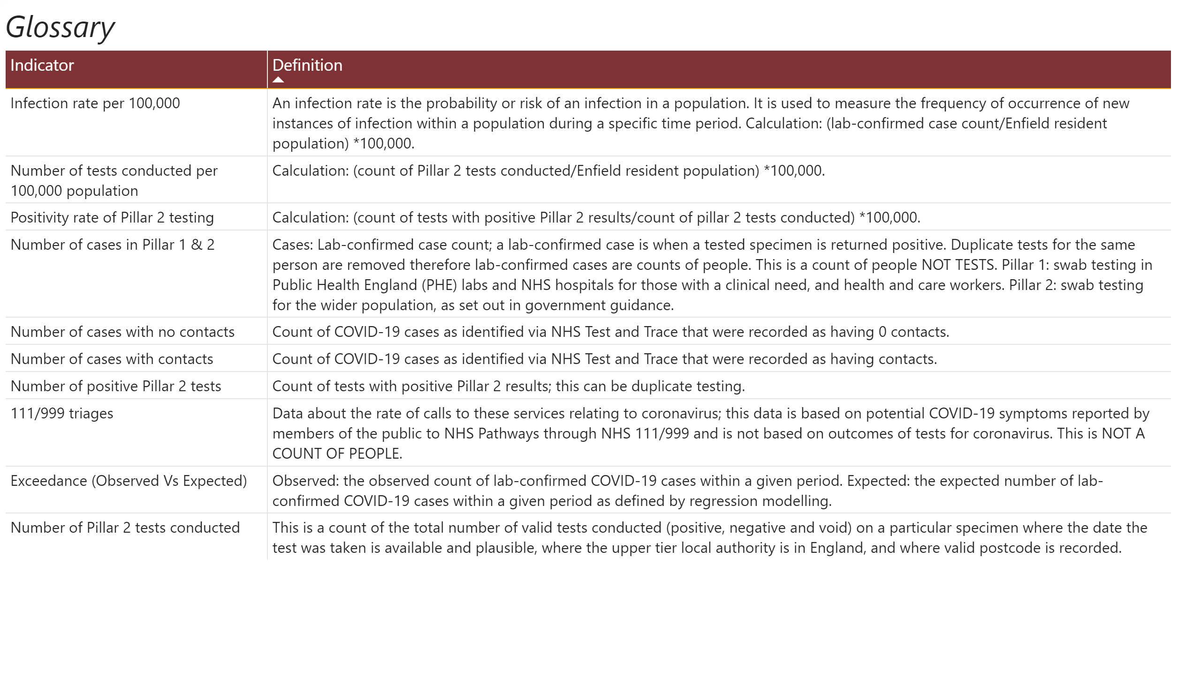
Glossary
Notes:
textbox
No alt text provided.
tableEx
No alt text provided.

