Slide 1
Enfield COVID19 Dashboard
View in Power BI
Last data refresh:
10/03/2021 15:48:28 GMT Standard Time
Downloaded at:
10/03/2021 17:14:56 GMT Standard Time

Slide 2
Data Summary
Notes:
TOTAL
No alt text provided.
NEW CASES
No alt text provided.
RECENT DEATHS
No alt text provided.
INFECTION RATE PER 100,000
No alt text provided.
RANKS
No alt text provided.
textbox
No alt text provided.
TESTING RATE PER 100,000
No alt text provided.
VACCINATIONS
No alt text provided.
CARE SETTINGS
No alt text provided.
SCHOOLS
No alt text provided.
WARDS WITH HIGHEST INFECTION RATE
No alt text provided.
textbox
No alt text provided.
basicShape
No alt text provided.
basicShape
No alt text provided.
basicShape
No alt text provided.
basicShape
No alt text provided.
basicShape
No alt text provided.
basicShape
No alt text provided.
basicShape
No alt text provided.
basicShape
No alt text provided.
textbox
No alt text provided.
textbox
No alt text provided.
textbox
No alt text provided.
basicShape
No alt text provided.
basicShape
No alt text provided.
textbox
No alt text provided.

Slide 3
Observation Summary
Notes:
tableEx
No alt text provided.
textbox
No alt text provided.
image
No alt text provided.

Slide 4
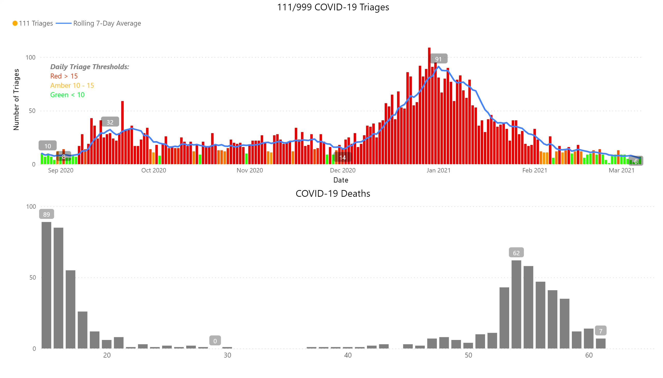
Charts
Notes:
111/999 COVID-19 Triages
No alt text provided.
COVID-19 Deaths
No alt text provided.
textbox
No alt text provided.

Slide 5
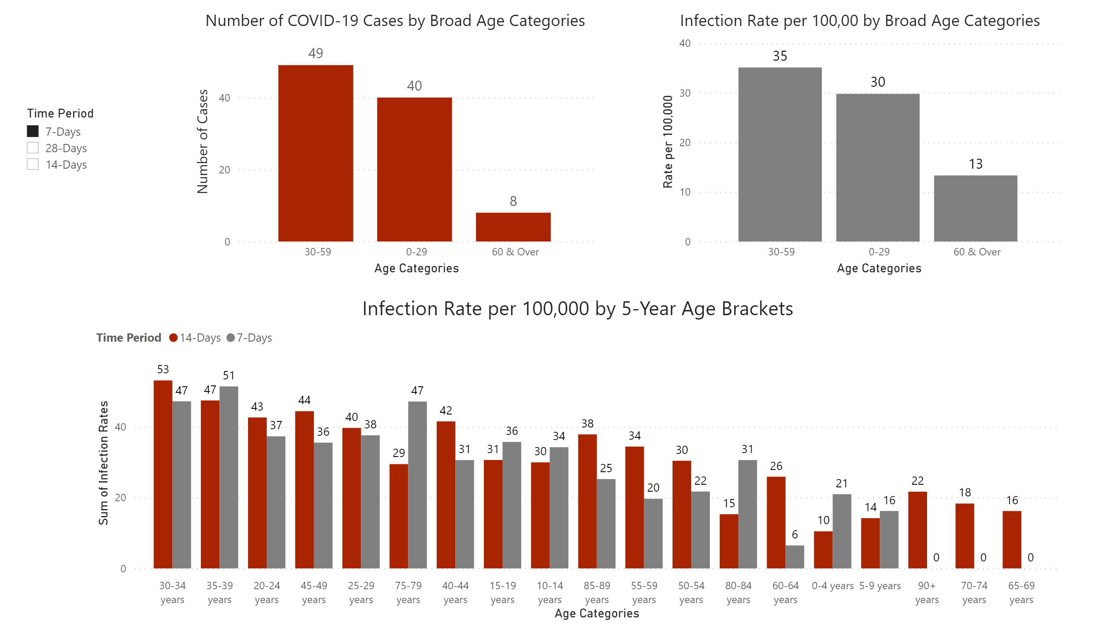
Age Stratified Infection Rates
Notes:
Number of COVID-19 Cases by Broad Age Categories
No alt text provided.
Infection Rate per 100,00 by Broad Age Categories
No alt text provided.
Infection Rate per 100,000 by 5-Year Age Brackets
No alt text provided.
slicer
No alt text provided.

Slide 6
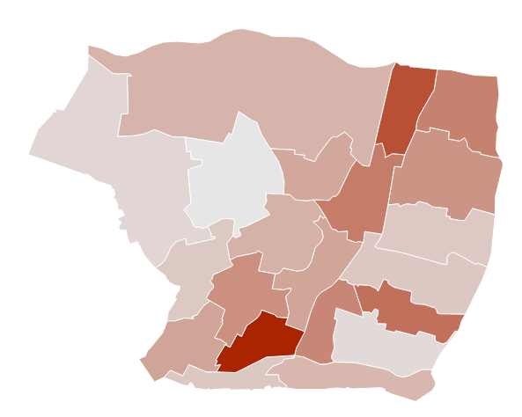
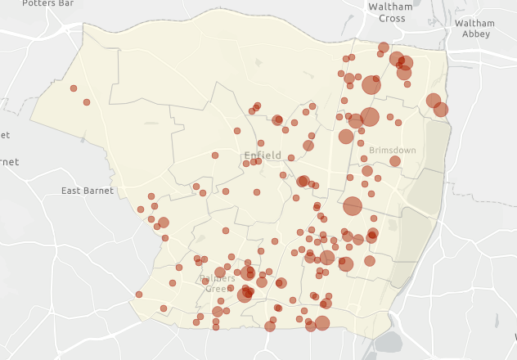
Maps (1)
COVID-19 Cases Lab-Confirmed in the Previous 2-Weeks (23 Feb – 08 Mar)
Previous Week Average Weekly COVID-19 Infection Rate per 100,000 by Ward (02 – 08 Mar)

Slide 7
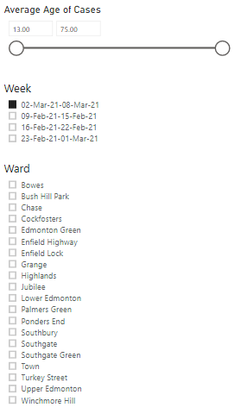
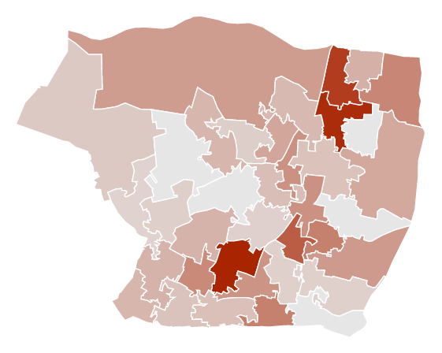
Map (2)
Weekly COVID-19 infection rate by MSOA (02 – 08 Mar)
Notes:
Weekly Infection Rate by MSOA
No alt text provided.
Week
No alt text provided.
Ward
No alt text provided.
Average Age of Cases
No alt text provided.

Slide 8
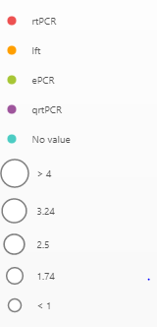
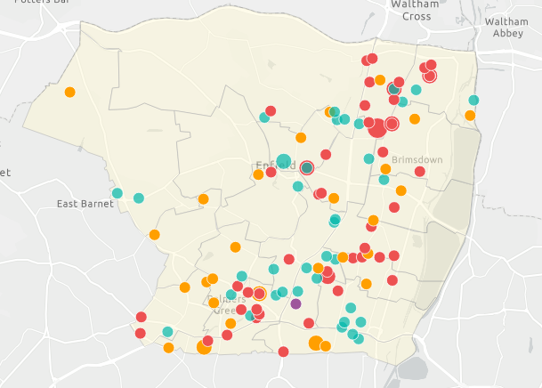
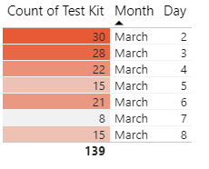
Map (3)
Map of COVID-19 Positive Tests in the Previous Week (02 – 08 Mar)
Notes:
Map of COVID-19 Positive Tests in the Previous Week (22 - 28 Feb)
No alt text provided.
slicer
No alt text provided.
slicer
No alt text provided.
slicer
No alt text provided.
slicer
No alt text provided.
slicer
No alt text provided.
slicer
No alt text provided.
tableEx
No alt text provided.

Slide 9
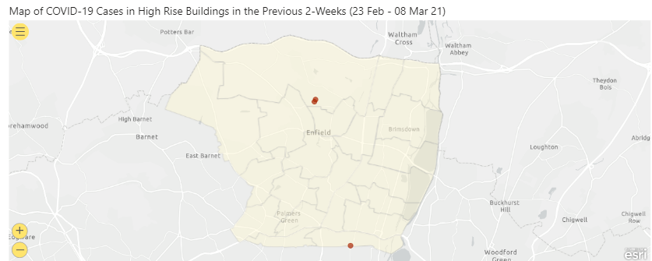
High Rise Buildings & Sheltered Housing
Notes:
Map of COVID-19 Cases in High Rise Buildings in the Previous 2-Weeks (23 Feb - 08 Mar 21)
No alt text provided.
COVID-19 Cases in Sheltered Housing
No alt text provided.
textbox
No alt text provided.
COVID-19 Cases in High Rise Buildings*
No alt text provided.

Slide 10
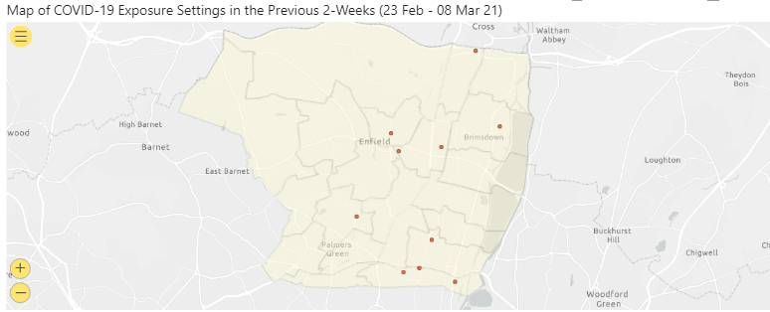
Exposure Settings
Notes:
Map of COVID-19 Exposure Settings in the Previous 2-Weeks (23 Feb - 08 Mar 21)
No alt text provided.
COVID-19 Exposure Settings
No alt text provided.
COVID-19 Exposure Descriptions
No alt text provided.

Slide 11
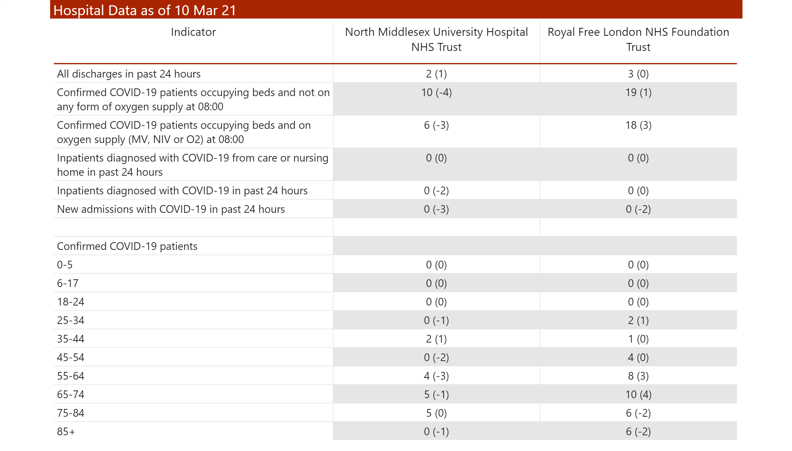
Hospital Data
Notes:
Hospital Data as of 10 Mar 21
No alt text provided.

Slide 12
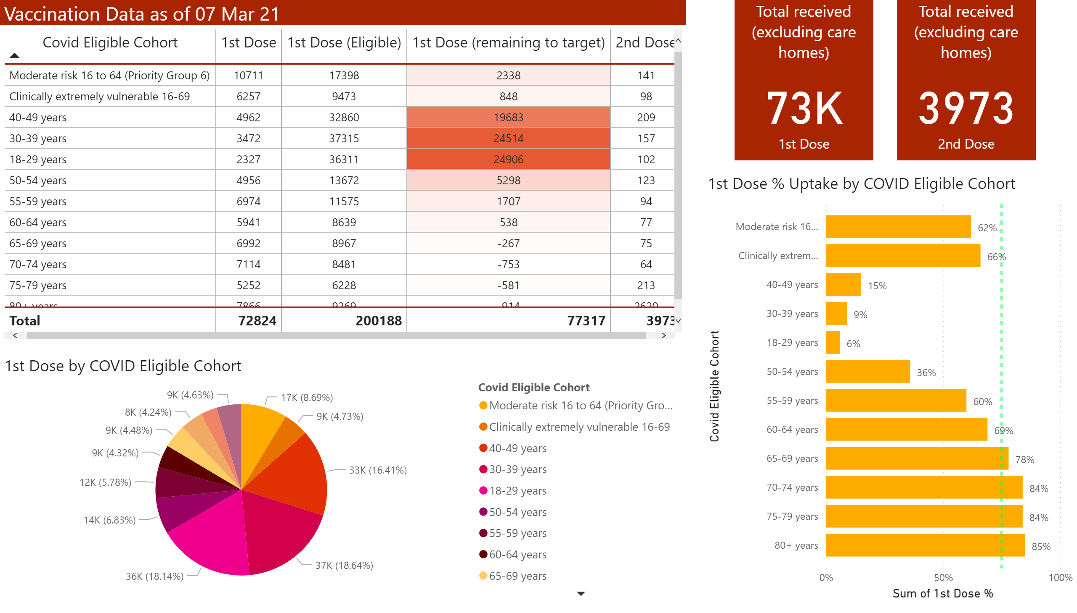
Vaccination Data
Notes:
Vaccination Data as of 07 Mar 21
No alt text provided.
1st Dose by COVID Eligible Cohort
No alt text provided.
Total received (excluding care homes)
No alt text provided.
Total received (excluding care homes)
No alt text provided.
1st Dose % Uptake by COVID Eligible Cohort
No alt text provided.

Slide 13
Community Mass Testing Demographics – Confirmatory Re-Test (Cumulative)
Results include data for Brigadier Hall, Southgate Library, Kempe Hall, Boundary Hall, British Alevi Foundation & Green Towers
Data as of 08 March 21
 | BCCS | KUTM | KSBM | GTCC | SUHF | JWHG | BCHO | BAFY
 | Brigadier Hall | Kempe Hall | Klinger Hall | Green Towers Community Centre | Southgate Library | John Wilkes House | Boundary Hall | British Alevi Foundation
Total tests | 5,812 | 2,703 | 988 | 2,678 | 7,062 | 4,384 | 4,237 | 4,244
Positive | 421 | 333 | 178 | 130 | 443 | 152 | 5 | 12
% of total | 7% | 12% | 18% | 5% | 6% | 3% | <1% | <1%

Slide 14
Community Mass Testing Demographics
Results include data for Brigadier Hall, Southgate Library, Kempe Hall, Klinger Hall & Green Towers
(09 Feb - 08 Mar 21)
Number of tests
Positivity rates highest school aged children, testing rate lowest in younger age groups
Males have highest positivity rate but lower testing rates
0-29 | 30-59 | 60 & Over | School aged
134,250 | 139,540 | 60,030 | 67649
1601 | 2872 | 1491 | 1373

Slide 15
School LFT Testing – as of 08 Mar 21
Negative/Void LFT
Week beginning | School | SS | FE | Independent | Other | PRU | New Academy | Weekly total | Cumulative total
02-Mar-21 | 4612 | 541 | 1052 | 280 | 27 | 7 | 0 | 6519 | 15435
23-Feb-21 | 1050 | 534 | 61 | 54 | 26 | 7 | 0 | 1732 | 8916
16-Feb-21 | 434 | 115 | 9 | 30 | 8 | 0 | 0 | 596 | 7184
09-Feb-21 | 624 | 264 | 30 | 33 | 7 | 7 | 1 | 966 | 6588
Positive LFT
Week beginning | School | SS | FE | Independent | Other | PRU | New Academy | Weekly total | Cumulative total | Weekly % Total
02-Mar-21 | 0 | 1 | 1 | 0 | 0 | 0 | 0 | 2 | 20 | 0.0
23-Feb-21 | 0 | 2 | 0 | 0 | 0 | 0 | 0 | 2 | 18 | 0.1
16-Feb-21 | 0 | 0 | 0 | 0 | 0 | 0 | 0 | 0 | 16 | 0.0
09-Feb-21 | 0 | 0 | 0 | 0 | 0 | 0 | 0 | 0 | 16 | 0.0
FE, Further Education; SS, Secondary School; PRU, Pupil Referral Unit.

Slide 16
% Uptake by Ward

Slide 17
% Decline by Ward

Slide 18
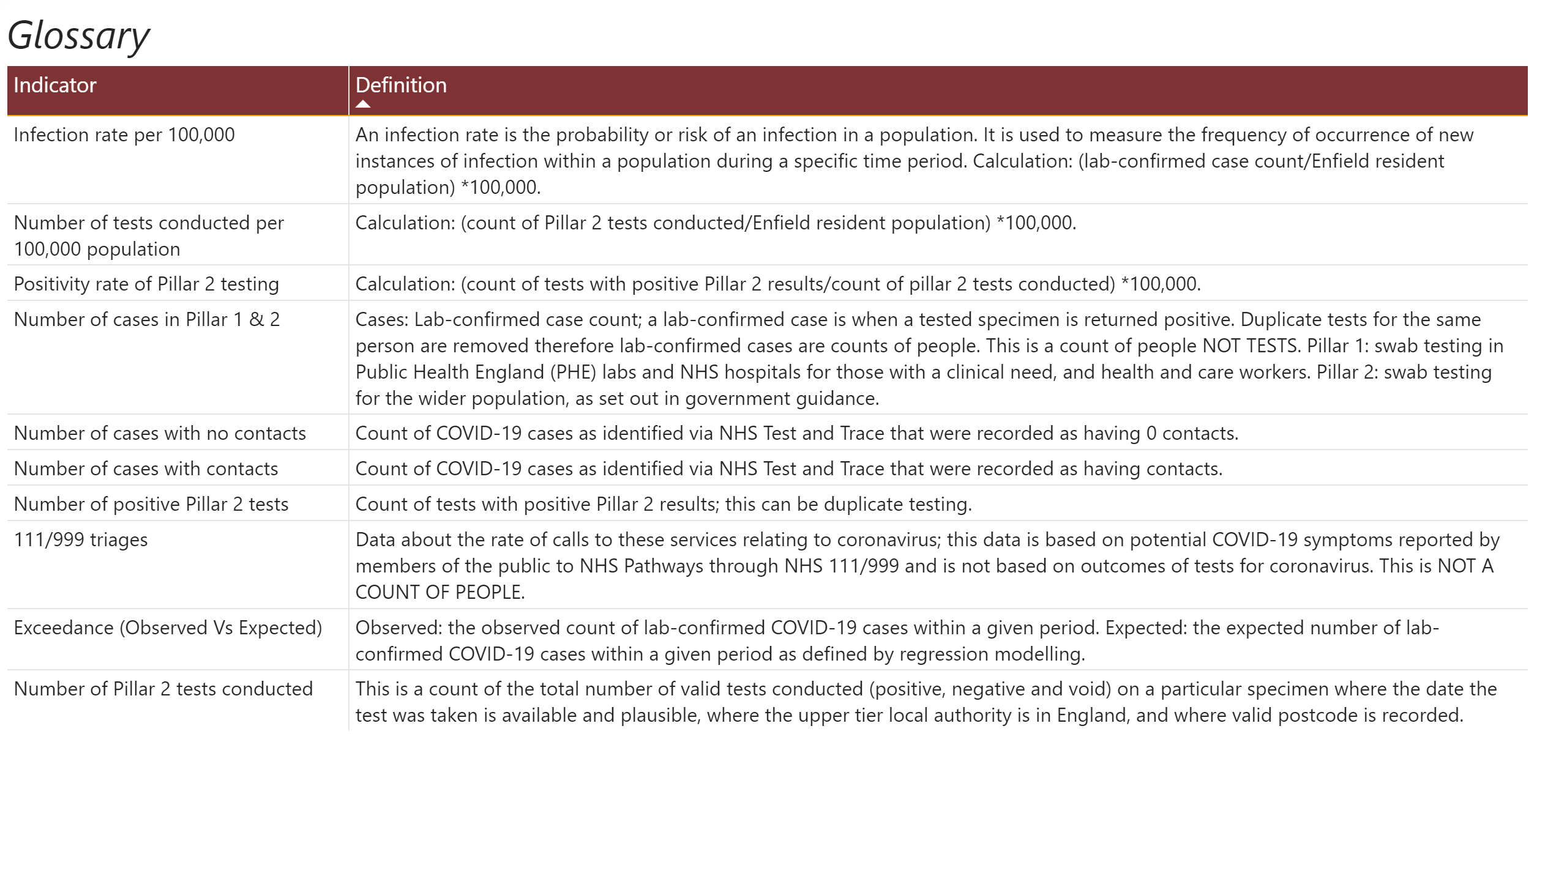
Glossary
Notes:
textbox
No alt text provided.
tableEx
No alt text provided.

