Slide 1
Enfield COVID19 Dashboard
View in Power BI
Last data refresh:
5/26/2021 7:24:59 AM UTC
Downloaded at:
5/26/2021 7:29:49 AM UTC

Slide 2
Data Summary
Notes:
TOTAL
No alt text provided.
NEW CASES
No alt text provided.
RECENT COVID DEATHS*
No alt text provided.
INFECTION RATE PER 100,000*
No alt text provided.
INFECTION RATE RANK*
No alt text provided.
Enfield COVID-19 Dashboard (16- 23 May 21)
No alt text provided.
TESTS*
No alt text provided.
VACCINATIONS 165,809 1st DOSES
No alt text provided.
CARE SETTINGS
No alt text provided.
SCHOOLS/ EARLY YEARS AFFECTED
No alt text provided.
WARDS WITH HIGHEST INFECTION RATES*
No alt text provided.
textbox
No alt text provided.
basicShape
No alt text provided.
basicShape
No alt text provided.
textbox
No alt text provided.
textbox
No alt text provided.
textbox
No alt text provided.
textbox
No alt text provided.
basicShape
No alt text provided.
image
No alt text provided.
image
No alt text provided.
image
No alt text provided.
textbox
No alt text provided.
textbox
No alt text provided.
image
No alt text provided.
textbox
No alt text provided.
textbox
No alt text provided.
textbox
0-29
textbox
No alt text provided.
textbox
No alt text provided.
basicShape
No alt text provided.
basicShape
No alt text provided.
basicShape
No alt text provided.
image
No alt text provided.
textbox
No alt text provided.
textbox
No alt text provided.
image
No alt text provided.
image
No alt text provided.
image
No alt text provided.

Slide 3
Observation Summary
Notes:
tableEx
No alt text provided.
textbox
No alt text provided.
image
No alt text provided.

Slide 4
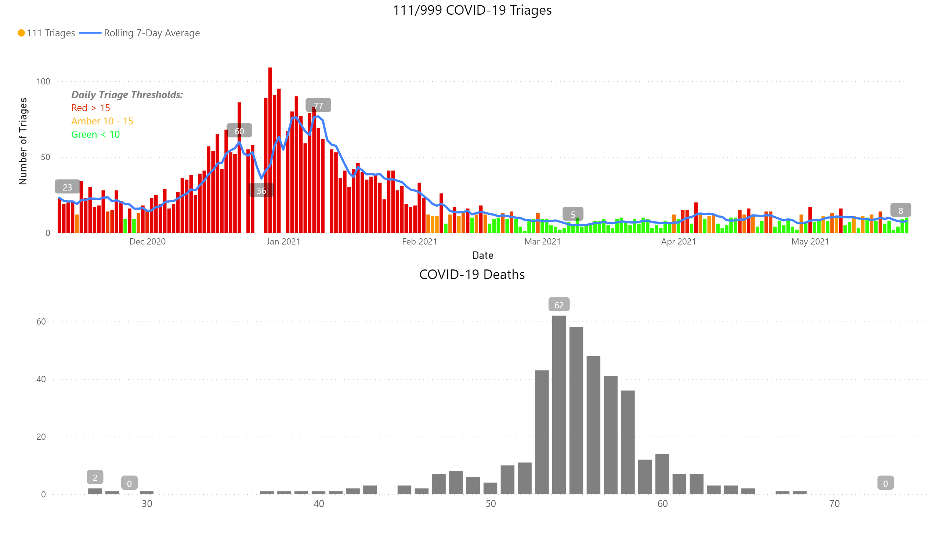
Charts
Notes:
111/999 COVID-19 Triages
No alt text provided.
COVID-19 Deaths
No alt text provided.
textbox
No alt text provided.

Slide 5
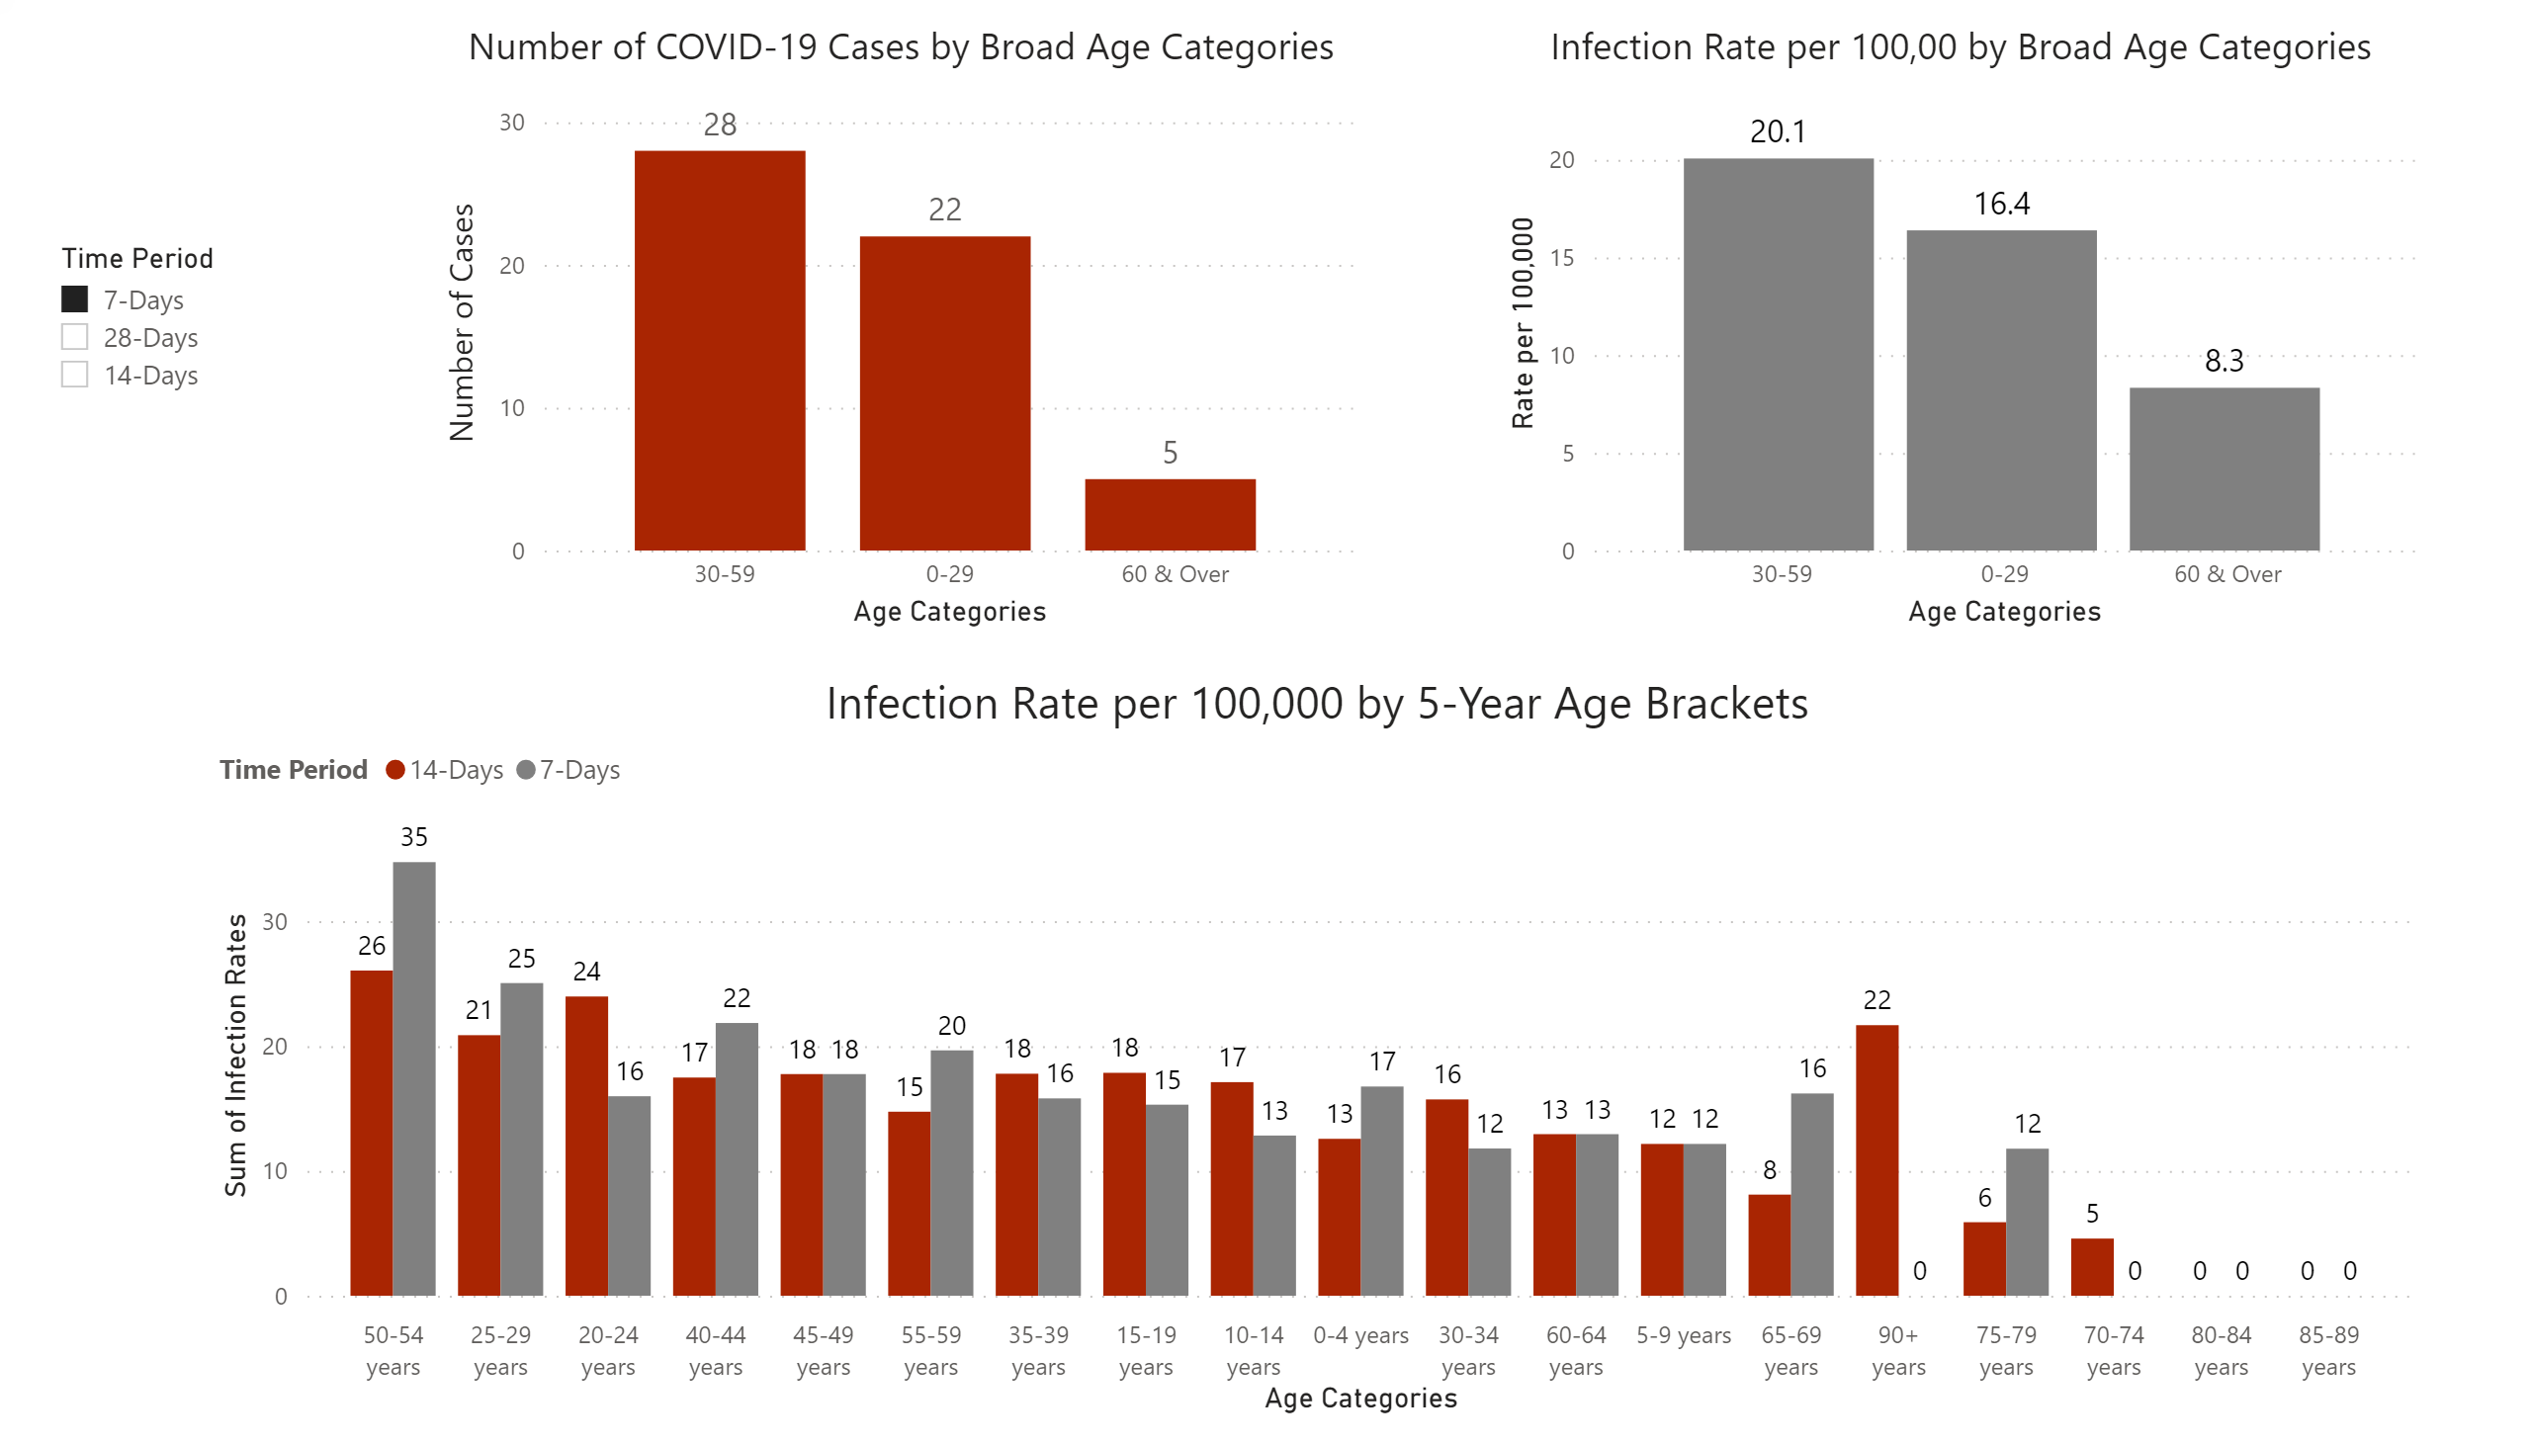
Age Stratified Infection Rates
Notes:
Number of COVID-19 Cases by Broad Age Categories
No alt text provided.
Infection Rate per 100,00 by Broad Age Categories
No alt text provided.
Infection Rate per 100,000 by 5-Year Age Brackets
No alt text provided.
slicer
No alt text provided.

Slide 6
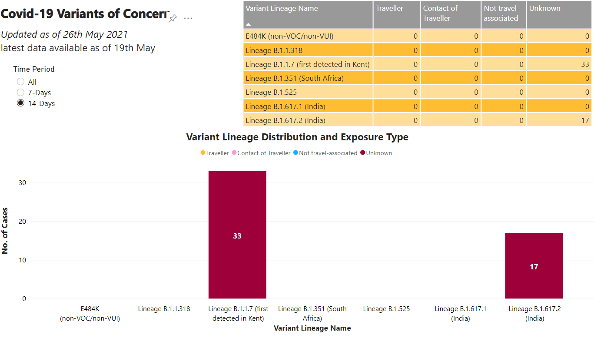
Variants of Concern
Notes:
tableEx
No alt text provided.
Variant Lineage Distribution and Exposure Type
No alt text provided.
textbox
No alt text provided.
textbox
No alt text provided.
Time Period
No alt text provided.

Slide 7
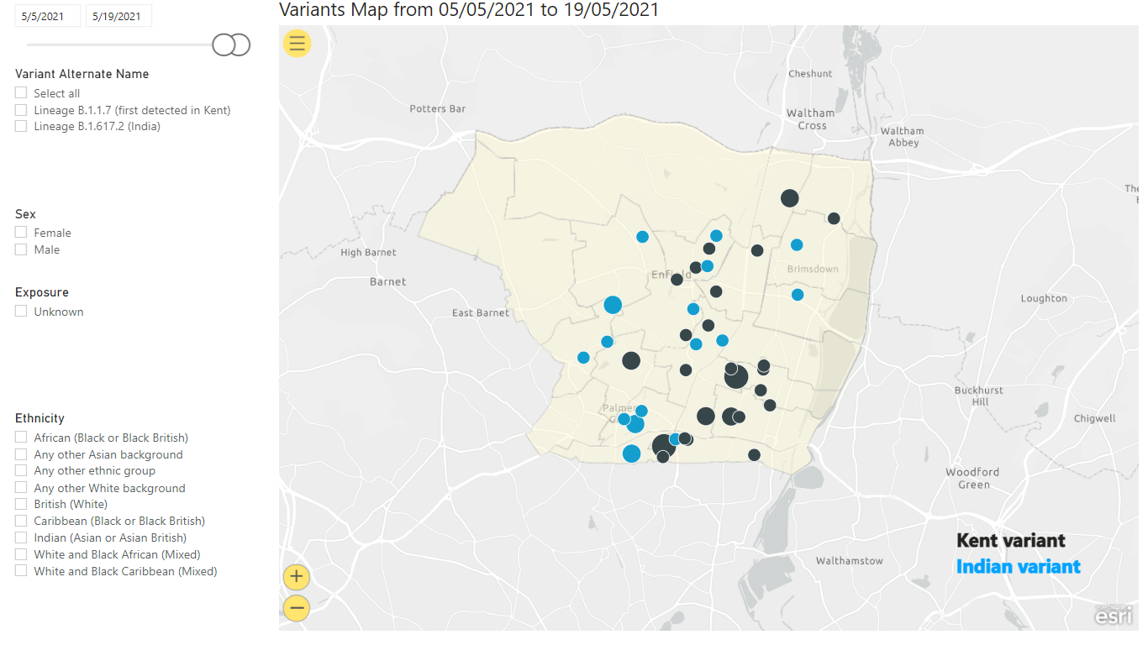
Variants Map
Notes:
esriVisual
No alt text provided.
slicer
No alt text provided.
slicer
No alt text provided.
slicer
No alt text provided.
slicer
No alt text provided.
slicer
No alt text provided.
textbox
No alt text provided.

Slide 8
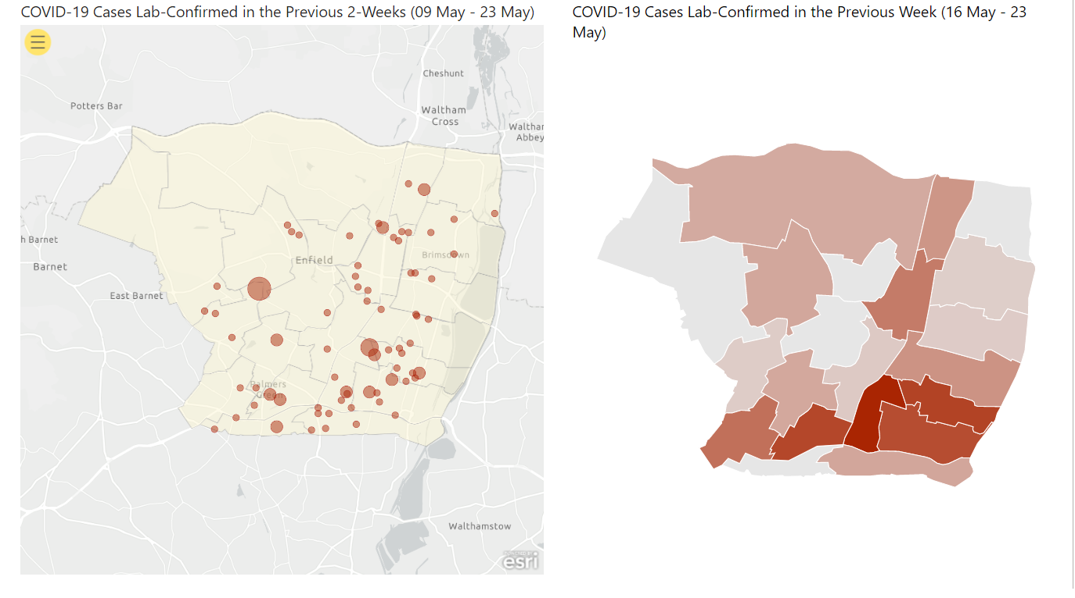
Map (1)
Notes:
esriVisual
No alt text provided.
COVID-19 Cases Lab-Confirmed in the Previous Week (16 May - 23 May)
No alt text provided.

Slide 9
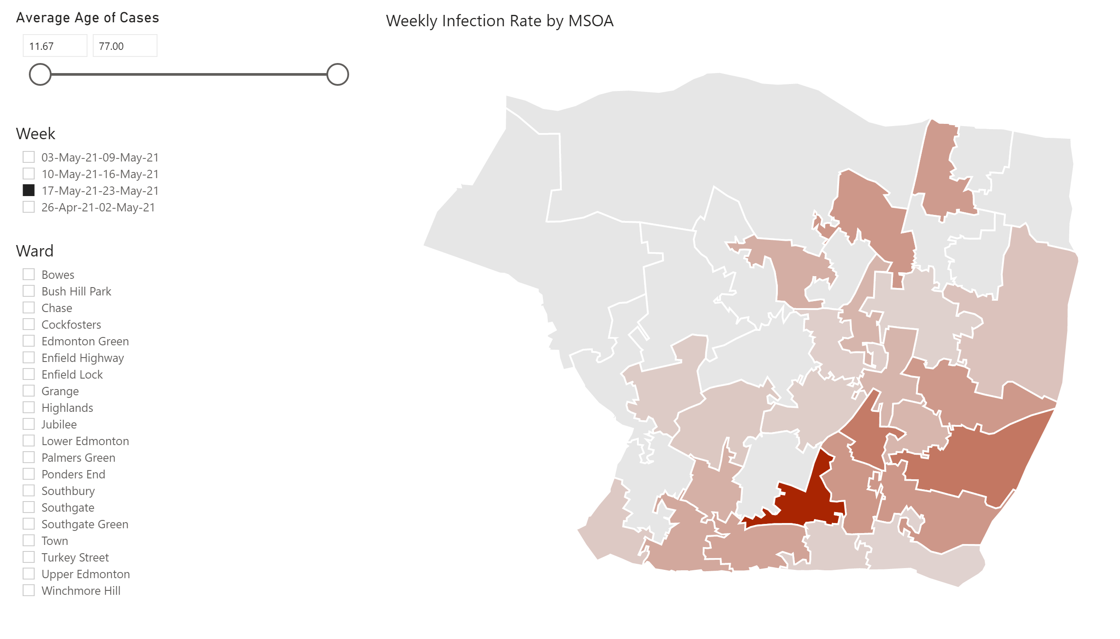
Map (2)
Notes:
Weekly Infection Rate by MSOA
No alt text provided.
Week
No alt text provided.
Ward
No alt text provided.
Average Age of Cases
No alt text provided.

Slide 10
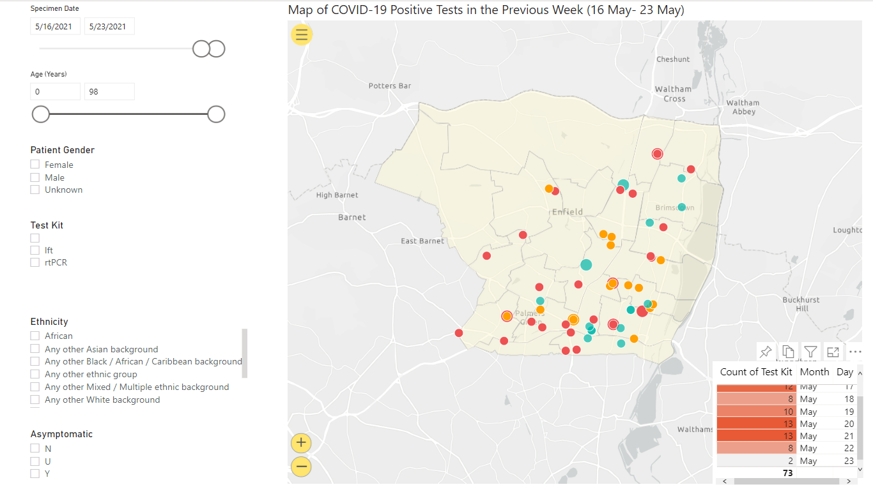
Map (3)
Notes:
esriVisual
No alt text provided.
slicer
No alt text provided.
slicer
No alt text provided.
slicer
No alt text provided.
slicer
No alt text provided.
slicer
No alt text provided.
slicer
No alt text provided.
tableEx
No alt text provided.

Slide 11
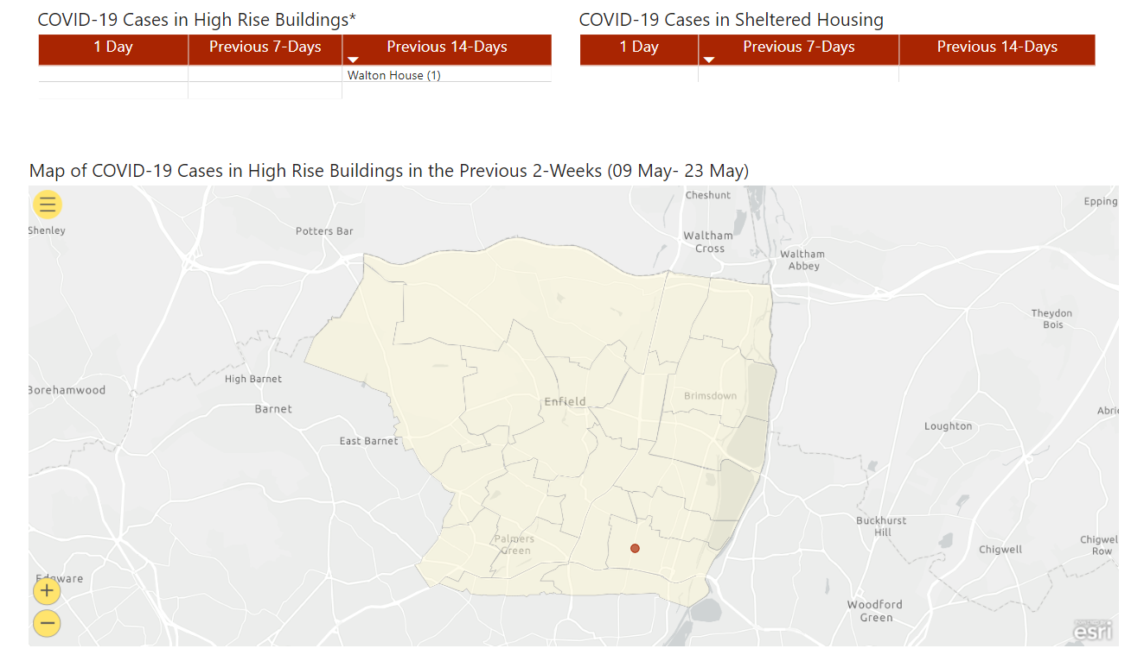
High Rise Buildings & Sheltered Housing
Notes:
esriVisual
No alt text provided.
COVID-19 Cases in Sheltered Housing
No alt text provided.
COVID-19 Cases in High Rise Buildings*
No alt text provided.

Slide 12
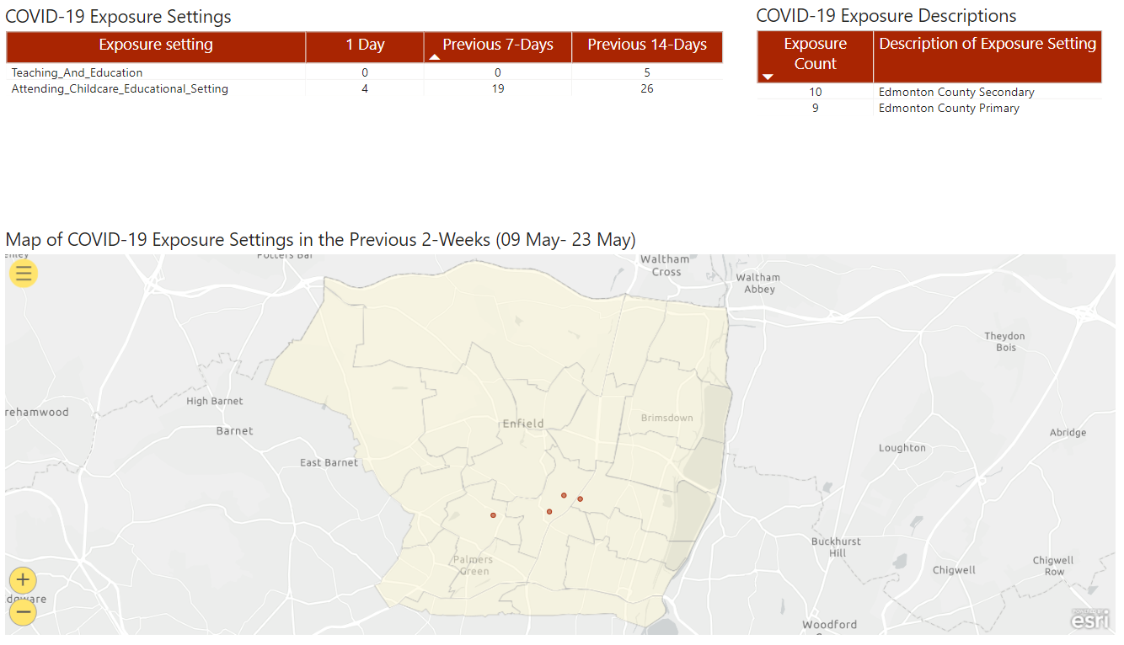
Exposure Settings
Notes:
esriVisual
No alt text provided.
COVID-19 Exposure Settings
No alt text provided.
COVID-19 Exposure Descriptions
No alt text provided.

Slide 13
Community Mass Testing
(updated 25th May)
Testing site | Total tests | Positive tests | % positive | Tests (this week) | Positive tests (this week) | % positive (week) | Tests (last week)
Boundary Hall | 2110 | 14 | 0.66% | 95 | 0 | 0.00% | -4
Kempe Hall | 10840 | 470 | 4.34% | 136 | 0 | 0.00% | 10
Brigadier Hall | 17477 | 492 | 2.82% | 193 | 0 | 0.00% | 39
Southgate Library | 21971 | 751 | 3.42% | 238 | 0 | 0.00% | -74
Green Towers Hall | 8475 | 185 | 2.18% | 263 | 0 | 0.00% | 18
John Wilkes House | 11039 | 209 | 1.89% | 279 | 0 | 0.00% | -24
Morson Road Depot | 1628 | 7 | 0.43% | 40 | 0 | 0.00% | -12
London Energy Ltd | 5942 | 1 | 0.02% | 213 | 0 | 0.00% | -157
British Alevi Federation | 505 | 3 | 0.59% | 125 | 1 | 0.80% | 125
Bowes Library | 503 | 0 | 0.00% | 106 | 0 | 0.00% | 106

Slide 14
School LFT Testing – as of 23rd April 2021
All LFTs conducted
Week beginning | School | SS | FE | Independent | Other | PRU | New Academy | Weekly total | Cumulative 4 week total
17-May-21 | 8594 | 38 | 4 | 2 | 7 | 0 | 0 | 8645 | 40777
10-May-21 | 9419 | 37 | 6 | 5 | 4 | 0 | 0 | 9471 | 32132
03-May-21 | 12388 | 30 | 1 | 6 | 4 | 0 | 0 | 12429 | 22661
26-Apr-21 | 10087 | 39 | 101 | 2 | 3 | 0 | 0 | 10232 | 10232
Positive LFTs
Week beginning | School | SS | FE | Independent | Other | PRU | New Academy | Weekly total | Cumulative 4 week total | % Positivity
17-May-21 | 4 | 0 | 0 | 0 | 0 | 0 | 0 | 4 | 26 | 0.0
10-May-21 | 7 | 0 | 0 | 0 | 0 | 0 | 0 | 7 | 22 | 0.1
03-May-21 | 10 | 0 | 0 | 0 | 0 | 0 | 0 | 10 | 15 | 0.1
26-Apr-21 | 5 | 0 | 0 | 0 | 0 | 0 | 0 | 5 | 5 | 0.0
FE, Further Education; SS, Secondary School; PRU, Pupil Referral Unit.

Slide 15
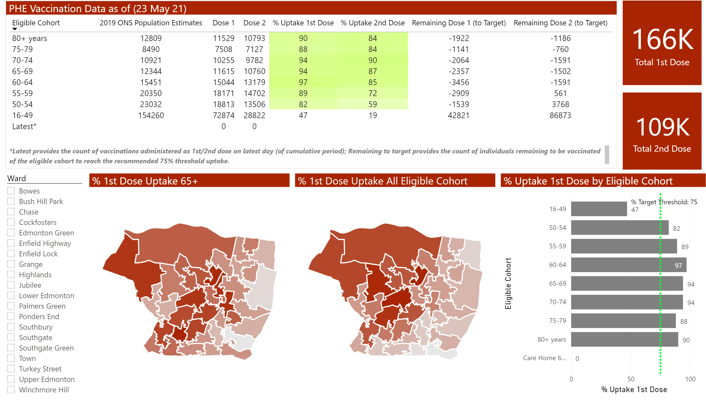
Vaccination Data
Notes:
% 1st Dose Uptake 65+
No alt text provided.
% 1st Dose Uptake All Eligible Cohort
No alt text provided.
PHE Vaccination Data as of (23 May 21)
No alt text provided.
clusteredBarChart
No alt text provided.
card
No alt text provided.
slicer
No alt text provided.
textbox
No alt text provided.
card
No alt text provided.

Slide 16
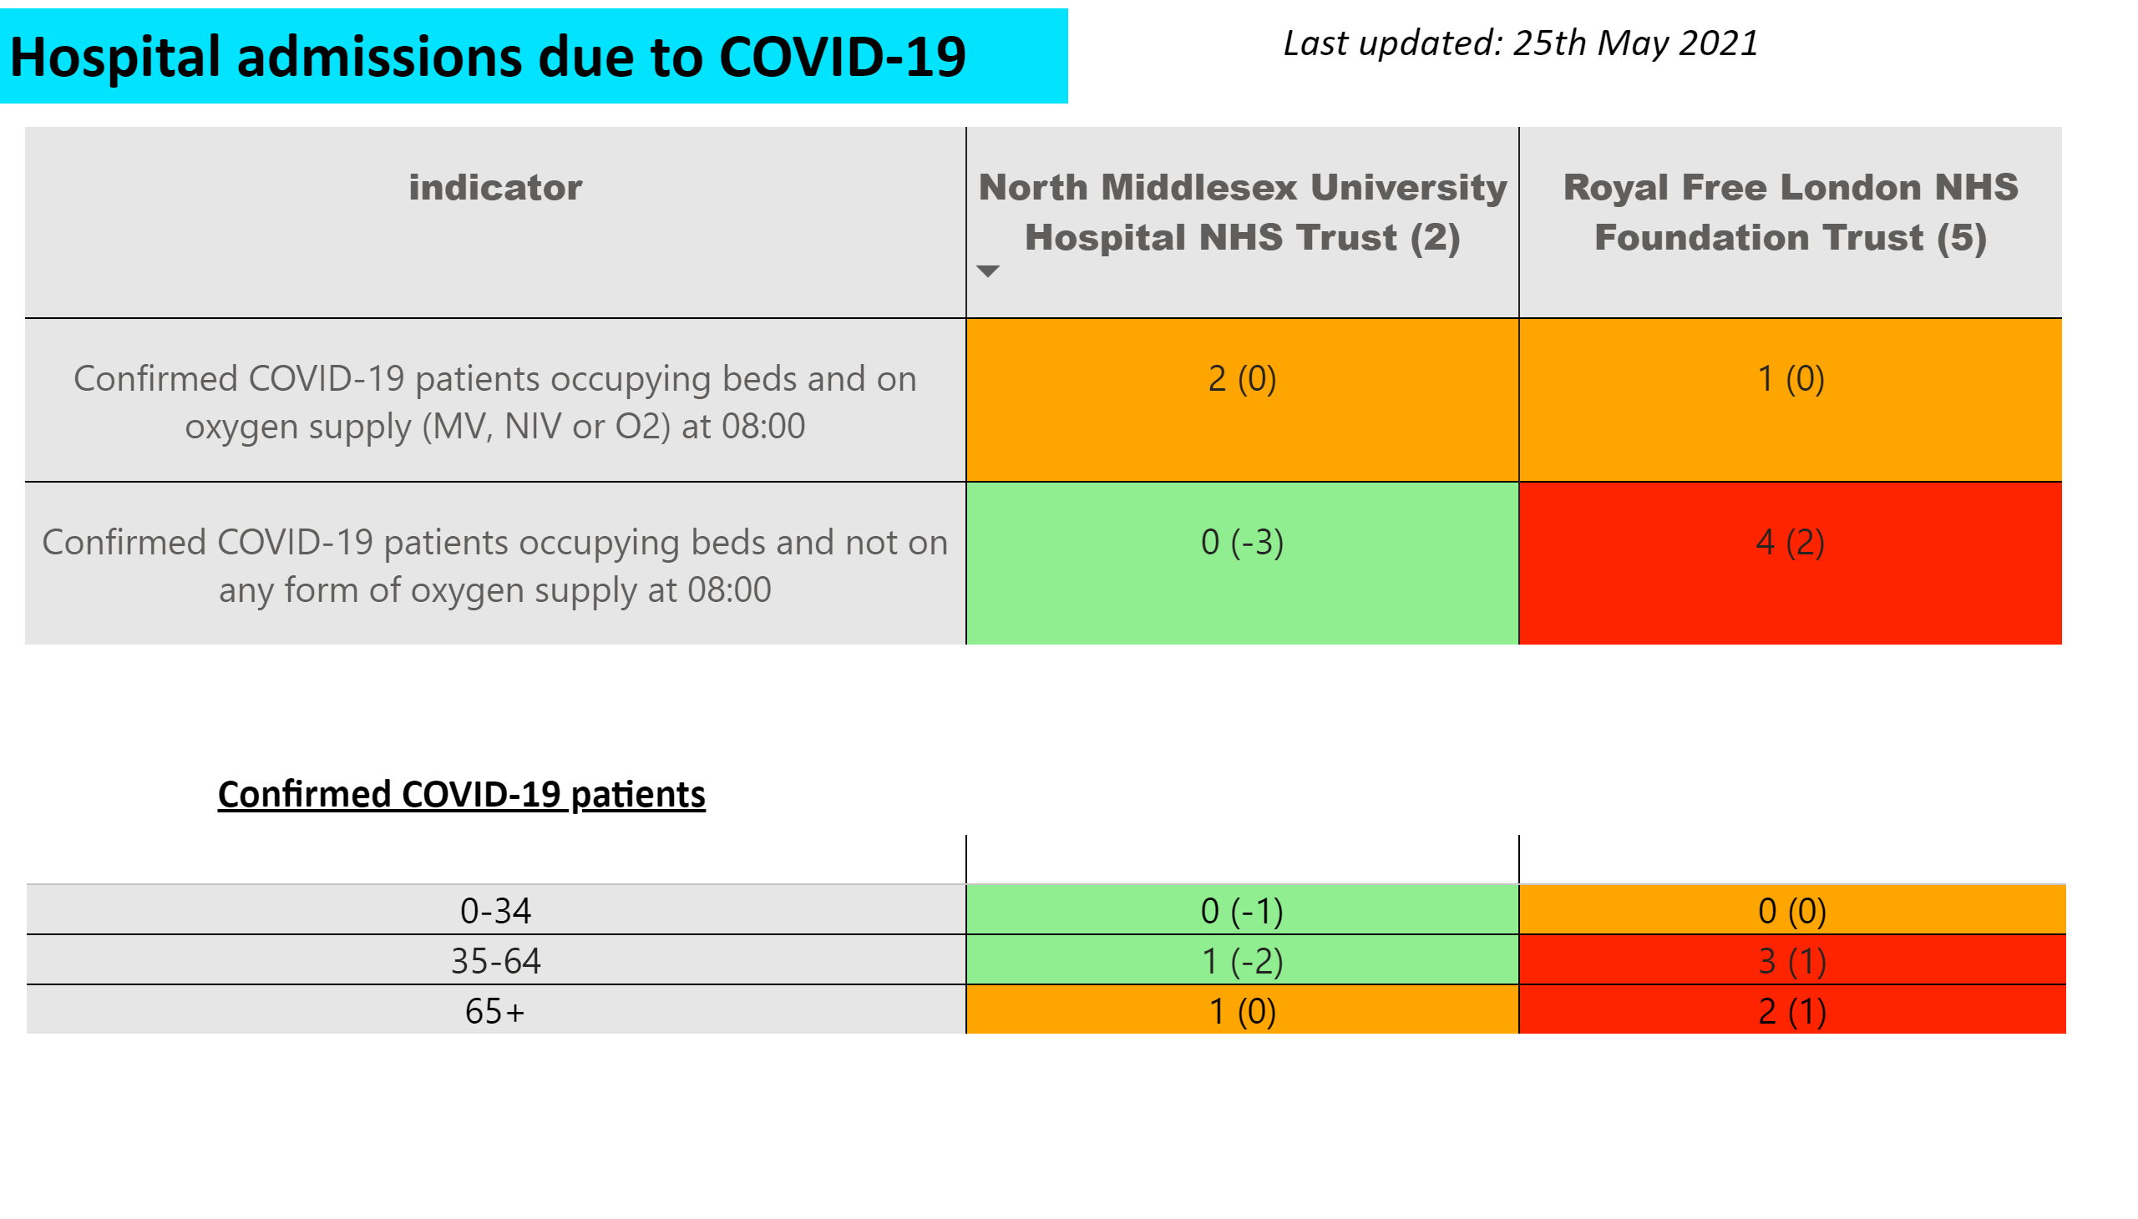
Hospital Data
Notes:
pivotTable
No alt text provided.
tableEx
No alt text provided.
textbox
No alt text provided.
textbox
No alt text provided.
textbox
No alt text provided.

Slide 17
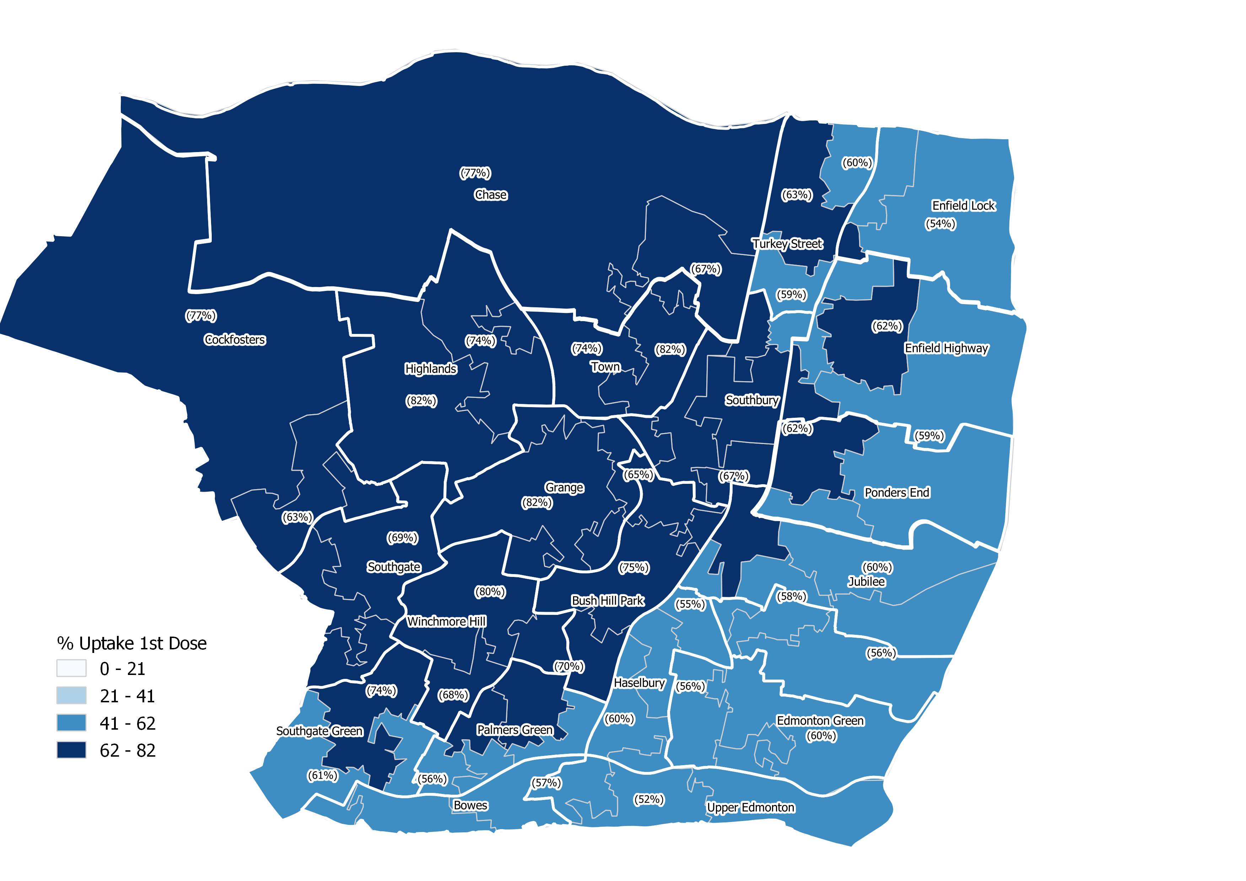
% Uptake first dose of COVID-19 vaccination in all cohorts

Slide 18
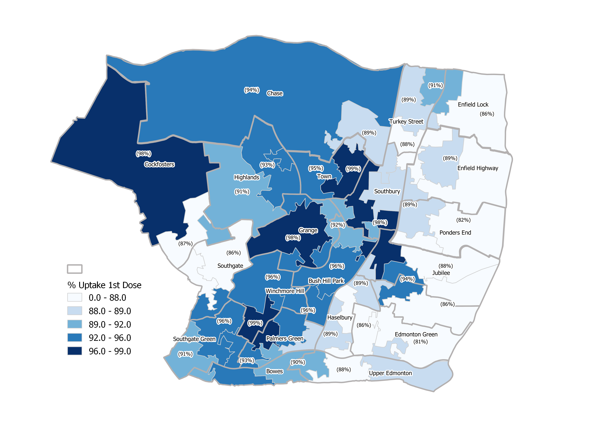
% Uptake (Over 65) first dose of COVID-19 vaccination

Slide 19
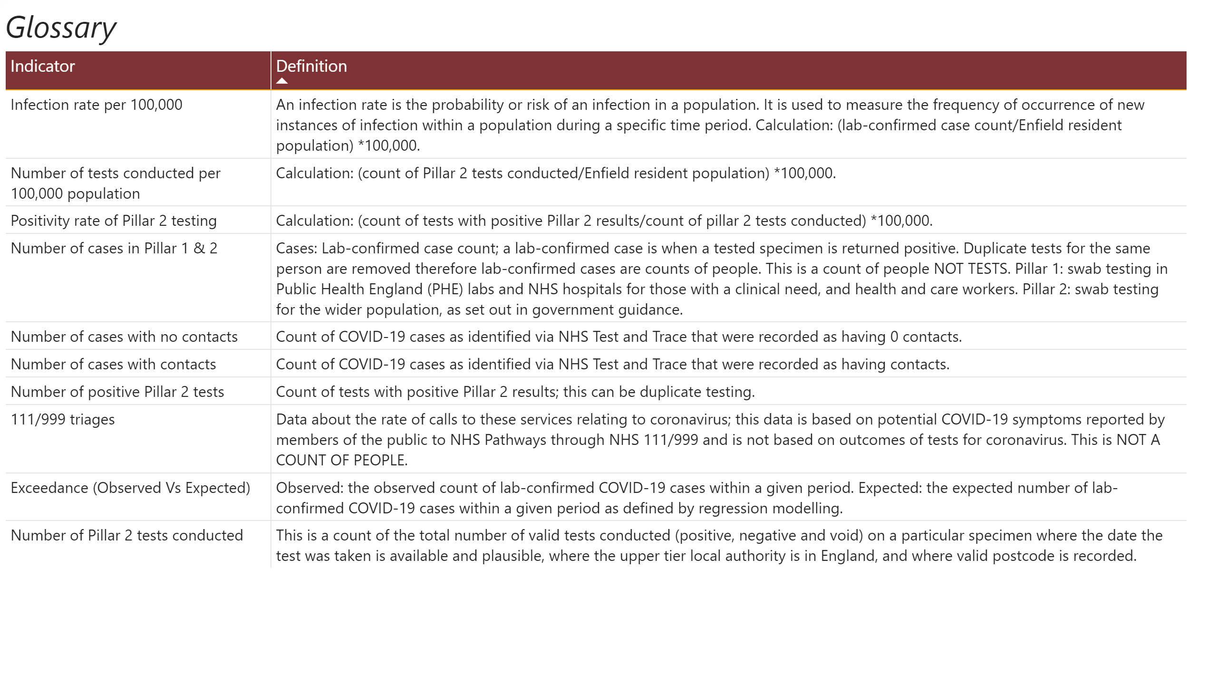
Glossary
Notes:
textbox
No alt text provided.
tableEx
No alt text provided.

