Slide 2
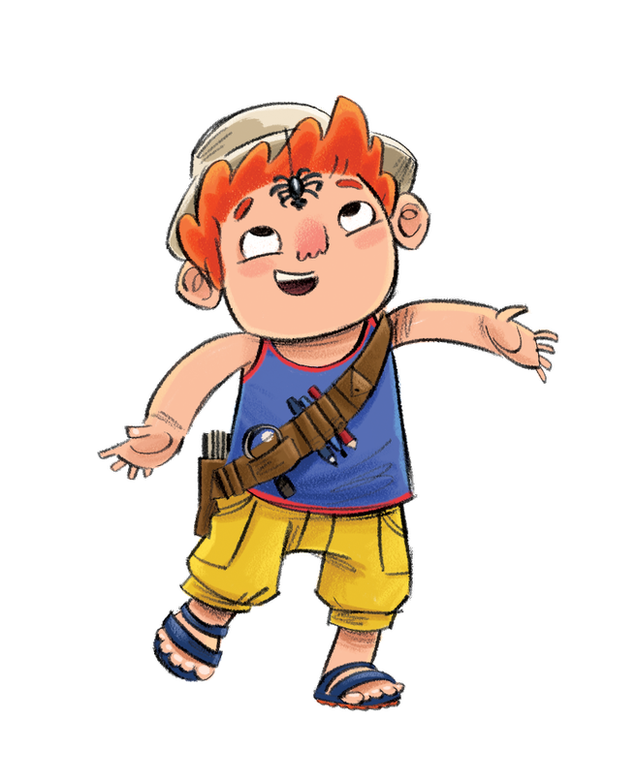
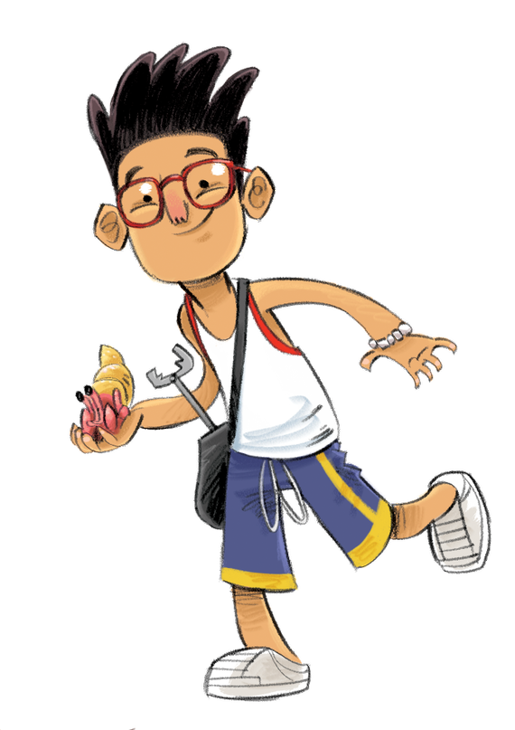
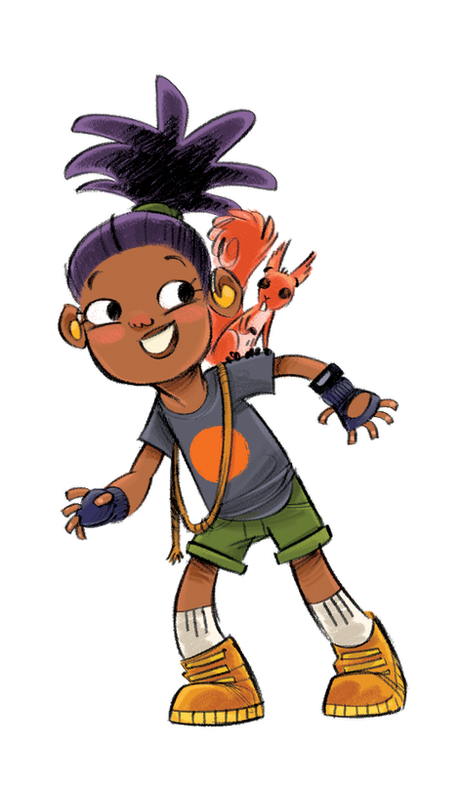
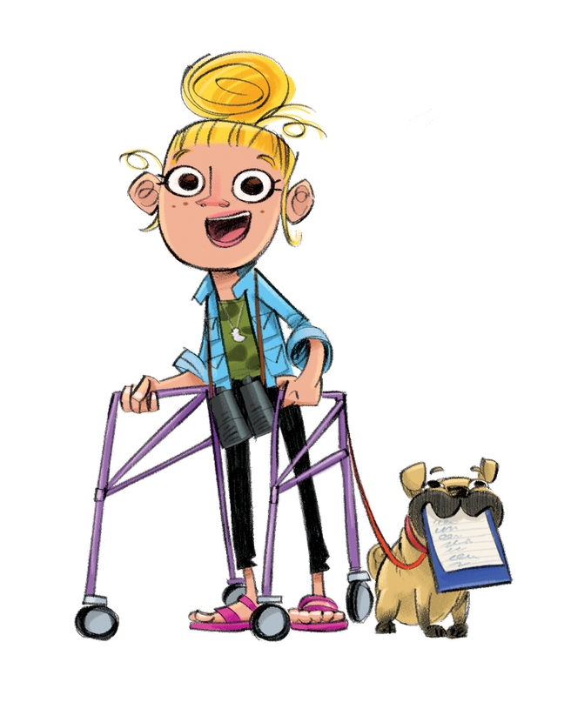
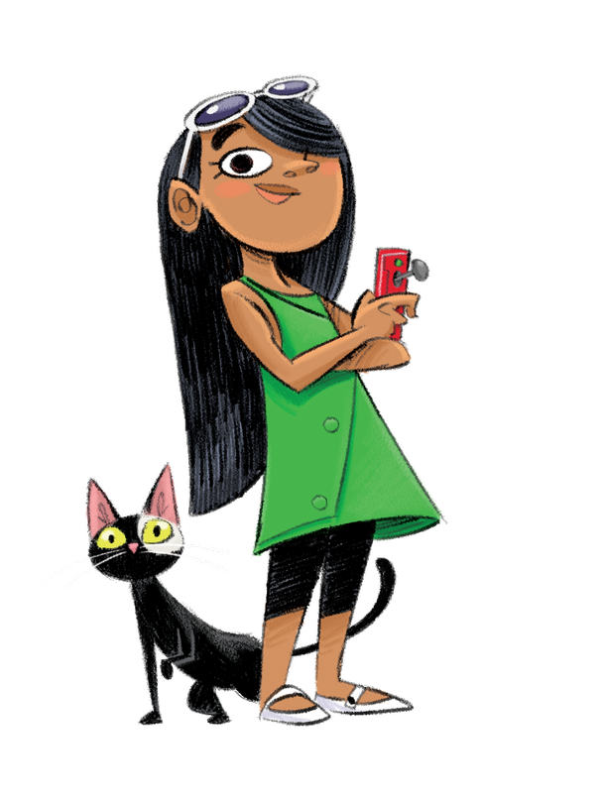
Notes:
Meet the Wild World Heroes! David, Willow, Marcus, Faiza, Carys and Callum.
The Heroes all live in Wilderville. It’s a pretty cool place, but recently the Heroes have noticed a few problems. Our Heroes need your help to fix them and to make Wilderville the best place to live for humans and animals.

Slide 3
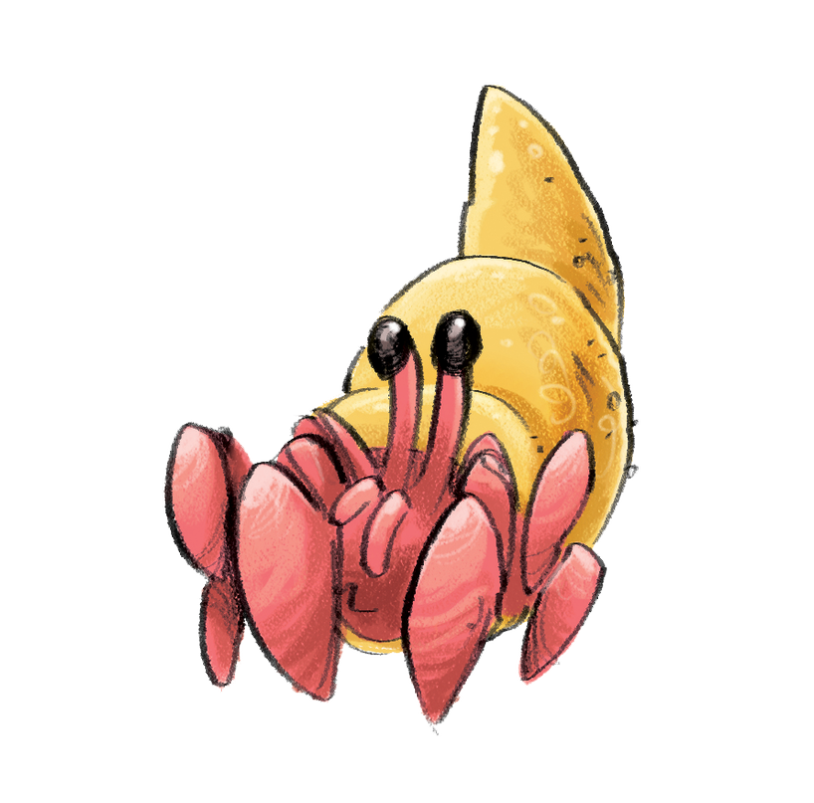
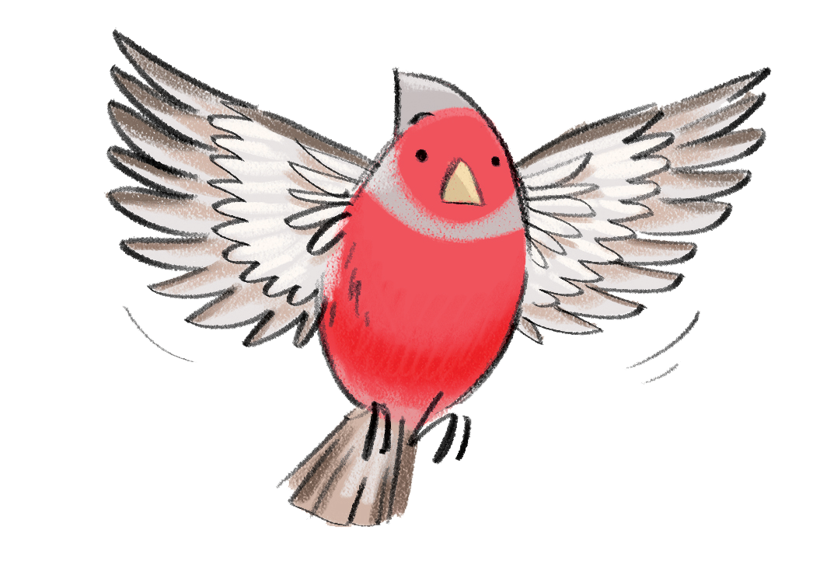
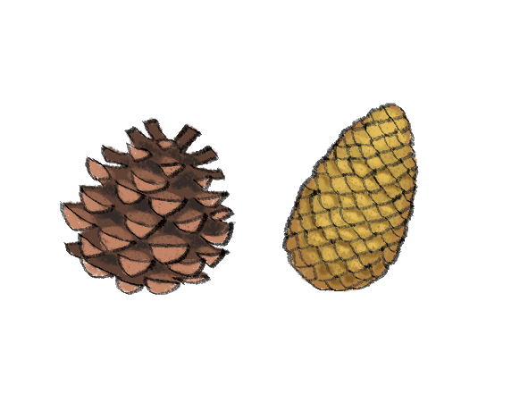
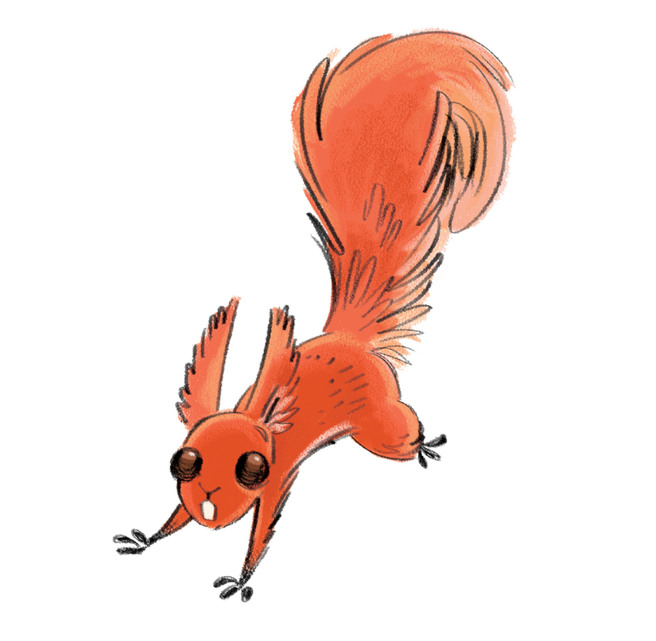
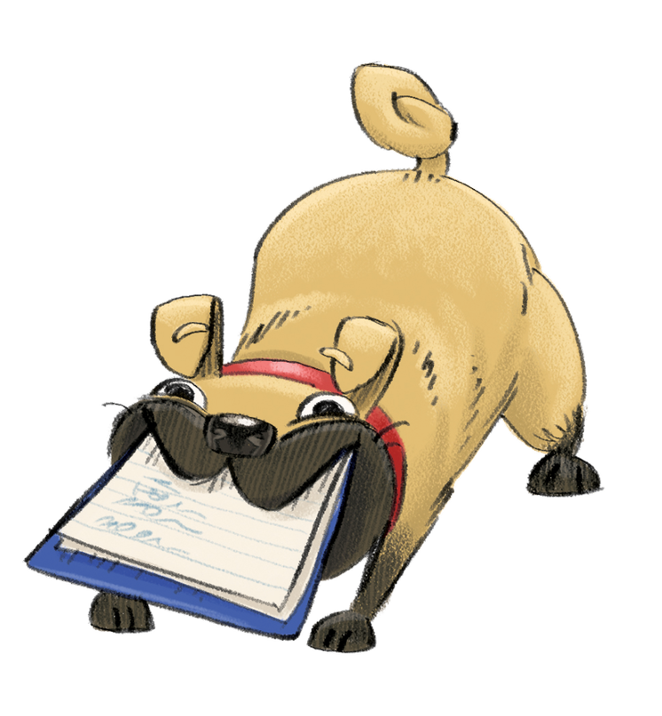
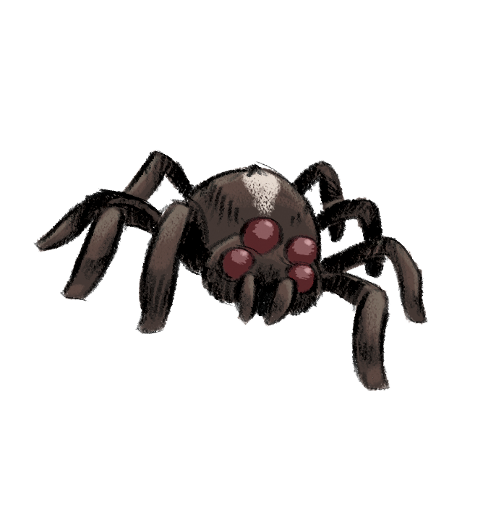
Notes:
All the Heroes know that we share our world with a whole host of wonderful creatures. Here are their animal companions: Charlie the Chaffinch, Shelby the Crab, Hazel the Red Squirrel, Doug the Dog, Webster the Spider and Mouse the Cat!

Slide 4
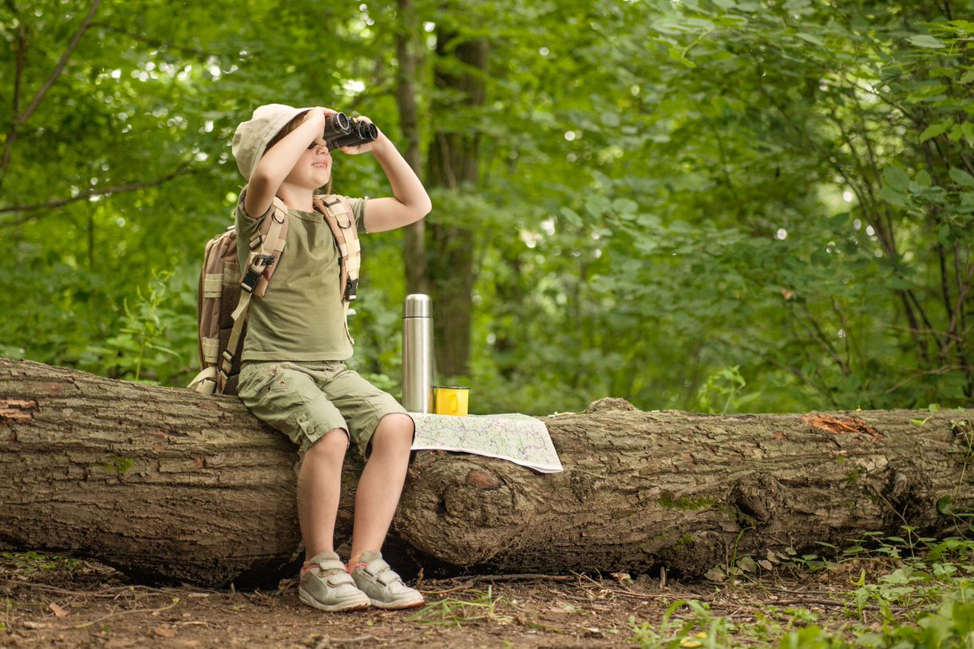
Children join the Challenge at their local library this summer – IT’S FREE!
They receive their special Wild World Heroes collector poster
They choose books to read over the holidays
They collect stickers for each book read
They also collect incentives, after two books a fold up paper game and after four books a pencil.

Slide 5
Children complete the Challenge to get their own certificate and medal
Notes:
To complete the Challenge children need to read six books
​

Slide 6
Notes:
We have a huge range of materials that children can read as part of the Challenge. General fiction (chapter books), non-fiction, I Can Read, New Readers, picture books, picture books for older readers, poetry, fairy tales and Super Readable titles for dyslexic readers.
Children can read more than six books if they would like to!

Slide 7
Take part this summer
All Enfield Libraries except Angel Raynham will be taking part
Opening days/times available here
Begins- Saturday 10th July
Ends- Saturday 18th September
Follow Enfield Libraries on Facebook Twitter or Instagram for information on internal events/competitions, restrictions permitting
Notes:
The Enfield Libraries taking part are-
Edmonton Green, Enfield Town, Ordnance Unity Centre, Palmers Green, Bowes Road, Bullsmoor, Enfield Highway, Enfield Island Village, Fore Street, John Jackson, Millfield House, Oakwood, Ponders End (limited opening), Ridge Avenue, Southgate, Winchmore Hill

Slide 8
Visit the website
wildworldheroes.org.uk
Children can set their own summer reading goal
Rate and review books to unlock badges
Play games and enter competitions
Enter the codes printed on the stickers to unlock extra rewards
Use the Book Sorter to find books recommended by other children
Notes:
The fun continues at home too! Children can visit the Wild World Heroes website to play games, review their latest reads and enter competitions to win amazing Summer Reading Challenge prizes. Children can also share their favourite books with other children taking part in the Challenge and even unlock extra rewards for their reading.

Slide 9
We hope to see lots of children joining in this year!

