Slide 1
Enfield COVID19 Dashboard
View in Power BI
Last data refresh:
7/2/2021 12:24:58 PM UTC
Downloaded at:
7/2/2021 12:27:00 PM UTC

Slide 2
Data Summary
Notes:
TOTAL
No alt text provided.
NEW CASES
No alt text provided.
RECENT COVID DEATHS*
No alt text provided.
INFECTION RATE PER 100,000*
No alt text provided.
INFECTION RATE RANK*
No alt text provided.
Enfield COVID-19 Dashboard (24- 30 Jun 21)
No alt text provided.
TESTS*
No alt text provided.
VACCINATIONS 188,413 1st DOSES
No alt text provided.
CARE SETTINGS
No alt text provided.
SCHOOLS/ EARLY YEARS AFFECTED
No alt text provided.
WARDS WITH HIGHEST INFECTION RATES*
No alt text provided.
textbox
No alt text provided.
basicShape
No alt text provided.
basicShape
No alt text provided.
textbox
No alt text provided.
textbox
No alt text provided.
textbox
No alt text provided.
textbox
No alt text provided.
basicShape
No alt text provided.
image
No alt text provided.
image
No alt text provided.
image
No alt text provided.
textbox
No alt text provided.
textbox
No alt text provided.
image
No alt text provided.
textbox
No alt text provided.
textbox
No alt text provided.
textbox
0-29
textbox
No alt text provided.
textbox
No alt text provided.
basicShape
No alt text provided.
basicShape
No alt text provided.
basicShape
No alt text provided.
image
No alt text provided.
textbox
No alt text provided.
textbox
No alt text provided.
basicShape
No alt text provided.
basicShape
No alt text provided.
basicShape
No alt text provided.
basicShape
No alt text provided.

Slide 3
Observation Summary
Notes:
tableEx
No alt text provided.
textbox
No alt text provided.
image
No alt text provided.

Slide 4
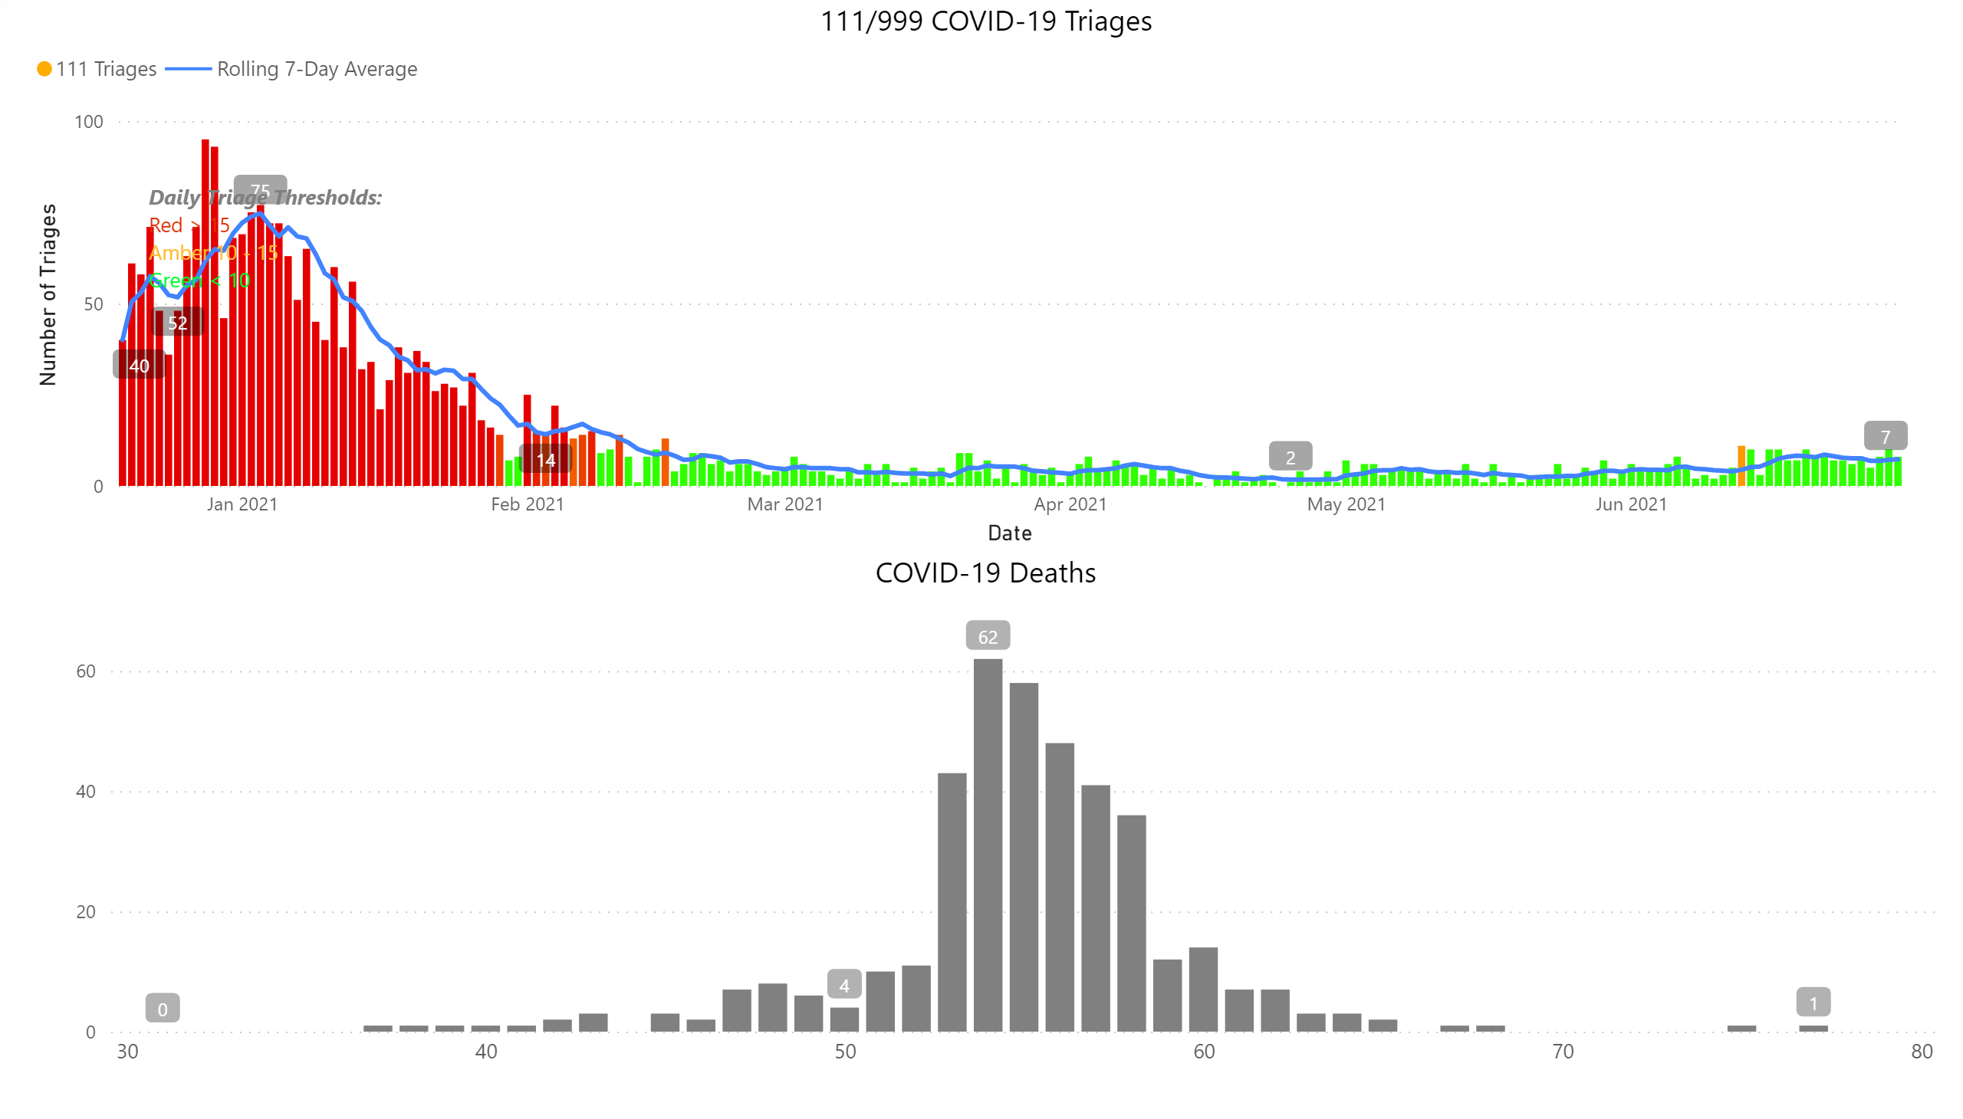
Charts
Notes:
111/999 COVID-19 Triages
No alt text provided.
COVID-19 Deaths
No alt text provided.
textbox
No alt text provided.

Slide 5
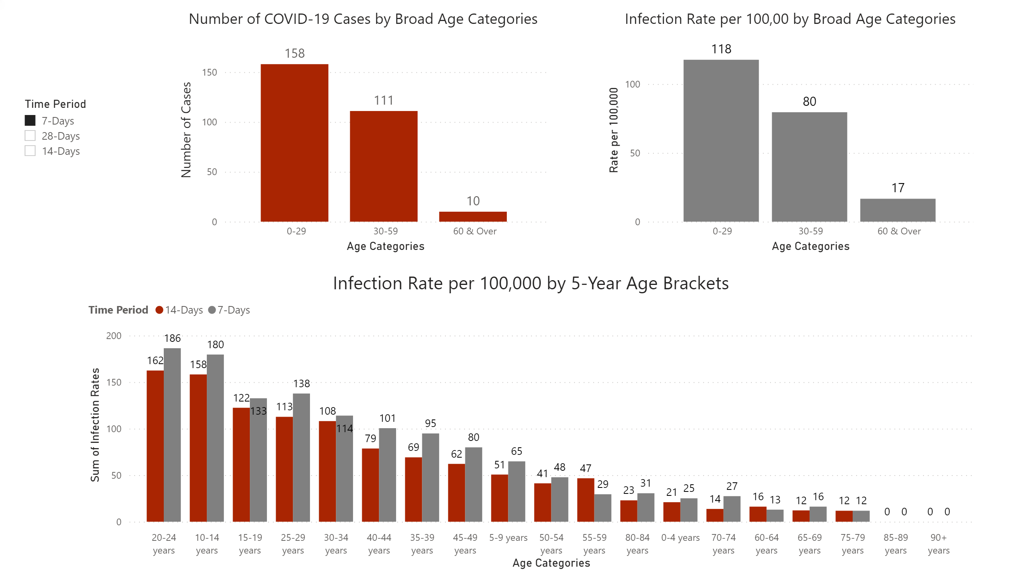
Age Stratified Infection Rates
Notes:
Number of COVID-19 Cases by Broad Age Categories
No alt text provided.
Infection Rate per 100,00 by Broad Age Categories
No alt text provided.
Infection Rate per 100,000 by 5-Year Age Brackets
No alt text provided.
slicer
No alt text provided.

Slide 6
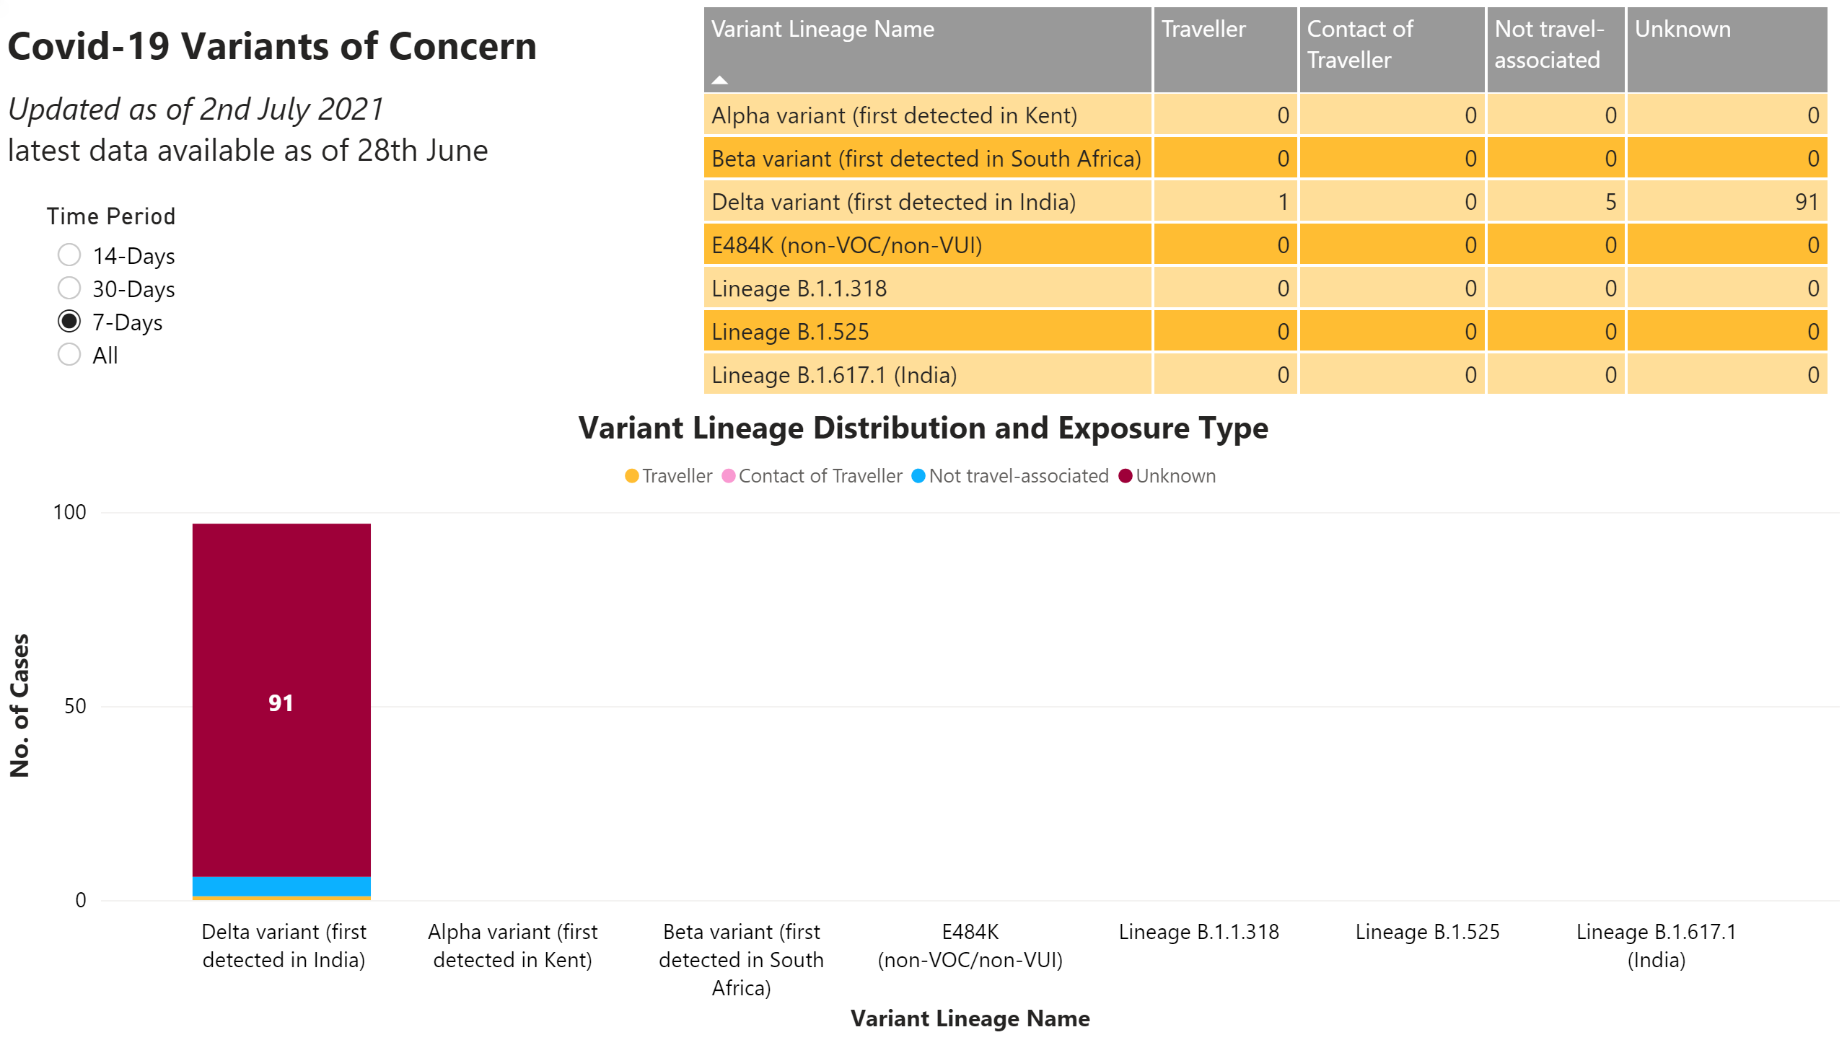
Variants of Concern
Notes:
tableEx
No alt text provided.
Variant Lineage Distribution and Exposure Type
No alt text provided.
textbox
No alt text provided.
textbox
No alt text provided.
Time Period
No alt text provided.
textbox
No alt text provided.

Slide 7
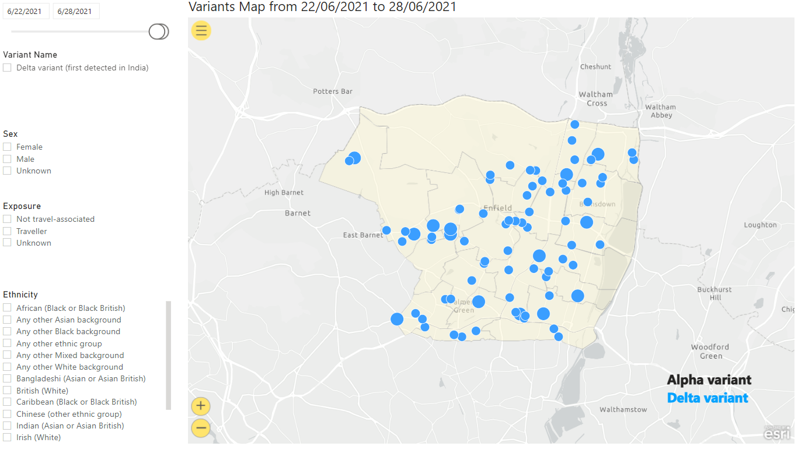
Variants Map
Notes:
esriVisual
No alt text provided.
slicer
No alt text provided.
slicer
No alt text provided.
slicer
No alt text provided.
slicer
No alt text provided.
textbox
No alt text provided.
slicer
No alt text provided.

Slide 8
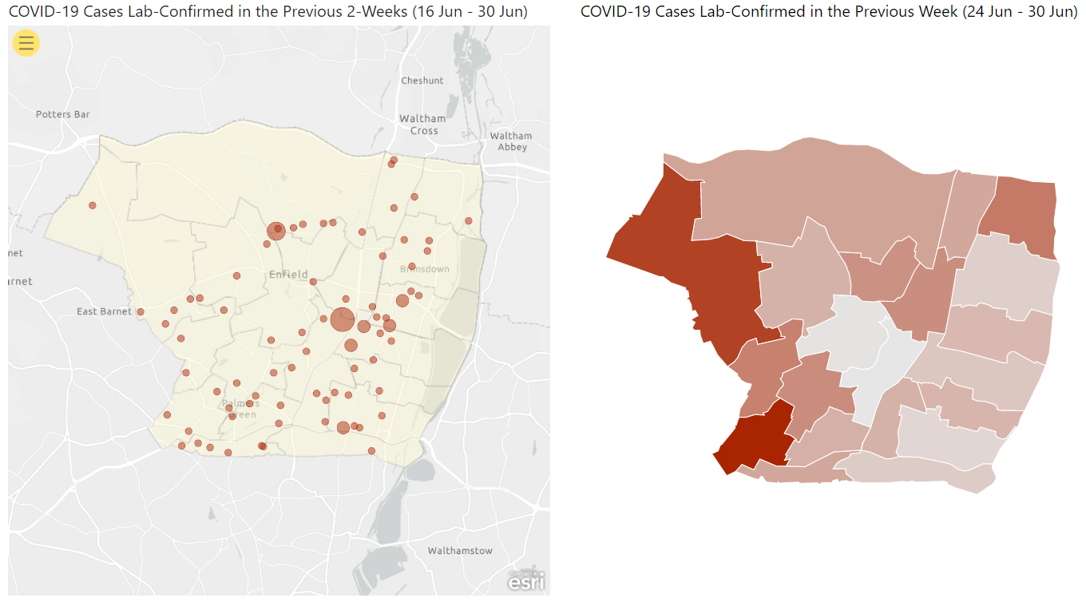
Map (1)
Notes:
esriVisual
No alt text provided.
COVID-19 Cases Lab-Confirmed in the Previous Week (24 Jun - 30 Jun)
No alt text provided.

Slide 9
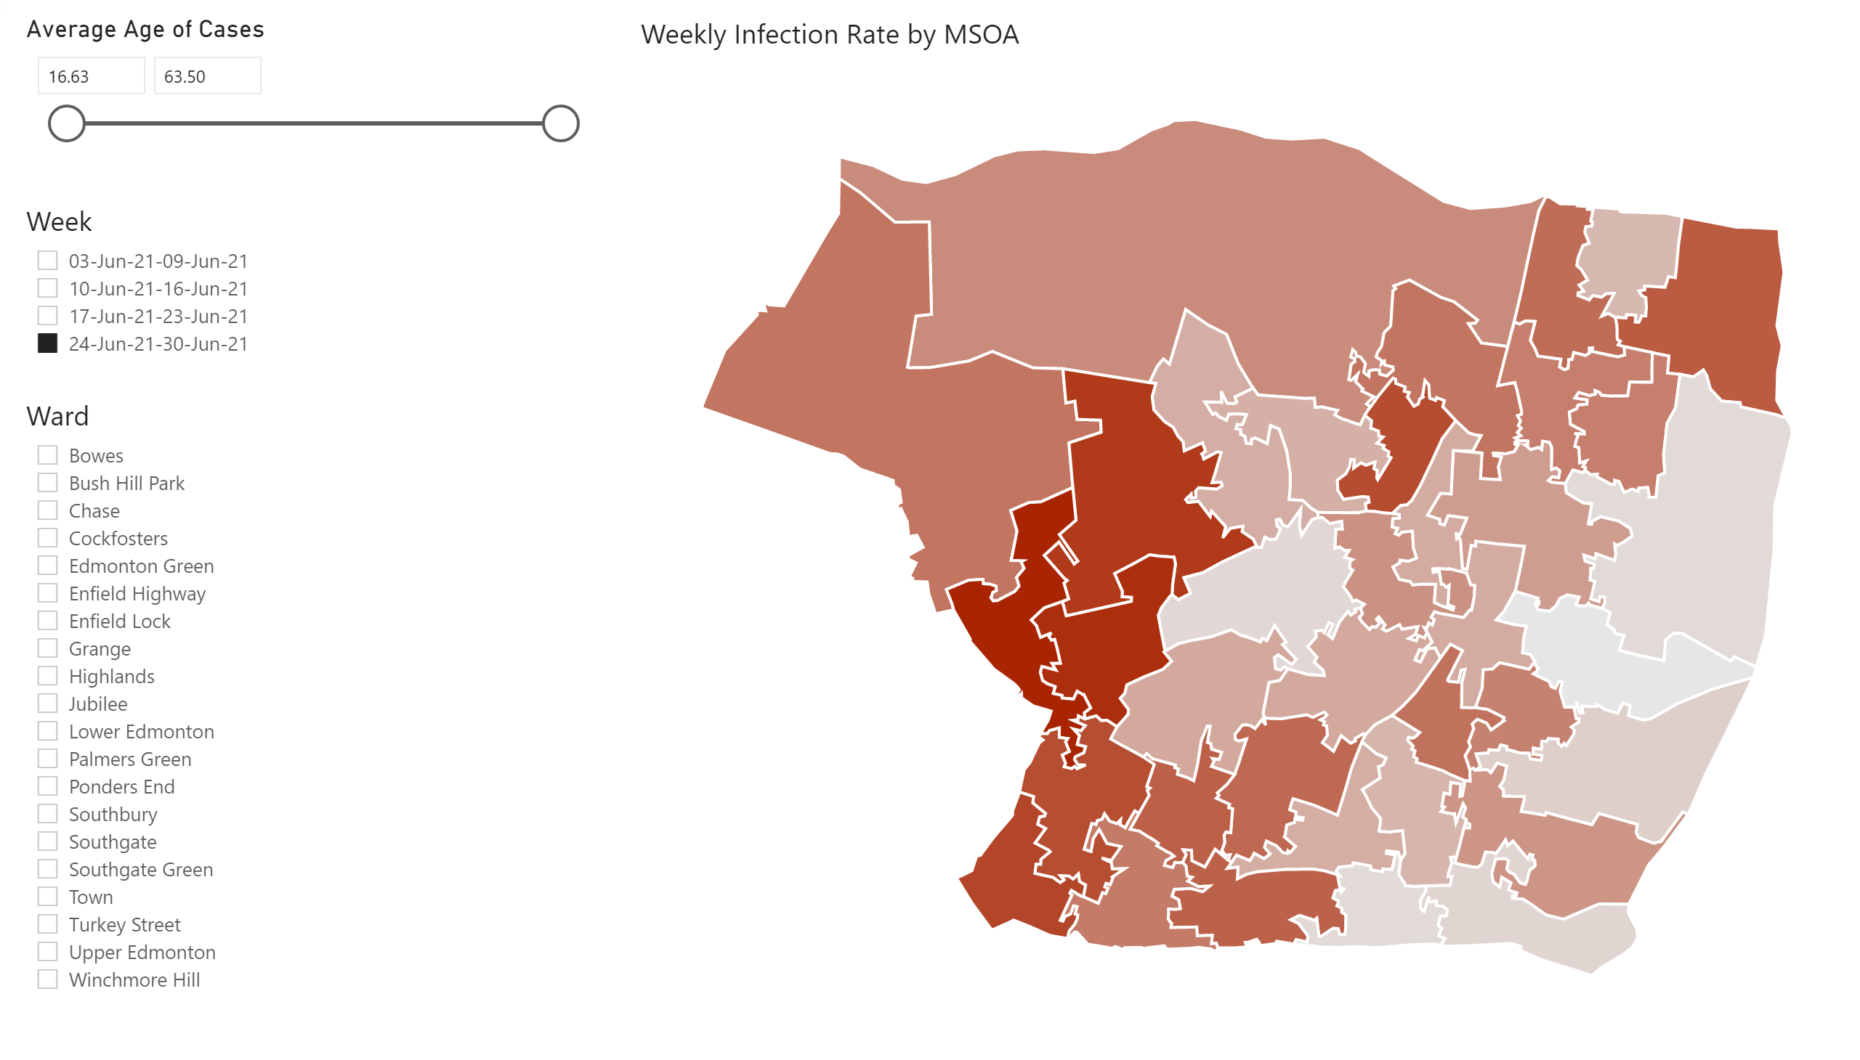
Map (2)
Notes:
Weekly Infection Rate by MSOA
No alt text provided.
Week
No alt text provided.
Ward
No alt text provided.
Average Age of Cases
No alt text provided.

Slide 10
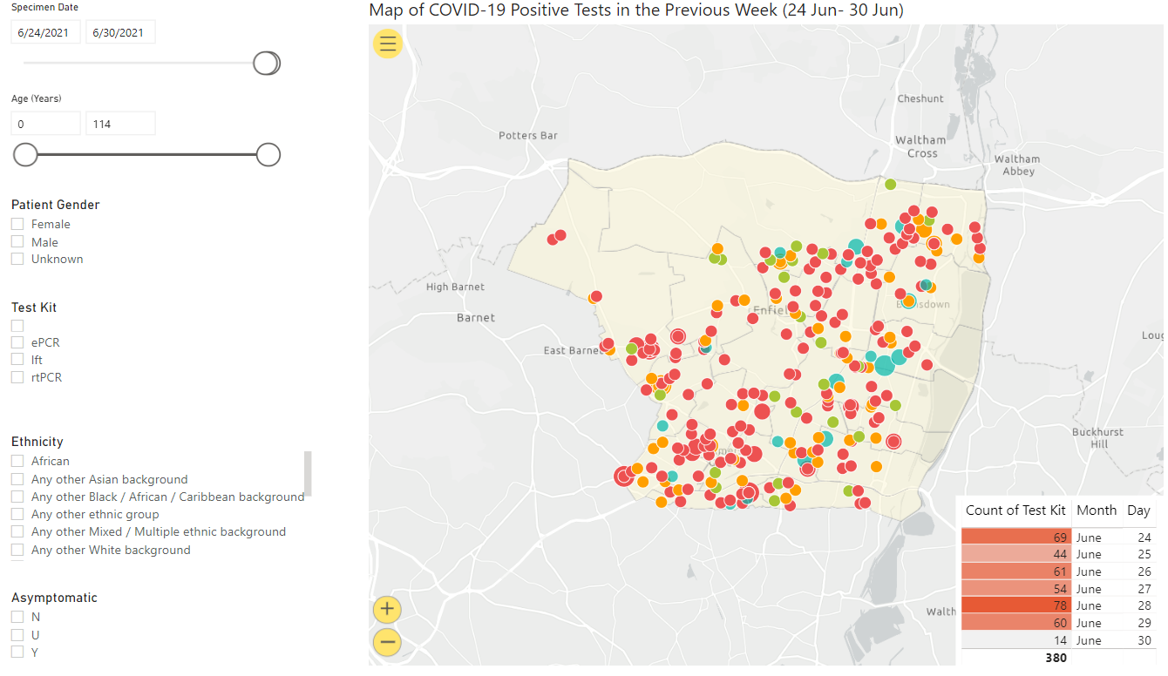
Map (3)
Notes:
esriVisual
No alt text provided.
slicer
No alt text provided.
slicer
No alt text provided.
slicer
No alt text provided.
slicer
No alt text provided.
slicer
No alt text provided.
slicer
No alt text provided.
tableEx
No alt text provided.

Slide 11
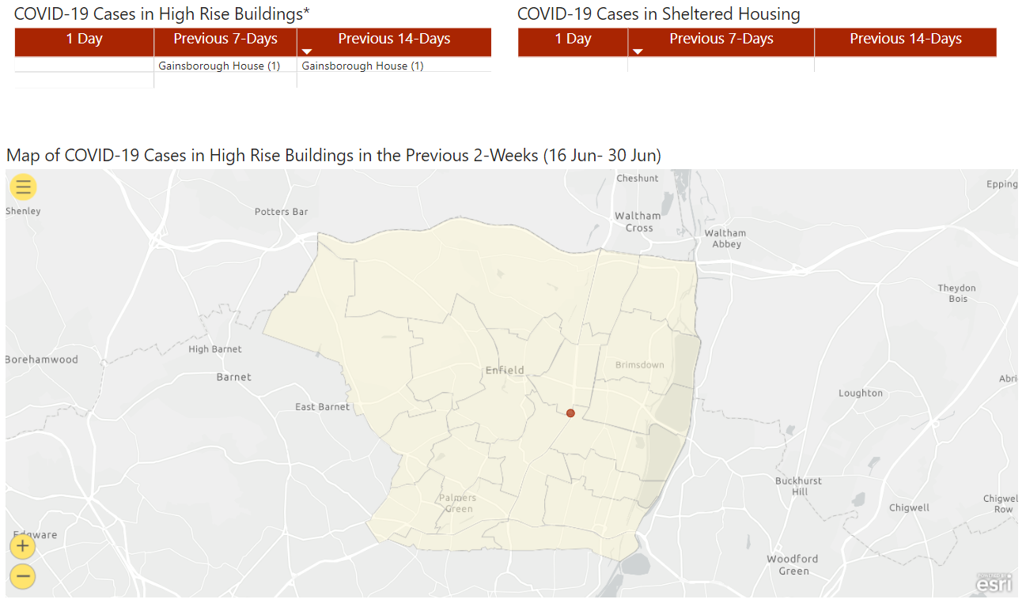
High Rise Buildings & Sheltered Housing
Notes:
esriVisual
No alt text provided.
COVID-19 Cases in Sheltered Housing
No alt text provided.
COVID-19 Cases in High Rise Buildings*
No alt text provided.

Slide 12
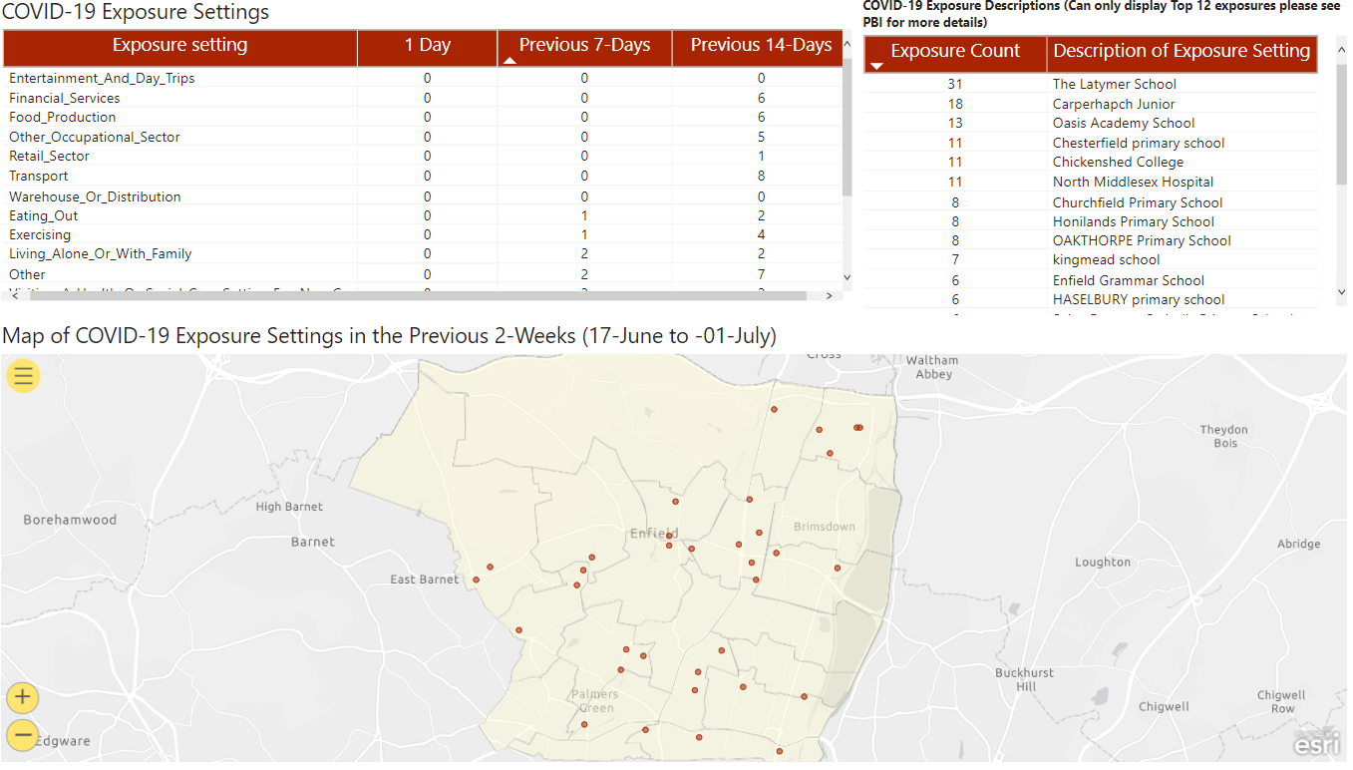
Exposure Settings
Notes:
Map of COVID-19 Exposure Settings in the Previous 2-Weeks (17-June to -01-July)
No alt text provided.
COVID-19 Exposure Settings
No alt text provided.
COVID-19 Exposure Descriptions (Can only display Top 12 exposures please see PBI for more details)
No alt text provided.

Slide 13
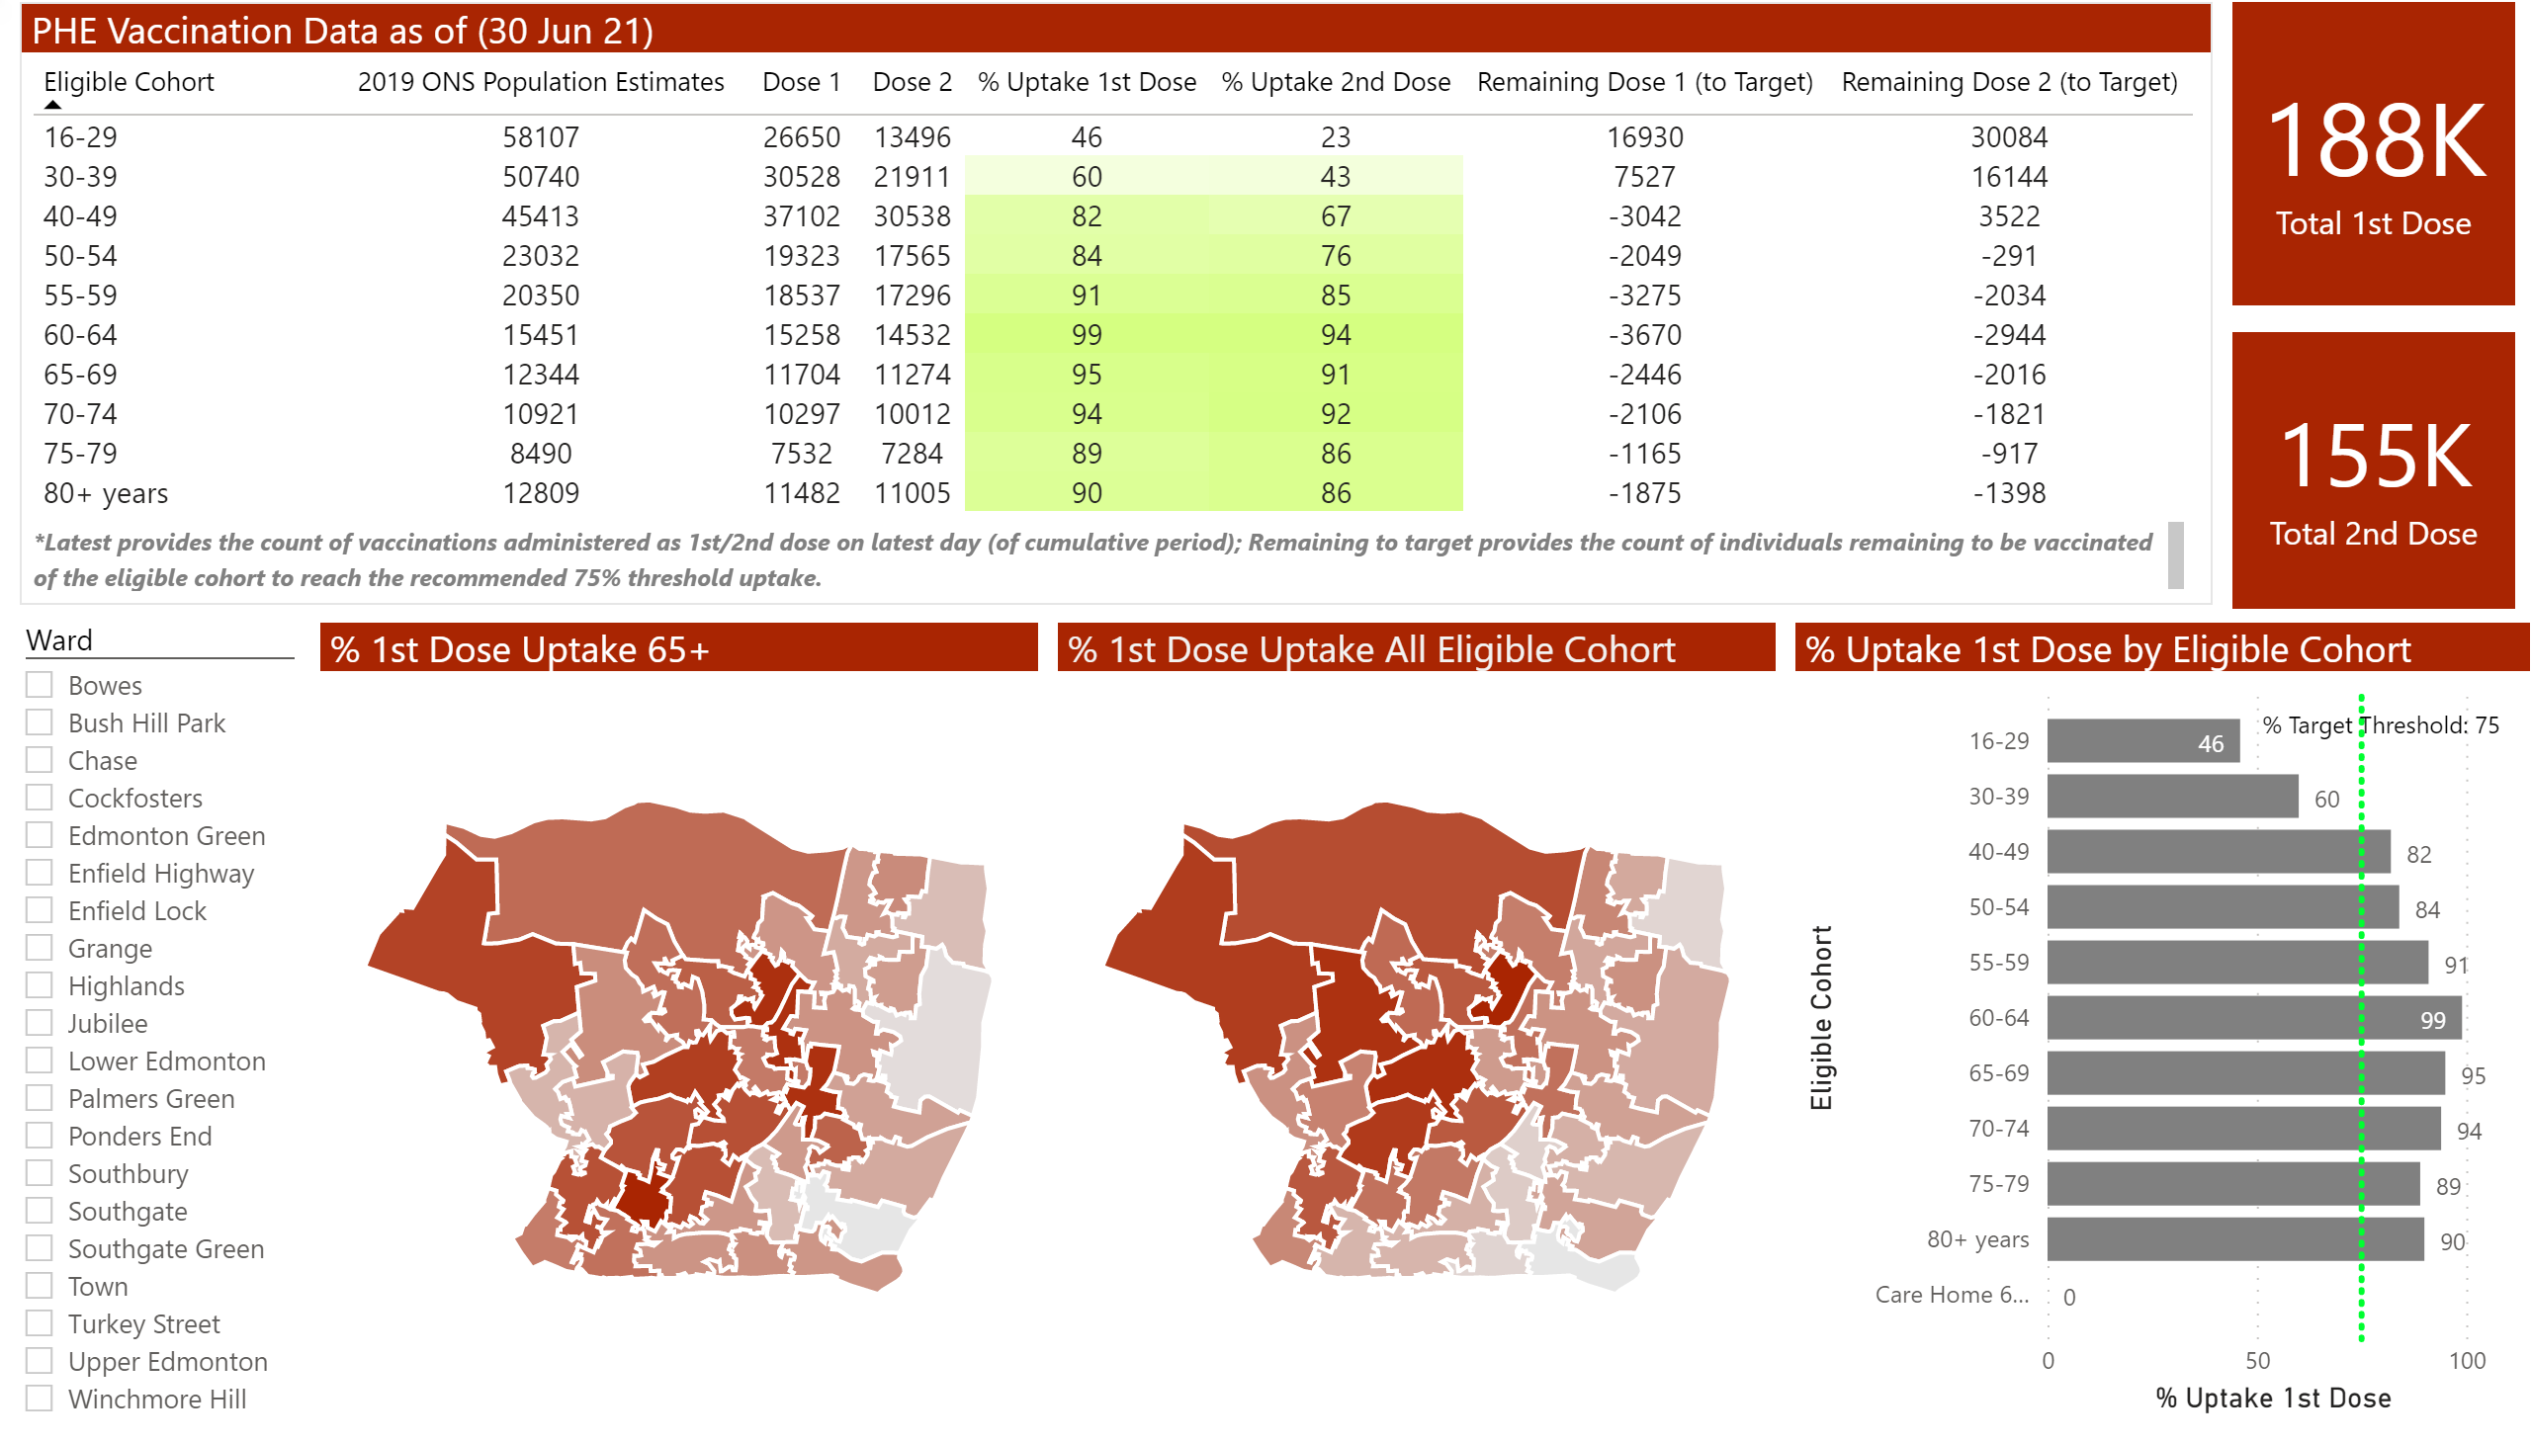
Vaccination Data
Notes:
% 1st Dose Uptake 65+
No alt text provided.
% 1st Dose Uptake All Eligible Cohort
No alt text provided.
PHE Vaccination Data as of (30 Jun 21)
No alt text provided.
clusteredBarChart
No alt text provided.
card
No alt text provided.
slicer
No alt text provided.
textbox
No alt text provided.
card
No alt text provided.

Slide 14
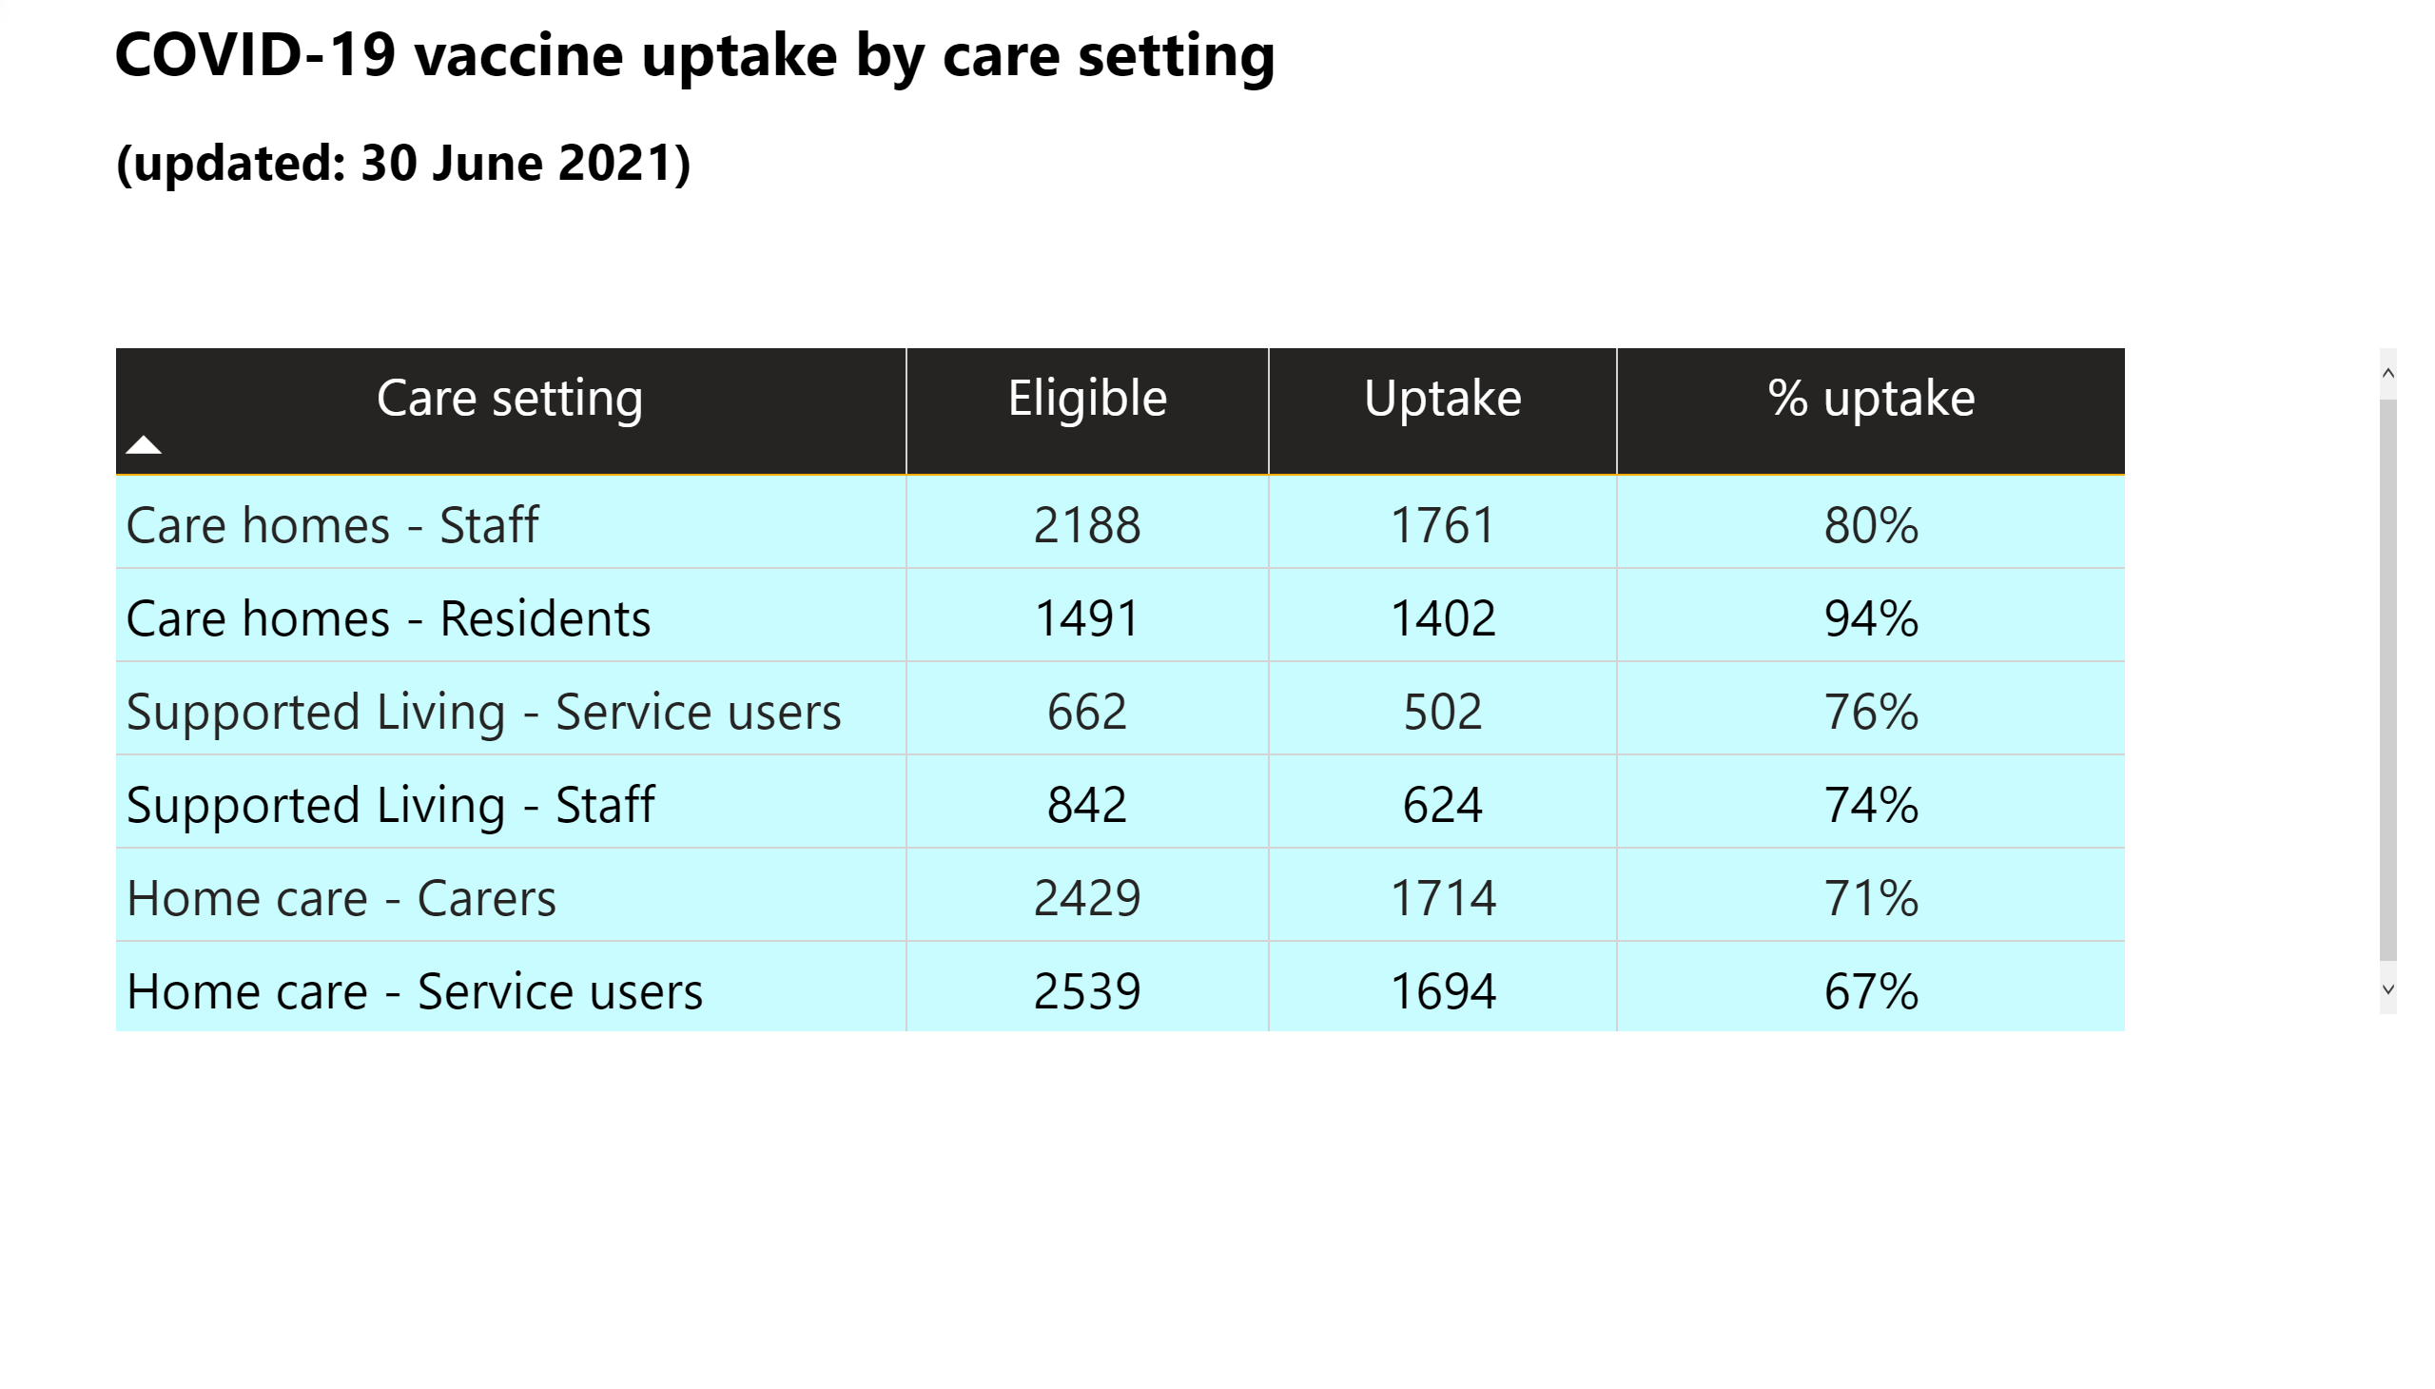
Vaccine Uptake by Care Setting
Notes:
tableEx
No alt text provided.
textbox
No alt text provided.

Slide 15
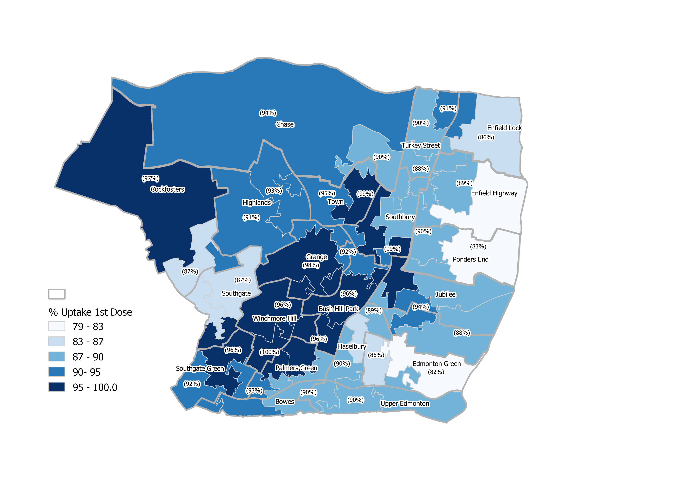
% Uptake first dose of COVID-19 vaccination in all cohorts

Slide 16
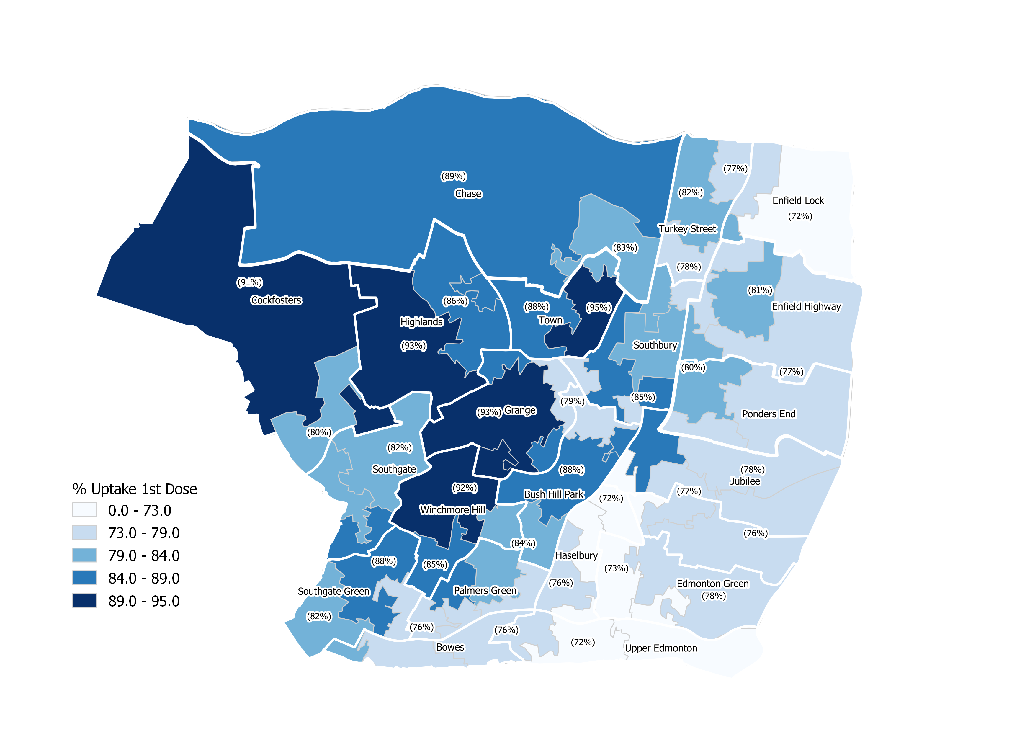
% Uptake (Over 65) first dose of COVID-19 vaccination

Slide 17
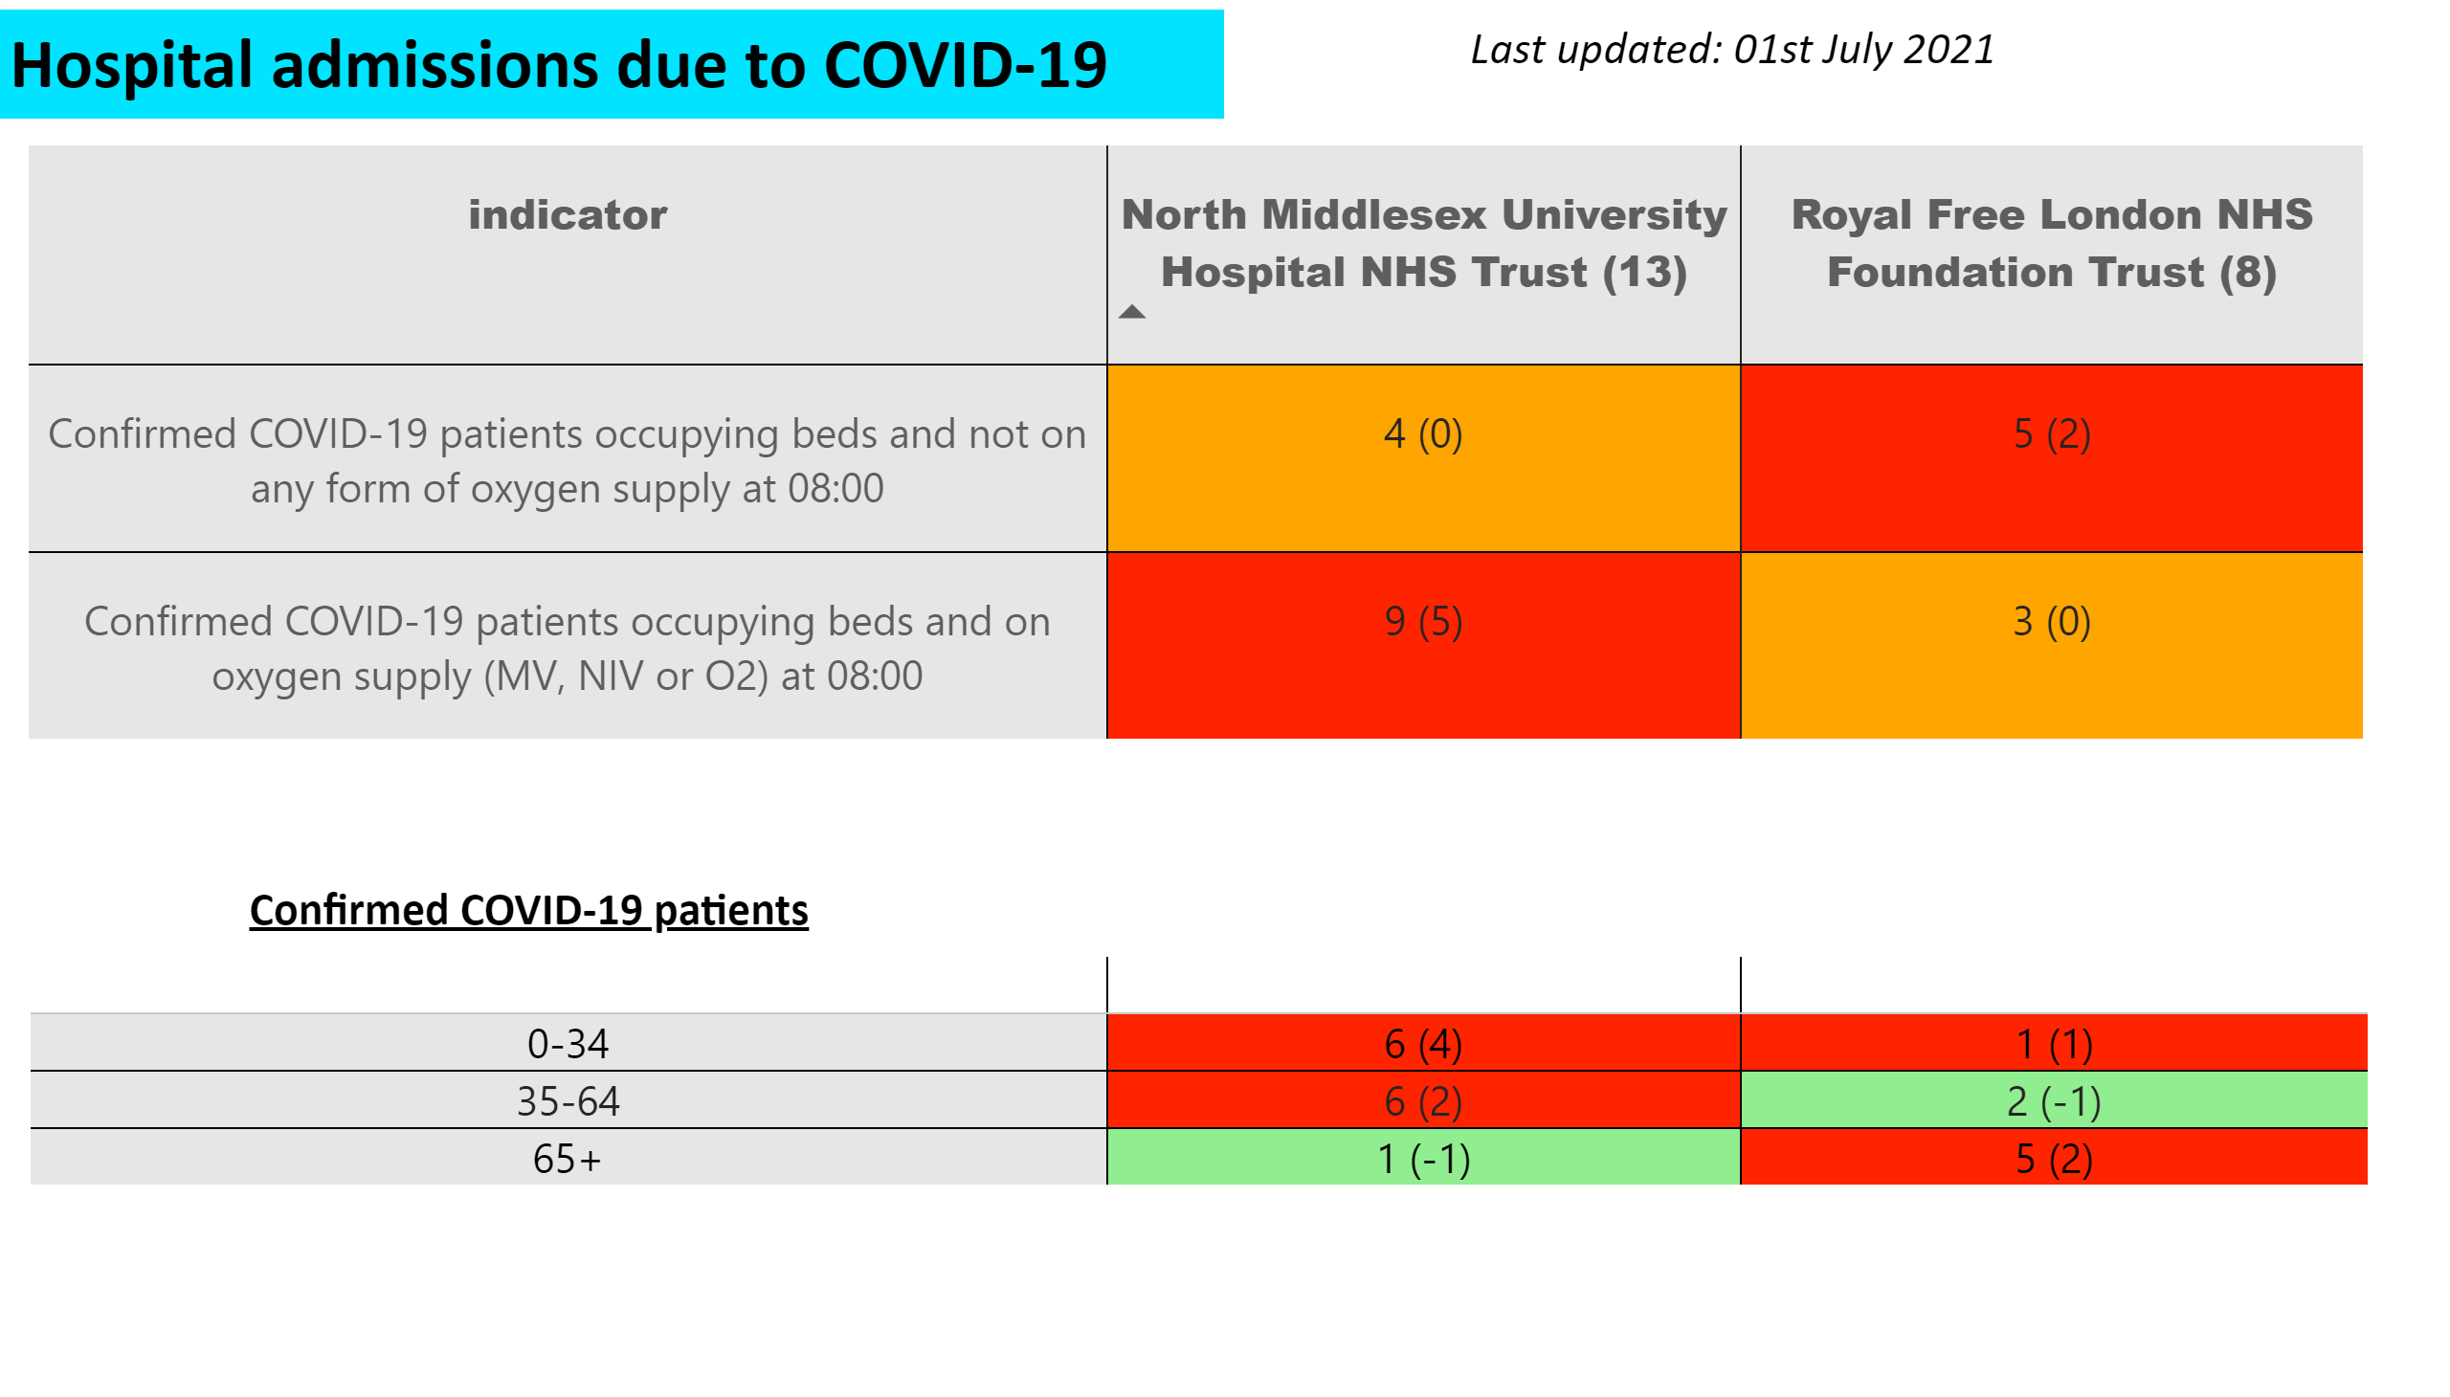
Hospital Data
Notes:
pivotTable
No alt text provided.
tableEx
No alt text provided.
textbox
No alt text provided.
textbox
No alt text provided.
textbox
No alt text provided.

Slide 18
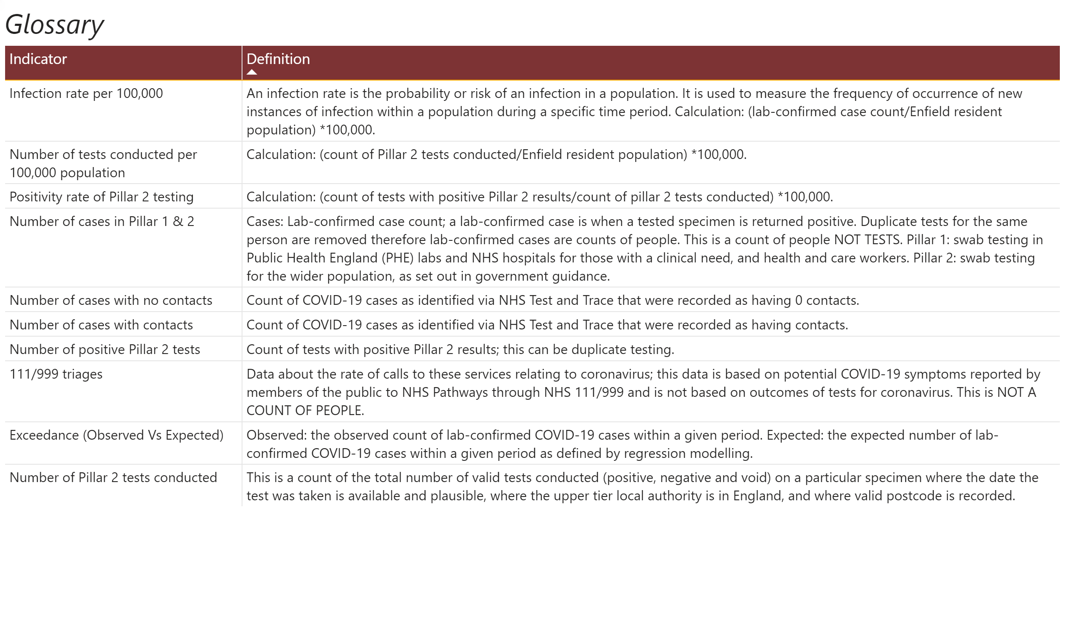
Glossary
Notes:
textbox
No alt text provided.
tableEx
No alt text provided.

