Slide 1
Tuesday 13th July

Slide 2
AGENDA
Welcome
Mike Sheridan – Ofsted Regional Director for London
3. Public Health update – COVID data update: testing:
vaccinations & guidance re’ Government
announcements
Gill Bal – Teaching School Hub – NPQs
ECTs/ECF – Anna Vaughan/Katie Dack
Cheryl Headon – School Uniform vouchers/ FSM vouchers.
Sharon Davies – HAF update
AOB -

Slide 3
ENFIELD COVID-19 DATA
TOTALS
($ 5 July – 11 July 21)
Cases = 01 Jan 20 – 11 July 21
Deaths = 01 Jan 20 – 25 June 21
3 July- 9 July
TOTAL
CASES = 31,565
DEATHS = 792
(669 excess#)
NEW CASES$
480
RECENT COVID DEATHS
0
(-1 excess deaths*)
INFECTION RATE PER 100,000*
143.8
AGE GROUP
0-29 30-59 60+
INFECTION RATE RANK*
NCL# = 5
LON= 32; Eng= 137
Variants of concern (1 months):
Alpha/ Kent: 7
Delta/ India: 399
HOSPITALISATIONS
On Oxygen = 16
Not on Oxygen= 1
TESTING RATE RANK
NCL# = 5
LON=33 Eng= 146
207
120
48
5 July – 11 July 21
11 July update
6 July update
11 July update
TESTS*
7,006
VACCINATIONS
191,090 (74%)
1st DOSES
(excluding care homes)
158,993 (62%)
2nd DOSES
Care Homes
Residents Staff
SCHOOLS/ EARLY YEARS AFFECTED
26
WARDS WITH HIGHEST INFECTION RATES $
Southgate Gren (197)
Cockfosters (154)
Southbury (140)
CARE SETTINGS
CARE HOMES = 2 deaths= 0; Staff = 1
Residents = 1
per 100,000
Number of tests:
PCR = 6,165 tests;
Lateral Flow = 17,221
Staff = 21 cases
Students = 73 cases
Contacts identified:
Staff: 122
Students: 2,008
SUPPORTED LIVING=0
Staff= 0; Users= 0
DOM CARE AFFECTED
0
Staff = 0, Clients = 0
1,383
1,659
*ONS weekly mortality records compared with 2015- 19 deaths.
#North Central London include Camden, Barnet, Enfield, Haringey & Islington
Change since last week of data

Slide 4
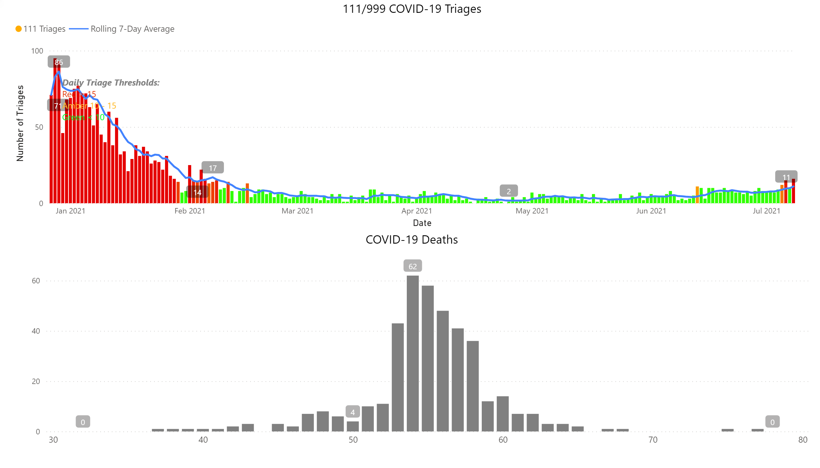
Charts
Notes:
111/999 COVID-19 Triages
No alt text provided.
COVID-19 Deaths
No alt text provided.
textbox
No alt text provided.

Slide 5
School LFT Testing – as of 08th July 2021
All LFTs conducted
Week beginning | School | SS | FE | Independent | Other | PRU | New Academy | Weekly total | Cumulative 4 week total
02-Jul-21 | 5466 | 41 | 0 | 0 | 3 | 0 | 0 | 5510 | 20436
25-Jun-21 | 7342 | 55 | 3 | 0 | 5 | 0 | 0 | 7405 | 14926
18-Jun-21 | 3798 | 48 | 3 | 3 | 6 | 0 | 0 | 3858 | 7521
11-Jun-21 | 3600 | 52 | 4 | 3 | 2 | 2 | 0 | 3663 | 3663
Positive LFTs
Week beginning | School | SS | FE | Independent | Other | PRU | New Academy | Weekly total | Cumulative 4 week total | % Positivity
02-Jul-21 | 50 | 0 | 0 | 0 | 0 | 0 | 0 | 50 | 97 | 0.9
25-Jun-21 | 38 | 0 | 0 | 0 | 0 | 0 | 0 | 38 | 47 | 0.5
18-Jun-21 | 7 | 0 | 0 | 0 | 0 | 0 | 0 | 7 | 9 | 0.2
11-Jun-21 | 2 | 0 | 0 | 0 | 0 | 0 | 0 | 2 | 2 | 0.1
FE, Further Education; SS, Secondary School; PRU, Pupil Referral Unit.

Slide 6
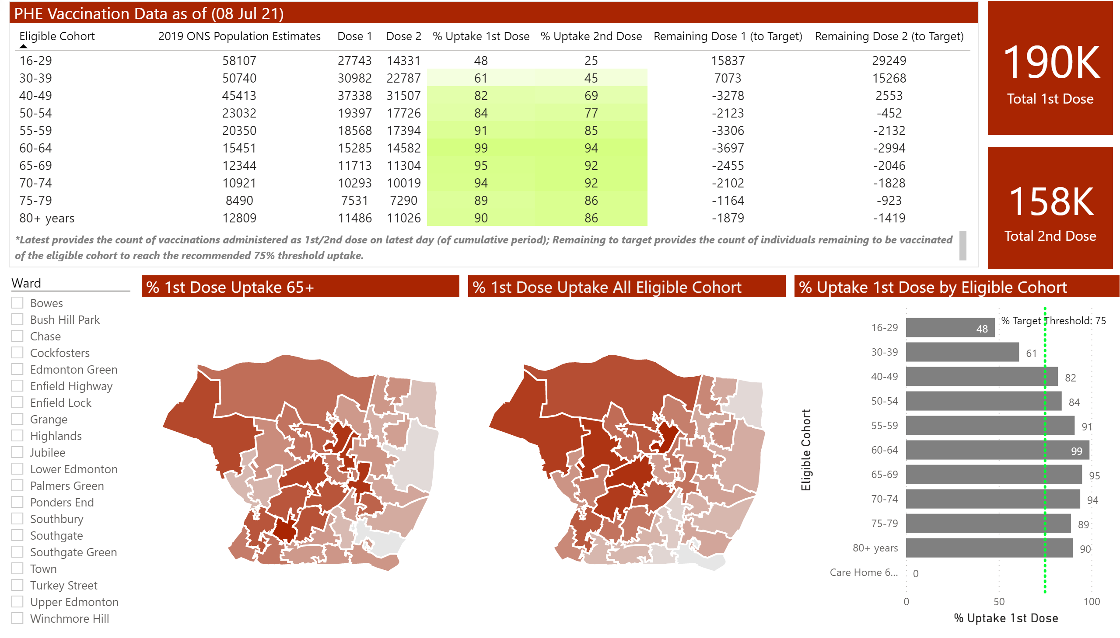
Vaccination Data
Notes:
% 1st Dose Uptake 65+
No alt text provided.
% 1st Dose Uptake All Eligible Cohort
No alt text provided.
PHE Vaccination Data as of (08 Jul 21)
No alt text provided.
clusteredBarChart
No alt text provided.
card
No alt text provided.
slicer
No alt text provided.
textbox
No alt text provided.
card
No alt text provided.

Slide 7
Head Teachers Briefing
COVID Management
Striving for excellence
www.enfield.gov.uk

Slide 8
Update – until 19th July/ until end of summer term
Continue with current measures including contact tracing
Continue reporting cases and self isolations to corona.virus@enfield.gov.uk
Request support via above
During summer holidays - encourage testing and vaccination for staff, families and anyone turning 18)

Slide 9
Update – from 19th July new guidance states; https://www.gov.uk/government/publications/actions-for-schools-during-the-coronavirus-outbreak
Bubbles – no longer recommended that necessary to keep children in consistent bubbles.
Face coverings – no longer recommended
Close contacts – will be identified via NHS T&T
Close contacts – advised to take PCR test
From 16th August <18s and fully vaccinated adults, will no longer need to self isolate
18 year olds have 4 months (following their birthday) in which to become fully vaccinated
School risk assessments must be updated – how to manage outbreak
Measures maybe re-instated in a school outbreak (in agreement with DPH)

Slide 10
Autumn Term
We will provide updated local flow chart for management of cases
Continue local reporting

Slide 11
NPQs Presentation for School Leaders

Slide 12
New NPQs, no ML, about developing specialism, available for all stages of a teacher’s career.
A golden thread:
The new NPQ framework continues a ‘golden thread’ throughout every stage of a teacher’s career. Schools and trusts can have confidence that all their educators, from early career teachers to leaders of multiple schools, are building and developing their practice from the same evidence-based framework (EEF).
More options:
The new specialist NPQs are designed to be complementary, giving teachers multiple career pathways and options at every stage.
Focus on what educators need to know and be able to do:
The new and reformed NPQs pay less attention to generic management and leadership styles. They pay more attention to the knowledge and skills that teachers and school leaders need to tackle the persistent problems of their daily roles.

Slide 13
6 New NPQs, no ML, about developing specialism, available for all stages of a teacher’s career.

Slide 14
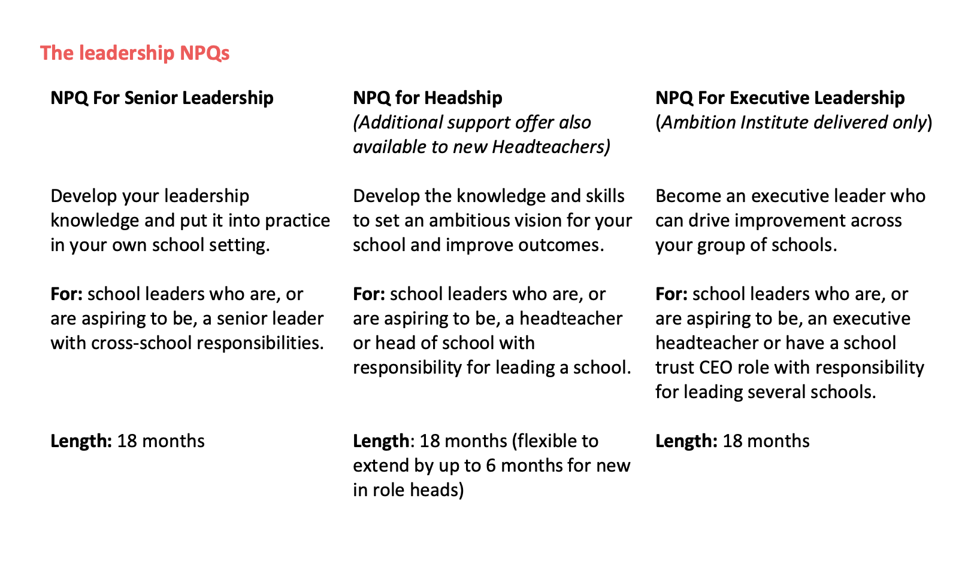

Slide 15
Content of NPQs

Slide 17
NPQ courses cost and duration
Qualification Type | Taught Course Duration | Total Duration to award of final mark | Cost | Cost to DfE identified Schools* (contact us)
Specialist: NPQLT | 12 months | 15 months | £900 | None
Specialist: NPQBC | 12 months | 15 months | £900 | None
Leadership: NPQSL | 18 months | 21 months | £1140 | None
Leadership: NPQEL | 18 months | 21 months | £4099 | None

Slide 18
NPQ courses cost and duration
Qualification Type | Taught Course Duration | Total Duration to award of final mark | Cost
Specialist: NPQLTD | 12 months | 15 months | None - no cost to schools (free to all schools)
Leadership: NPQH | 18 months | 21 months | 1. Full scholarship funding, with no cost to the participant is available for those who meet the following criteria: Are, or are aspiring to be, a headteacher or head of school with responsibility for leading a school; and Work in a state funded school in England that is eligible for DfE- funded scholarship. Contact us to find out if your school is eligible. 2. Full scholarship funding, with no cost to the participant is available for those who meet the following criteria: Are a headteacher or head of school with responsibility for leading a school; and Are in the first 2 academic years of headship; and Work in a state funded school in England. 3. You or your school can pay for the NPQH if you do not meet the above criteria. The NPQH costs £1,980.

Slide 19
Programme Elements of Specialist NPQs: NPQLT / NPQLBC / NPQLTD
Cohort start dates November 2021 and February 2022
c) 50 mins* 6 weeks per module*6 modules = 30 hours
d) Each module has a 2-hour clinic*6 modules = 12 hours
e) Each module has a 1-hour community*6 modules = 6 hours.
a) 2-hour webinar
g)
b) 6 hours -
f) 2-hour assessment support clinic
58 hours not including assessment

Slide 20
In a six week course

Slide 21
Insight Study and Practice Modules Structure

Slide 22
Programme approach
Highly flexible delivery - Participants can complete weekly, online units at times that fits around their existing commitments.
Work is done by the candidate – minimal time away from school (1 day conference).
Insight modules capture the very best that the sector can contribute on a given topic, while application modules help participants to use the ideas in context, with support from peers.
Combining insight and practice to drive habit change - Embedding new habits is hard and can take multiple attempts.
Granular, frequent and sustained curriculum design - Evidence tells us that a ‘little and often’ approach helps us learn more effectively.
Our programmes are delivered through a carefully structured and sequenced curriculum to support participants to see and feel that they are continually getting better.

Slide 23
Assessment
Candidates respond to a written task based on a case study - No projects.
Candidates response is limited to 1500 words.
Candidates are given an 8 day window to complete the assessment.
There are two assessment opportunities per NPQ per year.
Participants can take the assessment only two times.
Fail or pass.
THIS IS A NATIONALLY ACCREDITED QUALIFICATION (not an Ambition qualification)

Slide 24
Learning Management System
Steplab
A complete learning experience: self- study materials, videos, quizzes and peer coaching.
Dashboard informing you on levels of participant engagement.

Slide 25
Developmental opportunities for your staff as Visiting Fellows and Assessors
Focus on highly effective facilitation: A facilitation progression framework to break down what we think ‘expert’ facilitation looks like.
Ensuring equality of experience: Baseline standards that all facilitation needs to meet.
Support and training throughout: Training is provided from day 1 to support you to understand and meet Ambition facilitation expectations.
Coaching model: Instructional coaching format used to provide an agreed set of action steps to keep getting better.

Slide 26
Next steps: Help us promote the NPQs
Register your staff on the NPQ:
To register your staff for any of these programmes email us and we will register you. You will be getting an email with all of the detailed information on each NPQ today.
Email details: gbal@whtc.co.uk
PA details - Agata Czop: aczop@whtc.co.uk
Our website has all the details on NPQs: www.whtc.co.uk
Phone: 0208 385 4802

Slide 27
Early Career Teachers - ECTs
Primary
AB
ECF
Subject Focussed PL
Secondary
AB
ECF

Slide 28
Subject Focussed PL 2021-2022
£175 annual cost
Blended
Delivered by range of expertise including the PE Team and Sara Tilley & Peter Warwick
Child Protection; Maths KS1 & KS2; Safe Practice in PE; Gymnastics KS1 & KS2; Autism KS1 & KS2; Science KS1 & KS2; Maths Part 2 KS1 & KS2; Voice workshop; RE; Geography; PE for children with SEND 6 EYFS sessions

Slide 29
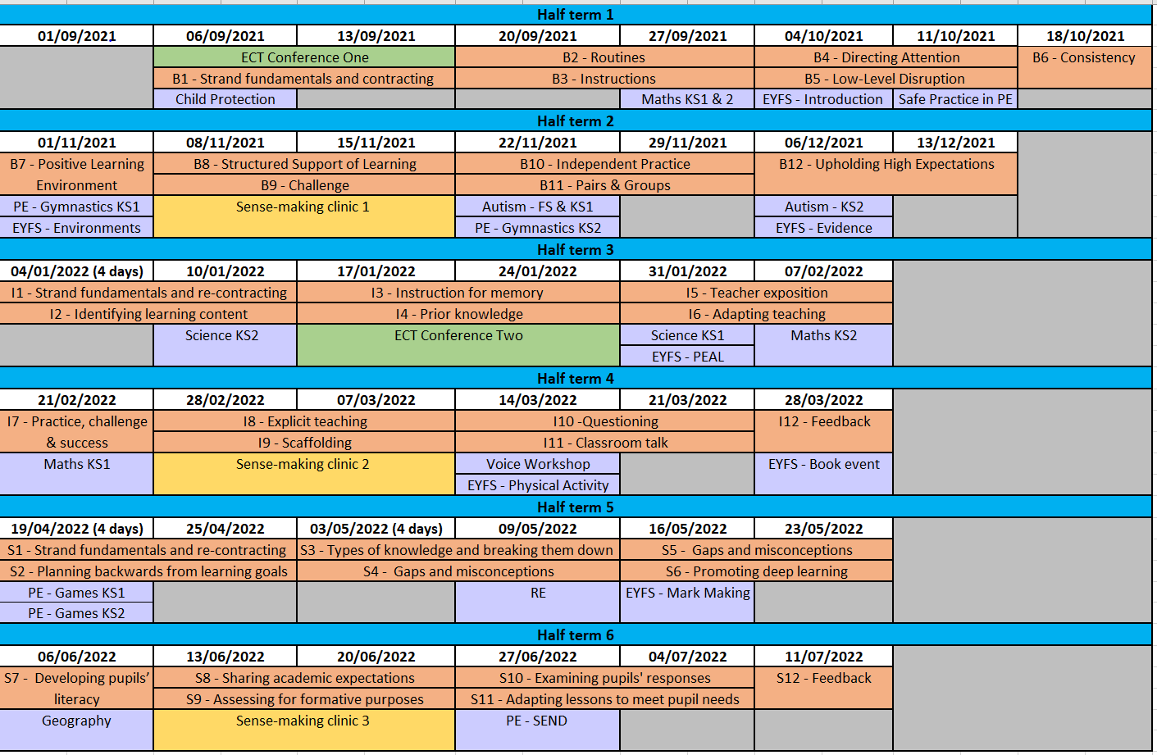
Enfield ECT Programme 2021-2022

Slide 30
Enfield ECT Programme
Conferences – 1 day training face to face
Conference One is in September and Conference Two is in January
Study & Coaching (weekly)
Teacher: Study (40 mins) Mentor: Observe (15 mins)
Teacher and Mentor meet for a 30-45 mins structured coaching conversation
Teacher embeds new target into their teaching habits and practice
Autumn focus is Behaviour, Spring focus is Instruction and Summer focus is Subject
Borough training (Tuesday afternoon)
Subject specific training
Some face to face and the rest online
Clinics – online in smaller groups
Clinics have been grouped by trusts and where possible by location
There are three clinics (November, March and June)

Slide 31
Primary Clinics
Secondary Clinics
Conferences
All dates will be confirmed in the next couple of days. All bookings are to be made through Katie Dack (katie@ivylearningtrust.org)

Slide 32
Yoga for Beginners – Session 1
How to Build an Inclusive Curriculum
Cultural Capital throughout the Curriculum
Restorative Practice – 4 session immersion program
Voice Work for Leaders
Learning Scientists: Six Strategies for Effective Teaching and Learning
County Lines: The What, How, Where & When and Why This Matters for Schools
Developing Your Coping Toolbox - for Leaders
Leading Your Subject: Creating, Developing, Reviewing - Art
Planning & Teaching English at KS2 in the New Normal
Reading in UKS2: Overcoming Barriers and Building Inference
Developing the Curriculum Intent

Slide 33
Coaching Circles
Hear from a school leader *
Thursday 15th 4 pm
https://zoom.us/j/96683054786

Slide 34
Secondary PL Leads?

Slide 35
Cheryl Headon
Head of Schools Traded Services

Slide 36
Covid Local Community Grant
£60 Voucher per FSM children and children in your schools who would most benefit.
£30 Uniform Vouchers
Key Dates
Deadline Uniform Vouchers - 12th July ( £30 vouchers)
Vouchers to be ordered on Enfield Edenred Account or Local System
Window to order vouchers – 7th and 16th July (£60 total - 2 £30)

Slide 37
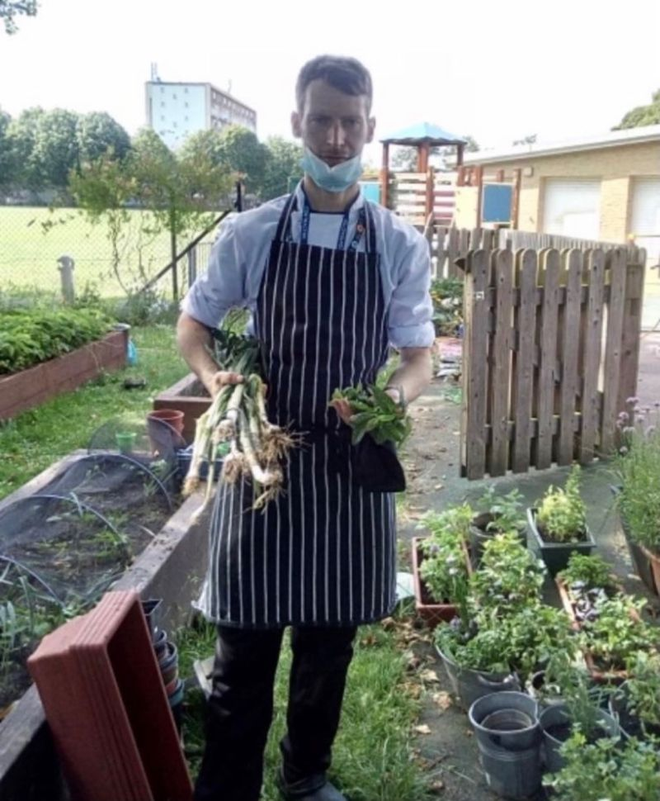
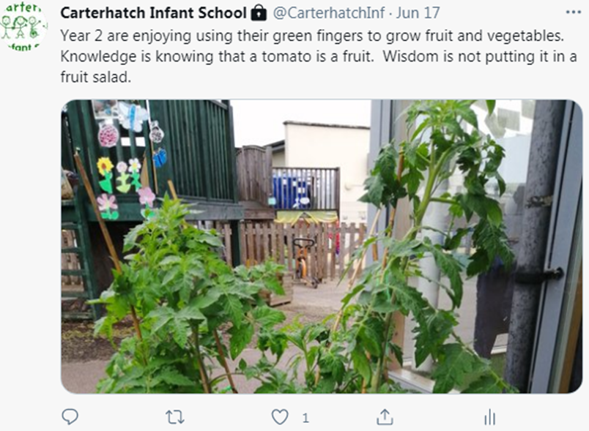
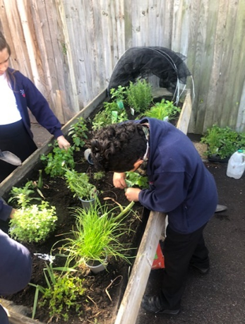
Natasha's Law
Summer HAF Programme
Edible Gardens

Slide 38
Programme is 3 blocks of 10 weeks 45 minutes pool time
Head Swimming Instructor
Swimphony
Any questions email sts@enfield.gov.uk
Hub
Have you updated your Government issue devices?
If you need support email sts@enfield.gov.uk
Procurement/Purchasing

