Slide 1
Tuesday 31st August 2021

Slide 2
AGENDA
Welcome back
2. Public Health update – COVID data update: Autumn
term, government asks, testing & contingency
planning. Vaccinations update & vaccine bus
Attendance form reporting requirements – 2019/20
official exclusions data
Mental Health Support Teams – possible expansion of
provision to schools
Safer Schools, Safer Routes, Schools Watch – updates
Professional Development – Anti-Racism
Caretakers’ Houses
AOB

Slide 3
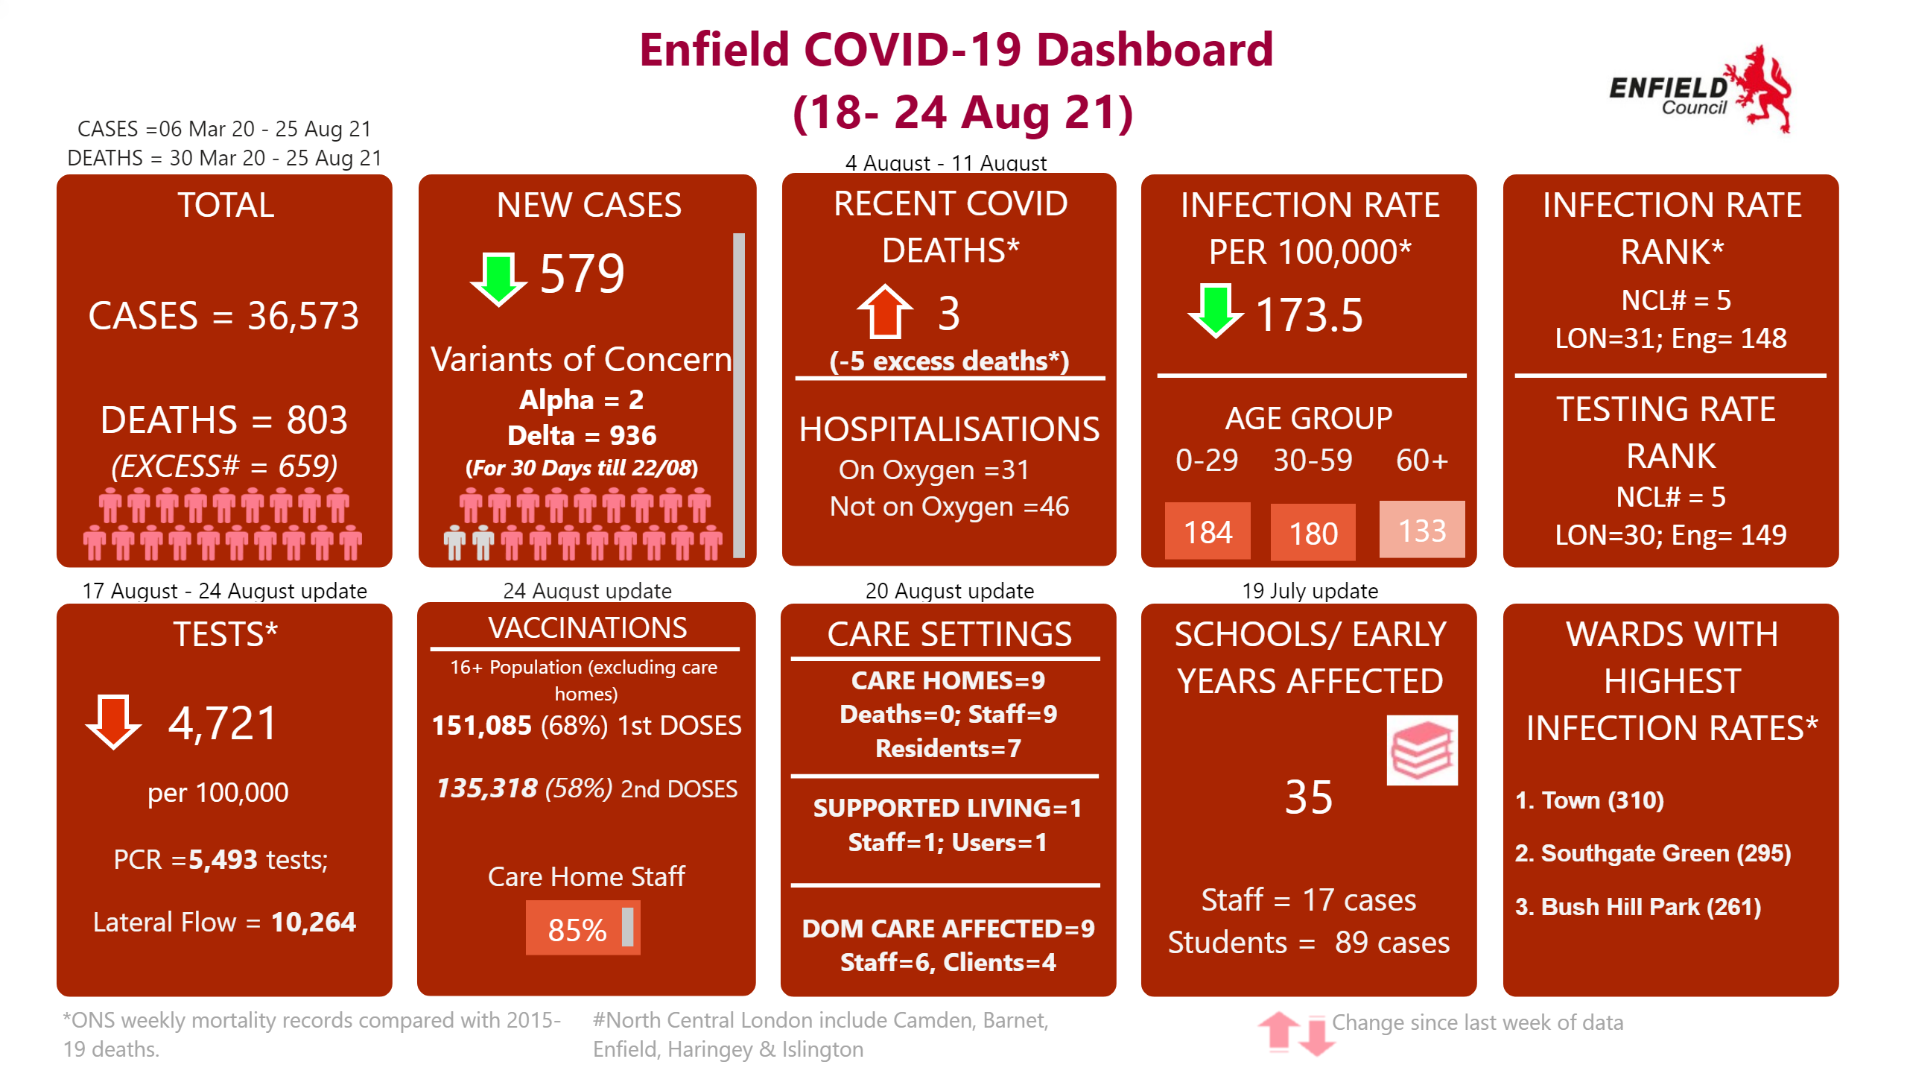
Data Summary
CASES = 06 Mar 20 - 25 Aug 21 DEATHS = 30 March 20 - 5 Aug 21
Notes:
TOTAL
No alt text provided.
NEW CASES
No alt text provided.
RECENT COVID DEATHS*
No alt text provided.
INFECTION RATE PER 100,000*
No alt text provided.
INFECTION RATE RANK*
No alt text provided.
Enfield COVID-19 Dashboard (18- 24 Aug 21)
No alt text provided.
TESTS*
No alt text provided.
VACCINATIONS
No alt text provided.
CARE SETTINGS
No alt text provided.
SCHOOLS/ EARLY YEARS AFFECTED
No alt text provided.
WARDS WITH HIGHEST INFECTION RATES*
No alt text provided.
textbox
No alt text provided.
basicShape
No alt text provided.
basicShape
No alt text provided.
textbox
No alt text provided.
textbox
No alt text provided.
textbox
No alt text provided.
textbox
No alt text provided.
basicShape
No alt text provided.
image
No alt text provided.
image
No alt text provided.
image
No alt text provided.
textbox
No alt text provided.
textbox
No alt text provided.
image
No alt text provided.
textbox
No alt text provided.
textbox
No alt text provided.
textbox
0-29
textbox
No alt text provided.
basicShape
No alt text provided.
basicShape
No alt text provided.
basicShape
No alt text provided.
image
No alt text provided.
textbox
No alt text provided.
textbox
No alt text provided.
basicShape
No alt text provided.
basicShape
No alt text provided.
basicShape
No alt text provided.
basicShape
No alt text provided.
basicShape
No alt text provided.

Slide 4
Head Teachers Briefing
31.8.21
Striving for excellence
www.enfield.gov.uk

Slide 5
New PHE guidance https://www.gov.uk/government/publications/actions-for-schools-during-the-coronavirus-outbreak/schools-covid-19-operational-guidance
Covers primary, secondary, special & post 16 providers
Key messages;
Keep some control measures in place – hand washing, cleaning, ventilation, follow advice on testing, self-isolation, managing cases
Testing – two LFTs at start of term (all staff & secondary school pupils), followed by home testing.
Contact tracing – close contacts will be identified by NHS Test and Trace.
Bubbles – no longer required to keep children in bubbles
Face coverings – no longer advised for pupils/ staff in class or communal areas but still required on public transport / dedicated school transport.
Stepping up measures – in case of outbreak

Slide 6
Change to control measures

Slide 7
Testing
Secondary
All secondary school pupils should conduct 2 on site LFDs 3-5 days apart at start of term.
Settings can start 3 working days prior to start of term
Can stagger the return of pupils to manage this
Secondary schools should retain small testing capacity on site until further notice to offer testing to pupils who are unable to test themselves at home
Pupils/ staff should then test twice weekly at home until end Sept (when this will be reviewed)
Notes:
Mention assisted LFTs – if positive legally binding to self isolate
PCRs – if positive legally binding to self isolate

Slide 8
Testing
Primaries
Staff should test twice weekly at home
No requirement to test pupils.
PCR tests should not be carried out for people who have had a + test in last 90 days (unless new symptoms)

Slide 9
Testing for a symptomatic or COVID + person
Symptomatic / COVID + LFD
If PCR + self isolate for 10 days
If PCR - continue school
(providing PCR carried out within 2 days of LFT & if staff double jabbed)
Notify COVID + to corona.virus@enfield.gov.uk
Self isolate whilst awaiting PCR test and results
Seek confirmatory PCR

Slide 10
Contact tracing
Close contacts will be identified by NHS Test & Trace and do not need to self isolate if the are:
Under 18 and 6 months
Fully vaccinated (14 days post 2nd jab)
Not able to vaccinated due to medical reasons
Taking part in an approved vaccine trial
Close contacts will be advised to take a PCR test and providing they are within categories 1-4 do not need to self isolate whilst awaiting results.
attend school,
do not need to wear face coverings (when in school but should on public transport)
Staff/ students are NOT required to self isolate if they live with someone who has been identified as COVID+ providing adhere to 1-4 above and are advised to take a PCR test.

Slide 11
Bubbles
No longer recommended
Mixing can take place during normal school day
Therefore school events such as assemblies, lunch, play time can involve mixing of pupils/staff

Slide 12
Face coverings
No longer recommended for pupils, staff or visitors in class rooms or communal areas
Face coverings are recommended in enclosed, crowded spaces containing people who don’t normally come into contact

Slide 13
If/ when a school has multiple cases
If you are concerned phone Public Health/ email corona.virus@enfield.gov.uk ;
Gov advises that you notify if/ when;
A member of staff/ child is hospitalised due to COVID (notify local team & DfE 0800 046 8687)
Special schools
2 COVID + cases among students/ staff who are likely to have mixed closely within the last 10 days
Most schools
5 COVID + cases among students/ staff who are likely to have mixed closely within the last 10 days
10% students/ staff who are likely to have mixed closely within the last 10 days

Slide 14
Cases among staff
Notify corona.virus@enfield.gov.uk
PHE guidance
For all cases relating to staff, please also see the guidance for workplaces: NHS Test and Trace in the workplace https://www.gov.uk/guidance/nhs-test-and-trace-workplace-guidance?utm_medium=email&utm_campaign=govuk-notifications&utm_source=09bc689c-73ca-4445-94fe-4f79828ed4e2&utm_content=daily
Employers should call the Self-Isolation Service Hub on 020 3743 6715 as soon as they are made aware that any of their workers have tested positive.

Slide 15
Stepping up and down measures https://www.gov.uk/government/publications/coronavirus-covid-19-local-restrictions-in-education-and-childcare-settings
See ‘Contingency Framework’ within PHE guidance
Contingency plans / school risk assessments should be updated to cover current guidance and measures the school will take if there is an increase in cases
Local Authority, DPH, and PHE Health Protection Teams will recommend measures identified in the Contingency Framework if an outbreak occurs

Slide 16
Actions that may be advised
Strengthened communications to encourage pupils / students to undertake twice weekly rapid asymptomatic home testing and reporting
Temporarily reinstating face coverings for pupils/students, staff and visitors in indoor and/or communal spaces in secondary schools, FE and HE settings, and for staff in primary, early years, out-of-school, and specialist settings. This should be for two weeks in the first instance, pending regular review
Reinstating on-site rapid LFD testing in secondary schools, colleges and universities for a two-week period to encourage uptake of twice weekly testing
Increased frequency of testing
Face coverings
Limit gatherings e.g. educational visits, open days, parental attendance, performances
Limit attendance

Slide 17
What do we want you to do
Review Risk Assessment documents
Inform us of COVID + cases using corona.virus@enfield.gov.uk (this requirement will be reviewed at half term)
We do not need to know about close contacts

Slide 18
Vaccination
Currently open for >16s.
The Government has announced that all 16 and 17 year olds are to be offered a first dose of the Covid-19 vaccine by Monday 23 August, to give them vital protection provided by the vaccine before returning to school in September.
Across NCL, pop-up clinics and PCN sites have already begun to offer vaccinations to 16 and 17 year olds. Meanwhile, young people within three months of turning 18 can now book their vaccine appointment online through the National Booking Service or by calling 119.

Slide 19
Vaccination
People aged 16 – 17 can find a nearby walk-in clinic via the national grab a jab website. A list of North Central London walk-in clinics currently offering vaccinations to 16 and 17 year olds can also be found on the CCG website. We will continue to add to this list – and keep the grab a jab site up to date - as more sites becomes available.
It’s important as many people in this age group as possible receive their vaccination before the school term begins. Please share this information widely with your networks and via your comms channels.

Slide 20
Education Settings Status Form
DfE Update
Confirmation that schools should continue to submit the Education Settings Status form
Completion will change from daily to weekly from 1st October
Software changes have been made to local management information systems to include further codes in relation to COVID-19 related absence
A preview of the form as well as a list of the additional absence codes are on the GOV.UK website (link on the Hub)

Slide 21
Mental Health in Schools Briefing
Suzy Francis
Principal EP/Strategic Lead for CYP Mental Health
Dr Chantell Douglas
Clinical Lead / Manager of the MHSTs
Striving for excellence
www.enfield.gov.uk

Slide 22
This briefing provides an explanation of DfE announcements re Mental Health in schools and plans for Enfield
Emotional Wellbeing and Mental Health Update for Enfield Schools and Colleges
July 2021
Link to the Briefing

Slide 23
Mental Health Support Teams
What are MHSTs?
Major expansion in the CYP mental health workforce funded by NHS England and Health Education England
Education Mental Health Practitioners (EMHPs) represent most of the MHST workforce with 4 EMHPs in each team.
Enfield’s MHST launched in October 2019 and currently has the equivalent of two MHSTs and the team is known locally as ‘My Young Mind Enfield’. CAMHS is the main provider with EPS input
Currently funded to work with 37 educational settings in Enfield and are part of the broader offer of support in schools.
Purpose:
MHSTs are commissioned to deliver three core functions:
Deliver evidence-based interventions for mild to moderate mental health and emotional wellbeing needs
Support senior mental health leads in education settings to develop and introduce their whole-school or whole college approach to mental health and emotional wellbeing
Providing timely advice to staff and liaising with external specialist services so that children and young people can get the right support and remain in education.

Slide 24
Expanding the Mental Health Support Teams
Enfield has been funded to expand the current team and train a further 4 EHMPs.
We are currently seeking between 8-10 primary and secondary settings to be training placements for the coming year (starting January 22). We will plan to extend the reach to more schools after this next year.
A letter providing more information and the EOI form will be coming out to schools this week.
We need to hear back from interested schools by 30th September.

Slide 25
Senior Mental Health Lead role
Government aim: all MH Leads in schools to receive approved training by 2025.
Training will be accessed via DfE ‘Training Provider Market Place’
Grant @ £1,200 per school.
DfE will ask about training needs and learning preferences when schools apply for the grant.
Can be integrated with existing training and resources.
Link to DfE page
To support the development of this emerging role, Enfield MH Partnership are setting up a Mental Health Leads Network – more details will follow

Slide 26
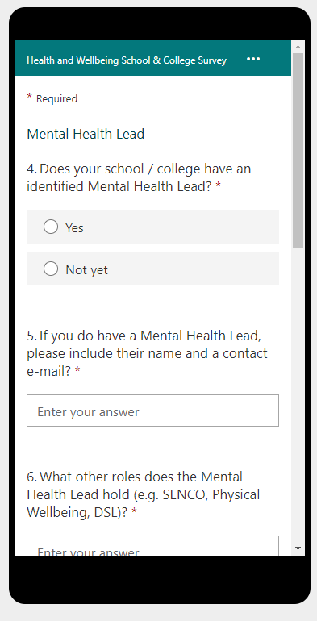
Health and Wellbeing Schools & College Survey
Why are we doing this:
The health and wellbeing for all of our school communities has never been so important.
This has been brought into a sharp focus as we recover from the impact of the pandemic.
We are keen to understand the needs of schools and provision, to help us plan as a partnership how to best provide additional help and guidance.
We are particularly focussing on supporting the role of the Senior Mental Health Lead in schools & colleges in light of the recent government announcement of Senior Mental Health Lead training and support.
Thanks for your help with this:
Link to the Survey

