Slide 1
Thursday 3rd October 2022

Slide 2
AGENDA
1. Welcome
2. Inspection Outcomes: Part-time timetables: Cyber Security Audit.
3. Low-level concerns policy: Staff pay awards & school finance
4. SEND outreach: SEND strategy
5. Inclusion Charter
6. Summer exams/SATs outcomes and analysis
7. Summer pupil admissions
8. Flu/Polio Vaccinations
9. Household Support Grant
10. George Spicer/Brettenham – Rights Respecting Schools
11. Energy Costs and Energy savings
12. Parenting courses
13 AOB (additional finance discussion)

Slide 3
Mapping Exercise and Gap Analysis
Special School Outreach Offer 2022-23
Striving for excellence
www.enfield.gov.uk

Slide 4
An Overview of Services – the current offer
Area of Need | Service
Multiple areas | Educational Psychology Service (statutory and traded) Virtual School for LAC students Attendance Support Unit Joint Service for Disabled Children SEN Careers Service Supported Internships for Post-16 Early Intervention Support Service (EISS) Early Years Social Inclusion (EYSI)/Early Years SEN Team (part-traded) SEND/Inclusion Professional Learning (traded) SEN Advisor Senior School Improvement Advisor for Safeguarding and Inclusion Special School Outreach Services: Oaktree, Durants, Waverley, Fern House, West Lea and Russet House
Cognition and Learning | Covered by services for multiple areas of need
Communication and Interaction | Speech and Language (education pathway) Enfield Communication Advisory Support Service (ECASS) Enfield Advisory Service for Autism (EASA)
Social, Emotional, Mental Health | SWERRL/Primary BSS Secondary BSS Enfield Trauma Informed Practice in Schools (ETIPSS) Mental Health Support Teams Emotionally Based School Non-Attendance Provision Orchardside’s Turnaround Project (traded)
Physical and Sensory | Covered by services for multiple areas of need
Medical/Health | School Nursing Occupational Therapy Speech and Language (health pathway) Home Hospital Tuition Service

Slide 5
Gap Analysis
Area/Need | Description of gap
Neuro-diversity | ADD (Attention Deficit Disorder), ADHD (Attention Deficit Hyperactivity Disorder), ODD (Oppositional Defiance Disorder), PDA (Pathological Defiance Disorder) – at SEND support Those on part-time timetables due to behaviours that are a challenge Fern House will cover some of this for 22-23
Behaviours of concern | CYP with EHCPs presenting with behaviours of concern (self-harm/absconders/emotionally dysregulated) Those on part-time timetables due to behaviours that are a challenge Fern House will cover some of this for 22-23 Oaktree will cover PRICE training at secondary for 22-23 Positive Behaviour Support – Russet House and Durants will cover this in 22-23
Emotionally Based School Non-Attendance Outreach | Outreach for EBSNA children and young people across both primary and secondary ages Meetings with parents and schools to provide support where there’s an underlying wellbeing difficulty to prevent escalation to EBSNA provision or needing an EHCP. Small package currently being negotiated for primary with West Lea for 22-23.
Sensory needs | Understanding and responding to sensory needs OT team currently exploring through EASA OT role
Speech and Language Therapy | School age pre-Statutory Speech and Language needs Monitor strand 5 from ECASS to determine if it meets enough need or needs expansion
Early Years | EPS – accurate identification and response to needs, strategies, parental support Toilet training for children who don’t meet EASA’s social communication needs criteria Reduced timetables – increasing access to education. Waverley will provide some support in 22/23. CYP who haven’t been seen but have significant delays in their development that requires intervention/cannot get or remain in a setting due to presentation of their needs (parents don’t feel confident the setting can meet their needs or the nursery setting has been unsuccessful) Sleep and feeding support for those who don’t meet EASA’s social communication needs criteria Insufficient speech and language

Slide 6
Gap Analysis
Area/Need | Description of gap
Preventative intervention for those with social vulnerabilities | Intervention programme (SEMH) for YP with a vulnerability to criminal exploitation
NEET prevention programme | Students who find school difficult and are socially estranged from peers Students with difficulties with social communication Students who have difficulties attending school
Specific learning difficulties | Dyslexia, Dyspraxia and Dyscalculia – assessment, screening and intervention (not diagnosis) Oaktree will be covering this for 22-23
Curriculum Guidance and Support for ARPs and Units | Training, Consultation and Advice, Practice Support offer in place from Russet House, Durants, EASA, Waverley and Oaktree for 22-23
 | Practice Support and modelling of inclusive classrooms and curriculum approaches e.g. shadowing opportunities in special schools and consultation at whole class/group level (not individuals) Parent workshops Providing a view on in-year arrivals of complex children for SEN Panel Waverley and Oaktree covering this in 22-23
Inclusive practice and modelling of strategies for SEND
Personal Care and Manual Handling
 | Manual Handling, Self-care and Safeguarding for children and young people with physical and continence needs Waverley covering this in 22-23

Slide 8
Enfield Inclusion Charter
Dani Lang, Senior School Improvement Advisor Safeguarding and Inclusion
Striving for excellence
www.enfield.gov.uk
Notes:
To create a shared vision of school inclusion and a set of principles that schools and educational settings can sign up to ensure inclusion for children and young people with special educational needs and disabilities.

Slide 9
Where has the Inclusion Charter come from?
Equality - SEND focus
Review - Ernst & Young re: High Needs Budget
Pressure on specialist places – higher demand, declining school numbers
Research - better achievement in mainstream schools

Slide 10
Outcomes of the Charter
Education settings to discuss inclusion together
Schools more conscious of their inclusion practices
Strengthen accessibility to resources, funding and training through the local SEND offer
An inclusive school will lead to:
More teachers trained to support children and young people with a range of needs
Reduce the number of exclusions
Schools welcoming children and young people from the borough with a range of needs, with support by the local authority
Notes:
Awareness and culture change
Renewed focus
Better and more consistent use of resources
Better education experience – enjoy learning and flourish
Education within the borough – less transportation time and costs, friends live in the community, less disruption/anxiety when attending after school activities (venue and people already known)

Slide 11
Relationship to other policy/strategies
Draft SEND Strategy
Draft Autism Strategy (all age)
Youth Development Service (Rafique Ullah)
Fairer Enfield Policy (Equality, Diversity and Inclusion)
Empowering Young Enfield (CYPP)
Supportive of SEND Review: Right support, right place, right time (green paper)
Schools white paper : Opportunity for all: strong schools with great teachers for your child
Notes:
Not an exhaustive list – could also mentioned Equality Act 2010, National Disability Strategy (2022) etc
Youth Development Service will adopt this charter for all their centres and services ensuring consistency for our young people in both formal and informal education settings.

Slide 12
The Journey
Inclusion Charter workshop
Feedback session to professionals
Launch
Autumn 2022
Youth engagement
Focus groups (x2)
Excellence Board for sign off
Heads review
Notes:
The journey of the Inclusion Charter and all the different engagement

Slide 13
Notes:
Not ordered as all equally important.
Image approved by a young person on a council work experience placement. This young person has high functioning autism.

Slide 14
https://traded.enfield.gov.uk/thehub/information/enfield-inclusion-charter
Notes:
The webpage
This has additional links and currently the option to find out more about the Inclusion Charter, however this will change after the launch so that schools and settings can sign up to the charter.

Slide 15
Ensure everyone is comfortable to be open and honest about what support they need to help children and young people in their care.
An inclusive school will:
Support school staff to have the knowledge and skills to recognise SEND and the changing needs of children and young people as early as possible.
Empower school staff to share their experiences with each other and the leadership team and ask for help when they need it.
Be honest and open about potential barriers to inclusion in the school and take steps to understand them better together to find positive and workable solutions.
Encourage all school staff to be reflective and to welcome support, mentoring and professional learning opportunities
Notes:
The Inclusion Charter Guidance.
Example of one bullet point will look like in an inclusive school.

Slide 16
Ensure everyone is comfortable to be open and honest about what support they need to help children and young people in their care.
Inclusion is one of the named school values or ambitions and school staff explore what this means with children, young people and their families to understand and demonstrate inclusive practice.
Staff at all levels attend community projects and programmes that help them to learn how to be more inclusive.
Teaching staff work with all children and young people to agree on their targets and review their progress in class against these.
Teaching staff attend appropriate training, such as the Whole school SEND gateway and the SEND inclusion professional learning package as promoted on the School Hub.
Staff are trained in supporting children and young people with SEND needs, including social, emotional, and mental health
Notes:
Evidence for an inclusive setting.

Slide 17
The Launch Event
You are invited to join the Inclusion Charter Teams Launch Event and hear about our journey in creating this document and its relevance for your setting. At the heart of this, is a culture where we embrace difference; where barriers are minimised or removed; and where the everyday lived experience, interests and needs of children and young people with Special Educational Needs and Disabilities (SEND) are better understood.
We are excited to have an exceptional young lady from Ambitious About Autism present about her school experiences, as well as schools sharing their views on inclusion.
We then invite your setting to sign up to the Inclusion Charter and show your commitment to provide an inclusive education.
Tuesday 18th October 3.30pm-5pm.
Meeting ID: 378 916 630 574 Passcode: kgAEkr

Slide 18
Early data analysis - PROVISIONAL
Borough profile was developed with the data group in ELEP, will come out this term.
Files uploaded to NCER Perspective Lite for schools to use themselves.
Aim declined to share KS 4 & 5 data.
Need more pupil level data before analysis can take beyond the headlines for KS 4 & 5

Slide 19
The number of pupils in the early years foundation stage (EYFS) reaching a good level of development (GLD) has risen steadily over the years from 2014 to 2019, and in LBE 2022 the reduction in percentage was only 4%, less than the dip both nationally and in London, (6% and 7% respectively.)
The number of pupils in year 1 who have achieved the mark of 32 in the phonics test has risen steadily over the years from 2014 to 2019. For the first time in 2022 the LBE outcome is the same as the national average but 2% behind the London average.
At KS 1 the LBE results were stronger in comparison to the national averages than in either 2018 or 2019. LBE pupils were equal to, or greater than national in all measures except the expected standard in writing (-2%) and maths greater depth (-1%).

Slide 20
Primary school performance in the KS 2 SATS the percentage of children achieving higher standard (greater depth) in reading, writing and mathematics, is above the national averages for all three.
The progress by children in LBE schools between KS 1 and KS 2 is above the national and London averages in reading and writing. The progress score in maths is well above the national average but below the London average progress score. Given the attainment is not yet above the London average, this suggest that the cohort had low outcomes at KS1.
In primary schools, outcomes for vulnerable children and young people, including those in receipt of the pupil premium and those children with Special Educational Needs and Disabilities (SEND), are above national averages for those groups, and overall the gaps in their attainment when compared with their peers are smaller than the national average gap.

Slide 21
At GCSE, the LBE average for the percentage of students achieving the pass grades 5-9 in English and mathematics is 52.2%, in line with the provisional national average of 52%, which is a smaller drop since 2019 than the national drop in 2022.
The pass rate for Business and Technology Education Council qualifications (BTecs) is good at 100% and in line with national outcomes.
The A level points per entry in 2022 is 37.7 an increase of 6.1 since 2019; higher than the increase across England of 3.9.
92.3% children and young people educated in the state sector in LBE have access to a good or outstanding school, and the number of schools rated as good or outstanding has increased from 84% to 93% over the last academic year.

Slide 22
EYFS
Core offer to school nurseries
Meet independent schools
L& M support
Ofsted updates / prep list
Network meetings
KS 1
Establish HT group
Girls’ maths
Specialist support
Projects
Training offer for maths
EASA
Special school offer
SWERL / BSS
Disadvantaged pupils
SEF workshops
Coaching approach to lesson feedback
Share excellent practice
Report to ELEP Board
Boys’ achievement
ECASS
ETIPS
Share excellent practice
Notes:
Networks – DSL, sendco sbm, mental health, virtual school / CLA, moderation – may get R/W out of that, RE training, ETIPS champions, climate change, 7th October 2-3

Slide 23
Admissions Autumn Update
Jo Fear
Striving for excellence
www.enfield.gov.uk

Slide 24
School place offers since 1st September
Offers - 817 primary
- 365 secondary
Secondary – approximately 60% of families are new to the country
Increase in secondary aged LAC – 24 CYP this term.
Too early to comment on spare capacity

Slide 25
Brettenham Primary School Gold Award

Slide 26
Been on the journey for over 10 years First achieved Level 2 (now Gold) in 2014 Reaccredited in 2017 and again in Nov 2021

Slide 27
Led by class teacher (Lucy Ahuja) who gets release time fortnightly when possible. Supported by part time teacher

Slide 28
Gone through the process of children understanding rights with specific lessons, incorporating into class topics Moved into explicit links within policies and more recently awareness of global issues

Slide 29
Our steering group of Unicef Ambassadors (similar to School Council) is made up of children from Y2-Y6 and changed yearly

Slide 30
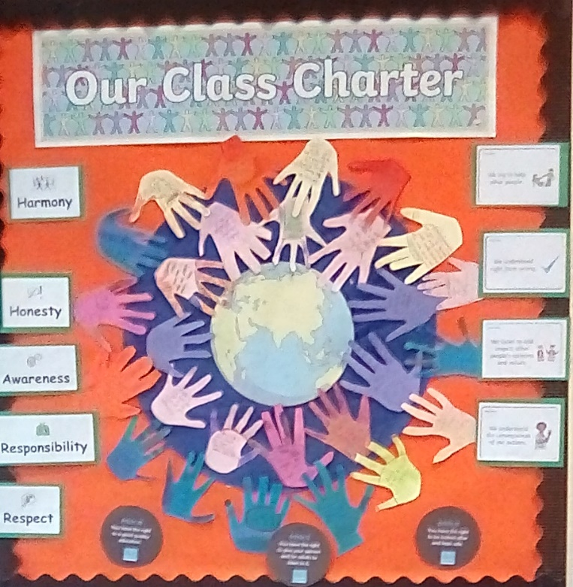
The year starts with classes setting their class charters with children as rights holders and adults as duty bearers

Slide 31
Ambassadors help to write charters for other parts of the school

Slide 32
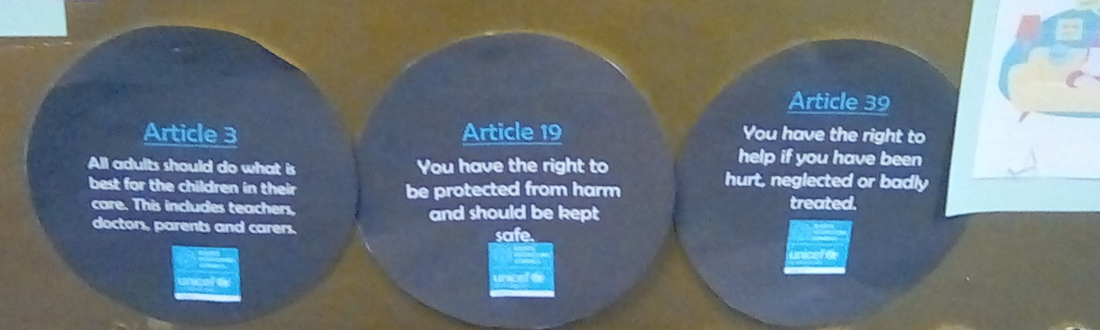
Ensure rights are prominent around school
Article circles on displays, linking rights to work being done in the classrooms

Slide 33
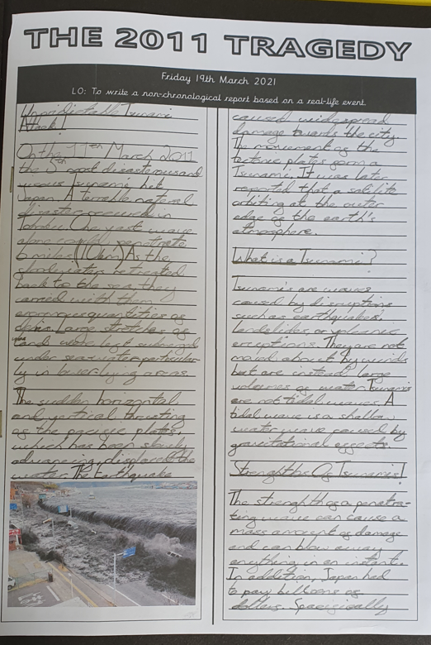
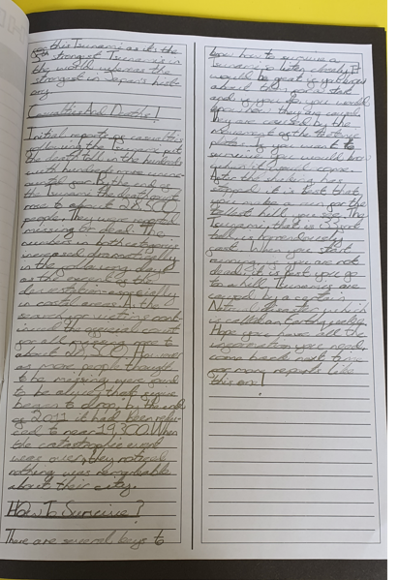
Linking work to different rights so children have an understanding of how different issues can impact on specific rights

Slide 34
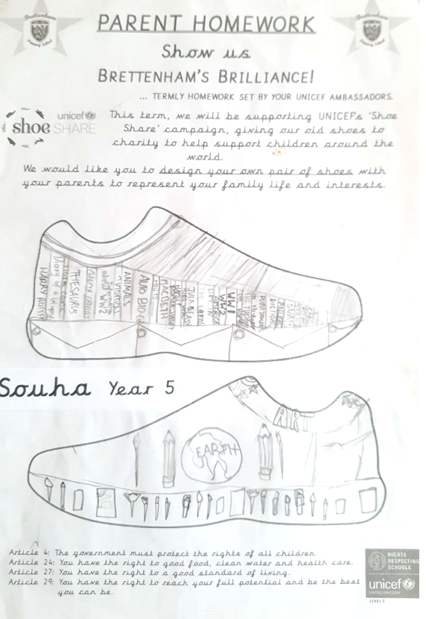
Monthly newsletters written by ambassadors to share information with the wider community
Ambassadors also set parent homework termly. This is linked to theme days or current issues & situations
Sharing the UNCRC with the wider communty via our monthly newsletter.​

Slide 35
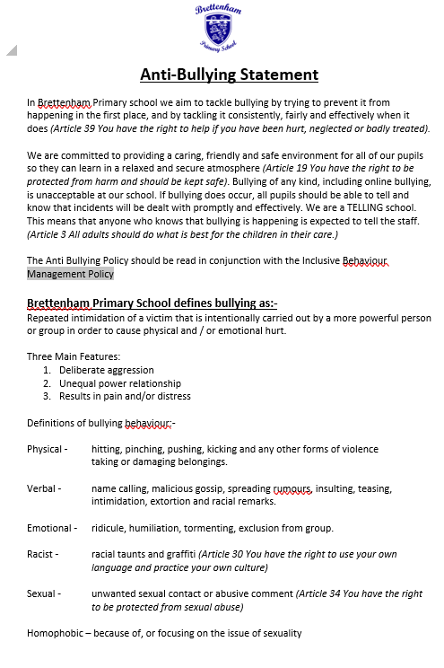
Steering group work to see what rights link to different policies

Slide 36
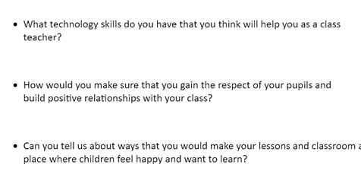
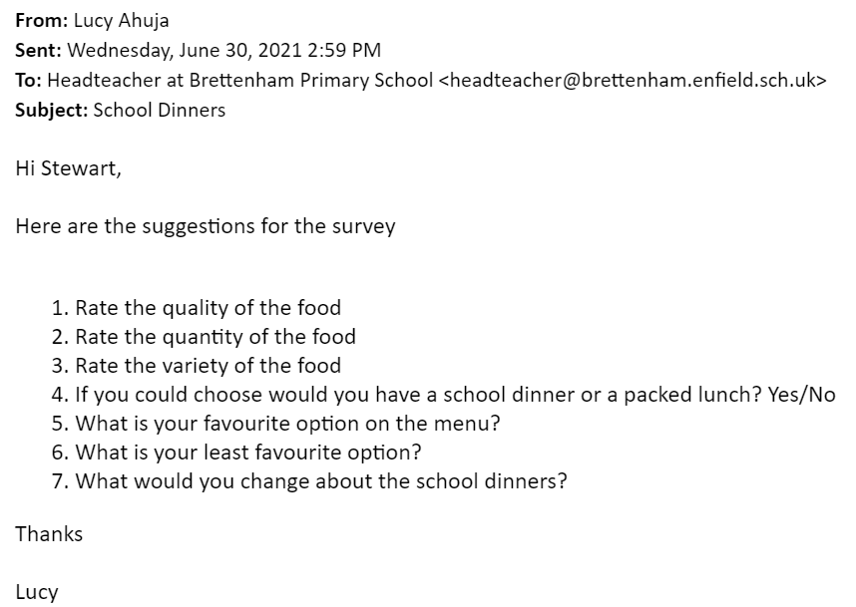
Pupil Voice is key, with ambassadors involved in interview process for ECTs, developing questions and being part of the interview process as well as designing questions for a survey around school lunches
Parking Patrol!

Slide 37
We have supported other schools on their journey, including schools in Barnet and Waltham Cross with ambassadors visiting each others schools

Slide 38
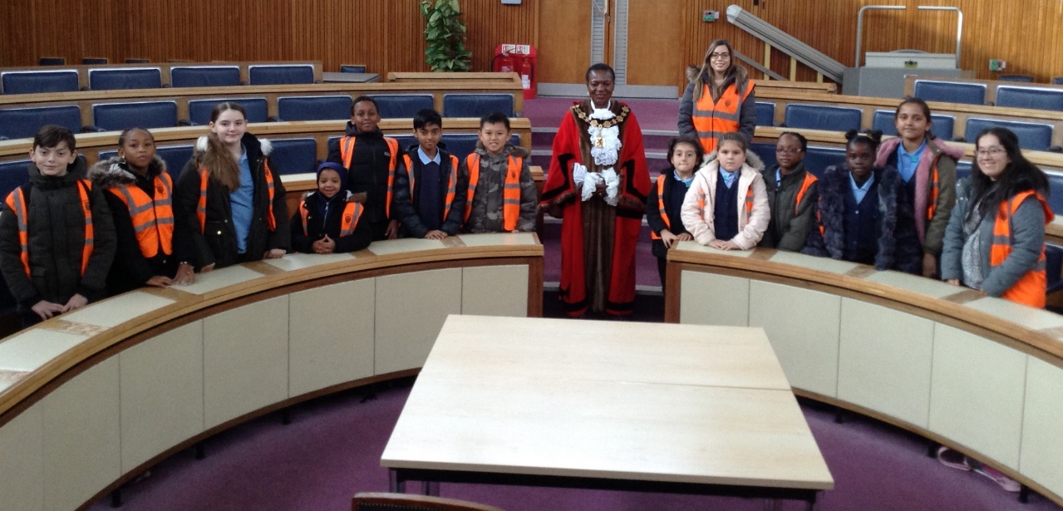
In the last couple of years ambassadors visited Enfield Council Chambers to see the Mayor and discuss rights

Slide 39
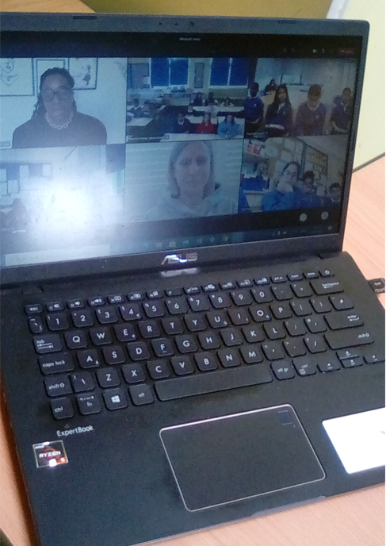
More recently, ambassadors had a virtual meeting with Kate Osamor alongside children from the other schools in the Children First Trust

Slide 40
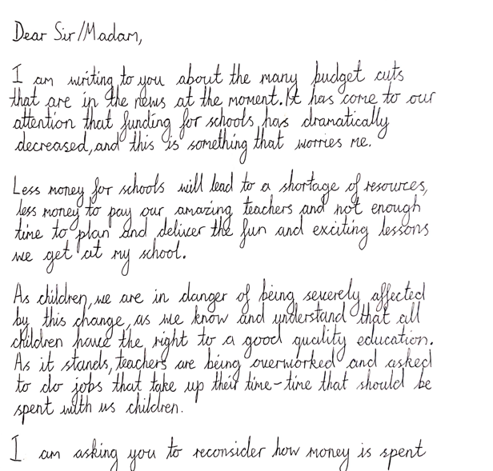
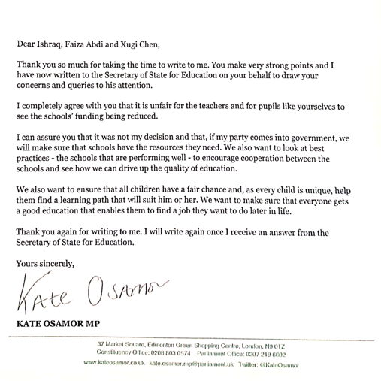
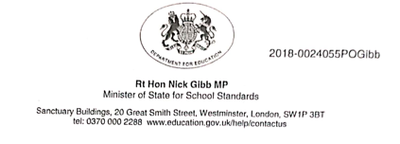
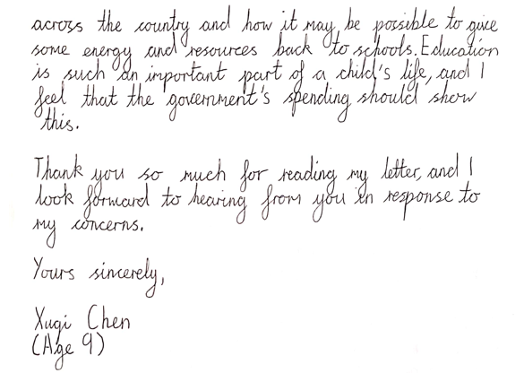
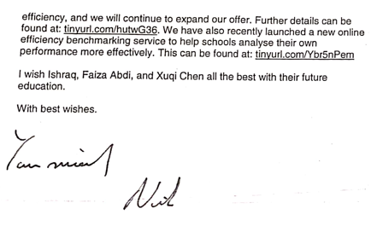
Outcome 9

Slide 41
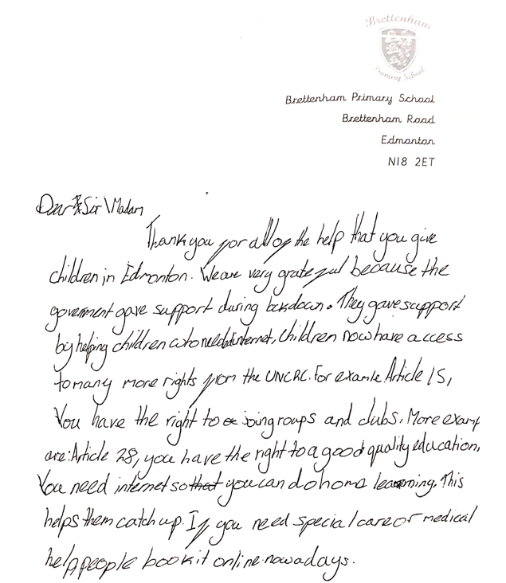
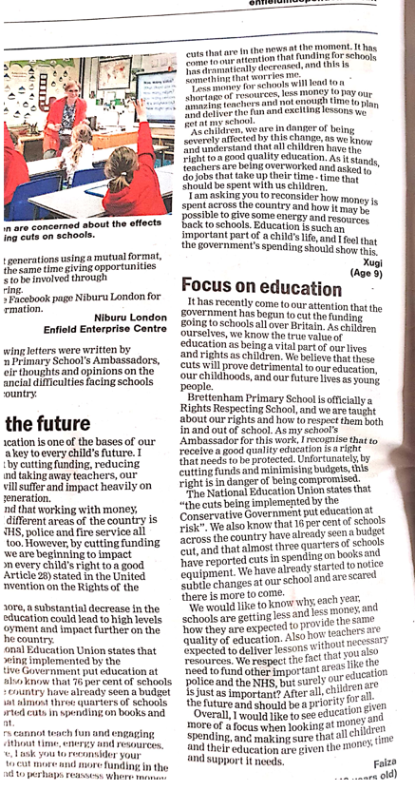
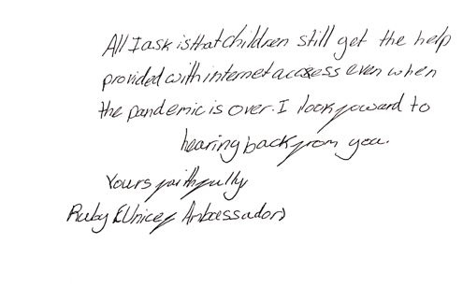
Outcome 9

Slide 42
More recent work has been around sustainable development goals with work around plastic packaging, environment days, waste warrior projects to reduce waste etc

Slide 43
Our children have a good understanding of their rights and it can be seen in the ethos of the school and calm environment. It has made our children more aware of local and global issues and the need to be good citizens for the future
IMPACT

