Slide 1
Thursday 23rd March 2023

Slide 2
AGENDA
10:00 Introductions and welcome
10:05 Key Updates
10:10 Household Support Grant & Free School Meals (Prim)
10:15 School Inspection – thought-piece
10:25 Asthma Friendly School: Smoke-Free School Gates: Tackling Obesity
10.45 SEYIS offer 2023/24: Holiday & Food Fund
11:00 SATS Moderation
11:10 Schools Capital Delivery Programme
11:15 Housing concerns impacting on Children: Mould!
11:30 Inclusive & Nurturing Schools (VRU)
11:40 Grassroutes – Behaviour Funding initiative ((EEF)
11:45 End

Slide 3
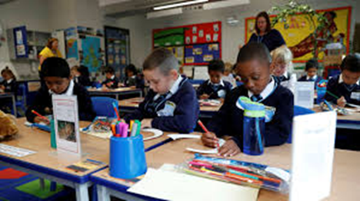
Asthma Friendly Schools Project
RFL Asthma Friendly Schools Team
Sammy Ndlovu-Dawika ( Camden)
Tamanna Begum (Enfield )
Notes:
The Camden Asthma Friendly Schools Initiative is a project that supports schools provide a safe environment for CYP with asthma.
This initiative is being delivered by Royal Free Children Community Nursing Team and CNWL School Nursing Team.

Slide 4
Asthma
Asthma is the most common long-term medical condition in children in the UK
Around 1 in 11 CYP have asthma
UK has one of the highest emergency admission rates for childhood asthma in Europe = about 25 000 admissions per year.
Worse outcomes for CYP living in deprived areas
London has had about 9-19 asthma deaths per year (2018-21)
Effects on CYP education:
Asthma is the main contributor to missed school days
Asthma is the commonest reason for CYP to take medication in school
Research shows that having a diagnosis of asthma is a risk factor in dropping a grade between mock and final exams
CYP often labelled as Poor Achievers linked to school absence- Research has shown that this stays with them throughout their school career.
Uncontrolled asthma can lead to a decrease in academic performance

Slide 5
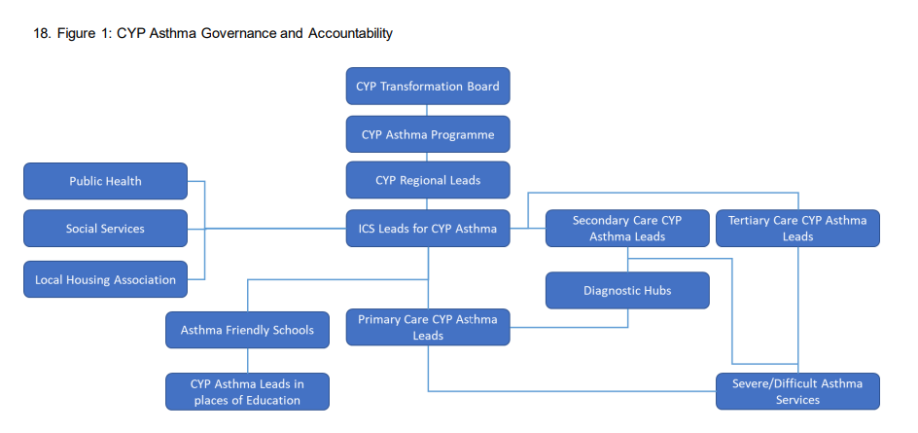
(National bundle of care for children and young people with asthma September 2021. )
Notes:
NHS England and NHS Improvement ambition is to reduce avoidable harm to children and young people from Asthma and improve the quality of life.
By taking a holistic approach to asthma management, involving all individuals who come in contact with CYP- same approach as safeguarding…..
AFS has been included in the National Asthma Bundle – which states that all places of education must have a CYP Asthma lead.

Slide 6
Asthma Friendly Schools Project
1. ASTHMA AWARENESS: empowering schools to support CYP and their families to have better understanding of their asthma care.
2. ASTHMA FRIENDLY SCHOOL ENVIRONMENT: enabling schools to manage CYP with asthma effectively.
3. IDENTIFY CYP WITH UNCONTROLLED ASTHMA: schools teams will monitor and liaise with Sch Nurses to support CYP struggling with their asthma
BENEFITS :
Early identification and Intervention
reduce number of missed school days or sch curriculum
reduce all unscheduled health appointments
Collaboration of community services in asthma care
To have unified approach to asthma care across all schools
Notes:
the main aims of this initiative are:
to develop asthma awareness: by empowering Enfield Schools to support Children, Young People and their families to have a better understanding of their asthma care.
We are creating a safe asthma friendly environment so that schools can manage cyp with asthma effectively
identification of all CYP with poor controlled asthma – school teams will refer these children
the benefits of AFS on our community include:
helping us to identify CYP with poorly controlled asthma – flag high risk asthma patients
thus allowing early intervention
so we can reduce the number of missed school days or CYP missing out on school activities
reduce the number unscheduled health appointments due to asthma
have a unified approach to asthma care across all Enfield Schools
CYP spend a large proportion of their day at school.
This project highlights the importance that schools provide a safe environment for CYP with asthma.
deliver a holistic approach for asthma management including a whole school approach to asthma training
ensure school systems are in place to identify and support pupils with asthma
encourage partnership working with families, schools, the NHS and the local authority
improve communication with parents
increase awareness of how to manage an asthma attack in an emergency

Slide 7
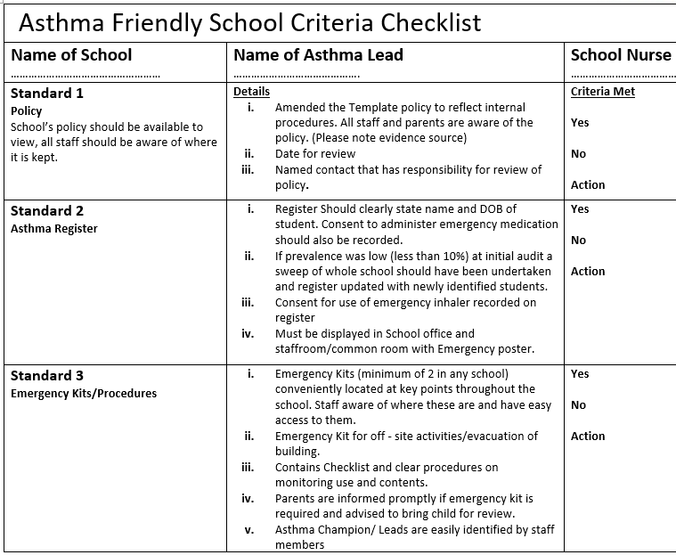
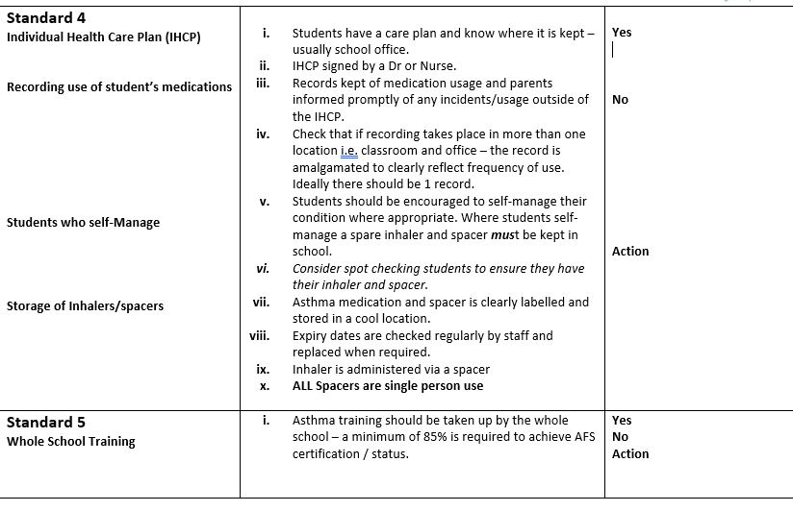
Notes:
Standard 1- Asthma lead and Asthma policy – Draft template available
Standard 2 – Asthma register and ensuring posters displayed – draft register available
Standard 3 - Emergency inhaler Kit- Incentive for Camden schools
Standard 4- Asthma care plans, record of medication use, students who self manage, storage of inhalers/ spacers
Standard5 – Whole school training – All school staff….especially teachers

Slide 8
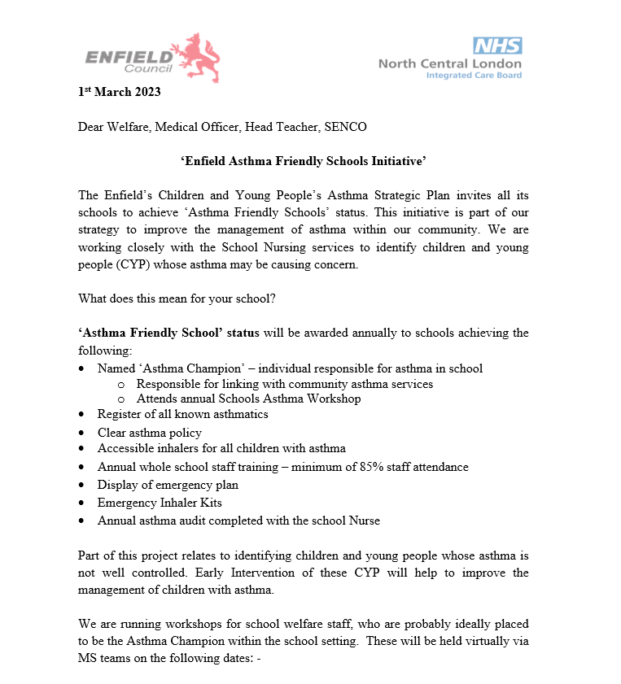
Asthma Champions Workshops

Slide 9
Thank You..
Please help us to improve asthma care for children and young people
Contact:
RFL Community Asthma/ Atopy Team
Sammy Ndlovu-Dawika
RFL Community Asthma Lead
Camden AFS Nurse
rf-tr.camdenasthmafriendlysch@nhs.net
Tamanna Begum
Enfield AFS Nurse
rf-tr.enfieldasthmafriendlysch@nhs.net

Slide 10
Obesity Plan
Striving for excellence
www.enfield.gov.uk

Slide 11
Excess weight in children: NCMP 2021/22
The 2021/22 NCMP programme found that around 1 in 4 children (25.3%) in Reception (aged 4-5 years) and around 2 in 5 children (42.2%) in Year 6 (aged 10-11 years) were overweight or living with obesity.
This means that Enfield has the 4th highest proportion of overweight and obese reception aged children in London and the 10th highest proportion of overweight and obese year 6 children in London.

Slide 12
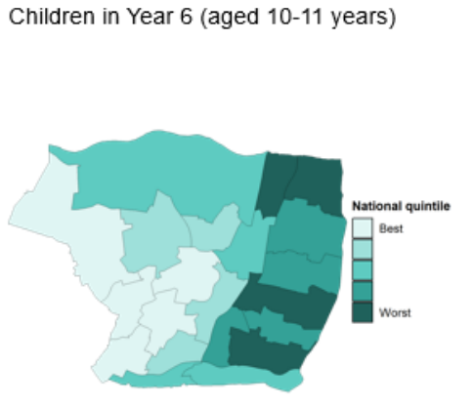
BMI categories by ward
The proportion of children who are overweight and obese differs significantly across the borough with the highest levels in both reception and year 6 aged children along the East of Enfield.
The highest level of overweight (including obesity) in reception aged children is in Edmonton Green, followed by Haselbury and Lower Edmonton with the lowest levels in Bush Hill Park and Bowes.
The highest level of overweight (including obesity) in year 6 children is in Enfield Lock, followed by Jubilee and Turkey Street with the lowest levels in Grange and Southgate.

Slide 13
Excess weight in children in Enfield: ethnicity
In Enfield, as in the rest of England, the proportion of overweight and obese children in reception and year 6 is highest in children of a Black Caribbean, African or other Black background.
Levels of overweight and obesity is lowest in children belonging to Asian ethnic groups, particularly in those of an Indian or Chinese ethnic background.
Some of this disparity may be due to differences in body composition of children from different ethnic groups e.g. Black children are typically taller than average and height is correlated with obesity

Slide 14
Reducing obesity during a cost of living crisis
NCMP will continue
Increase uptake of FSM – or maintain uptake post next year
Daily Mile
Food poverty action plan
Procurement, planning, land use
Food growing, cooking skills, food pantries
Food banks
Baby Friendly Initiative – breast feeding
Healthy Start – vitamins

Slide 15
Plan continued
Work with convenience stores re food offer
Advertise (for example) Jack Munroe recipes
Healthy catering commitment
Healthy Schools
Suggestions to glenn.stewart@enfield.gov.uk

Slide 16
Smoke-free school gates
Striving for excellence
www.enfield.gov.uk

Slide 17
Smoke-free school gates
Smoking greatest cause of preventable death and illness in borough
Significant cause of poverty
Estimated that at least 200,000 start smoking per year by age 15
Rite of passage / start because see adults smoking

Slide 18
What?
Pack sent to schools
Includes what and how to
Open to suggestions

Slide 19
Proposal
Introduce local legislation to prohibit smoking around schools
Exploring the legal implications
Ask for volunteers – glenn.stewart@enfield.gov.uk

Slide 20
2021
School and Early Years Improvement Service

Slide 21
Champion
of educational transformation, moral purpose, democratic mandate to ensure good outcomes, vision
Convenor
bringing leaders together, connecting to best practice within and beyond the system, facilitating partnerships
Commissioner
bringing the strategic picture, intelligence and data, enabling and commissioning support and development
The school improvement
model in LBE

Slide 22
Working in partnership with Headteachers to
Raise attainment across all key stages to above the London average
Ensure all Enfield schools are judged by Ofsted to be at least good
Address high levels of fixed term exclusions
Address the high levels of youth violence
Effectively meet the needs of pupils with special needs including mental health needs
Effective pupil place planning
Encourage high quality pre-school, nursery and early learning across the Borough
Service Priorities
Notes:
Ofsted Preparation booklet on the Hub
Virtual curriculum health checks with SIA and Ofsted Inspector
Mental health and well being within

Slide 23
Responsive to Need
Autumn term: Leadership and Management and Safeguarding
Spring term: Curriculum which may include a short review.
Summer term: Personal Development, Professional Learning and, Behaviour and Attendance.
Another focus may be agreed by the headteacher and SIA in terms 2 and 3.
Notes:
PL another corner stone

Slide 24
Significantly below acceptable | Below acceptable | Moving towards effective | Effective | Highly effective | Exemplary
Serious concerns are raised about members of the senior leadership team [SLT] and/or governing body, which have led to LA intervention. Serious concerns are raised about financial management which have led to LA intervention. The school is not genuinely inclusive. | Concerns have been raised about the SLT’s effectiveness (or governance) through a range of complaints, a serious safeguarding concern, a LA review or health check. Financial health concerns have been raised, either through audits, the LA or through budget reporting. Strategies for action are yet to be identified. Staff retention and well -being are causes for concern. | The capacity of the SLT is adversely affected by inexperience/ temporary long-term absence and lacks expertise and/or capacity. Intervention to strengthen leadership is in place and while green shoots are emerging, there has been insufficient time to fully impact on all aspects of school life. A financial management strategy has been identified, operational implementation has yet to realise impact. Pupils’ lived experience of school is positive & inclusive. | The SLT has the required capacity to carry out all required functions and are having a positive impact on the quality of education and all other areas of school life. The SLT and leadership in general provide clear, visible and strong leadership for inclusion. Lost learning is being well tackled. Pupils’ mental health, well-being, motivation and engagement have strengthened considerably following the extended periods of lockdown. Robust SEF in place; strong priorities identified. Strategic, operational oversight & resource management provide efficiencies, staffing organisation and/or deficit recovery plans are managed well. Issues relating to staff workload are well managed. Staff have positive working relationships with local community groups, youth centres and afterschool clubs. | The SLT and leadership in general are strong, and all metrics indicate the effectiveness of leaders at all levels to fulfil all of its functions. Strategic and operational oversight and management of resources to provide efficiencies, staffing organisation and/or deficit recovery plans are proactive, reviewed regularly and are responsive to change when needed. Pupils in the Foundation Stage / Sixth Form make at least good progress based on their assessment on entry to the school. Staff welcome all pupils, having the knowledge and skills to provide a genuinely inclusive environment. All points in effective are well managed. | School leaders provide support and expertise to other schools. The SLT for example, may include have National Leaders in Education (NLEs). The SLT know when to bring in external expertise to strengthen the school’s work. Strategic oversight of resources and staffing within the school provides efficiencies that have impacted positively on the long-term financial health of the school; this may include effective collaboration partnerships. The school/ setting celebrates the achievements and progress of all children and young people outside of academic achievements, including their contributions to after-school clubs and/or their personal interests. All points in the previous two columns are firmly embedded.

Slide 25
Self - evaluation: please select the best fit
Significantly below acceptable | Below acceptable | Moving towards effective | Effective | Highly effective | Exemplary
Examples of evidence linked to SEF and for external review might include: Schools will identify their own evidence linked to the self-assessment and external reviews. Below are some examples of evidence schools might choose (this list is not in any kind of hierarchical order.)
Evaluations of SLT in meeting key targets and priorities. Evaluation of leadership in curriculum reform. Any external and internal reports of moderation of KS1 reading, writing and maths and EYFS baseline, and KS2 writing. Any external’ consultants’ reviews. Staff, parents’, and pupils’ questionnaires in relation to leadership, safeguarding and well-being. Covid actions analysis including impact and outcomes. Long term, medium and short term plans for catch up programme. External reviews. |  |  | Performance management assurance. Relevant L&M PL and impact. Pupil falling roll analysis. Financial health – strategies/reports to show management of decreasing budget and compliance (Pupil Premium and Sports & PE Grant reports, budget management, financial audits, deficit recovering plans, staffing structure changes, including restructure.) Memorandum of Understanding showing shared resources with other schools and the impact on budget. Other evidence:
Comments to be completed with School Improvement Adviser

Slide 26
A common, vested interest in our children
Shared measure of success
The Head of SEYIS feeds into the wider LA
Seamless interlink with our statutory responsibilities
Access to local knowledge and intelligence with an data-led approach
Agile & dynamic collaboration to meet the needs of the children in our borough
Champion
Convenor
Commissioner
Notes:
Public health
Climate change
SIA are available to speak to headteachers at any time, to help discuss and formulate plans - regular SIA meetings
Support for distance learning is available from the CLC and the PL team
Holding weekly meetings with headteacher reps
Sending out updates as and when we receive them
Governor training

Slide 27
Core Offer – Early Years
EYFS Curriculum
Training
Access to the EY training offer - all courses at a reduced rate subsidised by the Early Years Team
Insert day on Ican training including resources pack (Value resources and training £750)
Parent workshops - Henry (healthy Eating) and introduction to Early Years and Childcare that supports parent volunteers in nursery and reception
Nursery Provision - Business Support and Funding Entitlement
Business support for setting up or expanding nursery offer
EYFS statutory requirements
Sustainable business model - Toolkit
Support to set up and access the funding entitlement via the provider portal
Marketing material - Funding entitlement
The EYFS support offer for schools has been reviewed and will now consist of the following:
Review of learning environment (indoors and outdoors)
Review observations, assessment, and planning
Observation of practice and interactions
Learning walk Nursery and Reception
Recommendations for further support
Working with EY team leader to support and challenge the quality of curriculum (curriculum conversations 1.5 days –on site for one day)
The EYFS Review could lead to joint working with EY team leader to support and challenge the quality of curriculum
Maximum six visits depending on need, including EYFS Profile moderation support visit (summer term)
Early Years Team Leaders forums once a term
Early Years EYFSP moderation training and support
Support to set up or expanding nursery provision
Quality check school census return data for pre-school children.
Early years funding entitlement including EYPP checks for pre-school age children including training of the Provider Portal.

Slide 28
Core Offer – Primary
Primary Curriculum and Ofsted Support
Network Meetings and Training
Lead moderators’ network
Advice and Guidance including School Business Support
Guidance documents to support schools in delivering the aspirations of the Inclusion Charter.
Regular network for School Business Managers.
Termly Designated Safeguarding Lead Good Practice Network, at least termly.
Access to ‘school to School' brokered support.
A local programme of induction support for Headteachers.
Statutory advice and guidance for Governing Bodies on the appointment of Headteachers, and attendance and support with final appointment panel.
The provision of an agreed local RE syllabus and related training, including RE Teach Meet.
A Good Practice Network focused on inclusion for Gypsy, Roma, traveler, Boater, Show person groups
Advice, support and attendance at appointment of a headteacher, including the statutory attendance at the final panel.
One half-day visits offered from the allocated lead adviser to provide advice on school self-review and improvement and commissioning plans across the academic year.
The provision of a school improvement adviser point of contact for schools having Section 5 or 8 Ofsted inspection and visits, and the attendance of an LA officer at the final feedback meeting.
Additional half-day targeted adviser quality assurance advice for SEN resource provision where this is identified as a significant area for development.
Regular briefings/updates from the Director of Education
Regular contact detail updates of key officers in the council that support schools.
Access to information from Enfield Education, borough partners and others through The Hub.
Termly ARP/SLRB Network meeting for relevant schools.
Termly Unit Network meeting and termly Unit CPD session for relevant schools.
Termly PHSE / RSE Network meeting.
In line with the SEN Codes of Practice – support from suitable qualified SEN Careers Advisors to work with SENCOs with regard to young people with an EHCP who are at risk of disengagement.
Statutory Assessment moderation and security visits in Key Stage 1 & 2.
Statutory advice and support for governors, including an induction package, production of Instruments of Government, LA governor appointments, half termly Governors’ newsletter, support for Chairs and LA governors through Member Governor Forum.
Support to streamline the process of KS 2 to KS 3 transition with the agreed data file.
History Subject leader Good Practice Network
Notes:
Access to Perspective Lite to compare school data to local and regional outcomes, and training to use the tool effectively.
Providing an annually updated borough data profile.
Statutory advice and support for education, training and employment pathways for young people 14–19, in line with Raising the Participation Age.
Level 6 Qualified CEIAG/annual review for all learners attending Enfield schools with an EHCP in years 9, 11. Further support for learners with EHCP in post 16 school transition year (NC years 12, 13 or 14)
Annual ‘financial sense check’ of all indicative school sixth form allocations awarded by ESFA.
Invite to termly 16-19 Partnership meetings – education policy updates, enrichment and other emerging skills/career opportunities, curriculum development updates)
Annual individual school report setting out ‘Activity Survey’ (September Guarantee / destinations and NEET/Not known)
Invitation to participate in annual Enfield High Achievers event and selected group visits to HE institutions.

Slide 29
Core Offer – Secondary
Secondary Curriculum and Ofsted Support
Network Meetings and Training
Termly Designated Safeguarding Lead Good Practice Network, at least termly.
Advice and Guidance including School Business Support
Guidance documents to support schools in delivering the aspirations of the Inclusion Charter.
Regular network for School Business Managers.
Access to ‘school to School' brokered support.
A local programme of induction support for Headteachers.
Statutory advice and guidance for Governing Bodies on the appointment of Headteachers, and attendance and support with final appointment panel.
The provision of an agreed local RE syllabus and related training.
A Good Practice Network focused on inclusion for Gypsy, Roma, traveler, Boater, Show person groups
Advice, support and attendance at appointment of a headteacher, including the statutory attendance at the final panel.
Three half-day visits offered from the allocated lead adviser to provide advice on school self-review and improvement and commissioning plans across the academic year.
The provision of a school improvement adviser point of contact for schools having Section 5 or 8 Ofsted inspection and visits, and the attendance of an LA officer at the final feedback meeting.
Regular briefings/updates from the Director of Education
Regular contact detail updates of key officers in the council that support schools.
Access to information from Enfield Education, borough partners and others through The Hub.
Termly ARP/SLRB Network meeting for relevant schools.
Termly Unit/ARP Network meeting and termly Unit CPD session for relevant schools.
Termly PHSE/RSE Network meeting.
In line with the SEN Codes of Practice – support from suitable qualified SEN Careers Advisors to work with SENCOs with regard to young people with an EHCP who are at risk of disengagement.
Statutory advice and support for governors, including an induction package, production of Instruments of Government, LA governor appointments, half termly Governors’ newsletter, support for Chairs and LA governors through Member Governor Forum.
Support to streamline the process of KS 2 to KS 3 transition with the agreed data file.
Level 6 Qualified CEIAG/annual review for all learners attending Enfield schools with an EHCP in years 9, 11. Further support for learners with EHCP in post 16 school transition year (NC years 12, 13 or 14)
Access to Perspective Lite to compare school data to local and regional outcomes, and training to use the tool effectively.
Invite to termly 16-19 Partnership meetings – education policy updates, enrichment and other emerging skills/career opportunities, curriculum development updates)
Statutory advice and support for education, training and employment pathways for young people 14–19, in line with Raising the Participation Age.
Annual ‘financial sense check’ of all indicative school sixth form allocations awarded by ESFA.
Annual individual school report setting out ‘Activity Survey’ (September Guarantee / destinations and NEET/Not known)
Invitation to participate in annual Enfield High Achievers event and selected group visits to HE institutions.
Providing an annually updated borough data profile.
Guidance documents to support schools in delivering the aspirations of the Inclusion Charter.

Slide 30
Traded Offer
9.5 days
Feedback on the school self-evaluation and forward plan Curriculum health check
Working with middle leaders to support and challenge the quality of curriculum (curriculum conversations)
Interviews with Governors
Interviews with pupils
Targeted Ofsted support and training for staff and Governors
Quality check of the website
Safeguarding review
6.5 days
Curriculum health checks
Targeted CPD for three identified areas
Working with 3 middle leaders to support and challenge the quality of curriculum (curriculum conversations)
Targeted learning walks
Interviews with pupils
5 days
Full day team review
Additional four SIA meetings throughout the year
Website compliance check
Many more optional extras are available to compliment our traded offer packages
Available: https://traded.enfield.gov.uk/TheHub

Slide 31
@EnfieldEdUK

Slide 32
Temporary Accommodation issues affecting Children and Young People
www.enfield.gov.uk

Slide 33
Increased use of hotel accommodation
Homelessness is currently at crisis point fuelled predominately by the collapse of available private sector properties, especially at the affordable end of the market. This impact is being felt all across London and in other parts of the country.

Slide 34
Homelessness pressures
December 2021
December 2022
Number of responses
+8%
+385
Total number of homelessness presentations
4,833
5,218
£275.18
28
+19.7%
+971
Total number of households owed a prevention or relief duty
5,900
28
4,929
£2,087.96
+3.6%
+1,853
Total number of households in TA
52,115
53,968
28
£48.73m
W
65,013
+3.2%
+2081
67,094
24
Total number of Children in TA
Total number of Children in TA
Families in Bed and breakfast (B&B) hotels)
x
+24.3%
+380
Total families in Bed and breakfast hotels (including shared annexes)
1,567
1,947
26
Total homelessness service net deficit for the financial year.
Total homelessness service net deficit for the financial year.
Total homelessness service net deficit for the financial year.
Families in B&B hotels for longer than 6 weeks
+184.9%
+577
312
889
22

Slide 35
TA procurement and supply
December 2021
December 2022
Number of responses
+4.1%
+1,995
Total number of TA units being used by councils
49,253
51,248
£275.18
26
+39.4%
+1,803
- Of which, how many are B&B (including shared annexes and commercial hotels)
6,376
27
4,573
£2,087.96
-6.0%
-1,716
- Of which, how many are PRS accommodation
26,772
28
28,488
W
662
-20.2%
-134
Total number of PRS units procured during the month for ending prevention or relief duty
528
25
245
+119.6%
+293
Number of TA units for which authorities have received a notice to quit
538
19
Total homelessness service net deficit for the financial year.
Total homelessness service net deficit for the financial year.
Total homelessness service net deficit for the financial year.

Slide 36
Implications for LBE
Far fewer properties to make homeless placements into, and those that are demand far higher costs
At LBE we try to Prevent homelessness as much as possible (with some success – see next slide) – but for families where this is not possible, often the only option is hotel or B&B style accommodation.
As move on options are also constrained – the placements are continuing for far longer than we would like, including past the 6 week statutory minimum.
This is having a detrimental impact on families
The service priority is to decrease numbers of placements, and decrease the length of stay

Slide 37
Taking a prevention approach

Slide 39
B&B reduction plan
We have implemented a comprehensive plan to reduce our use of commercial hotels and shared accommodation. The plan covers each stage of a family’s journey through the service, starting with prevention work.
It is a key service priority to drive down hotel usage absolutely, and particularly longer-term placements.
The short-term objectives of the B&B plan specifically are to reduce the number of households with children in commercial hotels over 6 weeks by realigning our resources to focus on rapid move on into the private rented sector or more suitable temporary accommodation.
The plan has started to reduce the length of stay in commercial hotels and is stabilising the number of placements in hotel accommodation beyond 6 weeks. We have also seen a clear reduction in the numbers of children housed beyond 6 weeks as some larger families have moved on.
Medium term plans include the conversion of Brickfield House into a rapid assessment and resettlement hub. Longer terms plans include new forms of temporary accommodation including meanwhile housing.

Slide 40
Current situation
We are aware that it will take time to move on the families currently in B&B / Hotels
We are working with Children’s Services to prioritise cases and attempt to limit impact on education via moves (we are aware this is a significant problem)
We are also looking at additional support that can be provided while families are in hotels

Slide 41
Escalation
We are aware that issues and challenges related to hotel usage come up in schools.
Cases can be escalated to HASurgentmoves@enfield.gov.uk

Slide 42
2. Damp & Mould
LBE takes damp and mould seriously, and all residents should not be living in conditions that affect their health
Following the tragic case in Rochdale, LBE is working to ensure conditions are improved across the borough – in all types and tenures of housing.
There is a history in social housing as a sector of damp & mould issues being too often dismissed as ‘lifestyle’ and the tenants’ responsibility – this is no longer acceptable

Slide 43
What is mould?
Mould is a type of fungus that grows in damp places. It looks like patches of black, white or green on walls and ceilings, and you may notice a damp smell.

Slide 44
Health impact
If someone has damp and mould in their home they are more likely to have respiratory problems, respiratory infections, allergies or asthma. Damp and mould can also affect the immune system.
Some people are more sensitive than others including:
babies and children
older people
those with existing skin problems, such as atopic eczema
those with respiratory problems, such as allergies and asthma
those with a weakened immune system, such as those having chemotherapy
Notes:
It may be useful here to mention the Rochdale case – and noting such deaths are rare - and some of the different ways mould can make people ill. This is taken from the NHS website – it also includes the following:
Moulds produce allergens (substances that can cause an allergic reaction), irritants and, sometimes, toxic substances.
Inhaling or touching mould spores may cause an allergic reaction, such as sneezing, a runny nose, red eyes and skin rash. Moulds can also cause asthma attacks.
Also worth I think specifying that damp cold conditions themselves can impact on breathing without mould spores ?
Worth noting that we need to bear in mind these sensitivities when dealing with D&M

Slide 45
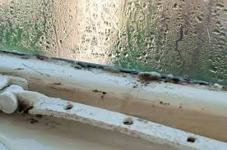
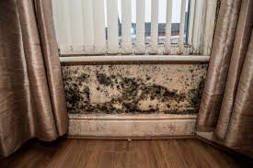
What causes Damp & Mould?
Mould and damp are caused by excess moisture.
Moisture in buildings can be caused by leaking pipes, rising damp in basements or ground floors, or rain seeping in because of damage to the roof or around window frames.
Moisture is also caused by day to day household activities like cooking, washing – even breathing.
Without good ventilation, and especially when its cold, this can form a lot of condensation – causing damp and mould.

Slide 46
Damp caused by condensation – context
Work with the resident to resolve the issue – ensure any mould growth is treated.
The cost of living crisis is making it hard for everyone to do things like put the heating on that keeps condensation at bay. Make links to organisations like CAB where relevant
Be aware of vulnerabilities and how some residents may struggle to manage condensation.
We do give out sympathetic advice about how to limit condensation (we are producing a leaflet)
We don’t brush off the issue as a result of ‘lifestyle’

Slide 47
What are we doing? 1
The Housing Ombudsman’s 2021 report sets out key recommendations which we are taking up. The LG ombudsman is also working on a similar basis and looking more closely at D&M cases.
A key one is for the sector to shift focus from blaming many cases of D&M on tenant lifestyle, to working with the tenant to address conditions and properly investigating all issues raised.
We are already making this move at LBE and have a new policy on assessing and handling D&M repairs in Council Housing

Slide 48
What are we doing ? 2
Using existing repairs data to identify hotspots and conduct door to door investigations of D&M
Commissioning stock condition surveys focused on D&M
Looking at adding a specific additional data module to help us predict where there might be D&M in council homes
Overhauling how D&M complaints are dealt with in Temporary Accommodation – a key risk area

Slide 49
The Damp & Mould Taskforce
We have formed a multidisciplinary task force to address damp and mould issues across all tenures – working towards taking a ‘one council approach’ to the issue.
The task force includes EHOs, Public Health, Building safety and Asset Management, ERD, Housing Management and managers of TA / HGL / PSL / EL stock
It is currently meeting twice weekly to co-ordinate across issues like policy change, communications, staff training and responding to requests we have had from government and the Regulator for Social Housing for information and formulating a full D&M strategy.

Slide 50
Reporting issues
We are aware the health impacts of living with D&M are being picked up in schools
We would like to ensure these issues are raised with the D&M taskforce directly – for the rest of this academic year issues can be raised directly with Eloise.shepherd@enfield.gov.uk (a generic email will be set up going into 2023/24)
www.enfield.gov.uk/condensation

Slide 51
Thursday 23rd March 2023

