Slide 1



Online Actions, Real World Consequences
Striving for excellence
www.enfield.gov.uk
Notes:
Ensure that you have enabled content otherwise videos will not play.

Slide 2
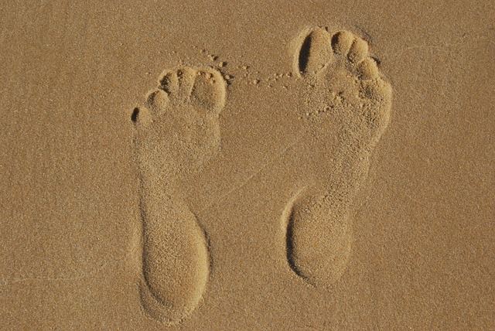
Notes:
Show this picture as an introduction/ teaser to the session You will be asking the pupils what this picture shows later in the session which is based around our ‘footprint’ – the impressions we leave behind in both the real and digital worlds.

Slide 3

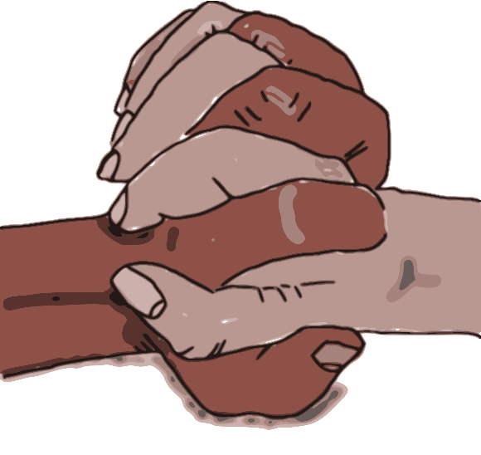
Have you heard of these words before?
Respect
Tolerance
Notes:
Ask the children to work in partners. They should tell each other what they think these words mean – then ask them to feed back their partners answer to you. Emphasise you want their opinions and ideas – it’s not about finding the ‘right’ answer.

Slide 4
Tolerance
Tolerance means accepting others who have different opinions, beliefs, lifestyles, and cultures to your own.
Respect
Respect means accepting that everyone’s ideas and contributions are equally important, even if they are different from your own. Treat people how you would want to be treated.
Notes:
Share these definitions with the class and discuss. How does treating others with respect and tolerance affect the class, our friendships etc.

Slide 5


Real world footprint
Digital Footprint
Notes:
Explain the concept of ‘footprints’ – we leave an impression behind us! (The picture on the first slide is a good visual illustration of this.)

Slide 6
Real world footprint
How do we ensure we leave a good impression behind us when we meet people?
Notes:
Good first impressions (examples)
Polite
Friendly
Approachable
Good body language

Slide 7
Online Actions, Real World Consequences
We have discussed how to make a good impression when we meet someone in real life.
But what about online? Do we leave the same kind of footprint?

Slide 8









What do you do online?
Notes:
Ask the children what they do online – these are some of the most widely used apps and platforms by their age group (although most are not aimed at their age group and are recommended for 13+)

Slide 9
Online Actions Real World Consequences
Creating something
Taking and sharing photos?
Playing Games
Learning
Bullying
What do you do online?
Talking to family
Arguing?
Talking to friends
Sharing information?
Playing Games
School work
Talking to strangers
Notes:
Some of these things are in green, indicating ‘good’, some are red, indicating ‘bad’. Do pupils agree with this? Would they always be red or green?

Slide 10
Online Actions Real World Consequences
Taking and sharing photos?
Creating something
Playing Games
Bullying
Learning
Would any of these things
be weird if we did them
in real life?
Talking to family
Arguing?
Talking to friends
Sharing information?
Playing Games
School work
Talking to strangers
Notes:
This should hopefully get a lively discussion going about the differences between the online and real world.

Slide 11
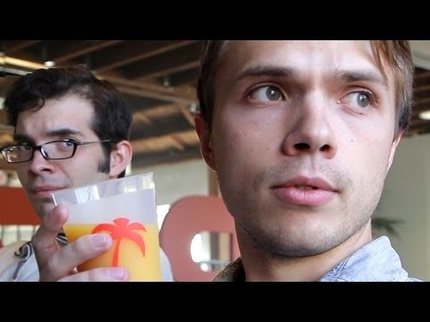
Notes:
https://www.youtube.com/watch?v=ziQFFh5jznI This is a humorous look at what it would be like if the real world imitated how we behave online (like, follow, overshare etc)

Slide 12
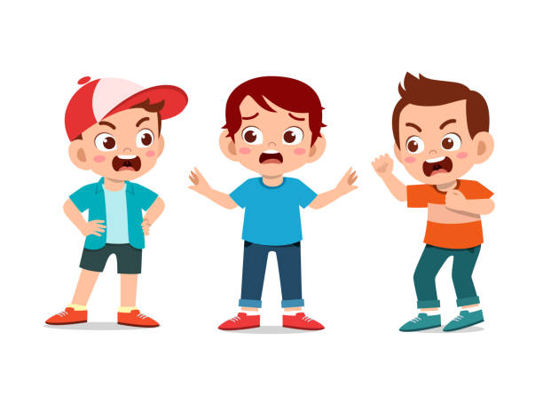
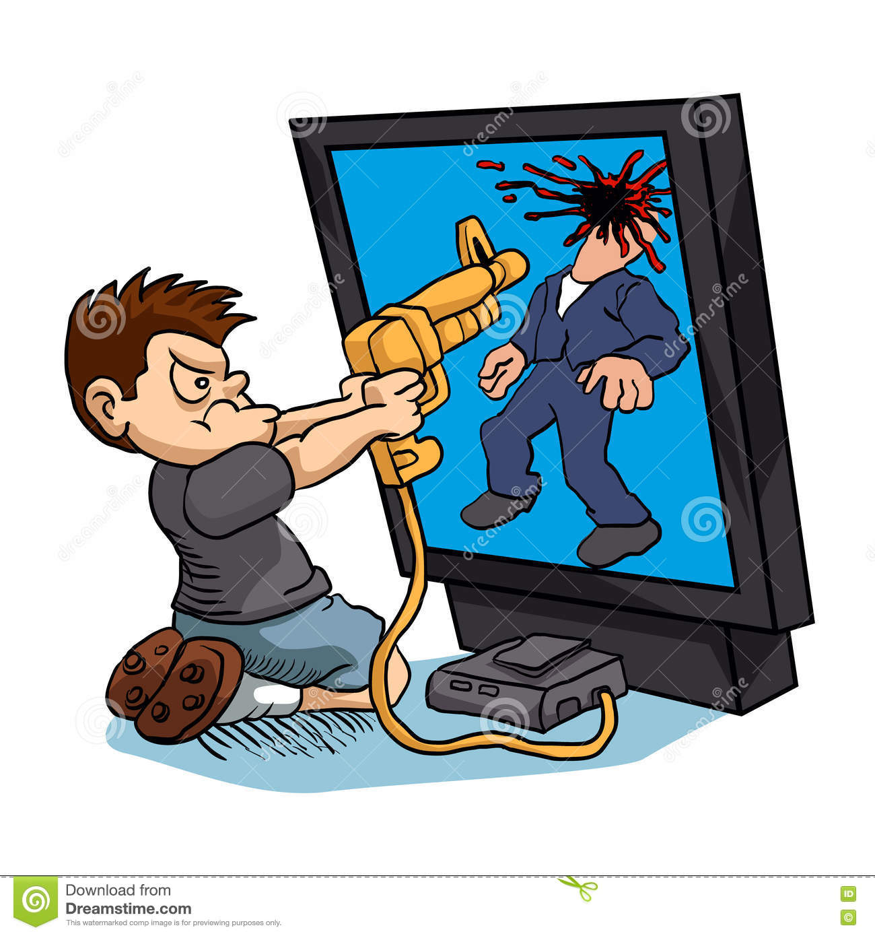
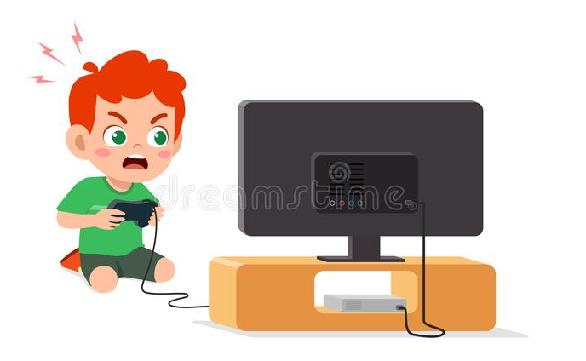
Would any of these things be weird if we did them in real life?
Is your online behaviour different to your real life behaviour?
A – YES! It is
We do behave differently online
Notes:
Allow pupils to tell you what is going on in the pictures. They should conclude that this isn’t how we generally behave in the real world.

Slide 13
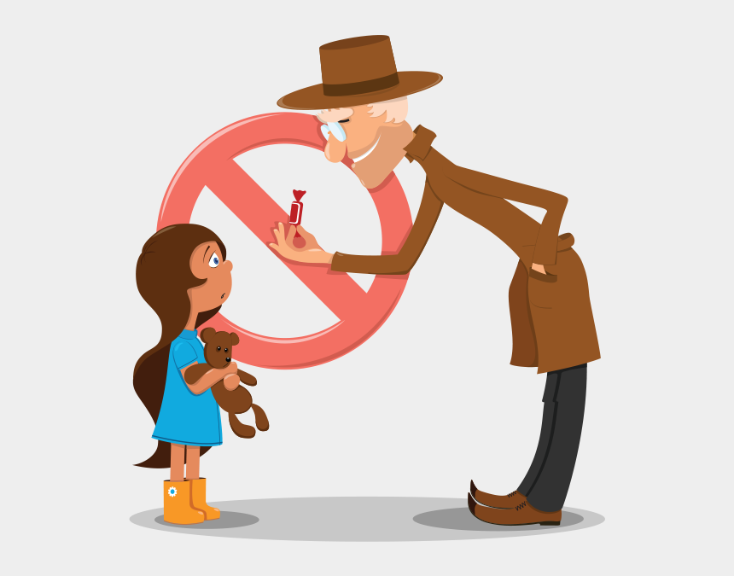
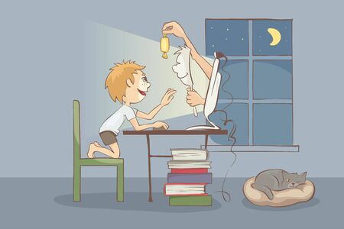
We do behave differently online
So it is important to be aware of how our online actions can impact the real world
Notes:
Interacting with strangers! Although pupils will know not to talk to or interact with strangers in the real-world, lots of them will game or talk to strangers online.

Slide 14



Scenario 1.
A pupil at your school creates an account with your schools’ name in it and posts other pupil’s photos with comments that everybody hears about.
Some of the comments are hurtful and some are compliments.
Do you report the hurtful comments, the whole account, or both?
What could be some consequences of this activity?
Online consequences
Offline consequences
Notes:
Ask children to read each scenario and raise your hand if you’d report it in the app or service where you found it.
Ask them to explain why they would or wouldn’t report it.
(Remember that there is seldom one right choice to make, which is why discussion is helpful. No one should feel bad about what they chose to do. Even adults don’t always know when or how to report.)

Slide 15




Scenario 2.
You’re playing an online game with friends and someone none of you know starts chatting with you. They’re not being nasty or anything, but you don’t know them.
Do you ignore them, report them, or do nothing?
The group continue playing, the stranger joins in your conversation and asks your ages. One of your friends tells the stranger, who then asks more questions about school and where you live.
What do you do next?
What could be the consequences of this action?
Offline consequences
Online consequences
Notes:
The pupils could vote for ignore, report or do nothing. Allow/ ask for comments as the scenario plays out.

Slide 16
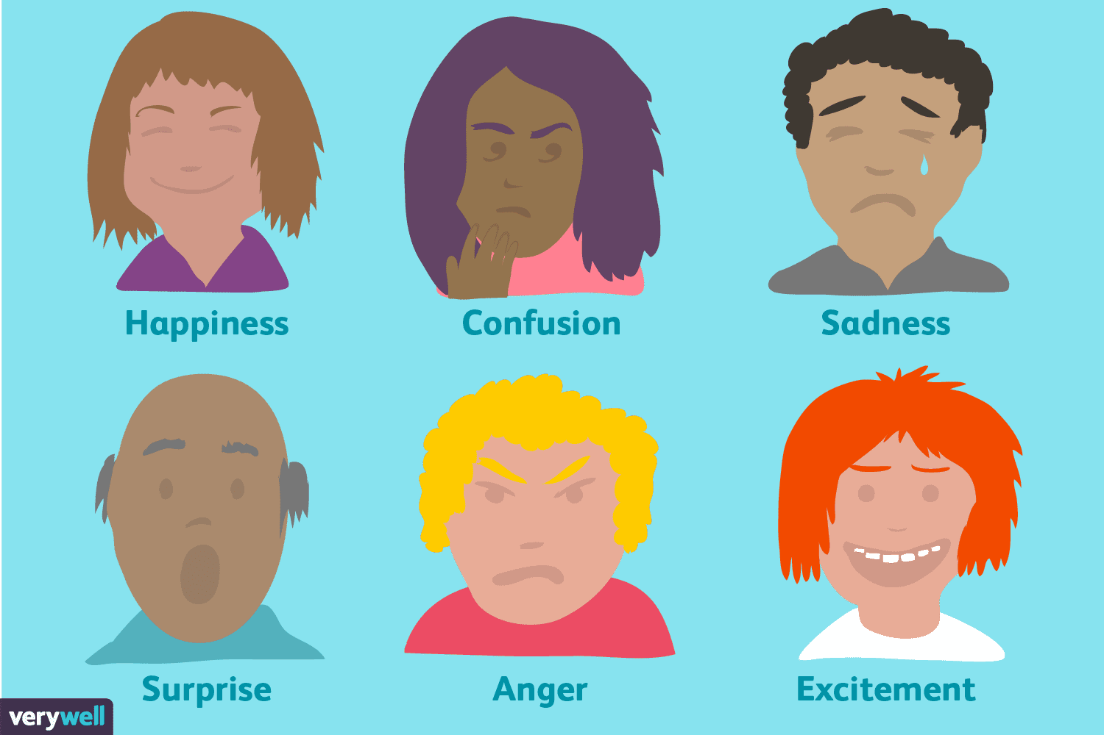

Sometimes when we are online it’s hard to tell what will upset someone and what will make them laugh.
When we communicate using the internet we can’t be sure if other people will always understand what we mean because…
We can’t always use body language or facial expressions
In a message you can’t always express your tone of voice
We might find something funny, but someone else finds it unkind
Notes:
It can be easy to join in with or make hurtful comments online. When we post something online it is permanent (unless removed by a moderator) which means it can be read over and over and shared with others easily.

Slide 17
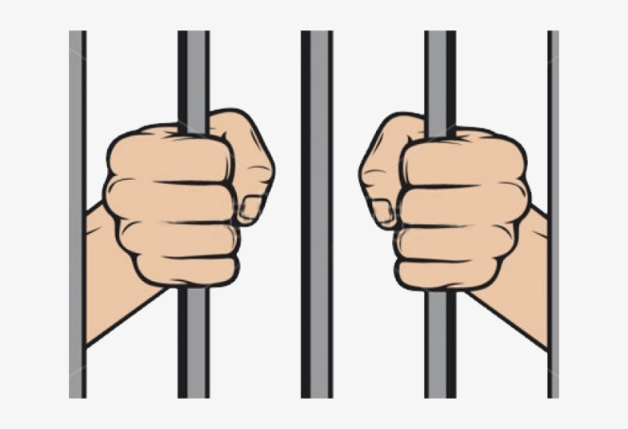

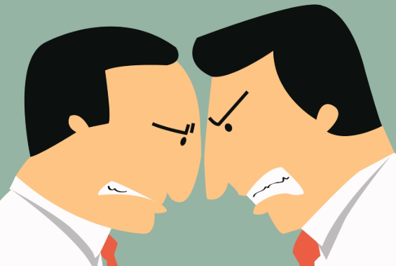

What kind of consequences could our online actions have in the real world?
Notes:
Friends can fall out and arguments spill over in to the real world. Although it may seem a long way off, when you apply to college, university or for a job they are likely do an online search – what impression do you want them to get of you? The impression you leave now may affect your future. There are also things which are illegal to say online – someone’s race, faith, sexual orientation, disability and gender identity are protected characteristic. Making unkind comments about these can be a hate crime and against the law!

Slide 18
Looking after our digital footprint
Think about our online-offline discussions
- How would you look after your digital footprint?
Notes:
Think before you post. Every time you post, comment, like or share you leave an impression behind (footprint). Imagine your grandma sitting behind you? What would she think?!
Initial examples of looking after footprint:
Being kind to people online, both people that we know and strangers we might come across
Don’t share rude or unkind things
Don’t post or share things that we aren’t sure about, or things we might regret.
Don’t post our personal information e.g. where we live, school uniform, phone numbers

Slide 19
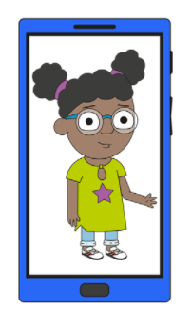
Keeping safe when online
Sharing Pictures
Asking permission
Sharing with people you know and trust
Personal information
Your real name
Where you live
Your age
Your username and password
Where you go to school
Chatting online
It’s easy for people to pretend when they are online
Switching off!
Watching videos
Good communication
Notes:
Asking our friends before we share a picture or video with them in
Checking in with our friends if there has been an argument, or if they seem sad/worried/angry
Telling an adult if we are worried/upset/scared/think we have made a mistake
If something has made you upset or angry:
Telling an adult
If we are angry take five minutes before responding. Close the screen or the game
Chatting online - How might it be easy for someone to pretend to be someone else when they are online?
Fake profiles
Anonymous usernames
Lying about their age
Where might we come across strangers online?
Gaming platforms
Streaming sites
Comment sections
Group chats

Slide 20
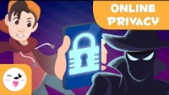
Personal information
Notes:
Although this video is very simplistic in production, it does re-enforce important e-safety messages.

Slide 21
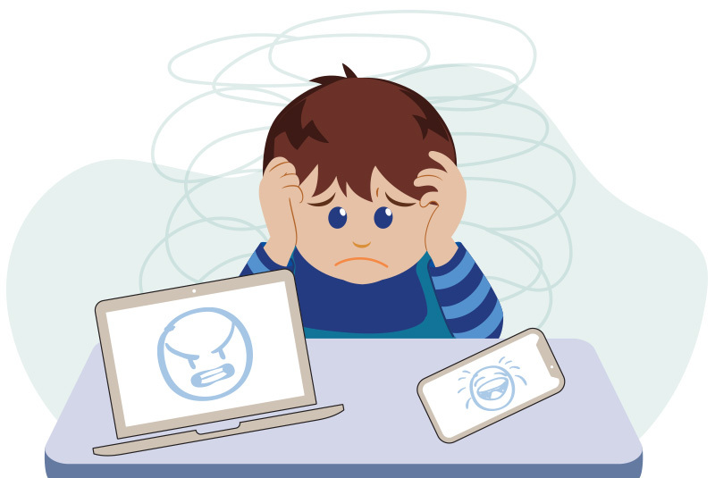
Looking after each other
I’ve made a mistake!
What should I do?
Someone who feels safe,
Can solve problems
and communicate well with others
Notes:
It’s easy to make mistakes, but these can be fixed! Don’t ignore when something goes wrong online, problems have a habit of growing and getting out of hand when not dealt with. Encourage pupils to think about who their trusted adults are and what skills they will be able to contribute. During the Summer term when students will be thinking about moving to secondary school, talk to them about form tutors, head of year etc.

