Slide 1
Hate Crime Assembly
KS3 / KS4
Striving for excellence
www.enfield.gov.uk

Slide 2
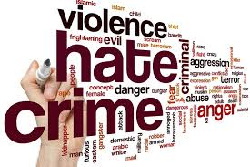
Why does Hate Crime matter?
Notes:
Use this slide as an opportunity to get some ideas from pupils about why hate crime matters and gauge their understanding.

Slide 3
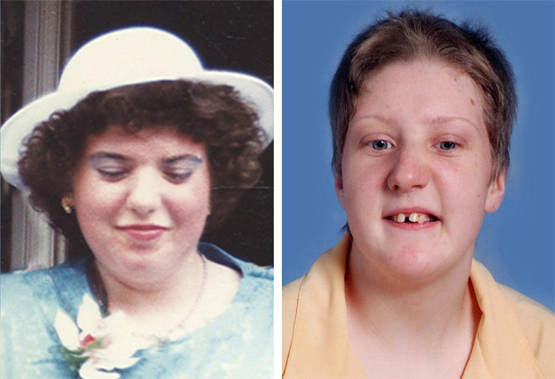
Why does Hate Crime Matter?
True Story
Fiona and Frankie Pilkington
Frankie had severe learning difficulties.
More than a decade of abuse and bullying from local teenagers.
Groups of up to 16 young people pelted their home with flour, eggs and stones and shouted abuse every night.
Fiona was eventually driven to commit suicide by setting fire to her car while she and Frankie were sitting side by side in the back.
I have just given up,” she wrote. “I am just not cut out to take this much harassment
Notes:
Choose either this case study about disability hate crime or the following one about homophobic hate crime. Background to the case: Fiona spent much of her life isolated and alone caring for her daughter, Frankie who had severe learning difficulties. None of her neighbours seemed to know her personally. “We saw nothing” neighbours claimed despite the Pilkingtons being subjected to bullying and abuse from local teenagers for more than a decade. They felt isolated and did not feel safe in their own homes. No-one seemed to take their case seriously despite complaints to police and MP. There was an attitude of ‘not getting involved’. A report by the Independent Police Complaints Commission found that that Leicestershire police had repeatedly missed opportunities to identify the Pilkingtons as vulnerable and lik the individual cases of ASB as harassment. This was a watershed case which put the issue of disability-related hate crime in to the spotlight. October now includes National Hate Crime Awareness week.

Slide 4
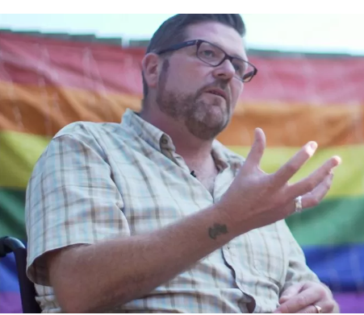
Why does Hate Crime Matter?
In 2018, Tommy was attacked after London Pride.
His attackers began by shouting homophobic abuse.
Tommy was then hit, he felt his back crack and fell to the floor. He was stamped on, sworn at and told he deserved it.
The attack has left Tommy in pain and needing to use a wheelchair.
He has lost his livelihood because he can no longer run the shop he owned.
He struggles to sleep and has flashbacks and nightmares.
His attackers were never found.
True Story
Tommy Barwick
Notes:
Choose either this case study about homophobic hate crime or the previous one about disability hate crime. This homophobic assault - an attack based on prejudice against LGBT people - was part of a surge in such cases over recent years. 2022 Galop poll reported hate crime up overall by almost a third, these figures show a 41% increase in hate crime against LGB people and a staggering 56% increase in transphobic hate crimes in this country over the last year. According to the charity Stonewall, 80% of LGBT people don't report hate crimes, so this is really just the tip of the iceberg.

Slide 5
What is Hate Crime?
A Hate crime is any criminal offence which is perceived, by the victim or any other person, to be motivated by a hostility or prejudice based on a person’s:
Race
Faith
Sexual orientation
Disability
Gender Identity
Notes:
Explain meaning of definition. Anyone can be affected by Hate Crime. You don’t have to be a member of the group to which the hostility is targeted at. You don’t have to be gay to have homophobic abuse shouted at you. You may not be part of a religion and still have someone target you because they think you are.
Race – nationality, ethnicity, skin colour and heritage.
Faith – religion, beliefs and non-religious beliefs
Sexual orientation – gay, lesbian, bi-sexual, heterosexual etc.
Disability - physical, hearing, visual, mental ill health, learning difficulties, neuro-diversity eg Autism.
Gender identity – People identifying as Trans including transgender.

Slide 6
What does Hate Crime look like?
Verbal Abuse
Vandalism
Intimidation and Threats
Harassment
Physical Abuse
Incitement to hatred
Notes:
Briefly explain what each of these means. Incitement to hatred - The offence of incitement to hatred occurs when someone acts in a way that is threatening and intended to stir up hatred. That could be in words, pictures, videos, music, and includes information posted on websites. The law states that harassment is when a person behaves in a way which is intended to cause you distress or alarm. The behaviour must happen on more than one occasion. It can be the same type of behaviour or different types of behaviour on each occasion.

Slide 7
What is online Hate Crime?
Notes:
In order to play the video from within the presentation you will need to have enabled the content and allowed it as a trusted document. If not, the video can be found at: https://www.youtube.com/watch?v=LbilEnZxhco.
This video contains graphic text and images so please view before showing pupils and decide if it is appropriate for your cohort.

Slide 8
What about Online Hate Crime?
Online Hate is posting and sharing hateful and prejudiced content against an individual, group or community.
If a post is hostile towards a person’s race, religion, disability, sexual orientation or gender identity – it can be viewed as Hate Speech and could break the law.
Online Hate includes texts, images, videos and audio – or a combination of these. It can include Cyberbullying, Cyberstalking, harassing people and encouraging others to commit violence.
Notes:
Messages calling for violence against a specific person or group. Web pages with pictures, video or descriptions of violence against someone due to perceived differences. Chat forums asking others to commit hate crimes.

Slide 9
Online versus Offline Hate
There are some key differences between online and offline hate:
Online hate is usually permanent.
Online hate has a wider audience.
People who create online hate content usually do so anonymously but they can be identified and prosecuted.
Notes:
Online content once posted remains hosted on the internet indefinitely. Online hate can spread to a large audience quickly. People who post hate content can be identified and prosecuted though.

Slide 10
Results of Online Hate
Sharing hate online can encourage people to commit harm in the real world. This could include physical assault, verbal abuse or damaging property.
On occasion, it can encourage individuals to take part in extremist acts.
Notes:
Recent tragedies where the perpetrators had a history of spreading hate online include the 2019 Christchurch Mosque shooting in NZ, 2021 Spa shooting in Atlanta USA and the Plymouth Shooting in 2021 (Jake Davison shot and killed 5 people and injured 2 others – Incel, misogynist and homophonic)

Slide 11
Why should I Report a Hate Crime?
To help make your area safer for vulnerable people.
To increase support available for victims of hate crimes
Knowing where and when hate crimes take place can inform better policing
Notes:
83% of people taken to court for hate crimes either admitted the offense or were found guilty by a judge or jury.

Slide 12
How do I report a Hate Crime or incident?
Call 999 if you’re reporting a crime that’s in progress or someone is in immediate danger
Report a hate crime online or offline through True Vision www.report-it.org.uk
It is important to report Hate Crimes or Hate Incidents.
By reporting Hate Crime you can help make your area safer.
Report hate speech on social media by reporting the post or user.
You can report a Hate Crime easily on the Enfield Council web page: www.enfield.gov.uk/hatecrime
Call the police on 101 if it isn’t an emergency or you could visit a police station.

