Slide 1
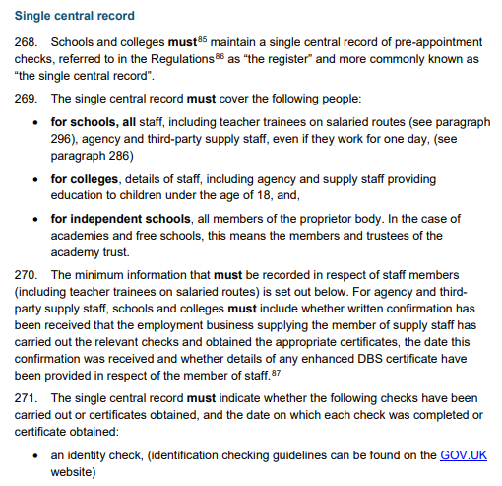
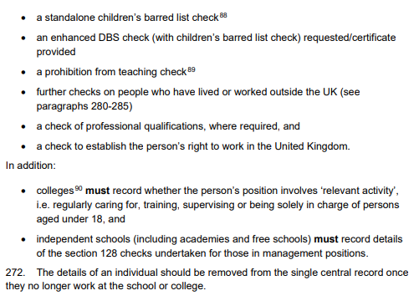
A Whirlwind Guide to…. THE SCR
SCR = Single Central Record. It is an extremely important and mandatory document which all schools must maintain without error. This should be regularly monitored by the headteacher or other senior leader. It is a live document.
Pages 71-83 of KCSIE 2023 specifies what needs to be included in the SCR
All adults who regularly visit the school should be included on the SCR. This includes agency staff, kitchen staff, cleaners, volunteers and regular contractors.
Some specific groups (e.g. student teachers who are not on payroll) do not need to be included but a letter of assurance from their provider should be attached to the SCR
The SCR needs to verify whether the following checks have been made:
Identity check
Enhanced DBS check
Children’s Barred List check
A Prohibition from Teaching check (teachers only)
A check on the right to work in the UK
Further checks on people who have lived or worked outside of the UK
A check of relevant professional qualifications

