Slide 1
PLEASE DO SHARE
Would you like to contribute to this newsletter?
Email Samantha.hill@enfield.gov.uk
SAFEGUARDING ROUND UP
01/03/24
SEYIS
Schools and Early Years Improvement Service
Striving for excellence
www.enfield.gov.uk

Slide 2
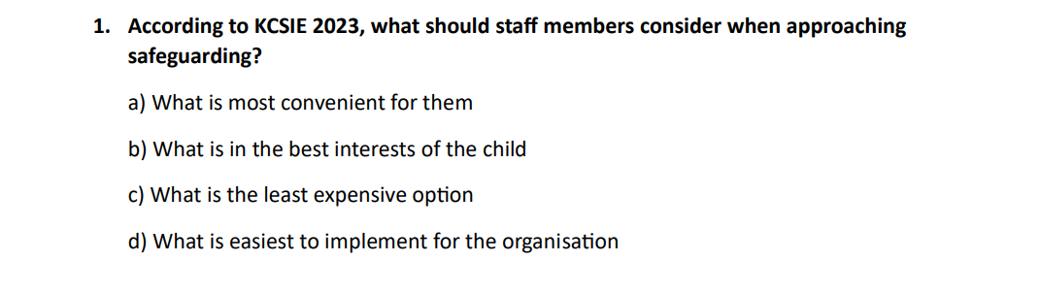
Quiz: KCSIE Part 1

Slide 3
For Your Diary
E-Safety Working Party: 28th March, 10am, Carterhatch Junior School. All welcome.
DSL Network meetings, Summer Term
Planning meeting: 16th April, 3.30pm
Microsoft Teams meeting
Join on your computer, mobile app or room device
Click here to join the meeting
Meeting ID: 393 764 611 517 Passcode: YGT4ZT
Download Teams | Join on the web
DSL Network meeting: 30th April, 3.30pm
Microsoft Teams meeting
Join on your computer, mobile app or room device
Click here to join the meeting
Meeting ID: 328 397 142 833 Passcode: c2yEKM
Download Teams | Join on the web
Or call in (audio only)
+44 20 7660 8328,,97746014# United Kingdom, London
Phone Conference ID: 977 460 14#
Find a local number | Reset PIN
Planning meeting: 18th June, 3.30pm
DSL Network meeting: 9th July, 3.30pm
Microsoft Teams meeting
Join on your computer, mobile app or room device
Click here to join the meeting
Meeting ID: 316 212 411 126 Passcode: N3yoG8
Download Teams | Join on the web
Or call in (audio only)
+44 20 7660 8328,,362507483# United Kingdom, London
Phone Conference ID: 362 507 483#
Find a local number | Reset PIN
If you would like to contribute to our Network meeting, or have an idea of what might be useful, then please contact Samantha.hill@enfield.gov.uk or attend our planning meetings, where all are welcome.

Slide 4
Safer Schools App
Safer Schools - Ineqe Safeguarding Group
Filtering and Monitoring tools
Filtering and Monitoring | SWGfL
Protect your school from phishing
https://www.ncsc.gov.uk/guidance/phishing

Slide 5
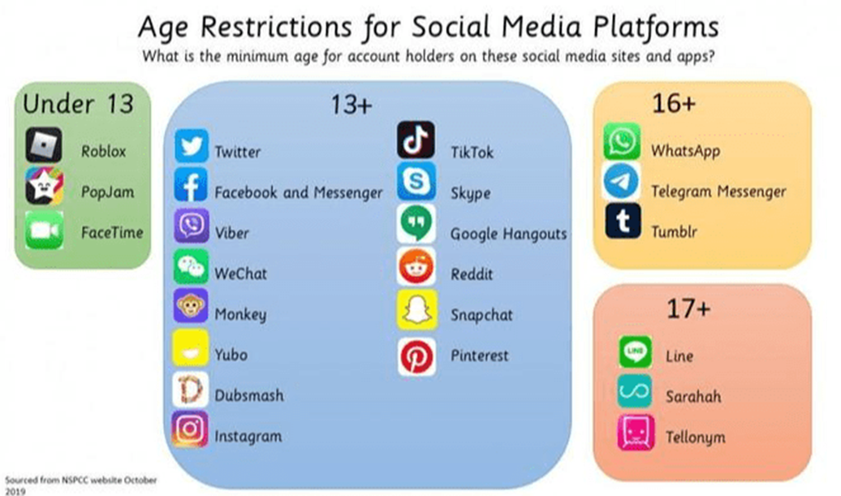

Slide 6
PRICE training
Each school should have at least two PRICE trained members of staff who can be called upon to support in de-escalating a challenging situation safely.
Training in Enfield is offered through SWERRL (Primary) and OAKTEE OUTREACH (Secondary).
Primary: The training offered by SWERRL is ‘COSIE’. This training is has a PRICE foundation and is also aligned to E-TIPSS. Website: Behaviour support service | Enfield Council. Contact SWERRL by emailing office.bss@enfield.gov.uk or by calling 020 3855 5879
Secondary: PRICE training is offered through the Oaktree Outreach offer: Oaktree School - Outreach Support You can book directly with Oaktree. Email: outreach@oaktree.enfield.sch.uk or office@oaktreeschool.org.uk

Slide 7
E-Safety Working Party
The E-safety working party next meets at 10am on the 28th March, Carterhatch School. We are now also working with EPs Dr Becky Mulhall and Dr Stacy-Ann Williams, who have both studied aspects of e-safety as part of their doctorates and will be sharing their findings with the group.
The working party aims to identify key concerns and key actions which would have a positive impact in keeping our children safe online. We aim to have a clear set of guidelines and actions for schools and parents by the end of the year.
Your input is invaluable. All are welcome at our meetings, or email any suggestions to Samantha.hill@enfield.gov.uk

Slide 8
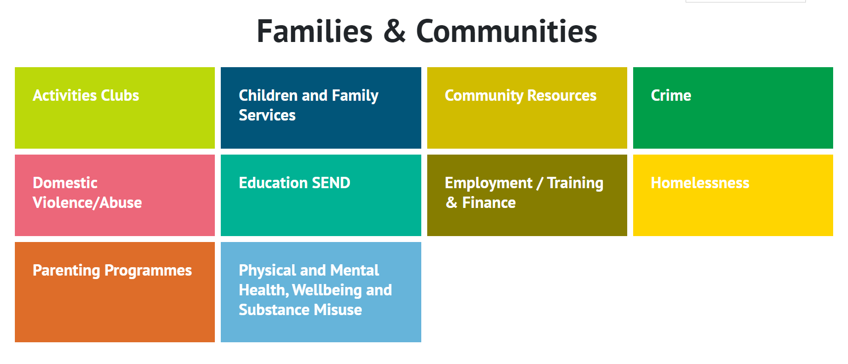
A whirlwind guide to….
Early Help
Referrals
Make a referral through this link, or call 0208 379 2002
Early Help is an intervention designed to support families who do not meet the threshold for statutory intervention. It sits before Child In Need and Child Protection. There is a broad range of services designed to target specific needs. Families need to agree to engage.
Early Help Family Hub (enfield.gov.uk)
Enfield Early Help work with the whole family to improve wellbeing, relationships, behaviour and communication by offering advice, support and direct interventions at any point in a child or young person's life, from pre-birth to adulthood. The type of support offered will depend on the needs of the family. The Enfield Early Help Hub has services that support children, young people and families.
Early Help Directory - Community services for the London Borough of Enfield (enfielddirectory4all.co.uk)

Slide 9
Questions we’ve been asked this week
Q: Where can Secondary schools access PRICE training?
A: We strongly recommend PRICE training for Secondary schools as well as Primary. PRICE training is offered through the Oaktree Outreach offer: Oaktree School - Outreach Support You can book directly with Oaktree. Email: outreach@oaktree.enfield.sch.uk or office@oaktreeschool.org.uk
Q: Can I join your e-safety working party?
A: Yes! Details on Diary page

Slide 10
Traded Services
If you would like to commission a safeguarding or SEND review, or would simply like more information about what we offer, please email the SEYIS team
Social Media and Online Safety – a working party
Want to join our working party? Email Samantha Hill.
The Hub
Welcome to The Hub | Enfield Council
The Hub Safeguarding Pages contain useful documents, links and summary guidance. Pop a shortcut on your desktop.
Let us know if you would like anything added or amended.
Contribute
Want to add a page to an upcoming RoundUp? Send it in!
For all the above, email Samantha.Hill@enfield.gov.uk or SEYIS@enfield.gov.uk

Slide 11
Training – Professional Learning Portal
Book on our professional learning portal:
https://traded.enfield.gov.uk/thehub/professional-learning-portal/safeguarding
Upcoming courses:

Slide 12
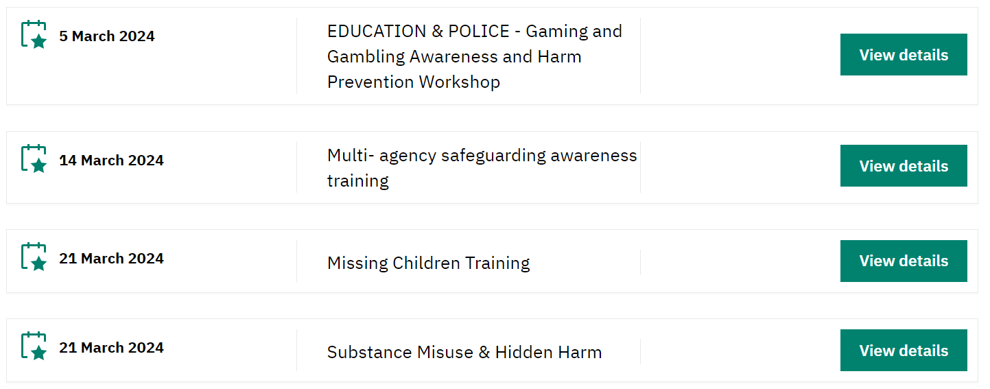
Training – Safeguarding Enfield
There is a great deal of quality (and FREE) training available from Safeguarding Enfield. Please take a look.
Training | Safeguarding Enfield

Slide 13
Training and Information - other
NSPCC Learning – low cost, well made, broad range
ESFA Fast Form (fasst.org.uk) – £1200 Government grant to train a Senior Mental Health Lead
https://youtu.be/OTJYYNP9AEc?si=q7RRMvBVjuWLouze – Ofsted webinar
Events - UK Safer Internet Centre – Online events and webinars
Filtering and Monitoring | SWGfL - a series of webinars
Home | KCSIE Webinar Series (orcula.co.uk) KCSIE 2023 webinars
Virtual College - free safeguarding courses
Safeguarding In Schools - Andrew Hall
Educate Against Hate - Prevent Radicalisation & Extremism

Slide 14
Safeguarding Triads
We are developing a peer-audit structure which would occupy the space between self-audit and a commissioned review.
Triads would use the self-audit spreadsheet to review each others’ schools, with each person taking a different role in the gathering of information. You would receive some initial training and guidance.
If your school would be interested in taking part, email Samantha.hill@enfield.gov.uk

Slide 15
Partner agency work – a very important message
Effective partner work is essential in our bid to safeguard our children.
It is incredibly important that schools do their utmost to comply with what is needed to safeguard our most vulnerable children.
DSLs: This is your responsibility. You must make sure the paperwork for statutory assessments, partner checks and other requests is promptly produced, especially for Section 17 and Section 47 assessments. For section 47 this needs to be produced within 24 hours. For Section 17 this needs to be produced within 72 hours.
These tight turnaround times are because a child has been deemed as being potentially at risk of immediate and serious harm. The picture you paint helps to form the decision which will affect their future.
Equally, ensuring paperwork is ready and an appropriate and well-informed school representative has been released to attend CiN and CP meetings is absolutely essential. We cannot get this wrong.
It is rare that we receive any report from social services of a school not fulfilling its part in this duty, but as each one has such a profound effect, we wanted to emphasise the message here.
We are all partners, working with the same precious aim: to keep children safe.

Slide 16
Useful People, Useful Links
KCSIE 2023 | Keeping children safe in education - GOV.UK (www.gov.uk)
The Hub | Welcome to The Hub | Enfield Council
Safeguarding Enfield webpage | Safeguarding Enfield
Professional Learning Portal | https://traded.enfield.gov.uk/thehub/professional-learning-portal/safeguarding
Mind in Enfield | 0208 906 7505 mindinenfield.org.uk
Prevent Education Officer | New appointee Madeleine Street from March 4th 2024
HEART Team for Looked After Children and Post Adopted CYP | Suzanne.Rowson@enfield.gov.uk
MASH Service Manager | Michelle.Ferdinand@enfield.gov.uk
LADO (Bruno Capelo) | safeguardingservice@enfield.gov.uk
Enfield Educational Psychology Service | eps@enfield.gov.uk
CAMHS Crisis Line 24/7 | 24/7 Crisisline 0800 1510023 [9-5pm Monday to Friday all Crisisline calls get diverted to SAFE . T/N 0208 7024070]
Samantha Hill Senior School Improvement Advisor for Safeguarding and Inclusion | Samantha.Hill@enfield.gov.uk

