Slide 1
PLEASE DO SHARE
Would you like to contribute to this newsletter?
Email Samantha.hill@enfield.gov.uk
SAFEGUARDING ROUND UP
16/02/24
SEYIS
Schools and Early Years Improvement Service
Striving for excellence
www.enfield.gov.uk

Slide 2
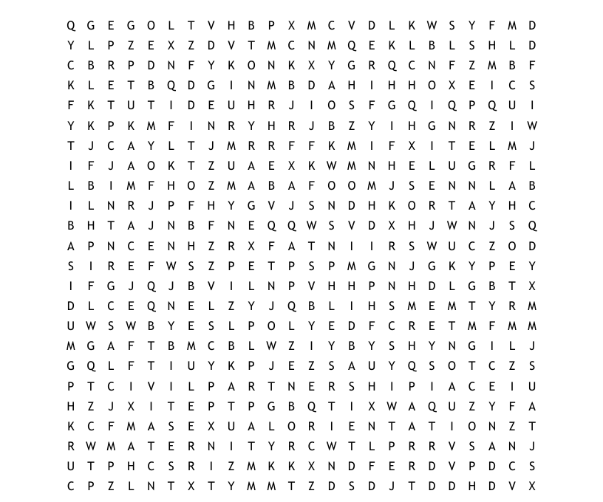
The Equality Act 2010: Protected Characteristics

Slide 3
For Your Diary
Safer Internet Day: 6th February
E-safety working party: 8th February, 2pm, Carterhatch School
All welcome. Email Samantha.hill@enfield.gov.uk
Children’s Mental Health Week: 5-11th February
DSL Network meetings, Summer Term:
Planning meeting: 16th April, 3.30pm
DSL Network meeting: 30th April, 3.30pm
Planning meeting: 18th June, 3.30pm
DSL Network meeting: 9th July, 3.30pm
If you would like to contribute to our Network meeting, or have an idea of what might be useful, then please contact Samantha.hill@enfield.gov.uk or attend our planning meetings, where all are welcome.

Slide 4
General Updates
1. Updates to Working Together to Safeguard Children 2023
Working together to safeguard children 2023: statutory guidance (publishing.service.gov.uk
2. Online Safety Act 2023
Online Safety Act 2023 (legislation.gov.uk)
3. Consultation out for draft government guidance for Gender Questioning Students
Gender Questioning Children - non-statutory guidance (education.gov.uk)Equality Act 2010: guidance - GOV.UK (www.gov.uk)
Enfield are creating a guidance page for schools, signposting advice and resources. This will replace the draft toolkit sent for consultation earlier this year. We recommend schools read our LGBTQ+ advice on the Hub: LGBTQ+ | Enfield Council
4. Changes to Prevent Duty Guidance have come into effect
Prevent duty guidance: England and Wales (2023) - GOV.UK (www.gov.uk)

Slide 5
Safeguarding Software Survey – the results

Slide 6
A whirlwind guide to…
LGBTQ+ and Gender Questioning Students
Enfield Council's commitment to equality, inclusion and effective safeguarding is unwavering.
This advice aims to signpost schools to guidance, legal responsibilities and useful resources in order to support the development of inclusive and safe environments for gender questioning children and those who identify as LGBTQ+.
Practice to support LGBTQ+ children and young people should be embedded across policies and the curriculum and build on best safeguarding and inclusive practice already in place. We encourage schools to place the well-being of children at the heart of all decision-making.
LGBTQ+ | Enfield Council
Students who are questioning their sexuality and/or gender are at significant risk of harm. These risks include bullying and assault from peers, abuse within the family home, online abuse and vulnerabilities, greater use of adult dating apps and associated vulnerabilities, homelessness, self harm, and a greatly elevated risk of suicide and suicidal thoughts.
The Equality Act 2010 already protects the rights of those identifying as LGBTQ+, and both curriculum and inspection expectations are that children are explicitly taught about diversity, acceptance and respect.
Additionally, schools are expected to safeguard their LGBTQ+ and gender questioning young people through their policies, safeguarding procedures and every day inclusive practice. LGBTQ+ young people are extremely vulnerable and benefit from the provision of safe spaces, check-ins and adult responsiveness to emerging issues.
Gender Questioning Children - non-statutory guidance (education.gov.uk)
Equality Act 2010: guidance - GOV.UK (www.gov.uk)
Relationships and sex education (RSE) and health education - GOV.UK (www.gov.uk)
Trans Inclusion Schools Toolkit 2021 (brighton-hove.gov.uk)
Enfield Inclusion Charter | Enfield Council
Keeping children safe in education - GOV.UK (www.gov.uk)
Safeguarding Enfield
Safeguarding in Schools | Enfield Council
Inspecting teaching of the protected characteristics in schools - GOV.UK (www.gov.uk)
Resources, guidance and responsibilities are outlined in full on The Hub’s LGBTQ+ page:
LGBTQ+ | Enfield Council
Key documents and links:

Slide 7
Ending Gender-based violence – a teacher toolkit from www.tender.org.uk
Ending Gender-Based Violence Teacher Toolkit – free resource and CPD accredited training https://tender.org.uk/our-services/training/toolkit-training/
The Teacher Toolkit is a free resource, developed to help schools facilitate important conversations with children and young people around GBV, and meet key elements of the RSE curriculum. It can also support staff’s vital safeguarding role.
The Secondary Toolkit is available now: https://www.london.gov.uk/VAWGToolkit
The Primary Toolkit will soon be launched here: https://www.london.gov.uk/programmes-strategies/mayors-office-policing-and-crime-mopac
To support the use of the Toolkit in schools, Tender are offering free, CPD accredited and online training to teachers and school governors in every London borough.
Details of Enfield’s sessions are below. You can find further information and all sessions here: https://tender.org.uk/category/toolkit-training/
Secondary Teachers: Increasing Awareness of Gender-Based Violence
Date & Time: 26th March 16:00-17:00
Registration: https://GBVToolkitIncreasingAwarenessEnfield.eventbrite.co.uk
Primary Teachers: Talking to Children and Young People about Relationships and Gender Equality
Date & Time: 12th June 16:00-17:00
Registration: https://GBVToolkitTalkingtoCYPEndfield.eventbrite.co.uk
SEN Teachers: Supporting Children and Young People with SEN to Understand Healthy Relationships and Gender Equality
Date & Time: 4th July 16:00-17:00
Registration: https://GBVToolkitSupportingSENEnfield.eventbrite.co.uk
School Governors: Introduction to Ending Gender-Based Violence Toolkit
Date & Time: 28th March 17:30-18:30
Registration: https://GBVToolkitIntroEnfield.eventbrite.co.uk

Slide 8
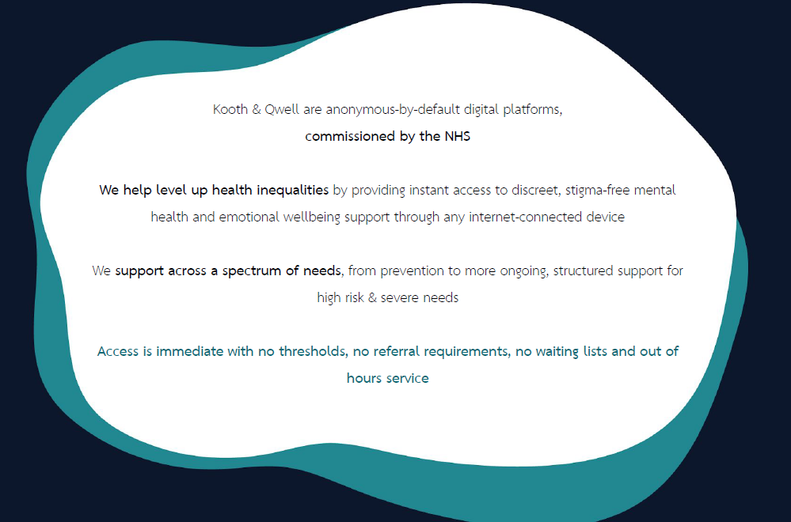
Kooth
Kooth.com

Slide 9
How we help and support
Cyber Choices
Referral
Can easily be made through our team who are on hand to provide support and advice.
Provide help and advice on how to best approach the situation.
Signposting to useful digital/print resources.
Provide a Teacher and/or Pupil Presentation
Work on a 1to1 basis with a referred person.
https://www.met.police.uk/cyberchoices

Slide 10
Traded Services
If you would like to commission a safeguarding or SEND review, or would simply like more information about what we offer, please email the SEYIS team
Social Media and Safeguarding – a working party
Want to join our working party? Email Samantha Hill.
The Hub
Welcome to The Hub | Enfield Council
The Hub Safeguarding Pages are now live, so please take a look. Let us know if you would like anything added or amended.
Contribute
Want to add a page to an upcoming RoundUp? Send it in!
For all the above, email Samantha.Hill@enfield.gov.uk or SEYIS@enfield.gov.uk

Slide 11
Training – Professional Learning Portal
Book on our professional learning portal:
https://traded.enfield.gov.uk/thehub/professional-learning-portal/safeguarding

Slide 12
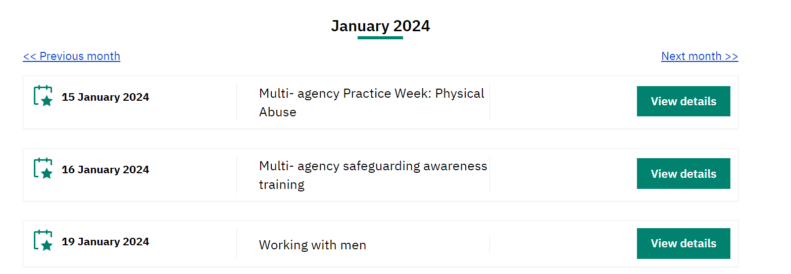
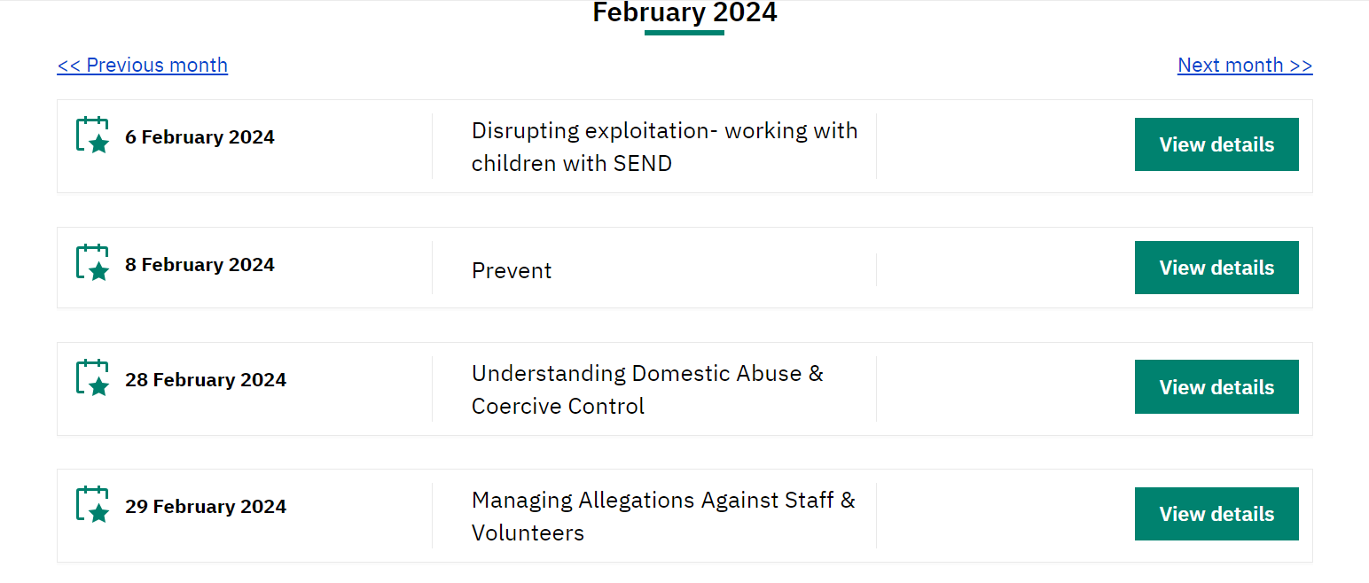
Training – Safeguarding Enfield
There is a great deal of quality (and FREE) training available from Safeguarding Enfield. Please take a look.
Training | Safeguarding Enfield

Slide 13
Training and Information - other
NSPCC Learning – low cost, well made, broad range
https://youtu.be/OTJYYNP9AEc?si=q7RRMvBVjuWLouze – Ofsted webinar
Events - UK Safer Internet Centre – Online events and webinars
Filtering and Monitoring | SWGfL - a series of webinars
Home | KCSIE Webinar Series (orcula.co.uk) KCSIE 2023 webinars
Virtual College - free safeguarding courses
Safeguarding In Schools - Andrew Hall
Educate Against Hate - Prevent Radicalisation & Extremism

Slide 14
Ofsted Safeguarding Links
The OFSTED Update: https://educationinspection.blog.gov.uk/2023/11/09/how-we-inspect-safeguarding-in-schools/
The School Inspection Handbook: https://www.gov.uk/government/publications/school-inspection-handbook-eif/school-inspection-handbook-for-september-2023
The OFSTED Webinar: https://youtu.be/OTJYYNP9AEc?si=q7RRMvBVjuWLouze
OFSTED Webinar Scenarios: https://youtu.be/OTJYYNP9AEc?si=mKQU9tONaizJsYBk&t=2341
DfE SCR Webinar:
https://www.safeguardinginschools.co.uk/dfescr
SCR FAQs: https://6282.s3.eu-west-1.amazonaws.com/FAQs+KCSIE+Series+Webinar+2+-+Single+Central+Record.pdf
Scenario Transcripts: https://6282.s3.eu-west-1.amazonaws.com/How+Ofsted+inspects+safeguarding+in+schools.pdf
DfE’s ‘Keeping children safe in education’ webinars: https://kcsie.orcula.co.uk/home

Slide 15
Useful People, Useful Links
KCSIE 2023 | Keeping children safe in education - GOV.UK (www.gov.uk)
The Hub | Welcome to The Hub | Enfield Council
Safeguarding Enfield webpage | Safeguarding Enfield
Professional Learning Portal | https://traded.enfield.gov.uk/thehub/professional-learning-portal/safeguarding
Mind in Enfield | 0208 906 7505 mindinenfield.org.uk
Prevent Education Officer | New appointee from Feb 2024
HEART Team for Looked After Children and Post Adopted CYP | Suzanne.Rowson@enfield.gov.uk
MASH Service Manager | Michelle.Ferdinand@enfield.gov.uk
LADO (Bruno Capelo) | safeguardingservice@enfield.gov.uk
Enfield Educational Psychology Service | eps@enfield.gov.uk
CAMHS Crisis Line 24/7 | 24/7 Crisisline 0800 1510023 [9-5pm Monday to Friday all Crisisline calls get diverted to SAFE . T/N 0208 7024070]
Samantha Hill Senior School Improvement Advisor for Safeguarding and Inclusion | Samantha.Hill@enfield.gov.uk

