Slide 1
PLEASE DO SHARE
Would you like to contribute to this newsletter?
Email Samantha.hill@enfield.gov.uk
SAFEGUARDING ROUND UP
16/02/24
SEYIS
Schools and Early Years Improvement Service
Striving for excellence
www.enfield.gov.uk

Slide 2
For Your Diary
E-Safety Working Party: Date is currently being rearranged and will be shared shortly. All welcome.
DSL Network meetings, Summer Term:
Planning meeting: 16th April, 3.30pm
DSL Network meeting: 30th April, 3.30pm
Microsoft Teams meeting
Join on your computer, mobile app or room device
Click here to join the meeting
Meeting ID: 328 397 142 833 Passcode: c2yEKM
Download Teams | Join on the web
Or call in (audio only)
+44 20 7660 8328,,97746014# United Kingdom, London
Phone Conference ID: 977 460 14#
Find a local number | Reset PIN
Planning meeting: 18th June, 3.30pm
DSL Network meeting: 9th July, 3.30pm
Microsoft Teams meeting
Join on your computer, mobile app or room device
Click here to join the meeting
Meeting ID: 316 212 411 126 Passcode: N3yoG8
Download Teams | Join on the web
Or call in (audio only)
+44 20 7660 8328,,362507483# United Kingdom, London
Phone Conference ID: 362 507 483#
Find a local number | Reset PIN
If you would like to contribute to our Network meeting, or have an idea of what might be useful, then please contact Samantha.hill@enfield.gov.uk or attend our planning meetings, where all are welcome.

Slide 3
General Updates
1. Updates to Working Together to Safeguard Children 2023
Working together to safeguard children 2023: statutory guidance (publishing.service.gov.uk
2. Online Safety Act 2023
Online Safety Act 2023 (legislation.gov.uk)
3. Consultation out for draft government guidance for Gender Questioning Students
Gender Questioning Children - non-statutory guidance (education.gov.uk)Equality Act 2010: guidance - GOV.UK (www.gov.uk)
Enfield has created a guidance page on The Hub which replaces the draft toolkit document sent for consultation earlier this year. LGBTQ+ | Enfield Council
4. Changes to Prevent Duty Guidance have come into effect
Prevent duty guidance: England and Wales (2023) - GOV.UK (www.gov.uk)

Slide 4
Child Sexual Abuse Report – Internet Watch Foundation
The Internet Watch Foundation (IWF) has recently published their findings from an investigation undertaken alongside Anglia Ruskin University's Policing Institute. One of the report's key findings was that young people often don't know how to react to requests for indecent images from online actors.
https://www.iwf.org.uk/about-us/why-we-exist/our-research/talk-trust-empower/
Undressed - London Grid for Learning
The Undressed Song by the London Grid for Learning, is designed to help younger children understand how to respond to inappropriate online requests – through the medium of song
https://undressed.lgfl.net/

Slide 5
A whirlwind guide to…
The London Inclusion Charter
London's Inclusion Charter | London City Hall
What is The London Inclusion Charter?
An initiative from the Violence Reduction Unit (VRU), designed to reduce school exclusions and reduce violence related youth crime.
What does it involve?
Download it here: London's Inclusion Charter
There are 4 overarching ‘principles’, underpinned by various examples and initiatives. The VRU wants all London LAs and schools to sign the charter and commit to its principles and inclusive practice.
What else?
As part of the launch of the London Inclusion Charter, the VRU has secured funding for every maintained school in London to sign up to the UNICEF Rights Respecting Schools Award and begin the journey toward becoming a Rights Respecting School. This is a highly respected programme which we would encourage schools to explore, and is now FREE for London schools. This is an incredible offer.
About the Rights Respecting Schools Award - UNICEF UK
What about the Enfield Inclusion Charter?
They may share some elements of their titles, but the London Inclusion Charter and the Enfield Inclusion Charter are very different, with different approaches and different aims. We have given some thought to our Enfield Inclusion Charter and whether it should be rewritten or replaced by the London Charter. However, our Enfield Charter has a greater emphasis on SEND and we believe its principles remain very important. There are no contradictions between the two and many places where they overlap. We would encourage schools to sign up to the London Charter’s principles but we will continue to put our energies behind our Enfield Inclusion Charter.
Enfield Inclusion Charter | Enfield Council
What about E-TIPSS?
We strongly believe in E-TIPSS (Enfield Trauma Informed Practice in Schools and Settings) and its power
to achieve the same aims set out in the London Inclusion Charter.
Please see the E-TIPSS slide later in this RoundUp
Enfield Trauma Informed Practice in Schools and Settings | Educational Psychology Service

Slide 6
Partner agency work – a very important message
Effective partner work is essential in our bid to safeguard our children.
It is incredibly important that schools do their utmost to comply with what is needed to safeguard our most vulnerable children.
DSLs: This is your responsibility. You must make sure the paperwork for statutory assessments, partner checks and other requests is promptly produced, especially for Section 17 and Section 47 assessments. For section 47 this needs to be produced within 24 hours. For Section 17 this needs to be produced within 72 hours.
These tight turnaround times are because a child has been deemed as being potentially at risk of immediate and serious harm. The picture you paint helps to form the decision which will affect their future.
Equally, ensuring paperwork is ready and an appropriate and well-informed school representative has been released to attend CiN and CP meetings is absolutely essential. We cannot get this wrong.
It is rare that we receive any report from social services of a school not fulfilling its part in this duty, but as each one has such a profound effect, we wanted to emphasise the message here.
We are all partners, working with the same precious aim: to keep children safe.

Slide 7
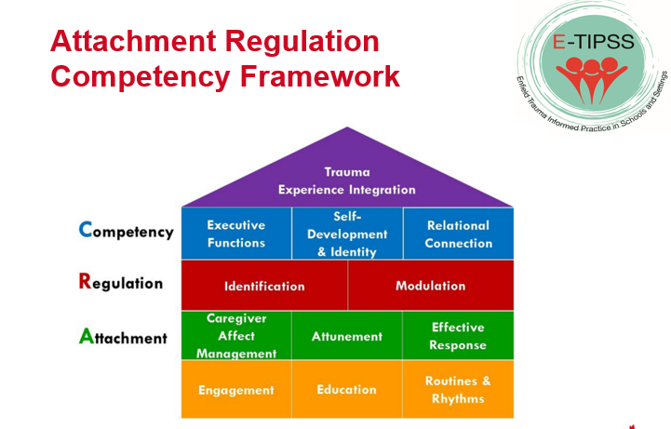
E-TIPSS (Enfield trauma informed practice in schools and settings)
We love E-TIPSS!
75% of Enfield schools have signed up to some form of E-TIPSS training, with feedback overwhelmingly positive. We know that trauma informed practice reduces exclusion, improves behaviour, increases positivity and can have life changing impact on children, families and entire school communities. Let’s make it 100% of schools. Join in!
Enfield Trauma Informed Practice in Schools and Settings | Educational Psychology Service

Slide 8
Business Continuity Plan
We have recently seen some impressive practice in Enfield as schools have responded to serious local events in ways which significantly reduced impact on children and families.
Has your school updated and shared its business continuity plan and emergency planning? This plan should outline the school’s response to any unexpected disaster, such as large scale theft, building safety issue, pandemic, local disaster, total IT failure, significant threat of harm or other critical incident.
The plan should include:
The school’s initial response, such as evacuation to a designated ‘place of safety’ or ‘invacuation’ within the school building.
Contingency planning in the event of reduced availability of buildings, resources, staff and IT systems
Plans to minimise disruption for students and ensure effective education remains accessible
Plans to maximise face to face education for students

Slide 9
Ending Gender-based violence – a teacher toolkit from www.tender.org.uk
Ending Gender-Based Violence Teacher Toolkit – free resource and CPD accredited training https://tender.org.uk/our-services/training/toolkit-training/
The Teacher Toolkit is a free resource, developed to help schools facilitate important conversations with children and young people around GBV, and meet key elements of the RSE curriculum. It can also support staff’s vital safeguarding role.
The Secondary Toolkit is available now: https://www.london.gov.uk/VAWGToolkit
The Primary Toolkit will soon be launched here: https://www.london.gov.uk/programmes-strategies/mayors-office-policing-and-crime-mopac
To support the use of the Toolkit in schools, Tender are offering free, CPD accredited and online training to teachers and school governors in every London borough.
Details of Enfield’s sessions are below. You can find further information and all sessions here: https://tender.org.uk/category/toolkit-training/
Secondary Teachers: Increasing Awareness of Gender-Based Violence
Date & Time: 26th March 16:00-17:00
Registration: https://GBVToolkitIncreasingAwarenessEnfield.eventbrite.co.uk
Primary Teachers: Talking to Children and Young People about Relationships and Gender Equality
Date & Time: 12th June 16:00-17:00
Registration: https://GBVToolkitTalkingtoCYPEndfield.eventbrite.co.uk
SEN Teachers: Supporting Children and Young People with SEN to Understand Healthy Relationships and Gender Equality
Date & Time: 4th July 16:00-17:00
Registration: https://GBVToolkitSupportingSENEnfield.eventbrite.co.uk
School Governors: Introduction to Ending Gender-Based Violence Toolkit
Date & Time: 28th March 17:30-18:30
Registration: https://GBVToolkitIntroEnfield.eventbrite.co.uk

Slide 10
How we help and support
Cyber Choices
Referral
Can easily be made through our team who are on hand to provide support and advice.
Provide help and advice on how to best approach the situation.
Signposting to useful digital/print resources.
Provide a Teacher and/or Pupil Presentation
Work on a 1to1 basis with a referred person.
https://www.met.police.uk/cyberchoices

Slide 11
Traded Services
If you would like to commission a safeguarding or SEND review, or would simply like more information about what we offer, please email the SEYIS team
Social Media and Safeguarding – a working party
Want to join our working party? Email Samantha Hill.
The Hub
Welcome to The Hub | Enfield Council
The Hub Safeguarding Pages contain useful documents, links and summary guidance. Pop a shortcut on your desktop.
Let us know if you would like anything added or amended.
Contribute
Want to add a page to an upcoming RoundUp? Send it in!
For all the above, email Samantha.Hill@enfield.gov.uk or SEYIS@enfield.gov.uk

Slide 12
Safeguarding Triads
We are developing a peer-audit structure which would occupy the space between self-audit and a commissioned review.
Triads would use the self-audit spreadsheet to review each others’ schools, with each person taking a different role in the gathering of information. You would receive some initial training and guidance.
If your school would be interested in taking part, email Samantha.hill@enfield.gov.uk

Slide 13
Training – Professional Learning Portal
Book on our professional learning portal:
https://traded.enfield.gov.uk/thehub/professional-learning-portal/safeguarding
Upcoming courses:

Slide 14
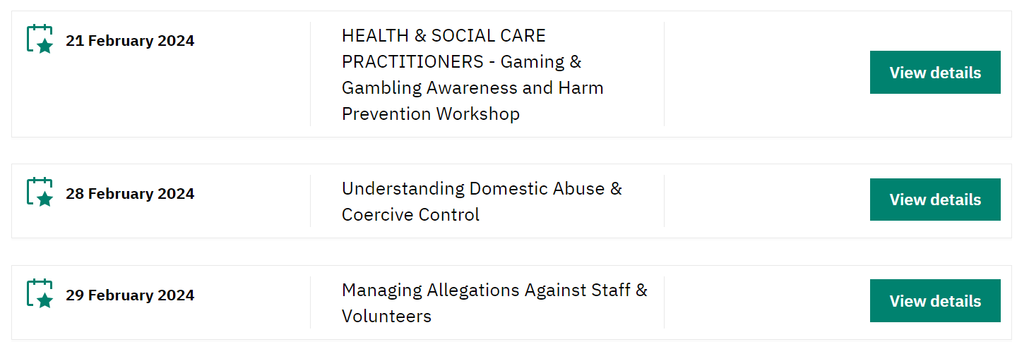
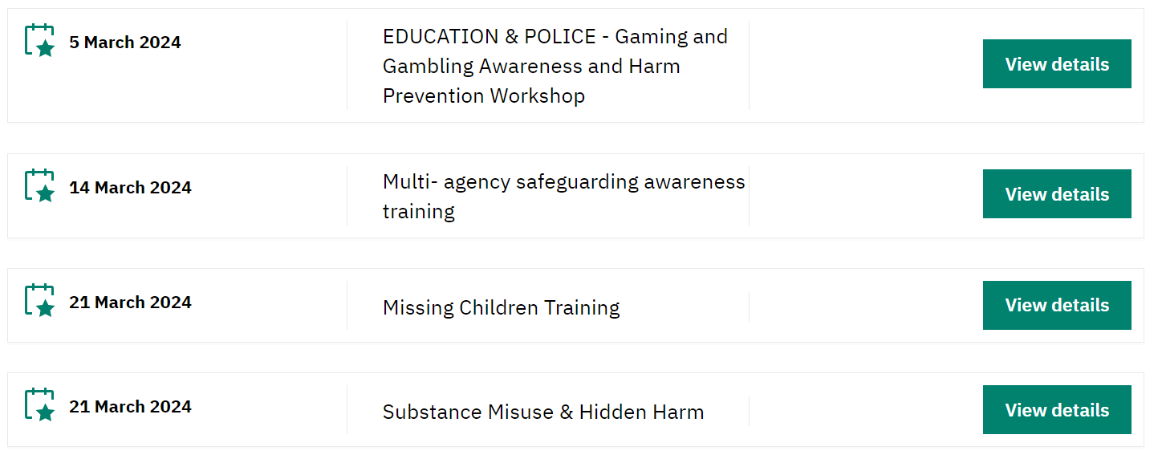
Training – Safeguarding Enfield
There is a great deal of quality (and FREE) training available from Safeguarding Enfield. Please take a look.
Training | Safeguarding Enfield

Slide 15
Training and Information - other
NSPCC Learning – low cost, well made, broad range
ESFA Fast Form (fasst.org.uk) – £1200 Government grant to train a Senior Mental Health Lead
https://youtu.be/OTJYYNP9AEc?si=q7RRMvBVjuWLouze – Ofsted webinar
Events - UK Safer Internet Centre – Online events and webinars
Filtering and Monitoring | SWGfL - a series of webinars
Home | KCSIE Webinar Series (orcula.co.uk) KCSIE 2023 webinars
Virtual College - free safeguarding courses
Safeguarding In Schools - Andrew Hall
Educate Against Hate - Prevent Radicalisation & Extremism

Slide 16
Ofsted Safeguarding Links
The OFSTED Update: https://educationinspection.blog.gov.uk/2023/11/09/how-we-inspect-safeguarding-in-schools/
The School Inspection Handbook: https://www.gov.uk/government/publications/school-inspection-handbook-eif/school-inspection-handbook-for-september-2023
The OFSTED Webinar: https://youtu.be/OTJYYNP9AEc?si=q7RRMvBVjuWLouze
OFSTED Webinar Scenarios: https://youtu.be/OTJYYNP9AEc?si=mKQU9tONaizJsYBk&t=2341
DfE SCR Webinar:
https://www.safeguardinginschools.co.uk/dfescr
SCR FAQs: https://6282.s3.eu-west-1.amazonaws.com/FAQs+KCSIE+Series+Webinar+2+-+Single+Central+Record.pdf
Scenario Transcripts: https://6282.s3.eu-west-1.amazonaws.com/How+Ofsted+inspects+safeguarding+in+schools.pdf
DfE’s ‘Keeping children safe in education’ webinars: https://kcsie.orcula.co.uk/home

Slide 17
Useful People, Useful Links
KCSIE 2023 | Keeping children safe in education - GOV.UK (www.gov.uk)
The Hub | Welcome to The Hub | Enfield Council
Safeguarding Enfield webpage | Safeguarding Enfield
Professional Learning Portal | https://traded.enfield.gov.uk/thehub/professional-learning-portal/safeguarding
Mind in Enfield | 0208 906 7505 mindinenfield.org.uk
Prevent Education Officer | New appointee from Feb 2024
HEART Team for Looked After Children and Post Adopted CYP | Suzanne.Rowson@enfield.gov.uk
MASH Service Manager | Michelle.Ferdinand@enfield.gov.uk
LADO (Bruno Capelo) | safeguardingservice@enfield.gov.uk
Enfield Educational Psychology Service | eps@enfield.gov.uk
CAMHS Crisis Line 24/7 | 24/7 Crisisline 0800 1510023 [9-5pm Monday to Friday all Crisisline calls get diverted to SAFE . T/N 0208 7024070]
Samantha Hill Senior School Improvement Advisor for Safeguarding and Inclusion | Samantha.Hill@enfield.gov.uk

