Slide 1
PLEASE DO SHARE
Would you like to contribute to this newsletter?
Email Samantha.hill@enfield.gov.uk
SAFEGUARDING
Weekly Round Up
29/09/2023
SEYIS
Schools and Early Years Improvement Service
Striving for excellence
www.enfield.gov.uk

Slide 2
Quiz
Question | Points
Q: What does the abbreviation KCSIE stand for? | 50
Q: What is the Single Central Record? | 50
Anagram Challenge: TOPTROEICN | 50
True or False: Schools MUST have a named Deputy DSL | 50
Two Minute Time Task: List the ways your school is proactive in its protection of children. | 50 (each)

Slide 3
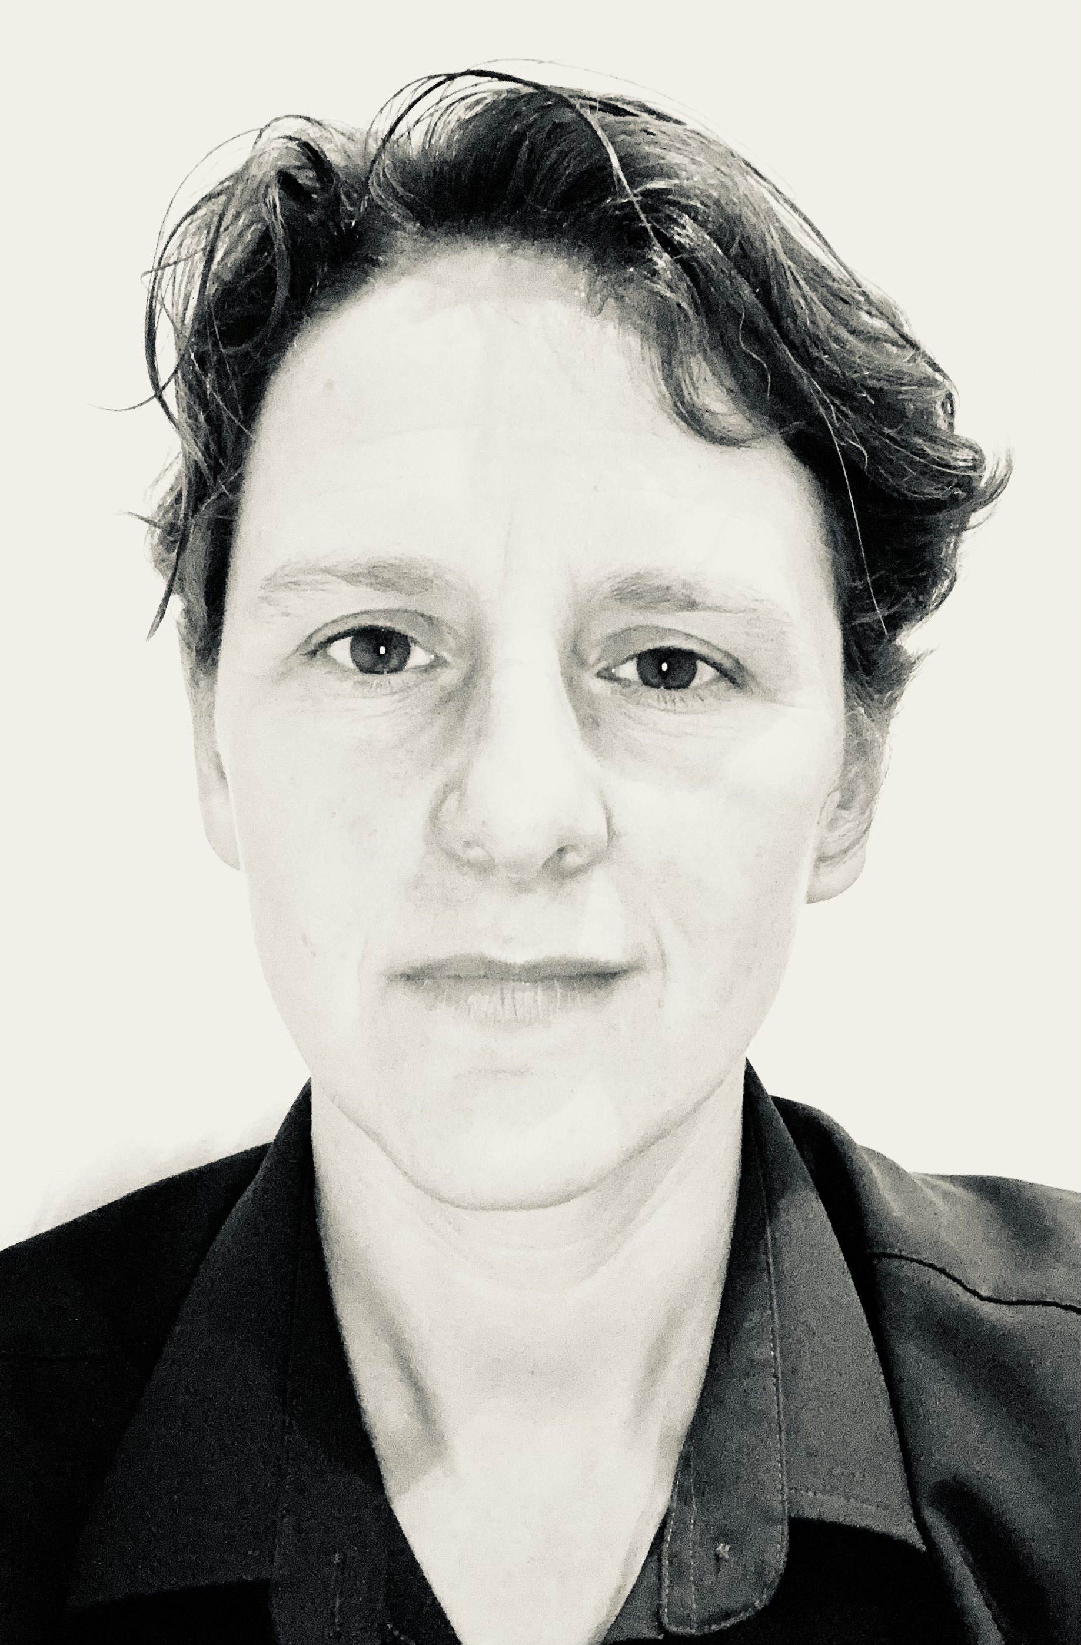
Introductions
Samantha Hill
Senior School Improvement Advisor (Safeguarding and Inclusion)
Email: samantha.hill@enfield.gov.uk
Tel: 07815479776

Slide 4
Updates – KCSIE 2023
KCSIE 2023
Keeping children safe in education - GOV.UK (www.gov.uk)
KEY CHANGES:
Addition of ‘filtering and monitoring’ responsibilities
Guidance and clarification about children who are missing or absent in education, including those who are absent for prolonged periods of time
Guidance for schools whose premises are used by other organisations
Guidance regarding safer recruitment, including online searches of candidates
Guidance regarding conduct the purpose of which is to cause a child to marry before their 18th birthday
http://safeguarding.info/kcsieposter

Slide 5
Other Updates
PREVENT DUTY
The Prevent duty: an introduction for those with safeguarding responsibilities - GOV.UK (www.gov.uk)
There are updates to the Prevent Duty in structure, protocol, terminology and expectation. The changes are designed to provide clarity and consistency and will be in place by December 2023. A new national referral form is being rolled out Making a referral to Prevent - GOV.UK (www.gov.uk) and there are renewed expectations for training and multi-agency co-operation for schools.
OUT-OF-SCHOOL GUIDANCE UPDATE
https://www.gov.uk/government/publications/keeping-children-safe-in-out-of-school-settings-code-of-practice
This non-statutory guidance dovetails with the KCSIE 2023 introduction of a duty on schools to have procedures in place to deal with allegations regarding an individual or organisation using school premises for non-school activities for children.

Slide 6
For Your Diary
DSL Network Planning Meeting
Got strong opinions? Or a useful idea?
Would you like to contribute to our planning meeting on the 31st October?
Email Samantha.hill@enfield.gov.uk
DSL Network 14th November 3.30pm
Email Felicia.Ferraro@enfield.gov.uk to book your free space.

Slide 7
Training – Available from Enfield
Book on our professional learning portal:
https://traded.enfield.gov.uk/thehub/professional-learning-portal/safeguarding

Slide 8
Training and information - other
Home | KCSIE Webinar Series (orcula.co.uk)
These recordings of 4 KCSIE 2023 webinars are free and informative
Safeguarding In Schools
If you haven’t already signed up to Andrew Hall’s free weekly briefing, then do it now! His entire site is filled with accessible and useful snippets; well worth a look.
Educate Against Hate - Prevent Radicalisation & Extremism
Links to videos, CPD plans and other resources

Slide 9
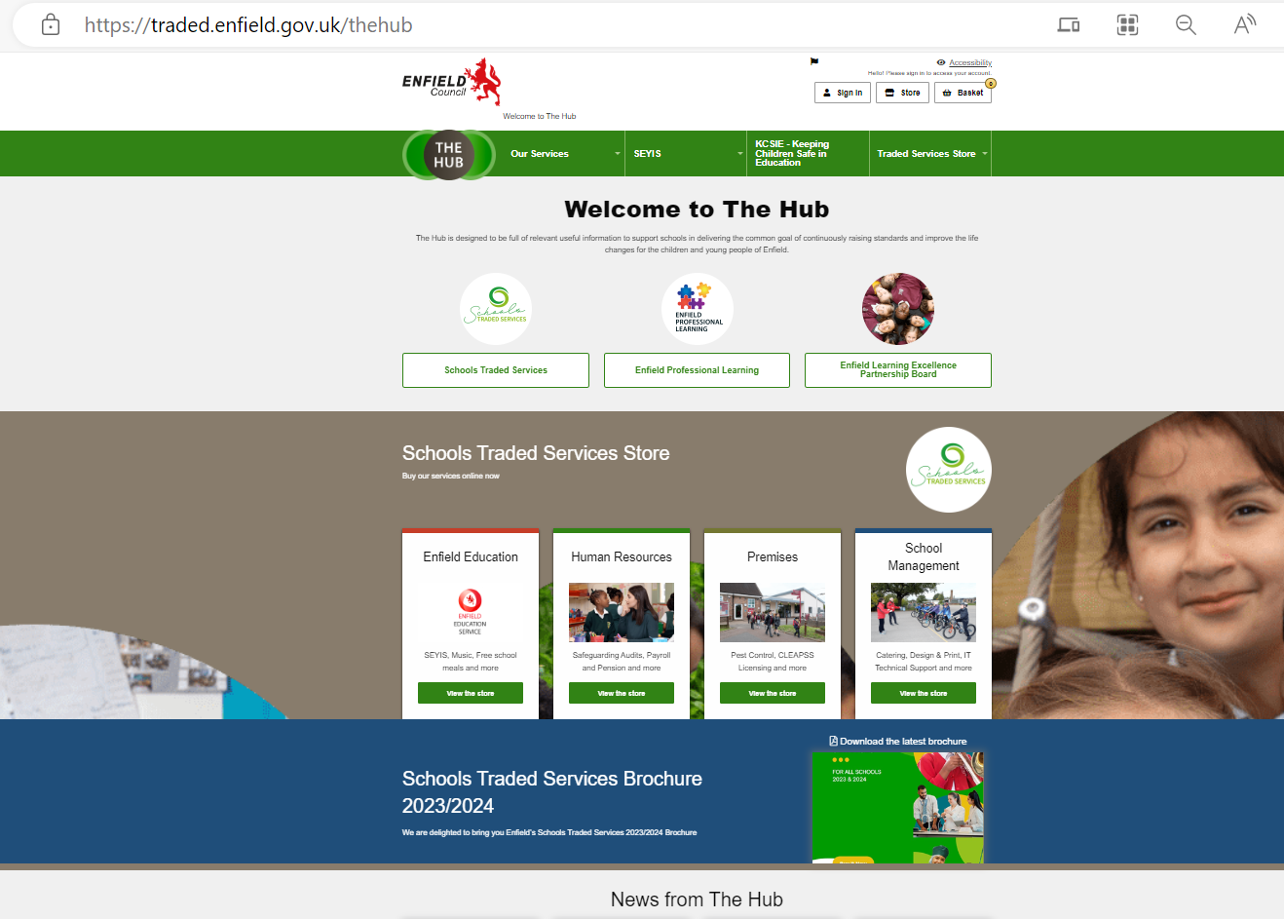
The Hub
Welcome to The Hub | Enfield Council
The Hub gathers useful resources and information for schools.
We are currently rebuilding the safeguarding pages.
What would be genuinely useful to you?
Email Samantha.hill@enfield.gov.uk

Slide 10
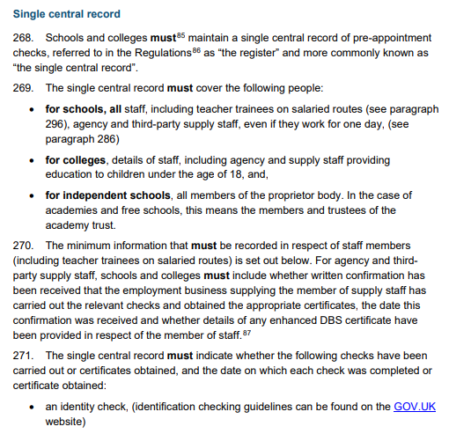
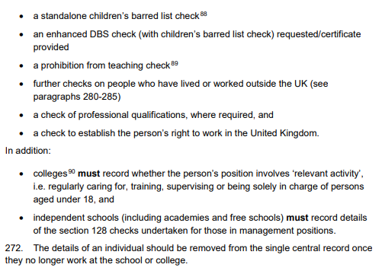
A Whirlwind Guide to…. THE SCR
SCR = Single Central Record. It is an extremely important and mandatory document which all schools must maintain without error. This should be regularly monitored by the headteacher or other senior leader. It is a live document.
Pages 71-83 of KCSIE 2023 specifies what needs to be included in the SCR
All adults who regularly visit the school should be included on the SCR. This includes agency staff, kitchen staff, cleaners, volunteers and regular contractors.
Some specific groups (e.g. student teachers who are not on payroll) do not need to be included but a letter of assurance from their provider should be attached to the SCR
The SCR needs to verify whether the following checks have been made:
Identity check
Enhanced DBS check
Children’s Barred List check
A Prohibition from Teaching check (teachers only)
A check on the right to work in the UK
Further checks on people who have lived or worked outside of the UK
A check of relevant professional qualifications

Slide 11
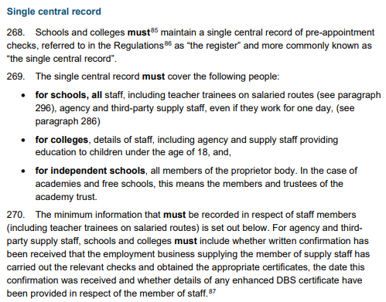
Questions we’ve been asked this week
Q: Do we have to move to an online recording system? Which one is best and how much do they cost?
ANSWER: No, there is no specification as to the type of recording system you use provided it is secure and up to date. An online system is often more efficient, particularly when it comes to analysing data or sharing records securely with other organisations.
There is a choice of software available. The most commonly used are CPOMS and Safeguard. We are looking into pricing and key features of each and will provide a summary in the next Round Up.
Q: Do supply teachers need to be recorded on the SCR?
ANSWER: Yes. The SCR is a live document and should contain checks on all adults working within your school. However, almost all supply agencies carry out full checks themselves and will provide a letter of assurance for their staff which you can attach to your SCR instead. You simply need to verify the identity of the person arriving at your school.
You can find full details on page 71 of KCSIE 2023
(copied right)

Slide 12
Useful People, Useful Links
KCSIE 2023 | Keeping children safe in education - GOV.UK (www.gov.uk)
The Hub | Welcome to The Hub | Enfield Council
Safeguarding Enfield webpage | Safeguarding Enfield
Professional Learning Portal | https://traded.enfield.gov.uk/thehub/professional-learning-portal/safeguarding
Statutory Policies guidance | Statutory policies for schools and academy trusts - GOV.UK (www.gov.uk)
Prevent Education Officer | Jenny.Merryweather@enfield.gov.uk
MASH Service Manager | Michelle.Ferdinand@enfield.gov.uk
LADO (Andreas Kyriacou) | safeguardingservice@enfield.gov.uk
Enfield Educational Psychology and Schools Emotional Well-being Service | EPS-SEWS@enfield.gov.uk
Samantha Hill Senior School Improvement Advisor for Safeguarding and Inclusion | Samantha.Hill@enfield.gov.uk

