Slide 1



DreamBox Reading Plus
Improving children’s life chances through education
Enfield Curriculum HT meeting
Ellis Sutherland – Reading Development Consultant

Slide 2

Reading Plus efficacy study with Derby Research School
September 2021 – July 2022
Summary of findings:
Over the academic year, Control school pupils achieved:
A 29% increase in test results from their first to the last test.
Reading Plus pupils achieved:
A 50% increase in their test results from their first to last reading paper.
A rise of six marks on their scaled scores.
PP children:
Pupil premium children using Reading Plus made 97% more progress than pupil premium children in the control schools.
EAL children:
EAL children using Reading Plus made 50% more progress than EAL children in the control schools.
SEN children:
Pupils identified as SEN who used Reading Plus made the most significant improvement throughout the study and achieved 119% more progress than SEN pupils in the control schools.

Slide 3

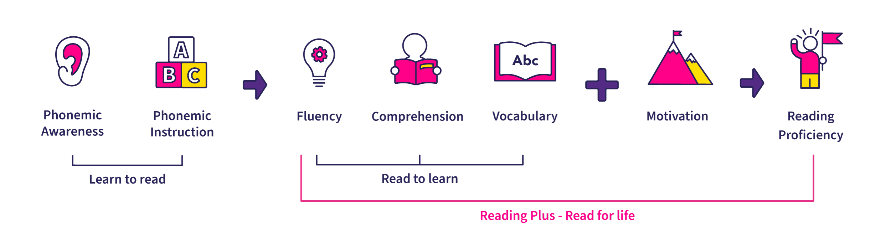
The Five Pillars of Reading

Slide 4

If you’re not a proficient reader this is what reading feels like
Notes:
This is Carla. She’s a 7th grade student reading below her grade level. You’re about to see how she reads silently - something a teacher can’t see. We know what disfluent reading sounds like, but we don’t know what disfluent reading looks like—until now. The red dot you see is where her eyes actually met with the test.
What can you see?
Yes! Lots of going back (regressions), lots of sticking on a word (Stops or fixation), lots of wandering around in the text. She’s also reading very slowly at 60 WPM. And all of these reading behaviors get in the way of comprehension.
Here is a more efficient student reading silently. You can see that they are reading much faster with fewer regressions, fewer fixations, and less wandering around in the text—in general, just more efficient reading.

Slide 5
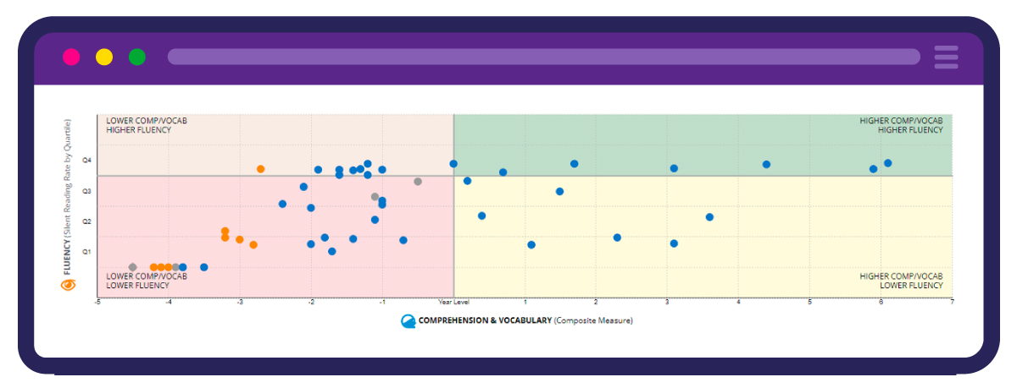
Screening Report

Slide 6

Book a FREE four-week pilot
We give you four weeks of full access to Reading Plus – so you are confident when you purchase the programme.
Ellis Sutherland – Reading Development Consultant

