Slide 1





Promoting Vocabulary Development
Tiered Vocabulary
@enfieldcass
ECASS@enfield.gov.uk
www.enfield.gov.uk

Slide 2
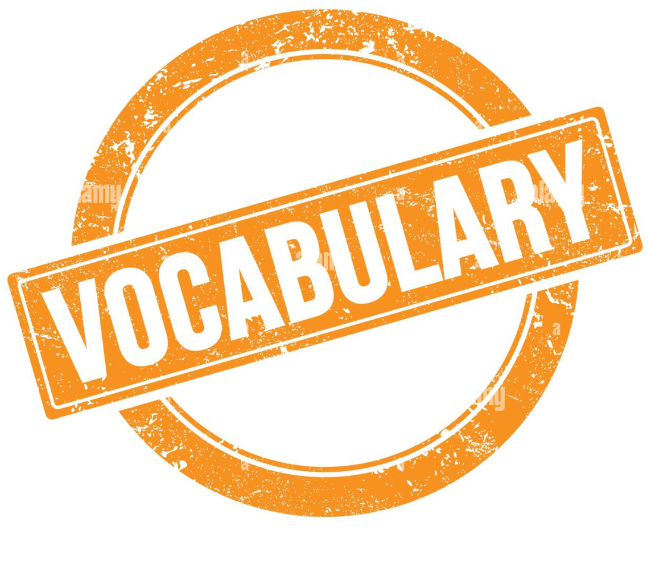

Statistics from 2020 ‘Bridging the Word Gap at Transition’ (Oxford University Press)
Almost half (49 per cent) of Year 1 pupils in the average UK primary school have a limited vocabulary (word gap) to the extent that it affects their learning.
The word gap is just as much of a challenge for UK secondary schools where, on average, 43 per cent of a school’s Year 7 students are felt to have a limited vocabulary to the extent that it affects their learning.
The word gap also affects pupils’ wider life chances, with over 80 per cent of teachers reporting that they believe it results in lower self-esteem. 82 per cent of secondary school teachers reported that pupils with limited vocabulary would be less likely to stay in education.
75% of schools believe supporting students with vocabulary is a high priority
Notes:
Word gap = children having vocab below age related expectations)

Slide 3
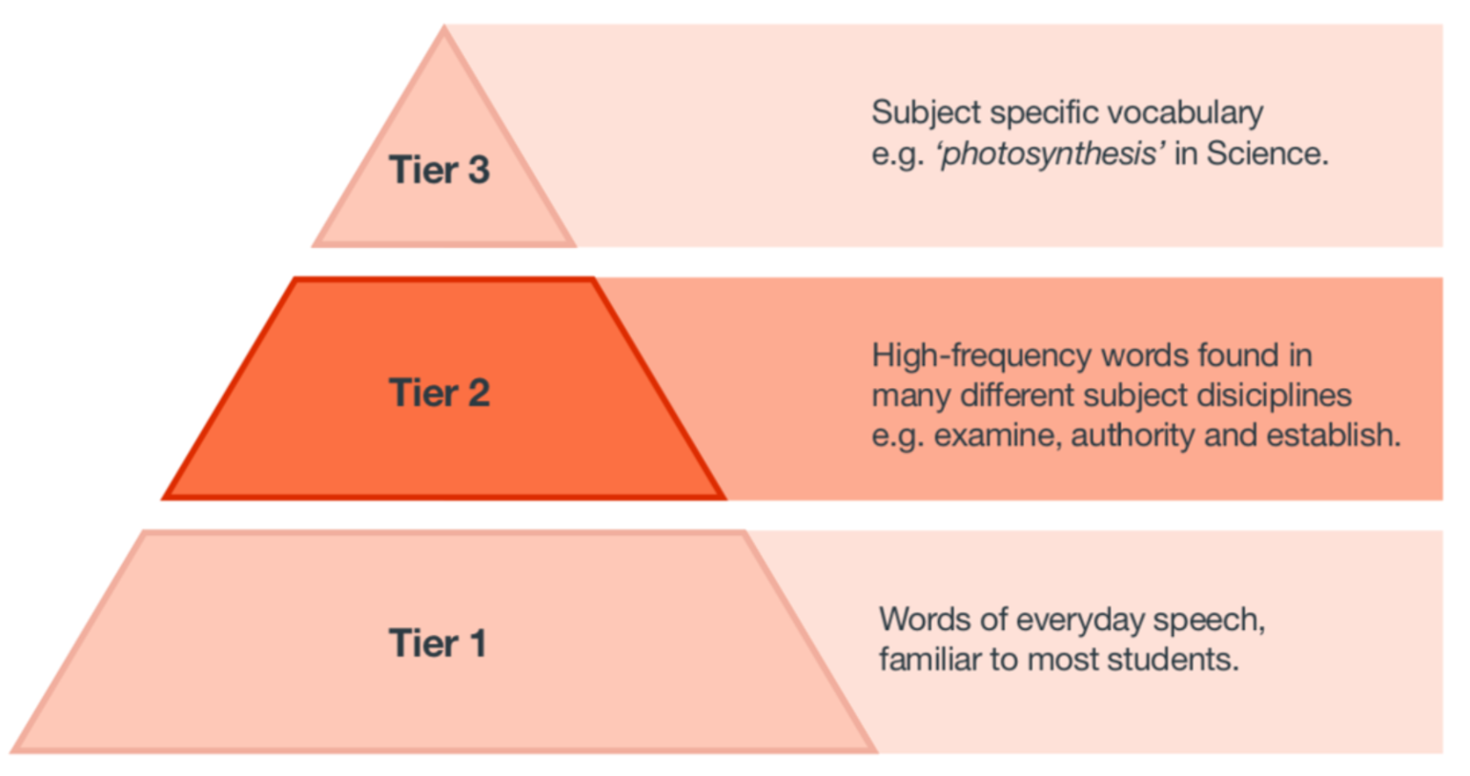
Types of words
When planning, make sure we are using words from different tiers
The pyramid is a way of categorising words and supporting our planning

Slide 4
Tier 1 words

Slide 5
Tier 3 Words

Slide 6
Tier 2 Words
Notes:
High frequency in written text
Low frequency in speech
Students need help with them and they tend to be taught less explictly

Slide 7
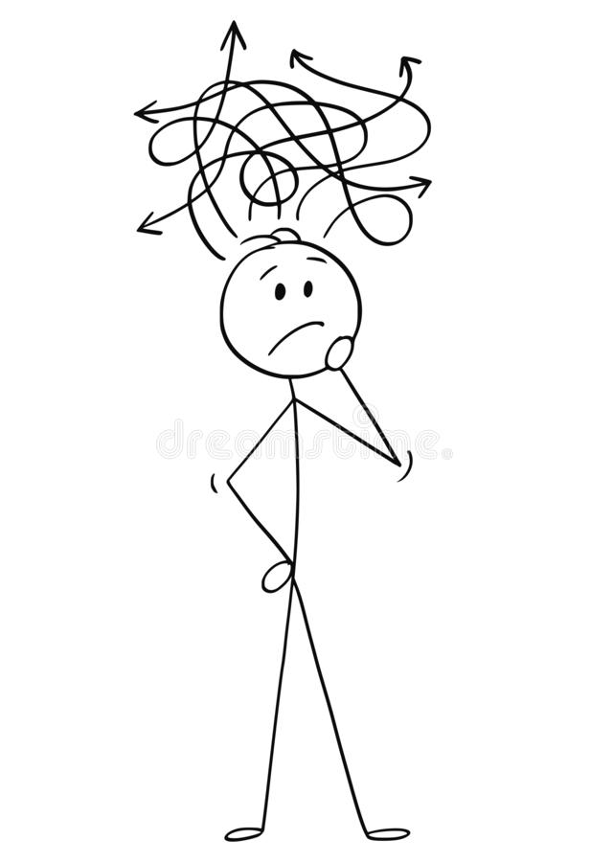
Tier 2 and 3 words
Tier 3 words are often taught using tier 2 vocabulary.
For example, to explain the word ‘propaganda’…
Propaganda – Poster used to persuade people to change their mind about a topic

Slide 8
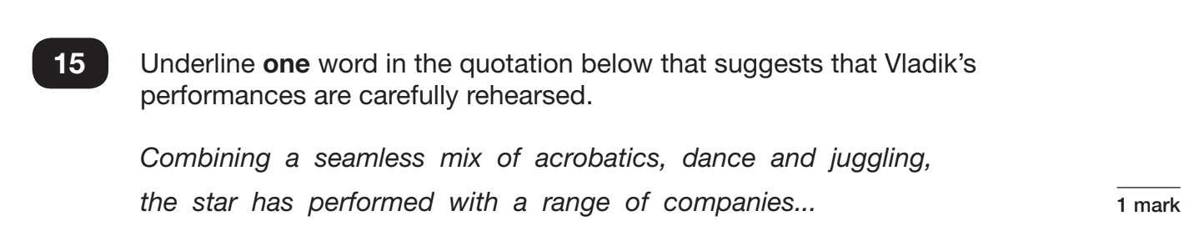
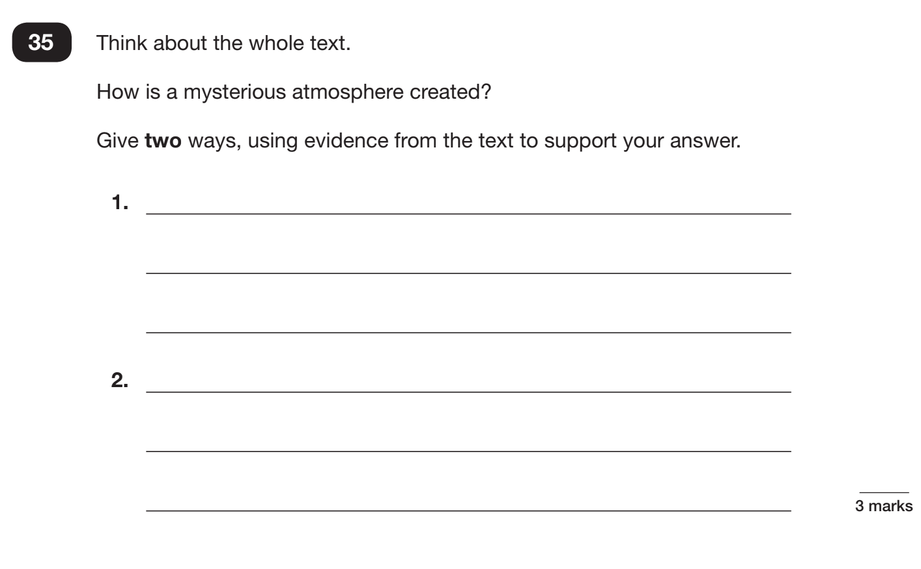
Why might a child be unable to access these Year 6 SATs questions?
Notes:
Think about the words rehearsed, seamless
Mysterious, atmosphere
Evidence
- Could all of your Y6 students access this text?

Slide 9
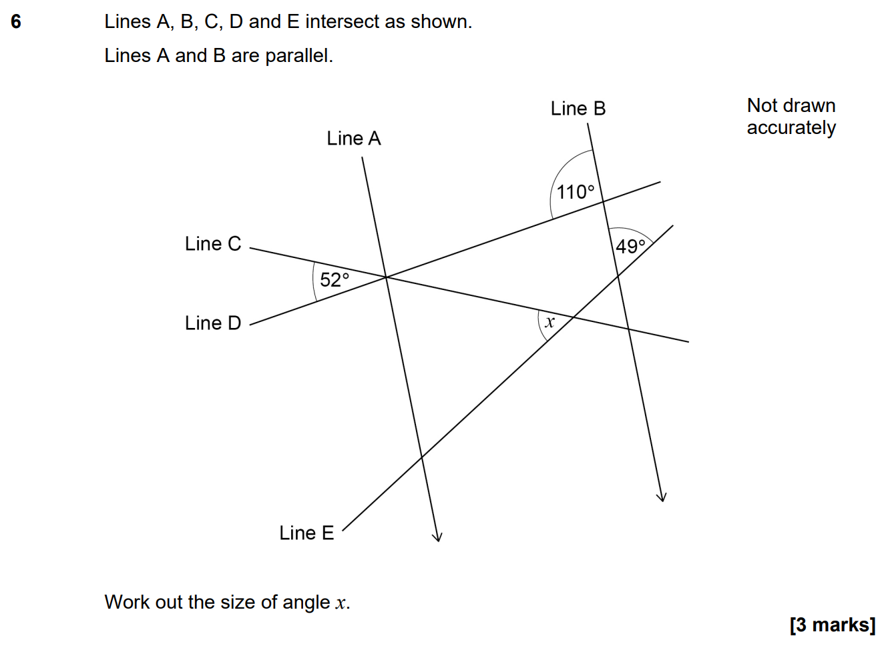
Notes:
2018-19 study showed a correlation between reading age and eventual performance in GCSEs. This found literacy levels were an even stronger predictor in Maths GCSE than in History or English literature – ‘justify’, ‘remaining’, ‘profit’, ‘loss’

Slide 10

Jonny Harrington was a kind master who treated his servants fairly. He was also a successful wool merchant, and his business required that he travel often. In his absence, his servants would tend to the fields and cattle and maintain the upkeep of his mansion. They performed their duties happily, for they felt fortunate to have such a benevolent and trusting master.
95%
90%
Matthew Effect
Merchant – shop keeper
Required – have to
Tend – look after
Maintain – keep going
Performed – did
Fortunate – lucky
Benevolent – kind
Provide a synonym!
Notes:
Need to know 95% to comprehend text
Less than 90% - probably in trouble
Matthew effect – greater our vocabulary the more vocabulary we will acquire

Slide 11

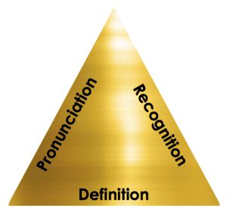
We will not have time to continually teach Tier 2 words in lessons.
Expose students to challenging texts = they automatically encounter more Tier 2 vocabulary.
Students can then concentrate on the ‘golden triangle’ of recognition, pronunciation and definition…
Recognition – how is the word spelt? Use phonics to decode vocabulary
Pronunciation – how is the word said? Making pupils say it aloud and use it in a sentence
Definition – what does the word mean? It might sound obvious, but if you know the meaning of a word, you’re much more likely to remember it.
Notes:
Explain that SALT is going to come back to this idea of being ‘word wise’ shortly

Slide 12
Frequent repetition, especially across different curricular activities
Being Word Wise
Heighten knowledge about the structure of words (phonological awareness)
‘Think of sound’
Strengthen general knowledge about the word (semantic awareness)
‘Think of meaning’
Syntactic awareness: using the word in a sentence appropriately

Slide 13
Strategies to support Tier 2
Reading for 20 minutes a day – exposure to text
Don’t assume knowledge of Tier 2 words – map them in to a whole school strategy
Word of the Week (Tier 2) – use Tutor time?
Use word investigations to support the whole school strategy of teaching Tier 2 words
Notes:
Reading - exposure to words. 20 mins day = 1,800,000 words a year

Slide 14
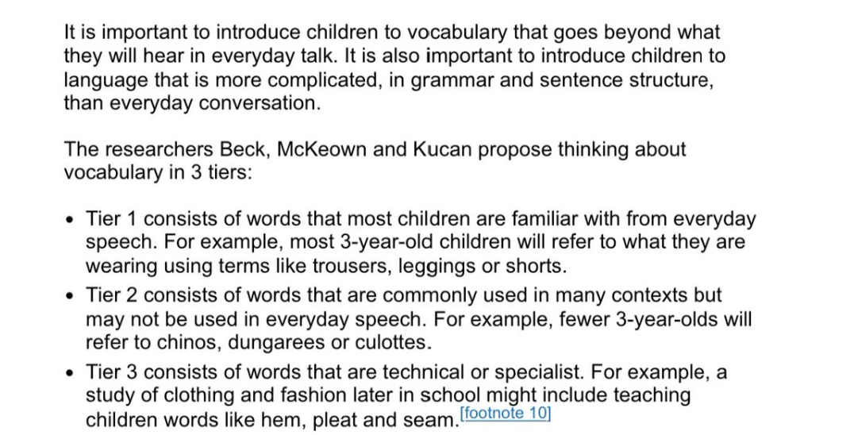
OFSTED reference to Tiered Vocabulary
Bringing Words to Life, Second Edition: Robust Vocabulary Instruction: Amazon.co.uk: Beck, Isabel L., McKeown, Margaret G., Kucan, Linda: 9781462508242: Books

