Slide 1
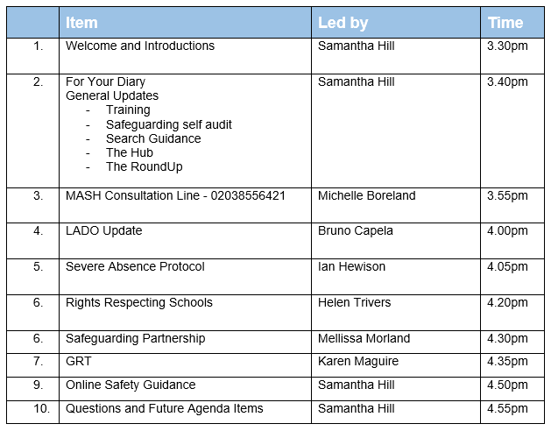
DSL Network
26th November 2024
Striving for excellence
www.enfield.gov.uk

Slide 2
November Bingo! What’s your score?
Heard more than four people say “isn’t it getting dark early?” | Had a child sneeze directly in your face | Have more than 5 Christmas themed events already in your diary | Your school has already had an issue with the heating/boiler/toilet pipes/icy pathways/Covid this winter
Picked up a more serious safeguarding issue from a tiny clue | Built a relationship with a child or family who can be difficult to reach | Provided a resource, referral or chat which made a genuine difference to a struggling family | Are currently a ‘trusted adult’ for at least 1 child
Passed the RoundUp onto the staff at your school | Attended any additional safeguarding training or supervision | Completed the Safeguarding Self-audit (or equivalent) and sent it in to us | Read the Keep Your Child Safe Online Guide (bonus points if it’s been shared with parents AND published on your website)

Slide 3
For Your Diary
Upcoming DSL meetings:
Tues 4 Mar 2025 – Planning meeting, 3.30-4.30
Microsoft Teams
Join the meeting now
Meeting ID: 349 824 733 006
Passcode: zkkyTA
Tues 18 Mar 2025 – Network meeting, 3.30-5.00
Microsoft Teams
Join the meeting now
Meeting ID: 385 926 110 442
Passcode: 4iz3Qg
Tues 10 June 2025 – Planning meeting, 3.30-4.30
Microsoft Teams
Join the meeting now
Meeting ID: 331 044 020 021
Passcode: WcVqzc
Tues 24 June 2025 – Network meeting, 3.30-5.00
Microsoft Teams
Join the meeting now
Meeting ID: 318 756 159 632
Passcode: GvceDH
Other dates for your diary:
Monday 9th December – Online Safety Guidance launch event
Wednesday 29th January – GRT Best Practice Meeting. Details to come.
Safeguarding self audit
Have you returned your audit yet? Autumn term is the ideal time to complete this. Any audit format is acceptable, but our form is easy to use, comprehensive and available on The Hub | Enfield Council. Send to seyis@enfield.gov.uk

Slide 5
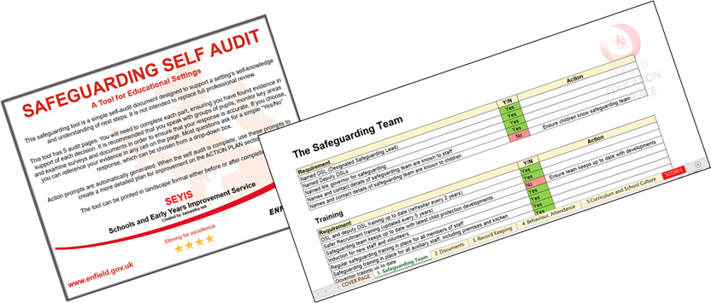
Annual Safeguarding Self Audit
Documents | Enfield Council
Our Safeguarding Self Audit Tool is a useful review of your school’s procedures and documents. Most schools complete an annual review using either this tool or an alternative document provided by their trust or partnership.
Enfield schools are expected to complete an annual safeguarding self-audit. This could be using our Enfield tool or any other document format.
When your school completes its annual audit for 2024-25, please return a PDF of the document to us at seyis@enfield.gov.uk.

Slide 6
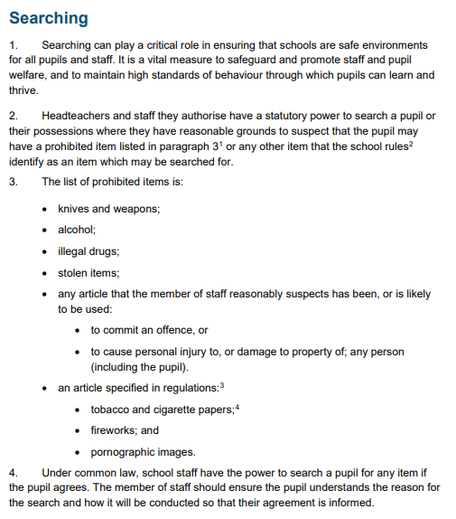
A Whirlwind Guide to… Searching and screening
Searching, Screening and Confiscation
If there are reasonable grounds to suspect that a pupil may have a prohibited item (see right), headteachers and the members of staff they authorise have a statutory power to search or screen
Note:
Possessions can only be searched if a second member of staff and the pupil are both present
No clothing should be removed except ‘outer clothing’ (coats, hats, scarves)
The child’s dignity should be preserved at all times
Schools should consider the age and needs of a pupil when conducting a search
The behaviour policy must be clear on what can be searched for and in what circumstances
A child carrying a prohibited item may be a victim of criminal exploitation. A referral to social services is needed if this is suspected.
The member of staff conducting the search should assess the urgency and risk to others before conducting a search.
All searches must be recorded and data analysed to ensure no group is unfairly targeted. Parents should be informed.
A risk assessment should be completed if the same child is routinely searched. The search should be warranted by the risks identified and the school should be sure that it has not acted unfairly.
Only the police can carry out more in depth searches. In this case, the school must advocate for the child’s wellbeing at all times.

Slide 7
A Quick Reference Guide
Safeguarding RoundUp | A weekly newsletter which gives an overview of updates, training and general information about safeguarding. Many schools share this with their entire staff body. Sign up: seyis@enfield.gov.uk
DSL Network Meetings | A half termly Teams meeting for DSLs and senior leaders, attended by most DSLs in the borough. Range of guest speakers and important updates. Dates and Teams links published in the Safeguarding RoundUp. Contact seyis@enfield.gov.uk.
The Hub | Lots of tools, documents and information to support your work in your school, including safeguarding audits, website audits, inclusion audits, online safety tools, signposting and model policies. Welcome to The Hub | Enfield Council
Safeguarding Enfield | Training, information and resources. Safeguarding Enfield
Safeguarding Self Audit | Your school is expected to return a self audit annually, using either our own Safeguarding Self-Audit Tool (available from The Hub or by emailing Samantha.Hill@enfield.gov.uk) or another format. It is recommended as part of your Autumn Term calendar. Email your document as a PDF to seyis@enfield.gov.uk
Ofsted/DfE/other official safeguarding complaints | These will be investigated either by the LADO or by SEYIS (Samantha Hill). We will contact you to explain the complaint and will request some relevant information from you, including the school’s narrative. A response is usually expected within a week.
Online Safety | New resources and guidance for Enfield schools and parents/carers, coming to you by half term. Guidance includes opt-out parenting courses for YR, 5, 7 and 9.
Safeguarding Reviews | Contact Samantha.Hill@enfield.gov.uk if you are interested in commissioning a full Safeguarding Review. We also offer SEND and curriculum reviews.
Advice and support | Contact me any time for reasons big or small. Always happy to help or point you in the direction of someone who can: Samantha.Hill@enfield.gov.uk

Slide 8
Michelle Boreland, MASH Team Manager
CHILDREN’S MASH
CONSULTATION LINE

Slide 9
Consultation Line - 0203 855 6241
The Consultation Line should be used when you have concerns about a child and have spoken to your Designated Safeguarding Lead and you feel you require further exploration around next steps on scenarios that you feel are above the threshold of Early Help, however, are unsure if they meet the threshold for safeguarding.
There is a professional expectation advice given will be followed and appropriately recorded within your own records.

Slide 10
Information that will help us to advise you Child’s age What the concern is If you’ve had previous safeguarding concerns – particularly of the same nature What you have already done If you have already spoken to the parent what their views were
What the consultation line is not for…
The consultation line cannot be used for queries on open cases – you should be speaking to the allocated SW or their manager
It is not to discuss the outcome of a previous referral, chase an outcome or provide updates on referrals already made
It is not used for making referrals by phone – you will be asked to use the portal

Slide 11
How to contact the children’s MASH team
Consultation Line - 0203 855 6241
(10am – 2pm Monday to Friday for professional use only)
Enfield Multi Agency Safeguarding Hub MASH) - 0208 379 5555
(Monday to Thursday 8.45am to 5pm and Friday 8.45am to 4.45pm)
Outside of normal office hours contact the Emergency Duty Team - 0208 379 1000
(select option 2 and you will be transferred to an advisor)
This should be used for cases which cannot wait until the next working day
You can make a referral via www.enfield.gov.uk/childrensportal

Slide 12
4pm LADO Update – Bruno Capela

Slide 13
4.05pm Severe Absence Protocol – Ian Hewison

Slide 14
4.20pm Rights Respecting Schools – Helen Trivers

Slide 15
4.30pm Safeguarding Partnership – Mellisa Morland

Slide 16
4.35pm GRT – Karen Maguire

Slide 17
GRT Gypsy, Roma, Traveller, Showman, Boatman
It is estimated that almost every school in Enfield has children with a GRT heritage enrolled. For multiple reasons, not least a long history of significant persecution, many of those with a GRT background are reluctant to share this information and may not have been identified by your school. This group of children has significant and particular vulnerabilities. There are community sensitivities which are essential for schools to understand in order to be able to offer effective support and combat discrimination.
It is essential that your school protects, supports and safeguards these children.
Has your school signed the GRT Pledge? Signing up is easy and the guidance is easy to follow.
Find out more here: GTRSB-Pledge-for-Schools-Report_FINAL.pdf
GRT Best Practice Meeting: Wednesday 29th January, details to be confirmed. We recommend that every school in Enfield is represented in this meeting.
Are these dates in your school diary?
Gypsy, Roma and Travellers in Enfield | Enfield Council
Email: karen.maguire@enfield.gov.uk

Slide 18
Keep Your Child Safe Online Quick Stats Quiz
Question | Answer
The majority of parents do not believe their child has viewed pornography online. What percentage of children report that they have viewed pornography by the age of 14?
What percentage of children have had online sexual interaction with an adult?
How many unique child sexual images are recorded in the Child Sexual Abuse Database (figure from 2019)?
What percentage of children have accessed hateful content online?
Online suicide and self harm sites have been indicated in what percentage of young suicides?
Alexander McCartney from Co Armagh was sentenced to 20 years in jail for what?
What is the number one way we can protect our young people from online harm?

Slide 19
Keep Your Child Safe Online Quick Stats Quiz
Question | Answer
The majority of parents do not believe their child has viewed pornography online. What percentage of children report that they have viewed pornography by the age of 14? | 94% (10% by the age of 10)
What percentage of children have had online sexual interaction with an adult? | 5-25%
How many unique child sexual images are recorded in the Child Sexual Abuse Database (figure from 2019)? | 8.3 million
What percentage of children have accessed hateful content online? | Up to 69%
Online suicide and self harm sites have been indicated in what percentage of young suicides? | 25%
Alexander McCartney from Co Armagh was sentenced to 20 years in jail for what? | Catfishing: Alexander McCartney jailed for minimum of 20 years - BBC News
What is the number one way we can protect our young people from online harm? | TALK

Slide 20
Keep Your Child Safe Online A Guide for Parents, Carers and Guardians
Our comprehensive, research-based guidance for schools and parents and has been sent to schools and services.
Please share with all parents now. Please also place the Guide on your school website, and display the poster at your school.
Schools are expected to deliver training for parents and staff later in the year.
Materials are published here:
Online Safety | Enfield Council
Training is available for schools and services on
15th January, 330-430pm
A launch event will be held at Carterhatch Junior School on Monday 9th December at 4pm

Slide 21
Any questions?

