Slide 1
Kinship Care
Jane Manning
Children Previously in Care and Kinship Education Officer
www.enfield.gov.uk

Slide 2
Kinship Care
Kinship care is any situation in which a child is being raised in the care of a friend or family member who is not their parent. Grandparents are the most prevalent carers, but also elder siblings, aunts, uncles, step- parents or siblings, as well as family friends.
Nationally, there are 130,000 children in kinship care in England – 3 times as many as in mainstream foster care – yet many people have never heard of kinship care.

Slide 3
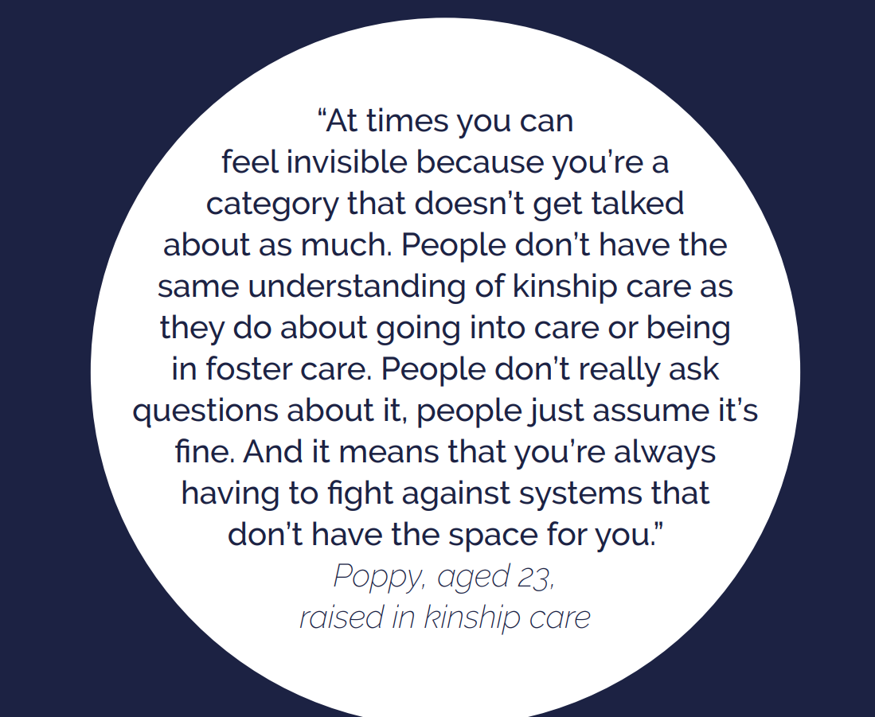

Slide 4
Who are they?
Kinship families are very varied and there are different legal arrangements, which can make it very confusing. Some children – if they have ever been in care – are entitled to Priority School Admission and Pupil Premium Plus. Others, who may have identical needs, will not be entitled to this additional support.
It is important to remember, that these are children who will almost certainly have suffered early childhood trauma and disrupted attachments. Many will have suffered abuse or neglect and been removed from their parents – yet schools may not even know who they are.

Slide 5
Enfield Stats
For 2024-25 there were 43 Special Guardianship Orders (SGO’s) of children in care, and this equates to 27 households being granted SGO’s, as there were a number of sibling groups who made up the total number of SGO’s made.
There were 7 children who were not in care made subject to SGO's, and this equates to 3 households.
There were 3 adoption orders made in 2024 – 25.
TOTAL – 53 children / young people in Enfield in one year.

Slide 6
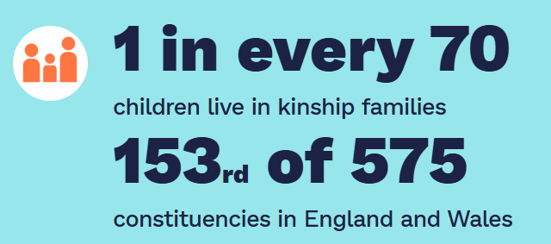
Edmonton and Winchmore Hill
Figures from KINSHIP

Slide 7
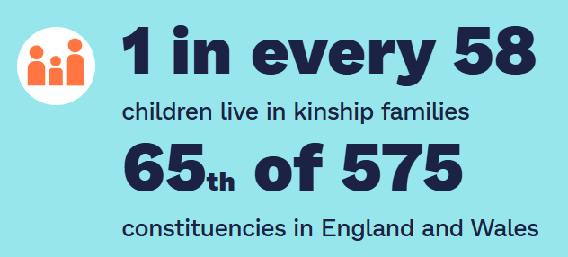
Enfield North
Figures from KINSHIP

Slide 8
Census Information
Is this a true reflection?

Slide 9
Disadvantaged group
There is currently a big focus on kinship care by the DfE and social care. This is because they are a vulnerable group, who have gone under the radar for a long time.
8% of kinship carers use a foodbank
17% have been unable to take on an additional sibling and so siblings are separated
75% of kinship carers have at least one measure of deprivation.

Slide 10
Educational Needs
Children who grow up in kinship care have better outcomes than children who grow up in other types of non-parental care. However, their outcomes fall behind those children with no social worker involvement.
47% of kinship carers surveyed by Kinship said their child had a special educational need or disability.
Kinship children are 5 times more likely to be attending a special school, than all pupils in England and Wales.
10% of those surveyed said their child has a diagnosis of ASD.
1 in 3 children in kinship care have SEMH needs.

Slide 11
Educational Needs
Kinship children in England were over three times more likely to have an EHC plan than all pupils, but far less likely than other social care groups.
There are discrepancies between the amount of support received, dependent on the type of kinship care, with those in kinship foster care receiving the most support, and those in informal arrangements the least. This is due to the differing entitlements dependent on legal orders. There is currently pressure on the Government to equalise support.

Slide 12
What support is available for those children who were previously in care?
Priority Admission:
Along with CIC, children previously in care are given the highest priority in school admissions. This means that even if a school is over-subscribed, or a year group is “full”, they will still be awarded a place.
This applies to all children previously in care – whether adopted in England or elsewhere from “state care.”
It does NOT apply to children who were never LAC.

Slide 13
Pupil Premium Plus and Children Previously in Care
Not a personal budget
From September 2025, this will be £2630.
The funding should be used to help meet the needs of the cohort of children who were previously looked after, but also for the first time: “to support other pupils with identified needs, such as those who have or have had a social worker, or who act as a carer.”
This can also include children in kinship arrangements who weren’t previously in care.
Vulnerable groups – those on CiN / CP Plans / Children in Care – similar needs.

Slide 14
Communication
Essential that DSL’s are aware of who these children are. Close communication is essential with:
Parents and carers (identify the children – VS has a model letter, but also put information regarding additional support in new starter packs and make regular requests in newsletters etc)
Designated teacher for children in care / previously in care
Class or form teachers
Subject teachers – certain topics can be triggering – eg sex education, family trees

Slide 15
Support offered by the Virtual School
For all kinship carers, we hold termly education coffee mornings whereby they can meet other carers in their position and discuss educational issues such as transitions, SEN, homework etc.
The Virtual School website contains information and advice.
If a child is at risk of suspension or exclusion please contact jane.manning@enfield.gov.uk

Slide 16
Enfield Virtual School
What do we offer?

Slide 17
Enfield Virtual School Website. Take a look at the advice and guidance available to schools and professionals as well as parents and carers.

Slide 18
Resources available

Slide 19
Who To Contact at the Virtual School
For queries regarding children in care: virtualschool@enfield.gov.uk
For advice and guidance regarding children with a social worker (CP & CIN): malaika.Williams@enfield.gov.uk
For advice and guidance regarding children who were previously in care, children who are adopted, live in kinship care, or under a Special Guardianship Order or Child Arrangement Order, please contact: jane.manning@enfield.gov.uk

