Slide 1
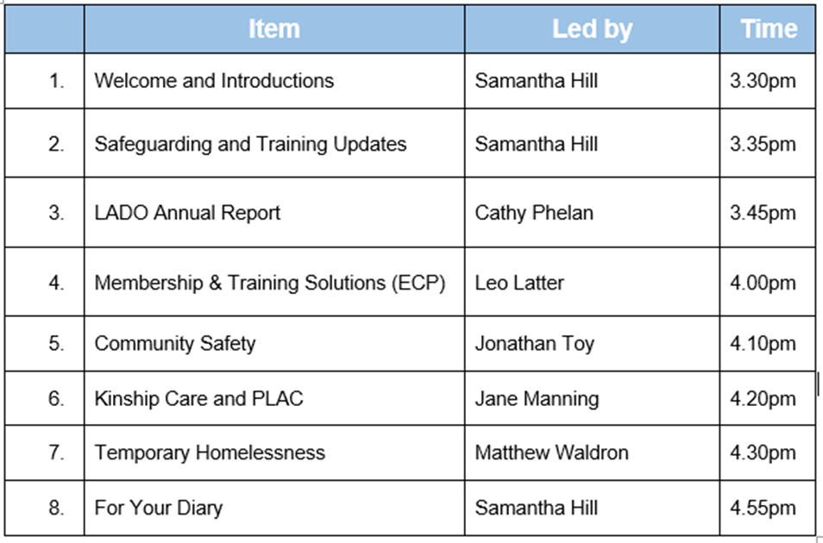
DSL Network Meeting
24th June 2025
SEYIS
(Schools and Early Years Improvement Service)
www.enfield.gov.uk

Slide 2
LOVE IS THE RUNNING TOWARDS
I saw this on a fire station in Shoreditch, and was reminded of the work all of us in safeguarding do each and every day. Much of what we do is thankless and running away can seem like a very attractive option – but we run towards, to help the children who need us to be brave.
Thank you for all you have done this year – and well done!

Slide 3
END OF YEAR BINGO! How many points do you have?
* No actual prizes
Sent us your self audit [100] | Put on opt-out Keep Your Child Safe Online courses for parents [100] | Attended DSL Network and other local events/working parties [100]
Stood your ground against a stubborn senior leader or challenging parent because you know it’s in the best interests of a child [100] | Did a little investigating on the back of a minor change in behaviour and uncovered a much more serious safeguarding issue [100] | Stayed late at school to await social services / the police [100]
Initiated another member of staff into the world of DSLing [100] | Seen a child or family change for the better in front of your eyes because of work your school has done [100] | Made plans for rest, relaxation and a pinch of fun over the summer – because you are a lighthouse on a rock and your self care is essential [100]

Slide 4
What has happened to KCSIE 2025?
We usually receive a draft of KCSIE in May, but even the grapevines are quiet. The silence is noticeable. What has happened?
The Labour government came to power only a year ago and timelines may have been altered or priorities reset
Ongoing consultations and research. The 12 week Call for Evidence in 2024 that KCSIE would draw from was never published.
The Children’s Wellbeing and Schools Bill is still making its way through parliament, as is the Crime and Policing Bill. An updated KCSIE is unlikely before key parts of these bills are agreed.
What can we expect when it is finally published?
Here’s an educated guess:
Alignment with these key bills
Changes to aspects of DSL role, possibly moving to shared leadership of safeguarding
Mandatory reporting of sexual abuse
Greater emphasis on AI and digital safeguarding
Stronger multi-agency partnership work and local oversight
So we suggest you hold off on writing new policies, keep your INSET plans a little flexible, and watch this space…

Slide 5
Professional Learning
Designated Safeguarding Leads Training - £80
To book – click here

Slide 6
Holiday Activities and Food Programme (HAF)
HAF is running over the Summer holidays
DfE funded programme for children Reception to year 11 in receipt of benefits related free school meals
Each programme provides hot food and a varied programme of physical and enriching activities
Attending holiday programmes keeps children safe, fed, active, engaged and in a routine for when they return to school after the holidays
Vouchers will be issued to all eligible children on 26th June
Please help to promote this programme to all of your eligible children

Slide 7
Holiday Activities and Food Programme (HAF)
Many schools host so please help us to promote
Ark John Keats
Aylward Academy
Bush Hill Park Primary
Chase Side Primary
Churchfield Primary
De Bohun Primary
Eldon Primary
Enfield Grammar
Eversley Primary
Fern House
Firs Farm Primary
Fleecefield Primary
Galliard Primary
Garfield Primary
Grange Park Primary
Houndsfield Primary
Latymer All Saints Primary
Oasis Academy Enfield
Oasis Academy Hadley
Orchardside
Prince of Wales Primary
Raynham Primary
St Michaels Primary
Suffolks Primary
West Grove Primary
Woodpecker Academy

Slide 8
Contact details
Professional.learning@enfield.gov.uk
haf@enfield.gov.uk

Slide 9
FOR YOUR DIARY
Thursday 3rd July - Enfield Inclusion Exhibition
Tues 16th September – DSL Network (planning meeting)
Microsoft Teams Need help?
Join the meeting now
Meeting ID: 373 883 018 830 7
Passcode: br3i2uY6
Tues 23rd September – DSL Network (full meeting)
Microsoft Teams Need help?
Join the meeting now
Meeting ID: 386 180 017 075 5
Passcode: FT7sC9Qq
Don’t forget
your
self-audit
Or your Online Safety parent workshops

