Slide 1
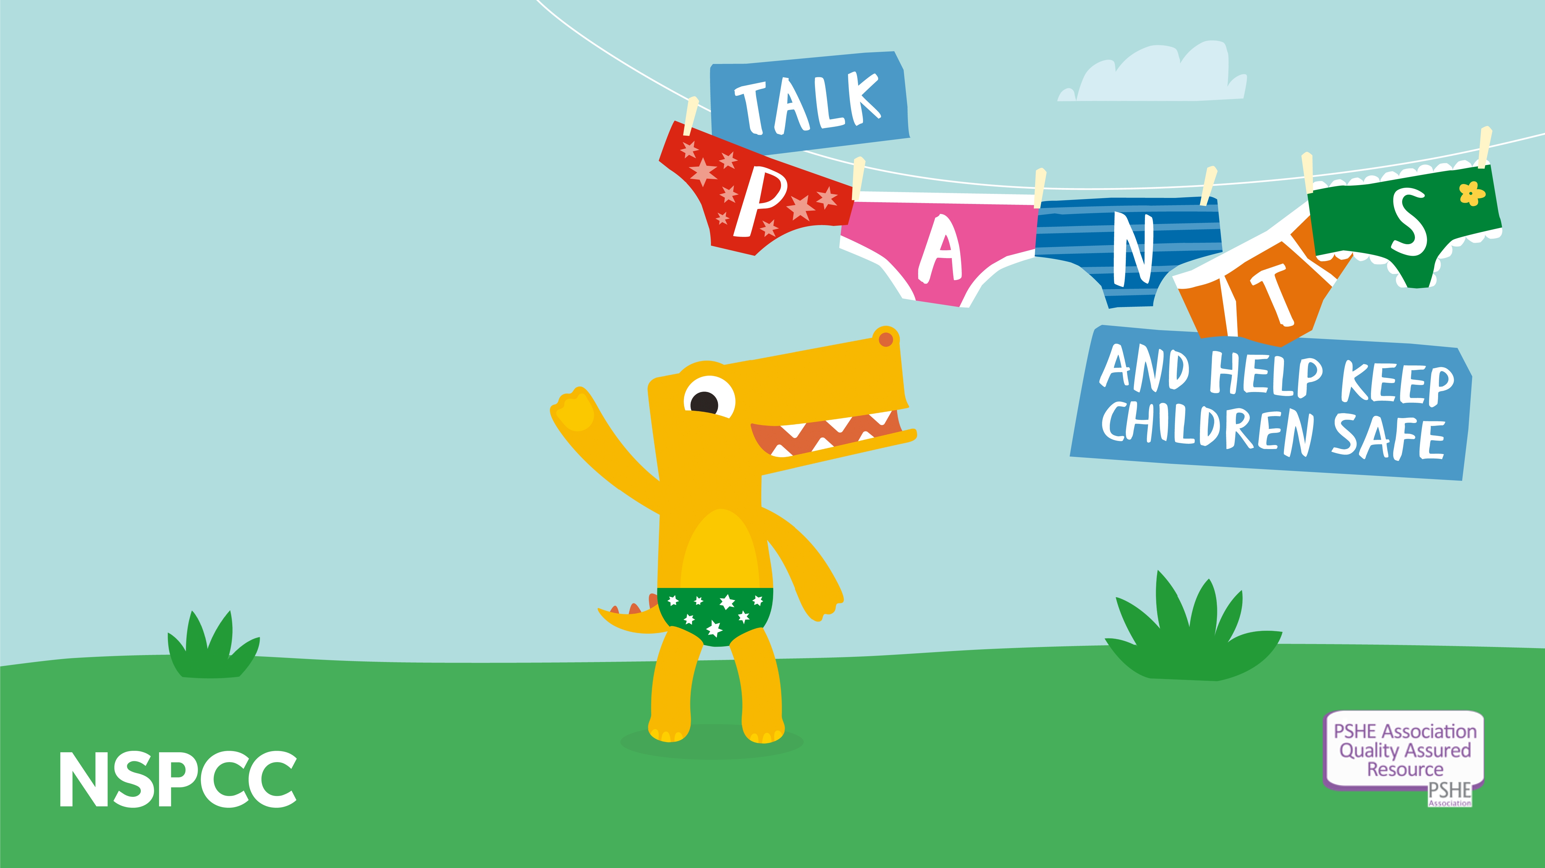

Insight session
Notes:
Thank you for having me – My name is Abi, the NSPCC Schools Coordinator for N. London.

Slide 2

Session overview
Aims of Talk PANTS
Why we talk PANTS
Overview of the Talk PANTS teaching resources
Further Talk PANTS resources, including information for parents/ carers
Wider NSPCC signposting/ resources
Notes:
This will be a short insight session to go through our updated Talk PANTS offer, what’s new and wider resources.
A reminder that NSPCC Helpline is also available if you have a concern about a child.
If you have any questions at any point please do jump in!

Slide 3
Aim of Talk PANTS
The Talk PANTS campaign launched in 2013
Talk PANTS aims to support parents, carers and professionals to help keep children safe from sexual abuse
Talk PANTS is about having simple and age-appropriate conversations with children aged 3-11.
We know that simple conversations can make a big difference and that’s what Talk PANTS is all about.
Notes:
As many of you may know..

Slide 4

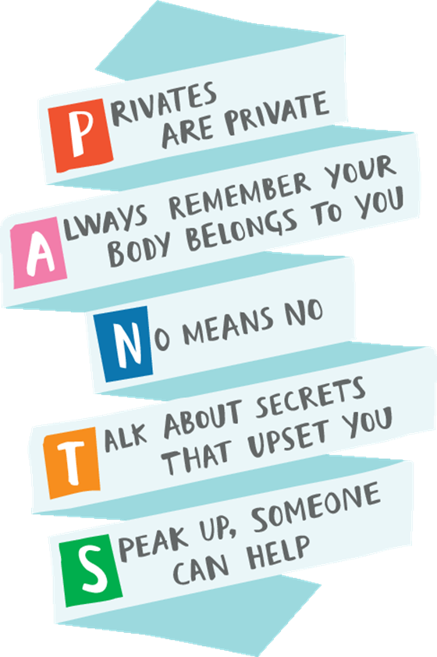
The PANTS rules
Notes:
We Talk PANTS by using our 5 rules that spell out PANTS – we want children to both be familiar with the rules AND to understand what they mean (for stakeholders who used the old PANTS teaching resources pre September 23, it may help to explain that the new teaching resources are more detailed with the aim of increasing dosage, impact and understanding).
NOTE TO PRESENTERS - You may choose to state the rules below or read them in full, as appropriate for your audience and timings..
P- underwear or swimwear covers up your private parts and that private means private.
Be clear with your child that parts of their body covered by underwear or swimwear (so including top half for girls) are private.
Explain to your child that no one should ask to see or touch their private parts or ask them to look or touch anyone else’s.
Sometimes doctors, nurses or family members might have to. Explain that this is OK, but that those people should always explain why, and ask your child if it’s OK first. Example of GP/ child interaction –child saying ‘no’ to GP asking to examine under child’s underwear. GP pleased to get advice from young patient about PANTS rule. Important professionals are aware of campaign -may be involved in more “PANTS-related” conversations
Within this message it’s a good idea to seek permission from their children for all sorts of things eg: to look at a cut or sore. This starts encouraging children to be confident in giving or not giving consent, and that this is their right
A-Let your child know their body belongs to them, and no one else.
No one has the right to make them do anything that makes them feel uncomfortable.
If someone asks to see or tries to touch them underneath their underwear they must say no – and tell an adult they trust. This might be a family member, a teacher, support worker or doctor.
We are emphasising children’s rights here also with this message.
We want to encourage parents to reinforce to their children that they can talk to them about anything that worries or upsets them, as well as any other trusted adult.
N- Make sure your child understands that they have the right to say “No” to unwanted touch – even to a family member or someone they know or love.
They’re in control of their body and no-one should ever make them do things that make them feel uncomfortable.
These messages are trying to move away from old ways of parenting, where children simply did as they were told by an adult without question, even if they felt uncomfortable.
T- Your child needs to feel able to speak up about secrets and other things that worry them and confident that saying something won’t get them into trouble.
Explain the differences between ‘good’ and ‘bad’ secrets. Bad secrets make you feel sad, worried or frightened, whereas good secrets can be things like surprise parties or presents for other people which make you feel excited.
Any secret should always be shared in the end.
Some families never use ‘secrets’ as a phrase and that is good but we must recognise that often children discuss having secrets and make sure they know the difference in good and bad secrets if they do use this term.
S-So if they ever feel sad, anxious or frightened they should talk to an adult they trust, so they can help.
Reassure them that whatever the problem, it’s not their fault and they will never get into trouble for speaking out.
And it doesn’t have to be a family member. It can be a teacher or a friend’s parent for example.
They can also call Childline on 0800 1111 and a friendly person will help. Childline also has a website which includes peer support via message boards (moderated by NSPCC) and offers 1 to 1 live counsellor chat

Slide 5

Talk PANTS teaching resources
Notes:
Now we're going to look at the Talk PANTS resources, we will go over the updates and what is available to you.

Slide 6
Teaching guidance overview
Talk PANTS overview
Lessons structure
Safeguarding
Reporting concerns/disclosures
Trauma-informed practice
Protective interrupting
Ensuring a safe learning environment (distancing, handling questions, signposting support)
Appendices
Template parent/carer letter
Curriculum references
‘I have a question’ cards
Notes:
Before starting your teaching of the material, it is recommended that you read the teaching guidance. It is a comprehensive 16-page document covering everything you need to know on how to help teach children about Talk PANTS safely and confidently. There is also a template letter for parents/ carers to outline the resources and support working with your parents/ carers to continue these important conversations at home. Implementing a whole school approach.
This includes new trauma informed approaches, including protective interrupting to interrupt public disclosures. An example is saying something like “Can I pause you there? I need to give you my full attention, so I’ll come and talk to you at the end of the lesson”. Trauma informed approaches are critical at the NSPCC to support children who have experienced abuse in the past.

Slide 7

Lesson plans overview
 | Age group | Resources
Early years | 3-4 | 1 learning opportunity plan
 | 4-5 | 1 learning plan with PowerPoint
Children aged 5-11 | 5-7 | 2 lesson plans, each with PowerPoint and supporting resources
 | 7-9 | 1 lesson plan with PowerPoint and supporting resources
 | 9-11 | 1 lesson plan with PowerPoint and supporting resources
SEND /ASN/ALN | 4-11 | 1 lesson plan with PowerPoint and supporting resources
Notes:
Talk PANTS is designed to embed learning for children as they progress through their primary education (ages 3 – 11). Evidence shows that continued / repeated learning about CSA prevention across time helps to keep children safe.
The resources for 3 – 5 year olds include opportunities for introducing the PANTS rules through both direct, teacher-led activities and more spontaneous, indirect activities. This can include a variety of books e.g. the Pantosaurus story book and the Pantosaurus song.
There are then 2 lesson plans for children aged 5 – 7, which help them recognise their rights over their own body and who can keep them safe.
There is one lesson plan for children aged 7 – 9 and a final lesson for children aged 9 – 11, which help them to develop a deeper understand of the PANTS rule, by exploring appropriate and inappropriate touch. This also gives schools an opportunity to address peer-on-peer abuse, where relevant.
There is also a specific lesson designed for children aged 4 – 11 with SEND, additional needs and/ or autism. This is designed to be flexible to best meet the specific needs of the pupils in your setting and is open to be further adapted. SEND guidance can be used separately and/or alongside other teaching guidance.

Slide 8

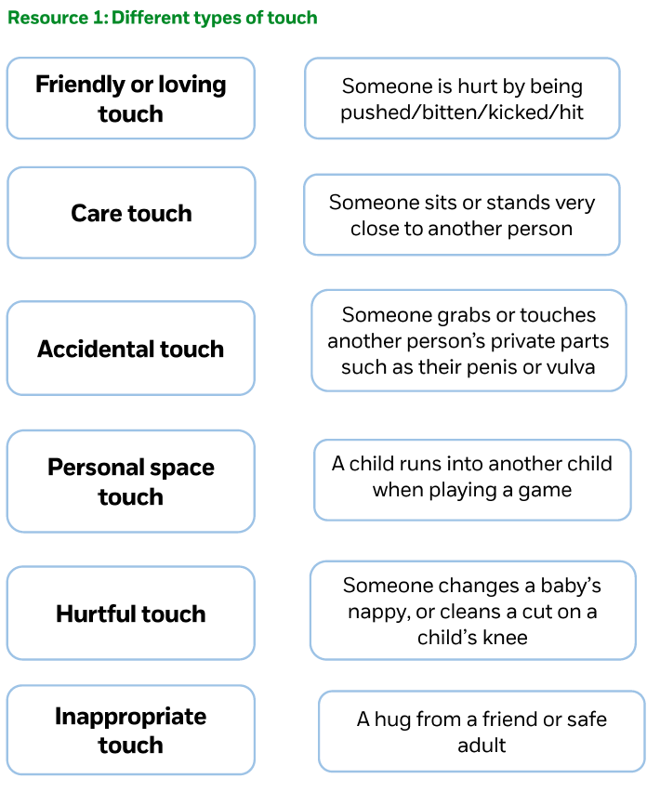
Example Lesson Plan: 7 - 9 year olds
‘Building confidence’
Types of touch
Safe and unsafe touch
Feelings and responses
Right to say ‘no’
Asking for help
Notes:
Example lesson plan - In the 7 – 9 year olds lesson plan ‘Building Confidence’, there are a number of activities including:
A types of touch matching activity which you can see on the screen. In this activity children explore different types of touch such as friendly/loving, care, accidental, personal space, hurtful, inappropriate
Pupils then explore the characters feelings associated with safe and unsafe touch and what could they do/say to respond in these examples.

Slide 9
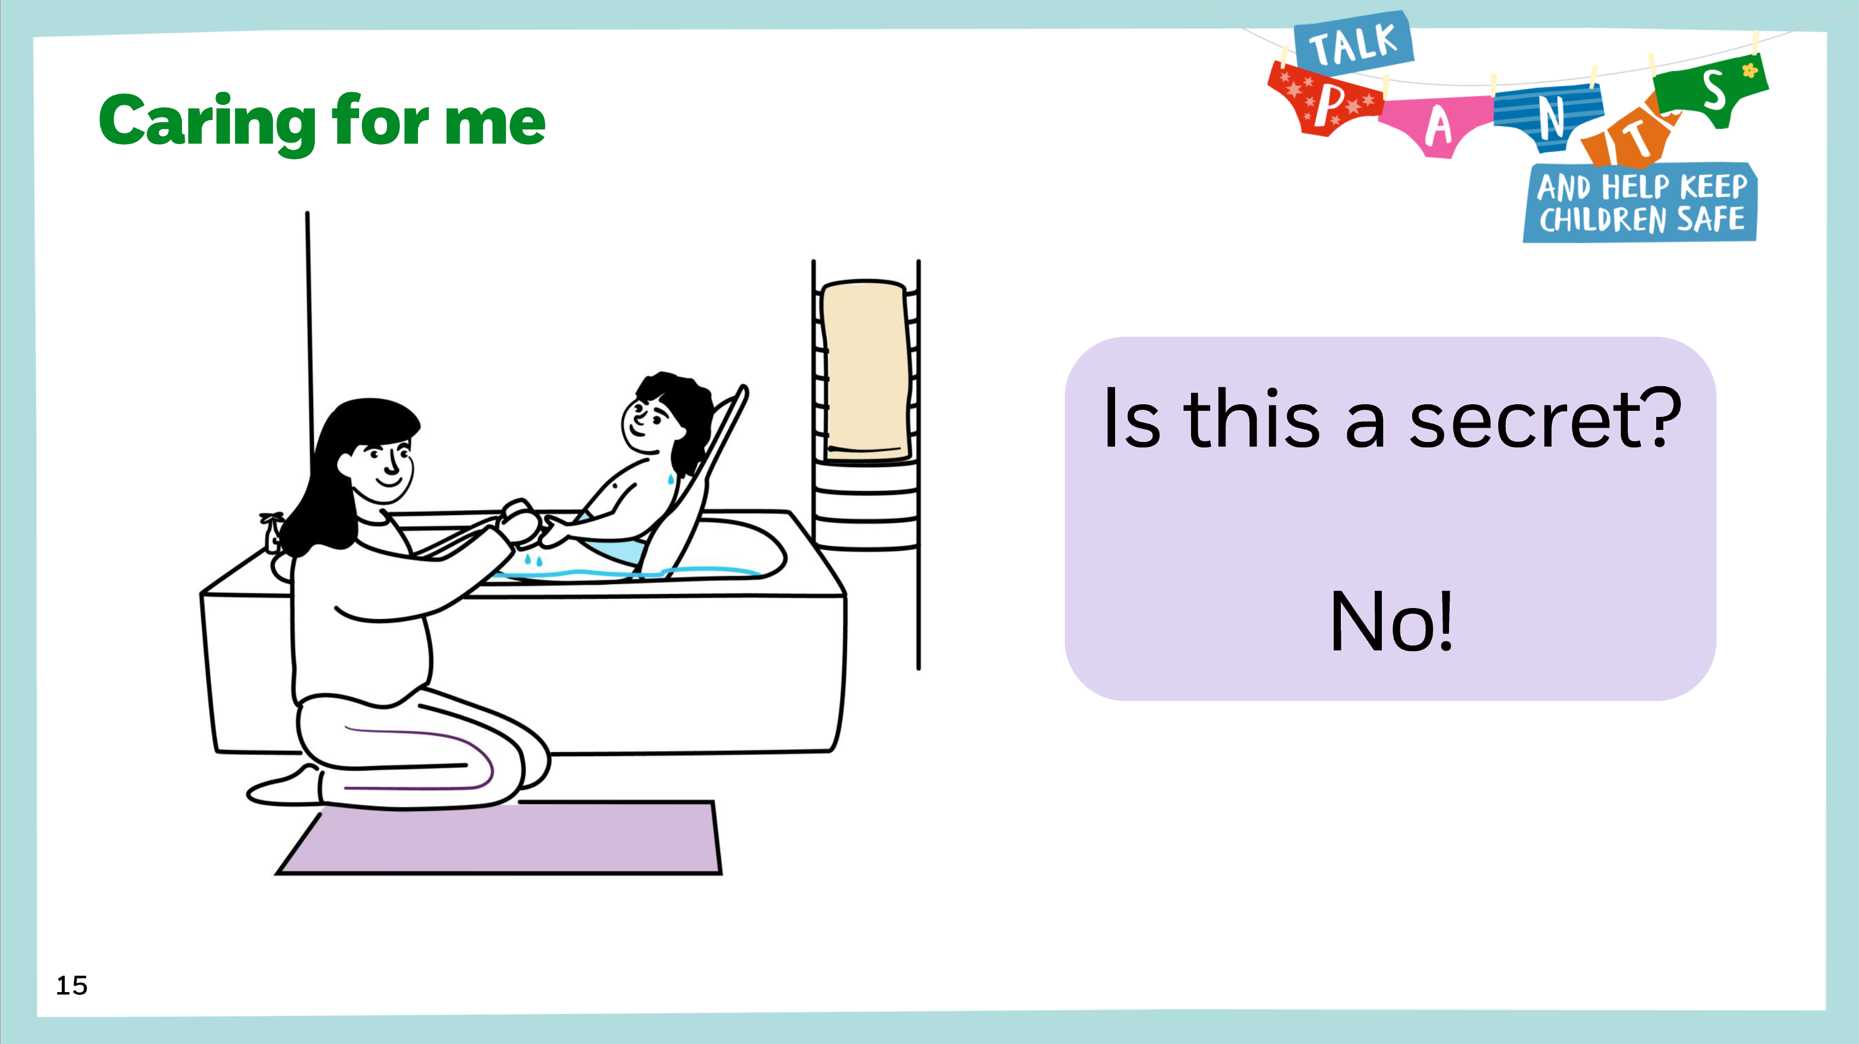
SEND/ASN/ALN lesson plan
One lesson plan with accompanying PowerPoint and resources:
Song video and introduce PANTS rules
Labelling body parts and identifying
which parts are private
Comfortable / uncomfortable touch
Practising saying ‘no’
Is this a secret?
Safe adults
Notes:
Learning Outcomes:
Remember and rehearse the PANTS rules
Name parts of the body which are private and know that their body belongs to them
Identify different touch and when touch feels unsafe and/or uncomfortable
Rehearse strategies for seeking help and telling trusted adults
Teachers/practitioners may need to adapt the SEND/ASN/ALN teaching resources and might want to spread over a longer period of time and/or use alongside the age-related teaching resources. This lesson plan is broken into parts with a section for each of the 5 PANTS rules, so it could be used alongside the Makaton resources which are also broken up into individual PANTS rules. (Makaton resources available at nspcc.org.uk/pantsguides)

Slide 10
Further Talk PANTS resources
Notes:
Additional resources

Slide 11
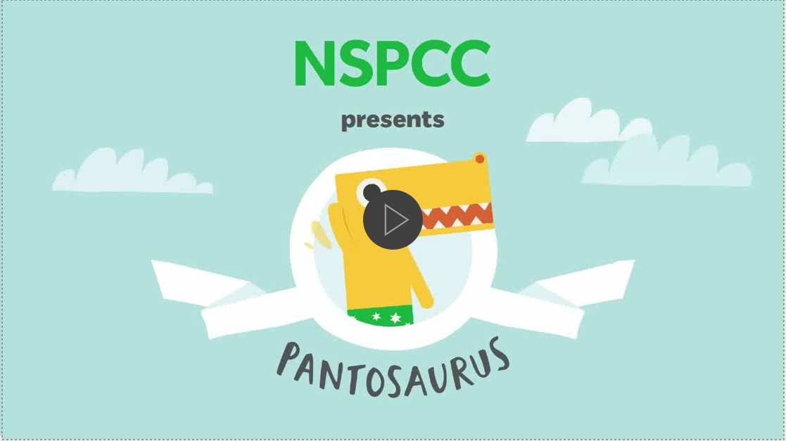
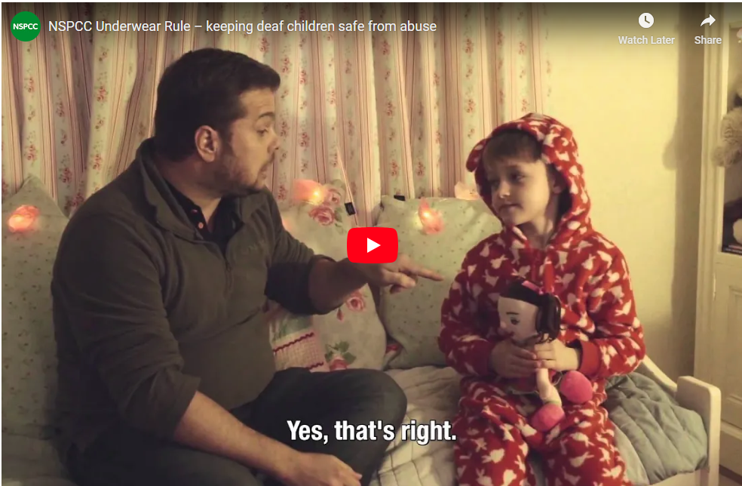
Additional resources
Talk PANTS story book
NSPCC shop
Colouring pages
Free Pantosaurus game app
Pantosaurus song
BSL Talk PANTS video
School display packs
Notes:
The Talk PANTS story book, Pantosaurus and the Power of PANTS, which is available at NSPCC shop, Amazon and elsewhere
NSPCC shop also includes Pantosaurus plush toy, downloadable song, and more Talk PANTS activities Pantosaurus Gifts | NSPCC Shop
Free display pack can be downloaded from the NSPCC Learning webpage (nspcc.org.uk/pants-teaching), and there’s also an option to download A4 posters there.
These are great companions for professionals and parents to use alongside the teaching resources.

Slide 12
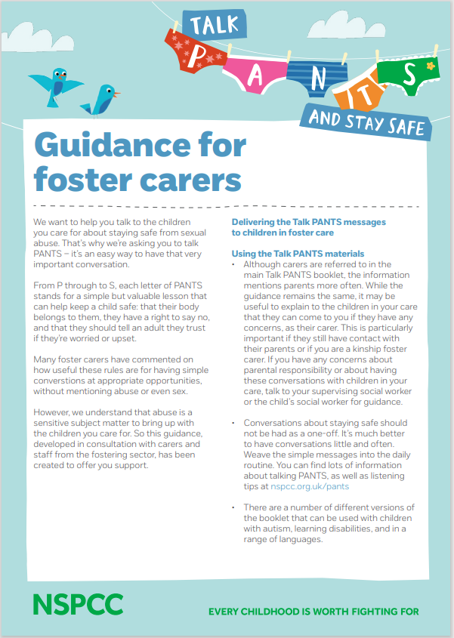

Supporting families to talk PANTS
nspcc.org.uk/pantsguides
Talk PANTS parent guide
Translated guides available
Guide for parents and carers with a learning disability
Guide for parents/carers of children with autism
Guide for foster carers
ReciteMe accessibility tool bar on NSPCC website
12
Notes:
As well as the professional resources that we have taken you through, we also have a Talk PANTS resources for parents and carers. These are accessible tools that can help parents/carers to Talk PANTs at home.
Tools such as: [read slide]
DO NOT READ BELOW
We also have guides for children that have autism and learning disabilities also, we would really recommend checking out the page (QR code above) and exploring the different support and accessibility function
Webpage has all the PANTS guides and the adapted Makaton, BSL, translated guides etc – it can be accessed through from the main parent webpage or direct at www.nspcc.org.uk/pantsguides

Slide 13
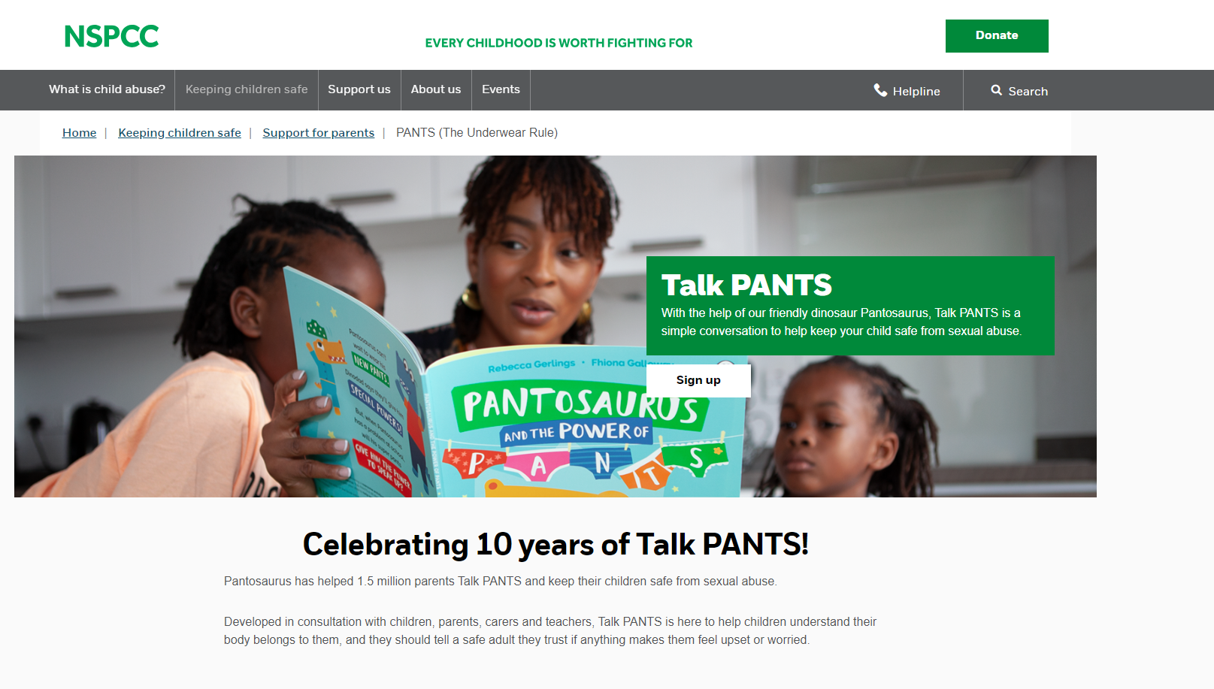
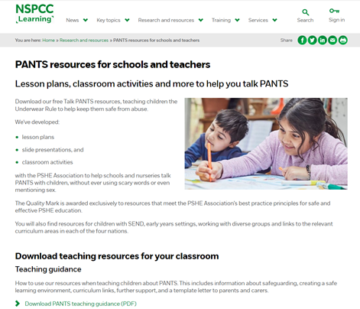
Accessing the Talk PANTS Resources
NSPCC webpage
nspcc.org.uk/pants
NSPCC Learning webpage
nspcc.org.uk/pants-teaching
search
search
‘NSPCC Learning PANTS’
‘NSPCC PANTS’
13
Notes:
Parents/ carers can access the resources by search NSPCC PANTS on the website. The resources for schools are found on the NSPCC Learning webpage by searching NSPCC Learning PANTS.
Post link to resources in the chat, if presenting virtually, https://learning.nspcc.org.uk/research-resources/schools/pants-teaching

Slide 14
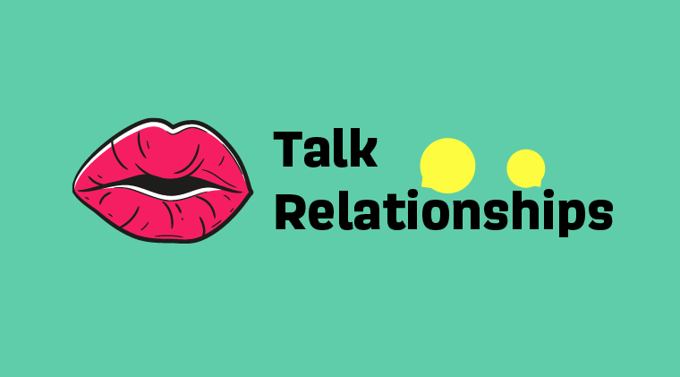

Other NSPCC resources
Notes:
Other NSPCC resources which complement and can sit alongside Talk PANTS:
SOSS: programme available for all primary-aged children to teach them about the different types of abuse and empower them to speak out to a safe adult if they need to. New supplementary lesson plans for when workshops are not able to be used in your area!
Talk Relationships: supports all UK secondary schools to confidently deliver inclusive sex and relationships education through lesson plans, training and a Whole School Approach framework.
Common Sense Media’s Digital Citizenship: educational resources engage learners to think critically and take ownership of their digital lives.

Slide 15
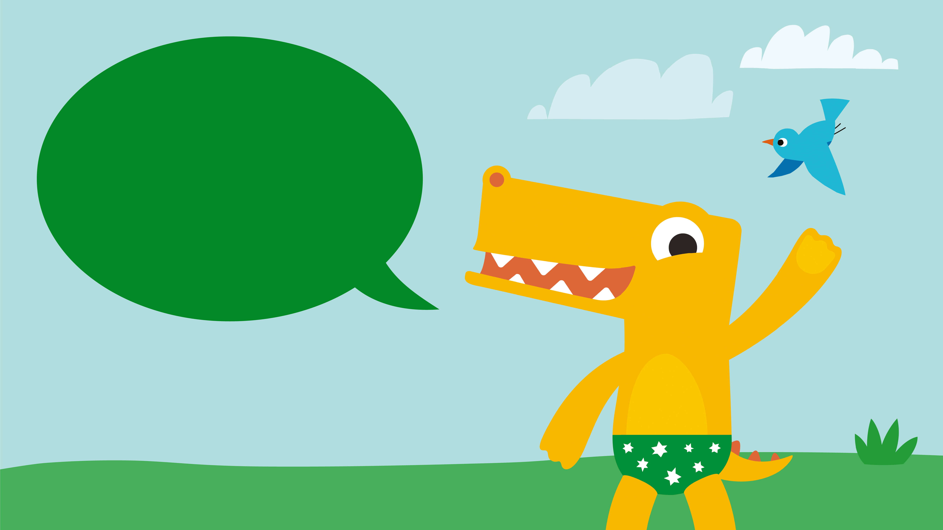
Any Questions?
Notes:
Abigail.Cole@NSPCC.org.uk

