Slide 1

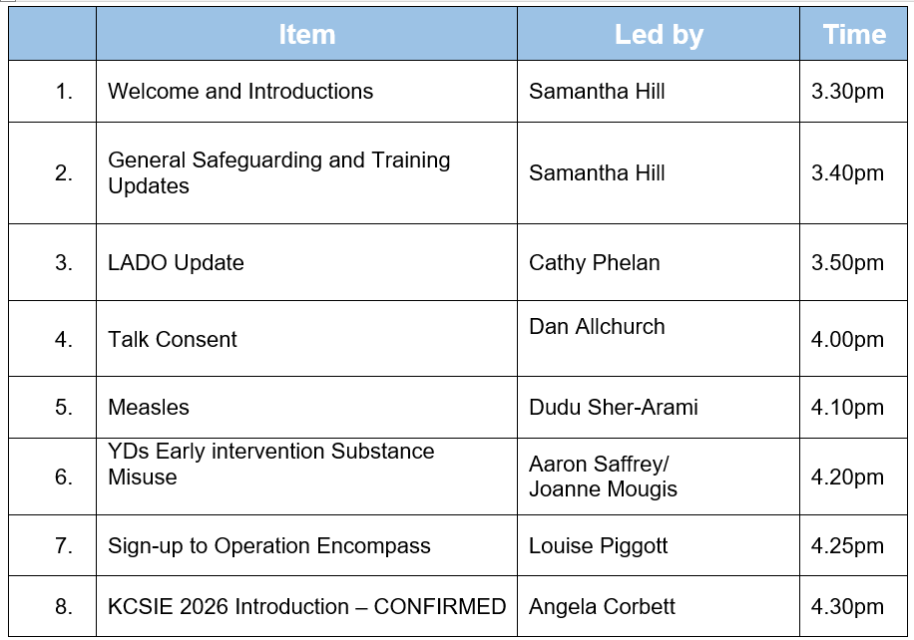
DSL Network Meeting
24th March 2025
www.enfield.gov.uk

Slide 2
Catchy Acronyms 2026
Can you guess what each of these stands for?
KCSIE
WTTSC
SCAYPWMCAA
CWASB
UORFAORI
EIF

Slide 3
Catchy Acronyms 2026
KCSIE
Keeping Children Safe in Education
WTTSC
Working Together to Safeguard Children
SCAYPWMCAA
Supporting Children and Young People with Medical Conditions and Allergy
CWASB
Children’s Wellbeing and Schools Bill
UORFAORI
Use of Reasonable Force and Other Restrictive Interventions
EIF
Education Inspection Framework (Ofsted)

Slide 4
KCSIE 2026
Keeping children safe in education: proposed revisions 2026 - GOV.UK
Out for consultation, with new document expected in May.
Lots of proposed changes, including:
Gender questioning students: schools should take a ‘very careful’ approach and single sex facilities should be maintained
‘Serious violence’ (weapons): early intervention, ‘teachable moments’ and the need for assessing risk and taking action
Mental health: ‘can sometimes develop into safeguarding concerns’, e.g. self harm and suicide risk
Child on child abuse: updated to include technological advances and other changes in the law, e.g. ‘deep fakes’, ‘upskirting’, misogyny, harmful sexual behaviours and sexual violence
Operation Encompass: domestic violence reporting duty made statutory
Mobile phone free schools: this should be the default
Safer Recruitment and managing allegations against staff: Guidance strengthened

Slide 5
Working Together to Safeguard Children 2026
Working together to safeguard children - GOV.UK
This statutory guidance was updated in March 2026 and replaces the 2023 document.
The guidance applies to all organisations and agencies working with children and young people in England and Wales, with particular reference to the local authority, the ICB (NHS Integrated Care Board) and the police.
The updated document clarifies and strengthens the previous document, particularly regarding:
Kinship care and adopted/LAC
‘hidden harms’
Data analysis
Annual reports which evidence impact
Learning from serious child safeguarding incidents, including alteration of the Rapid Review timeline
Some factual changes

Slide 6

Working Together to Safeguard Children – the illustrated version
Working together to safeguard children - GOV.UK
The DfE has issued an illustrated version of the Working Together to Safeguard Children guidance, specifically designed to be accessible and engaging for children and young people.
Working together to safeguard children - GOV.UK
There is also a short, animated version of this guidance for children and young people which explains how people who help them work together and what they can expect when they ask for help.
An animated guide to Working Together to Safeguard Children for children and young people
Plus a toolkit of resources which can be obtained by emailing:
workingtogether.statutoryguidance@education.gov.uk

Slide 7
Medical Conditions and Allergies
Proposal on support for pupils with medical conditions at school.
Supporting children and young people with medical conditions and allergy - consultation
The DfE is consulting on proposals to strengthen how children and young people with medical conditions and allergies are supported and kept safe.
The proposals include:
requiring every setting to have a published medical conditions policy
strengthening Individual Healthcare Plans (IHPs)
improving recording, reporting and learning from serious incidents and ‘near misses’
introducing a new requirement for a separate, published allergy safety policy, covering training and the use of
adrenaline devices.
The draft guidance is open for consultation for 8 weeks, closing on Friday 1 May.
The consultation can be found at Proposal on support for pupils with medical conditions at school.

Slide 8
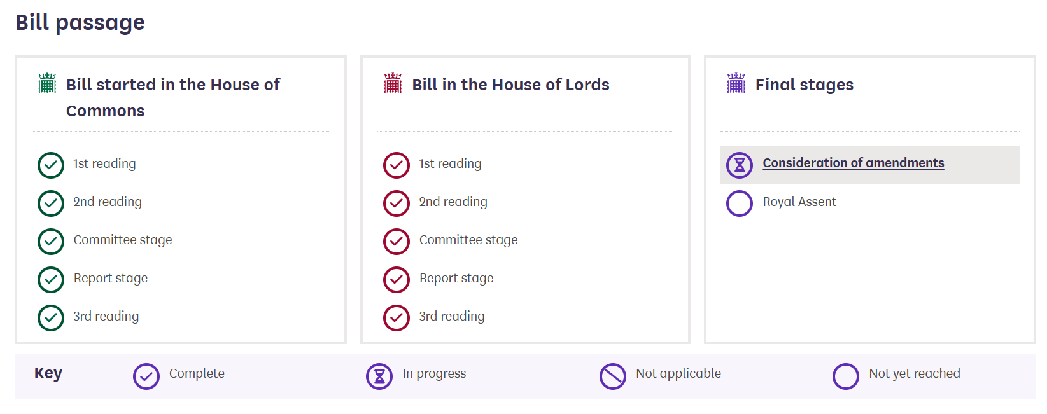
Children’s Wellbeing and Schools Bill
Children’s Wellbeing and Schools Bill - Parliamentary Bills - UK Parliament
Long title: A Bill to make provision about the safeguarding and welfare of children; about support for children in care or leaving care; about regulation of care workers; about regulation of establishments and agencies under Part 2 of the Care Standards Act 2000; about employment of children; about breakfast club provision and school uniform; about attendance of children at school; about regulation of independent educational institutions; about inspections of schools and colleges; about teacher misconduct; about Academies and teachers at Academies; repealing section 128 of the Education Act 2002; about school places and admissions; about establishing new schools; and for connected purposes.
The Bill is nearing the end of its journey and schools will soon need to meet its requirements.
These include:
Stronger safeguarding and social care measures
[better protection for vulnerable children, including care leavers and those in kinship care; stronger expectation for information sharing between agencies; regulation of agencies and care providers]
Tracking of children who are not in school
Changes to school and education policy
[free breakfast clubs, lower cost uniforms, greater government oversight of MATs]
Attendance and school oversight
Online safety powers

Slide 9
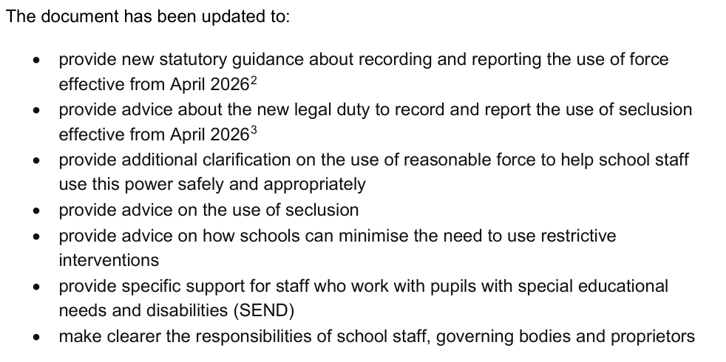
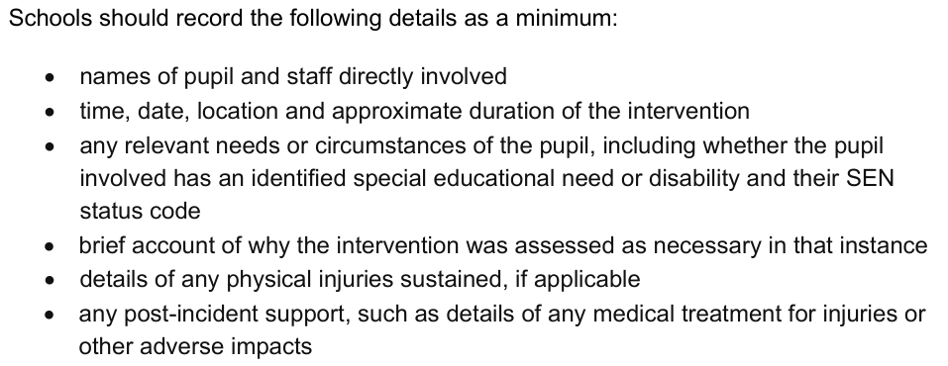
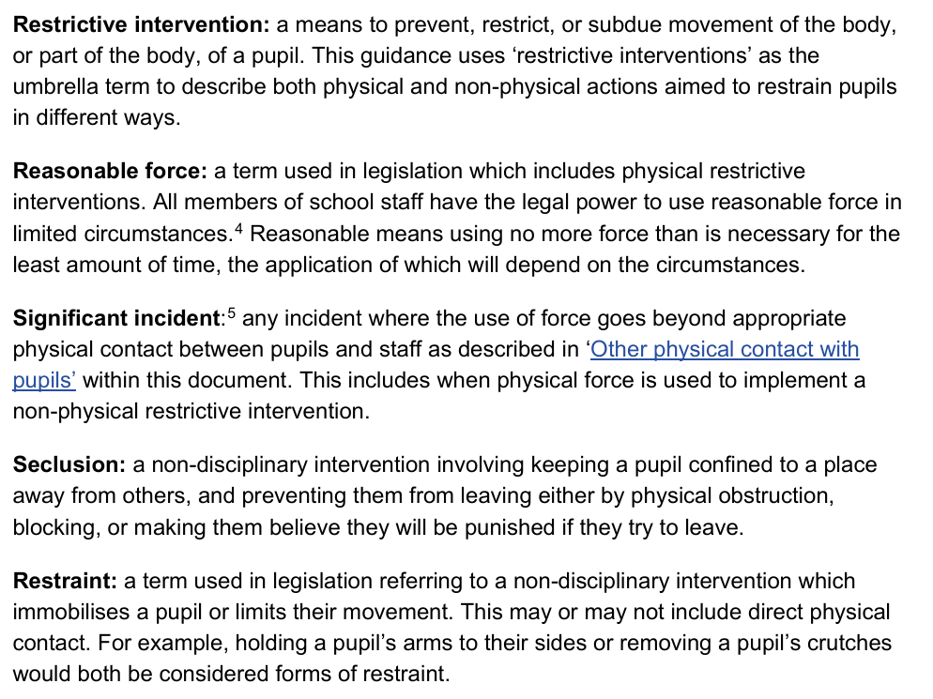
Use of Reasonable Force and
Restrictive Interventions
Use of reasonable force and other restrictive interventions guidance
New guidance on the Use of Reasonable Force and other Restrictive Interventions has been published for use from April 2026. It replaces the previous 2013 guidance.
The document is non-statutory, aside from Page 14 (recording and reporting). Recording and reporting any restraint is now mandatory.
All members of school staff have a legal power to use reasonable force in certain circumstances, namely to ensure the safety of others or to prevent a criminal act.
Adequate training, risk assessments and procedures which consider SEND needs are expected to be in place.
The definition of ‘restraint’ also covers ‘seclusion’. This is where a child may be, for example, trapped within a room during a period of dysregulation. Seclusion is separate from the use of internal exclusion or ‘’reset rooms’ which may be part of the disciplinary procedures laid out in the school behaviour policy. See Behaviour in Schools for more detail on this.
Behaviour in schools - GOV.UK
Searching, screening and confiscation in schools - GOV.UK

Slide 10
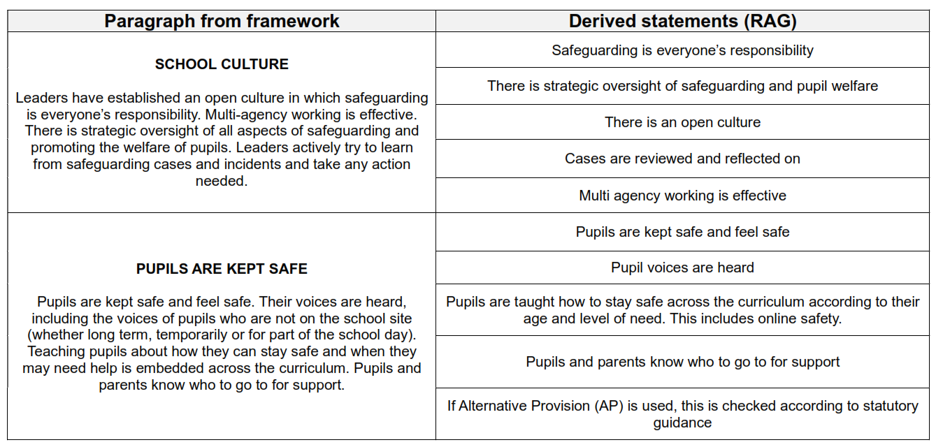
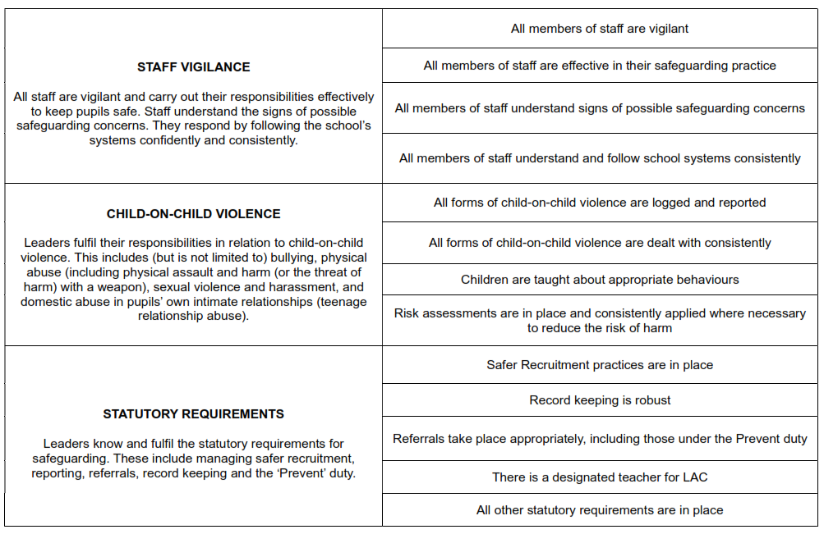
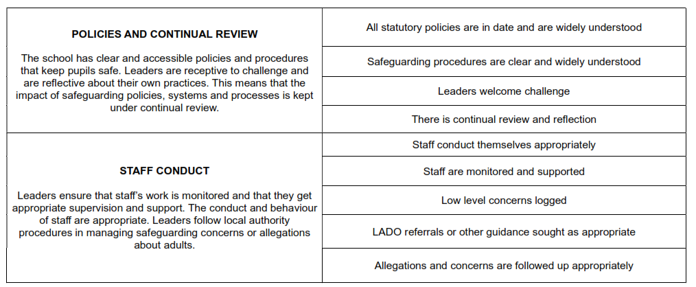
Ofsted – new Education Inspection Framework (2025)
https://www.gov.uk/government/publications/education-inspection-framework/education-inspection-framework-for-use-from-november-2025

Slide 11
The SEND White Paper 2026
Key proposed changes include:
A new national SEND framework based on five principles: Early, Local, Fair, Effective, and Shared support.
Introduction of digital Education, Health and Care Plans (EHCPs) and Individual Support Plans (ISPs)
Individual Support Plans (ISPs) for every child with SEND, legally required in all schools and colleges.
Three flexible layers of support: a universal offer, Targeted, Targeted Plus, and Specialist.
A focus on improving teacher recruitment and retention
Increased scrutiny and a new internal dashboard to identify school-level trends and patterns in pupil movement.
High expectations for behaviour while ensuring that sanctions do not result in pupils losing learning time or being removed from settings without appropriate oversight
These reforms aim to create a more consistent national SEND system, with clear legal duties, standards, and expectations across education, health, and local authorities.
Every child achieving and thriving and SEND consultation supporting information - GOV.UK

Slide 12
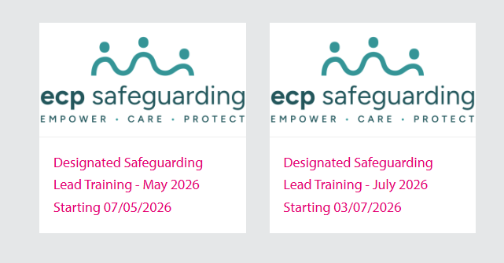
Professional Learning
Designated Safeguarding Leads Training - £80
To book – click here

Slide 13


