Slide 1
Introduction
Keeping children safe in education
(KCSIE) DRAFT for September 2026
SEYIS DSL Forum Meeting
24 March 2026
Angela Corbett
Education & safeguarding consultant, AJC Education
Notes:
Welcome

Slide 2
Outline for session
Context of planned changes
Recurring and/or strengthened themes
New / revised definitions and foci
Brief overview of key changes
Questions to consider re draft KCSIE
Suggested actions to take
Additional sources of information on changes
=> Handouts: slides, summary table and a summary leaflet

Slide 3
Overview of release
Draft version for consultation for September 2026
Long expected changes added
No structural change
Reduction in annexes (Annex A and Host families removed)
Now 200 pages long
Consultation
  Ends midday 22 April 2026
  70 plus questions
  Urge you to submit your views on aspects you feel strongly about
Increased responsibilities for DSL and governors
Aligns with Working Together 2026
https://www.gov.uk/government/publications/working-together-to-safeguard-children--2
Andrew Hall 10 minute VIDEO:
Changes to Working Together to Safeguard Children Match 2026
Watch the video here
Download the slides used in the video here

Slide 4
Recurring / strengthened themes
Greater focus on dealing with and staff awareness/knowledge; includes:
  Early identification and intervention
  Online safety
    Cybercrime
    AI
    Filtering and monitoring
  Age-appropriate and preventatives teaching
  Exploitation
  Serious violence
  Exploitation
  Misogyny and harmful sexual behaviours (HSB)
Updated definitions – harmful sexual behaviours, indecent images, online safety and two of the four categories of abuse

Slide 5
Role of DSL
Increased (see Annex B)
Greater specific knowledge of specific issues
(‘appropriate skills and expertise’)
EG: violence and misogyny
Cover arrangements for DSL absence/availability
Shared safeguarding inbox
Reminder that deputy DSL’s need to be trained at same level
Sharing concerns (via conversations) when pupils move in or out of school

Slide 6
Part 1
Safeguarding information for staff
Child-on-child abuse | 29-35 | Revised and added: Harassment and violence; Serious physical assault and harm; Theat of harm with weapon and Gender considerations
Community based early help | 81 | Updated and linked to WTSC (due to be revised) 2 stages of family and early help
CSE | 41 | Raised awareness of all areas of exploitation, including modern slavery, organised networks, CSE and county lines
Indecent images |  | Revised definition – nudes and semi-nudes; also covers Sefl generated intimate images and those created using AI (deep fakes)
LADO referral | 75 | In part 4 already but added to staff part 1
Mental health | 44-47 | Updated section – raised profile
Serious violence | 48-51 | Updated section. Expectation on staff to report concerns if a child maybe carrying or intending to carry a weapon. DSL must risk assess situation and take appropriate action.
Teenage relationship abuse | 20, 42 and 184 | Added category child on child abuse: ‘abuse in intimate personal relationships between children.’ Increased knowledge of DSL Covers physical, sexual, emotional and stalking; referenced in annex A seciton
Types of abuse - Emotional abuse | 25 | Revised
Types of abuse - Sexual abuse | 26 | Revised

Slide 7
Part 2
The management of safeguarding
Alternative education | 204 | New voluntary standards – suggestion to use the standards More emphasis on due diligence checks to ensure provision meets needs
Children with SEND | 240-242 | Added & updated with reference to intimate care /children SEND children likely to be more dependent on adults for care
Children with medical issues | 243 | New paragraph
Info security & access management | 170-172 | Redrafted. Cleaner link to cyber security standards
Information sharing | 137-145 | Expanded and updated
Online safety | 157-169 | Revised definitions of the 4 Cs – content, contact, conduct & commerce Age-appropriate teaching Governors to review filtering and monitoring Understanding of safe and effective use of AI and AI tools
Toilets & PE changing | 104-115 | New paragraph; Toilets 8 and over, PE secondary
Mobile phones | 163 | New paragraph; link to new DfE guidance April 2026
Young carers | 239 | New paragraph. Early identification and effective help
Preventative education | 153 | Also covers racism, derogatory behaviour and forms of physical violence and conflict. Also emphasised in other paras. Link to new RSE guidance Sept 2026
Restrictive interventions | 197-199 | Link to new guidance (April 2026) Clarifies use of reasonable force, advice for SEND pupils

Slide 8
Part 2
The management of safeguarding
Gender questioning
Children who are lesbian, gay or bisexual Para 244
  Standalone paragraph now
Children who are gender questioning Paras 245-275
Lengthy section explaining how schools should approach and manage arrangements for these children
Not standalone – differs from as it gives the how rather than the overarching policy & pointer to the guidance
Safeguarding and the child’s overall wellbeing must always be the primary consideration.
Staff should take a cautious and considered approach
Parents should usually be informed and involved in decisions affecting the child; unless safeguarding concern
Schools should not actively encourage or initiate social transition.
Actions carefully assessed on a case-by-case basis (eg: requisites for, name, pronouns, presentation)
Single-sex spaces and activities should normally be based on biological sex in line with legal duties.
Schools must promote respect and protect all pupils from bullying or discrimination (Equality and HR Acts)

Slide 9
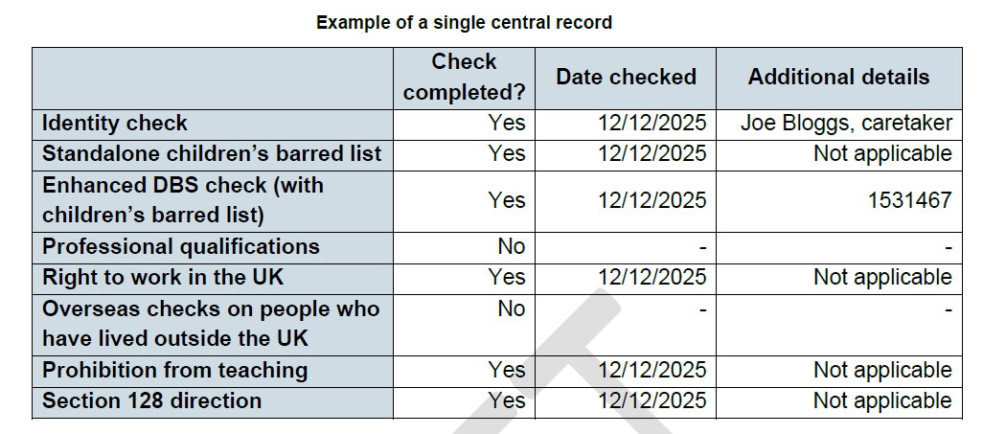
Part 3
Safer recruitment
Previous ‘online searches’ at shortlisting, now ‘search (via an online search engine)’ (Para 292)
DBS flow chart updated (after para 320)
Types of visitors to school
clarified (Para 369)
Addition of exemplar SCR
Question
is this helpful?

Slide 10
Part 4
Safeguarding concerns or allegations about staff
Added in trainee teachers throughout the section
Part 1 - Paragraph 75 states that
  ‘if staff have a safeguarding concern or an allegation about another member of staff, they should refer it to the headteacher or principal, who will consider whether an onward referral to the LADO is required.’
Note: already covered in Part 4

Slide 11
Part 5
Child on child sexual harassment and violence
Whole rewrite to improve clarity of the guidance
How schools should respond to all signs, reports and concerns of harmful sexual behaviour (HSB), child-on-child sexual harassment and sexual violence
Reference to HSB through sections
Focus on early recognition and action – prevention of escalation
Preventative education
Staff understanding of HSB
Increased knowledge of DSL and safeguarding staff

Slide 12
Key questions from the response
Is it too long?
Is it too technical for all staff to understand (Part 1)
(eg your staff, support staff, supply staff …)
Should there be an Annex A simplified version?
Is it doable – too much on the DSL?
Is gender questioning guidance in right place?
  Imbalance in part 2?
  1 para re LGB (many pupils) against 30 for gender questioning (very few).
  Explains the how rather than the strategic responsibility of leaders in line with other aspects
  Should this be separate guidance in line with other issues such as use of physical restraint or mobile phones)? View of the example table for SCR … is use of ‘no’ and ‘NA’ appropriate/ Does it simplify the SCR and 'Safeguarding Children and Safer Recruitment in Education’ (2007)

Slide 13
Implications & Actions to consider taking -
Approach, policy and procedure
Mobile phones (separate guidance from April 2026) (paragraph 163)
Restrictive interventions, including use of reasonable force (separate guidance from April 2026) (paragraph 197-199)
Gender questioning guidance (paragraph 245-275)
Use of premises PE changing and toilets (paragraph 104-105)
Undertake filtering and monitoring testing and keep a record of these (paragraph 166)
School’s use of AI and AI policy (paragraph 160-161)
Online safety new definition of indecent images (paragraph 156)
RSHE guidance (from September 2026) (paragraph 152)
Supporting pupils with medical needs & allergies (Draft out, likely from September 2026) (paragraph 243)
Dealing with all aspects of HSB (part 5 and threaded throughout)
Alternative provision Standards (voluntary) (paragraph 204)

Slide 14
Other actions to consider taking
Review the safeguarding team staffing – time, training, responsibilities and cover arrangements (paragraph 124-128)
Plan how you will train staff at all levels, so they are up to speed and can fully understand Part One
Recording system for checking school’s filtering and monitoring systems (paragraph 166)
Review stay safe curriculum (on and offline) – new RSE guidance and increased emphasis on preventative education (paragraph 151-156)
Consider responding to the consultation

Slide 15
Further sources of information
Weekley updates from SEYIS through next term
Safeguarding Network - summary leaflet (attached with slides), advice and training
Andrew Hall safeguarding updates, training, podcasts ….
NSPCC – helpful information, updates and research findings
SWGfL – filtering and monitoring testing tool, 360 deg audit tool, learning resources …
National Cyber Security Centre – cyber security advice and text tool
Watch out for:
  New online safety guidance for EYFS
  ????

Slide 16
Thank you for listening
Any questions?

