Slide 1
15.5. 2026

Slide 2
AGENDA
Welcome and updates – Elections: Kings Speech: Crisis Funding: Ofsted.
PE Team events!
SEND reform and Experts at Hand
Children & Wellbeing Bill
Violence & Abuse in Schools draft policy
Nurture UK
Transitions
ETIPSS Conference & research
MELSA
Moderation
Level 6 apprenticeships – Teacher training
AOB

Slide 3


Enfield PE Team

Slide 4


Inclusive PE: What Works in Practice
Summer Term Secondary Heads of Department meeting:
Date: Thursday 11th June, 2 – 4pm
Venue: Tottenham Stadium: Percy House 796 High Rd, London N17 0DH
Keynote Speaker: Dr Nicole Cara: Educational and Child Psychologist – Specialism PE and Inclusion
Practical adaptations to engage secondary school children in PE lessons / physical activity
How to articulate your approach during an Ofsted inspection
You will leave with something concrete to use straight away!
Optional tour of Tottenham stadium
Please feel free to bring other members of your department who would benefit from this meeting / CPD.
If you would like to attend, please email me to confirm at greg.heald@enfield.gov.uk

Slide 5



Primary PE Subject Leader Meeting: Inclusion
Date: Wednesday 24th June 1-3.30pm
Venue: Brettenham Primary School
Bupa / YST resource pack – Delivering inclusive activities that young people with SEND want to take part in
Opportunity to observe pupils participating in high quality / inclusive PE
Supporting pupils with Autism in PE
Sensory Dance ideas
Free boccia set + teaching resources for attendees
Bookings open on the website
www.enfieldpeteam.co.uk

Slide 6

Primary PE Premium Reporting
Reporting return opens in June
Complete and publish on school website by 31st July
afPE support page for planning /monitoring / evaluating PE Premium: Advice on Primary PE and Sport Premium - Association for Physical Education
Excel spreadsheet available for tracking spend – replicates what schools must complete
Monitoring form – more descriptive/evaluative and reflects school’s needs and context
Reminder of conditions of PE Premium: https://www.gov.uk/government/publications/pe-and-sport-premium-conditions-of-grant-2025-to-2026
Contact for support: fiona.hathaway@enfield.gov.uk greg.heald@enfield.gov.uk

Slide 7



Enfield SEND Reform Plan – Update
Headteacher Briefing
14th May 2026

Slide 8
SEND Reforms Update
DfE request
Response
Develop a SEND Reform Plan that supports LA management of the DSG moving forward
DSG Stability Grant completing:
reform template, maturity matrix, spreadsheet, QA template and a range of supporting documents
Feedback to date
Establishment of SEND Reform Board
Data workstream established
Task & finish groups to interpret the consultation responses & put into credible workstreams that meet DfE requirements
Partnership wide consultation
Next steps
DfE – excellent SEND Reform plan outline
High stakeholder engagement
Draft plan cross referenced with CPP boroughs -Positive feedback and alignment to CPP Reform plans
Submit draft plan – 19th May 2026
Commence recruitment during the summer term
Establish implementation of the consultation responses

Slide 9

SEND Reforms Consultation
19
CO-PRODUCTION
EVENTS
507
STAKEHOLDERS CONSULTED
& informed the SEND Reform Plan
8 x Multi Agency events
3 x Parent Carer events
4 x Head Teacher events
2 x SENCO events
1 x Early Years Leads
event
1 x College Leads
event

Slide 10
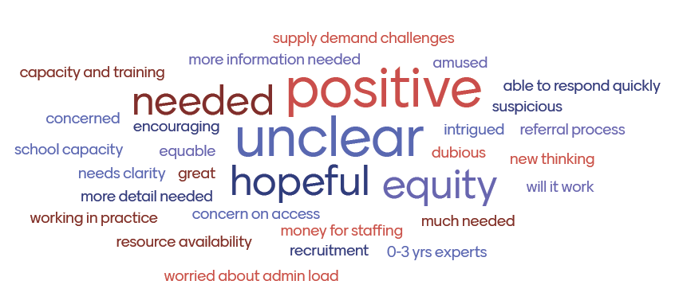
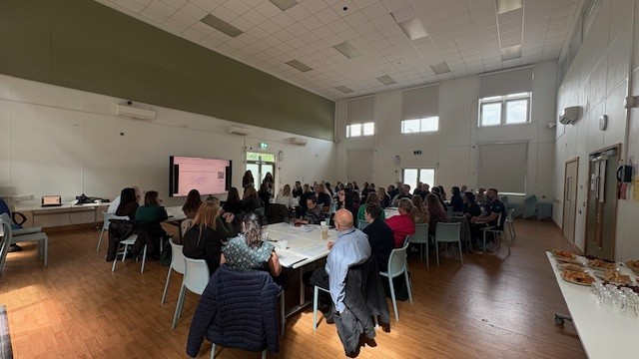

SEND Reforms Consultation Feedback
Key consultation trends:
Family support
Speech & Language
Alternative provision expansion
Attendance support – Primary & Secondary
Barriers to school attendance
Managing a range of needs in classrooms
Adaptions
Early Years modelling
Post 16 employability
Expansion in SRPs / Units

Slide 11


SEND Reforms Experts At Hand Offer
Enfield
SEND Reforms
Speech & Language
Early Years Inclusion
Specialist Teachers / Education Home Support
Enhancement of LISO
Post 16 Employment Pathways
Barriers to Attendance
Primary Alternative Provision
Inclusion Bases, SRP Expansion & PINS
Experts at Hand Workstreams
Secondary AP Outreach
EaH Project Management

Slide 12

Children’s Wellbeing and Schools Act 2026
Ian Hewison
www.enfield.gov.uk

Slide 13

Wellbeing Act – Important updates
Section 434A – Local authority consent to withdraw
This applies only to “relevant children”, defined as children of compulsory school age who are registered pupils and who either:
were placed in specialist or SEN provision by a local authority, or
are subject to current or recent (within the last five years) safeguarding intervention under section 47 of the Children Act 1989.
Where consent is required:
parents must apply to the relevant local authority;
the local authority must make its decision without undue delay;
consent must be refused if the authority considers that:
it is in the child’s best interests to remain in school, or
no suitable alternative education has been put in place.
If neither of these applies, consent must be granted.
Notes:
This presentation introduces Enfield Council’s 2026 guidance on Elective Home Education (EHE), setting out the legal context, shared responsibilities, and expectations for families and professionals. Elective Home Education refers to a parent’s decision to educate their child otherwise than at school, and it is recognised in law as a legitimate and lawful choice. Enfield Council’s approach is grounded in respect for parental autonomy while also fulfilling statutory duties to ensure that all children receive an efficient, full-time, and suitable education. The guidance reflects national legislation, including the Education Act 1996 and the Children’s Wellbeing and Schools Act 2026, and aligns with Department for Education guidance for local authorities. The purpose of the guidance is to provide clarity, transparency, and reassurance for families considering or undertaking EHE, while also explaining the local authority’s role in maintaining oversight proportionately and lawfully. It acknowledges that home education can take many different forms, from structured learning programmes to more autonomous, child-led approaches, and that there is no single model of suitable education. The presentation also emphasises partnership working, encouraging constructive dialogue between families, schools, and council services. Particular attention is given to children who may be considered more vulnerable, such as those with special educational needs, an Education, Health and Care Plan, or recent safeguarding involvement, where additional legal requirements apply. By outlining processes, timescales, and points of contact, the presentation aims to reduce uncertainty and prevent misunderstandings. Overall, this opening slide frames Elective Home Education in Enfield as a positive option for many families, supported by clear guidance, a wellbeing-focused legislative framework, and a commitment to acting in the best interests of every child.

Slide 14

Continued…
Section 434B – Mandatory local authority meetings (pilot scheme)(asking to be part of)
Under the pilot:
parents must attend and participate in a meeting with the local authority;
the meeting must cover the parent’s education duty, safeguarding and welfare, support needs, and reasons for withdrawal;
the child must normally attend, unless exceptional circumstances apply;
a school representative may attend with parental consent;
schools cannot remove the child from roll unless notified that the meeting has taken place.
Notes:
In most cases, parents do not need local authority consent to withdraw their child from school in order to electively home educate. However, the Children’s Wellbeing and Schools Act 2026 introduces an important exception for certain ‘relevant children’. Consent is required where a child of compulsory school age is registered at a school and has either been placed in specialist or SEN provision by a local authority or has been subject to current or recent safeguarding intervention under section 47 of the Children Act 1989. In these cases, parents must apply to the local authority before deregistration can take place. The local authority must make a decision without undue delay and must refuse consent if it considers that it is in the child’s best interests to remain in school or that no suitable alternative education has been put in place. If neither condition applies, consent must be granted. This process is designed to ensure that decisions are child-focused, evidence-based, and fair. It does not prevent home education, but it does ensure that additional safeguards are in place for children who may be more vulnerable. Clear explanation of this process helps families understand when consent applies and reassures them that decisions are made transparently and lawfully.

Slide 15

Continued…
Section 436B – Duty to Register Children Not in School
Local authorities must keep a register of children of compulsory school age who are not receiving full‑time education at a recognised school.
Who must be included on the register
A child must be registered if they:
live in the local authority’s area;
are of compulsory school age; and
are either:
not on the roll of any relevant school, or
still registered at a school but are being educated otherwise than at school (for example, an agreed alternative arrangement), or
attend a relevant school only part‑time and are not registered elsewhere.
Local authority duties after registration
Within 15 days of registering a child, the local authority must:
consider where the child lives;
consider what education settings the child is being educated in (so far as known);
and may request permission from parents to visit the child at home.
If a parent refuses a home visit, this must be treated as a relevant factor when deciding whether to take further action, such as issuing a preliminary notice under enforcement powers
Notes:
In most cases, parents do not need local authority consent to withdraw their child from school in order to electively home educate. However, the Children’s Wellbeing and Schools Act 2026 introduces an important exception for certain ‘relevant children’. Consent is required where a child of compulsory school age is registered at a school and has either been placed in specialist or SEN provision by a local authority or has been subject to current or recent safeguarding intervention under section 47 of the Children Act 1989. In these cases, parents must apply to the local authority before deregistration can take place. The local authority must make a decision without undue delay and must refuse consent if it considers that it is in the child’s best interests to remain in school or that no suitable alternative education has been put in place. If neither condition applies, consent must be granted. This process is designed to ensure that decisions are child-focused, evidence-based, and fair. It does not prevent home education, but it does ensure that additional safeguards are in place for children who may be more vulnerable. Clear explanation of this process helps families understand when consent applies and reassures them that decisions are made transparently and lawfully.

Slide 16
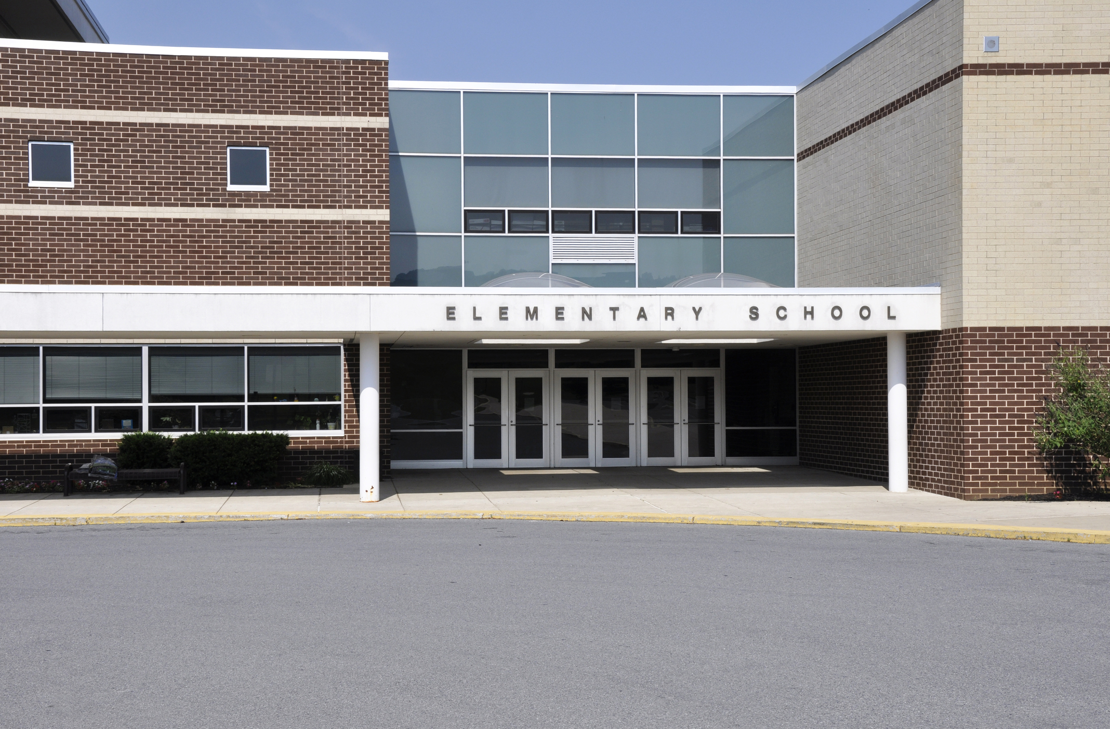
Admissions, place planning and Adjudicator
Clearer duty on schools and academies to cooperate with LAs
Admissions decisions must consider the impact on local sufficiency
Supports strategic place planning across an area
LA’s have the power to direct admissions extended to most academies
OSA have enhanced powers to set and amend admission numbers

Slide 17

Elective Home Education: Enfield Council Guidance 2026
Updated with Children’s Wellbeing and Schools Act 2026
Ian Hewison
Head of Service
Notes:
AI-generated content may be incorrect. ---

Slide 20
The notification and the first 15 days
Ask for a pause – they can refuse
Notes:
Wellbeing bill

Slide 21
If they agree to a pause
Notes:
Wellbeing Bill

Slide 22
Day 1
Day 15:
EHE team emails parents with an introduction email and requests to assess the suitability of education
the 15-day deadline

Slide 24
Within 15 days

Slide 28

ehe.team@enfield.gov.uk
Any questions?

Slide 29

Violence and Abuse in Schools Guidance
Promoting safe and supportive learning environments

Slide 30

Why the Violence and Abuse Guidance Was Developed
Rising Concerns in Schools
Increasing violence and abuse in schools caused stress and low staff morale.
Task and Finish Group Formation
Schools H&S Committee decided to create a multidisciplinary group to identify issues and practical solutions.
Evidence and Policy Review
Reviewed surveys, incident data, and policies to understand violence sources and gaps.
Guidance Development
The objective was to create clear guidance to prevent, manage, and respond to violence balancing staff and pupil needs.
Notes:
The guidance was developed in response to growing concerns raised by teaching unions about increasing levels of violence and abuse experienced by staff in schools - incidents were becoming more frequent and complex, contributing to challenges with low staff morale.
The decision was made by the schools H&S committee to set up a task and finish group comprising professionals from health and safety, education, and special educational needs (SEN) services to explore the underlying issues and identify practical solutions.
The group reviewed multiple evidence sources, including the 2025 violence and abuse survey of school staff, which, despite a low response rate, highlighted that around half of reported perpetrators were pupils with Education, Health and Care Plans or additional needs. Corporate health and safety incident data further reinforced that a significant proportion of incidents were linked to SEND-related needs. Existing policies were also examined, particularly the HR policy on violence and abuse towards employees, which was found to be effective for managing risks from external visitors but less detailed when incidents originated internally, such as from pupils.
The aim of the group was to produce guidance to manage and respond to violence balancing staff and pupil needs.

Slide 31

Understanding What Constitutes Violence and Abuse
Broad Definition of Violence
Violence includes verbal abuse, threats, and physical assault related to work.
Impact on Staff Wellbeing
Repeated abuse causes anxiety, and can lead to staff leaving their profession.
Context in School Settings
Many incidents involve children with additional needs, requiring understanding of behaviour causes.
Notes:
Violence is defined broadly to include verbal abuse, threatening behaviour, and physical assault that occurs in connection with work.
Such incidents can be harmful to staff wellbeing and professional confidence.
Many incidents involve children with additional needs. The guidance stresses that while violence and abuse towards staff is never acceptable, it is often a manifestation of distress, unmet need, or difficulty with communication and regulation rather than deliberate intent to cause harm. Schools are encouraged to respond in a way that protects staff while also seeking to understand and address the root causes of behaviour. This approach supports a culture where incidents are reported, investigated constructively, and used as opportunities for learning and improvement.

Slide 32





Accountability Across School Leadership
Strategic Governing Bodies
Governing bodies hold strategic responsibility for policies, resources, and oversight to address violence and abuse effectively.
Operational Headteachers
Headteachers implement guidance, foster safety culture, and ensure staff know how to report and seek support.
SENCO Coordination Role
SENCOs coordinate support for pupils with additional needs, liaise with services, and advise on risk assessments.
Line Manager Responsibilities
Line managers respond to incidents, initiate investigations, and ensure staff receive timely support.
Notes:
Clear roles and responsibilities are central to ensuring that concerns about violence and abuse are addressed promptly and effectively. The guidance sets out accountability at multiple levels, starting with governing bodies, who have strategic responsibility for ensuring appropriate policies, resources, and oversight are in place.
Headteachers are identified as having operational responsibility for implementing the guidance, fostering a culture of safety, and ensuring staff know how to report and access support.
SENCOs play a critical coordinating role, particularly where incidents involve pupils with additional needs, by liaising with external services, supporting risk assessments, and advising on appropriate strategies.
Line managers are responsible for responding to incidents, initiating investigations, and ensuring staff receive timely support. By clearly defining these roles, the guidance reduces ambiguity and the risk that concerns are overlooked or delayed. This clarity also reassures staff that incidents will be taken seriously and managed consistently, reinforcing trust in leadership and organisational processes.

Slide 33

Using Functional Behavioural Risk Assessments
Focus on Behaviour Drivers
Assessments emphasize understanding triggers, unmet needs, and early warning signs behind pupil behaviours.
Practical Control Measures
Risk controls include environmental adjustments, staffing, communication strategies, and routine adaptations.
Collaborative Risk Management
Sharing assessments with staff ensures everyone understands their role in managing behavioural risks.
Ongoing Risk Review
Risk management is continuous and adapts as pupils' needs and behaviours evolve over time.
Notes:
Effective risk management is a cornerstone of the guidance, particularly where the risk of violence or abuse is foreseeable. Schools are expected to complete and regularly review functional behavioural risk assessments for pupils whose behaviour may pose a risk to staff or others. These assessments go beyond listing hazards and instead focus on understanding the drivers of behaviour, including triggers, unmet needs, and early warning signs. Hazards may include behaviours such as hitting, kicking, biting, or throwing objects, but equal attention is given to the context in which these behaviours occur.
Control measures should be proportionate and practical, covering areas such as environmental adjustments, staffing arrangements, communication strategies, and routines.
Importantly, risk assessments should be shared with relevant staff so that everyone understands their role in managing risk.
The guidance reinforces that risk management is not a one-off task but an ongoing process that should evolve as a pupil’s needs change. When done well, functional behavioural risk assessments protect staff, support pupils, and reduce the likelihood of incidents escalating.

Slide 34

De-escalation and Relational Approaches
Early Recognition and Response
Staff identify early distress signals and respond with calm, clear, and simple communication to prevent escalation.
Supportive Environment Strategies
Providing space, sensory strategies, and trusted adults helps pupils regain regulation effectively.
Training and Organisational Support
Effective de-escalation requires time, training, and support from the school organisation, especially in busy settings.
Personalised Preventative Approaches
Strategies tailored to individual pupil needs reduce incidents and foster safer learning environments.
Notes:
Preventing escalation is a key theme of the guidance and relies on staff being supported to use calm, relational, and regulating approaches. When early signs of distress are recognised, staff are encouraged to reduce demands, use clear and simple language, and avoid confrontational interactions. Providing space, offering sensory strategies, or involving familiar and trusted adults can help pupils regain regulation before behaviour escalates. The guidance acknowledges that these approaches require time, training, and organisational support, particularly in busy school environments.

Slide 35

Learning From Incidents to Prevent Recurrence
Importance of Reporting
Reporting all incidents creates an accurate risk record and reveals patterns, protecting staff and preventing oversight.
Thorough Investigations
Investigations focus on triggers, environmental factors, and behaviour patterns to understand incident build-up.
Preventative Actions and Review
Managers review de-escalation strategies, staffing, risk assessments, and involve carers to implement clear preventive measures.
Learning Culture
A learning-focused approach drives continuous improvement and positive change.
Notes:
The guidance strongly emphasises the importance of reporting and investigating all incidents of violence and abuse, regardless of perceived severity. Reporting protects staff by creating an accurate record of risk and ensures that patterns are identified rather than dismissed as isolated events.
Investigations should focus on understanding the build-up to the incident, including triggers, environmental factors, and whether behaviour is part of a pattern.
Managers are encouraged to review the effectiveness of existing de-escalation strategies, staffing levels, and risk assessments, as well as the involvement of carers and external professionals.
Crucially, investigations must lead to clear preventative actions, not just continued monitoring.

Slide 36

Working in Partnership to Reduce Risk
Specialist External Support
Schools are encouraged to use specialist external services early when risks are not sufficiently reduced.
Range of Support Services
Services include Inclusion Support, Autism advisory, communication support, and Educational Psychology interventions.
Multi-agency Collaboration
Collaboration across agencies strengthens expertise and timely support for pupils and staff.
Encouraging Leadership Engagement
Teachers are urged to consult leadership teams for support rather than managing complex situations alone.
Notes:
When strategies in school are not reducing risk sufficiently, the guidance encourages early use of specialist external support. The guidance lists the range of services that are available, including Inclusion Support Services for primary and secondary schools, the Enfield Advisory Service for Autism, communication and interaction support through ECASS, and the Educational Psychology Service. These services can offer consultation, targeted interventions, training, and trauma-informed approaches.
Multi-agency working enables schools to draw on wider expertise and ensure pupils and staff receive the right support at the right time. Teachers are encouraged to speak with leadership teams about accessing this support rather than managing complex situations alone.

Slide 37

Balancing Staff Safety and Inclusive Practice
Addressing Staff Safety
Violence towards staff is unacceptable and must be addressed while considering children's needs.
Proactive Risk Management
Understanding behaviour and managing risk proactively helps create safer school environments.
Collaborative Leadership and Support
Clear leadership, consistent reporting, and specialist support reduce incidents and improve outcomes.
Inclusive Positive Culture
Confident, informed practice sustains a positive, inclusive culture supporting both staff and pupils.
Notes:
The central message of the guidance is that violence and abuse towards staff is not acceptable, and must be addressed in a way that recognises the needs of children and young people.
By understanding behaviour, managing risk proactively, and working in partnership, schools can create safer environments for everyone.
Clear leadership, consistent reporting, and effective use of specialist support all contribute to reducing incidents and improving outcomes. Ultimately, the guidance aims to support confident, informed practice that protects staff, supports pupils, and sustains a positive and inclusive school culture.
If there are any comments on the guidance please direct them to myself and they will be considered by the group.

Slide 38


Enfield Nurture Groups
Julia Hide
Enfield EY SEND Team Lead
julia.hide@enfield.gov.uk
Striving for excellence
www.enfield.gov.uk

Slide 39
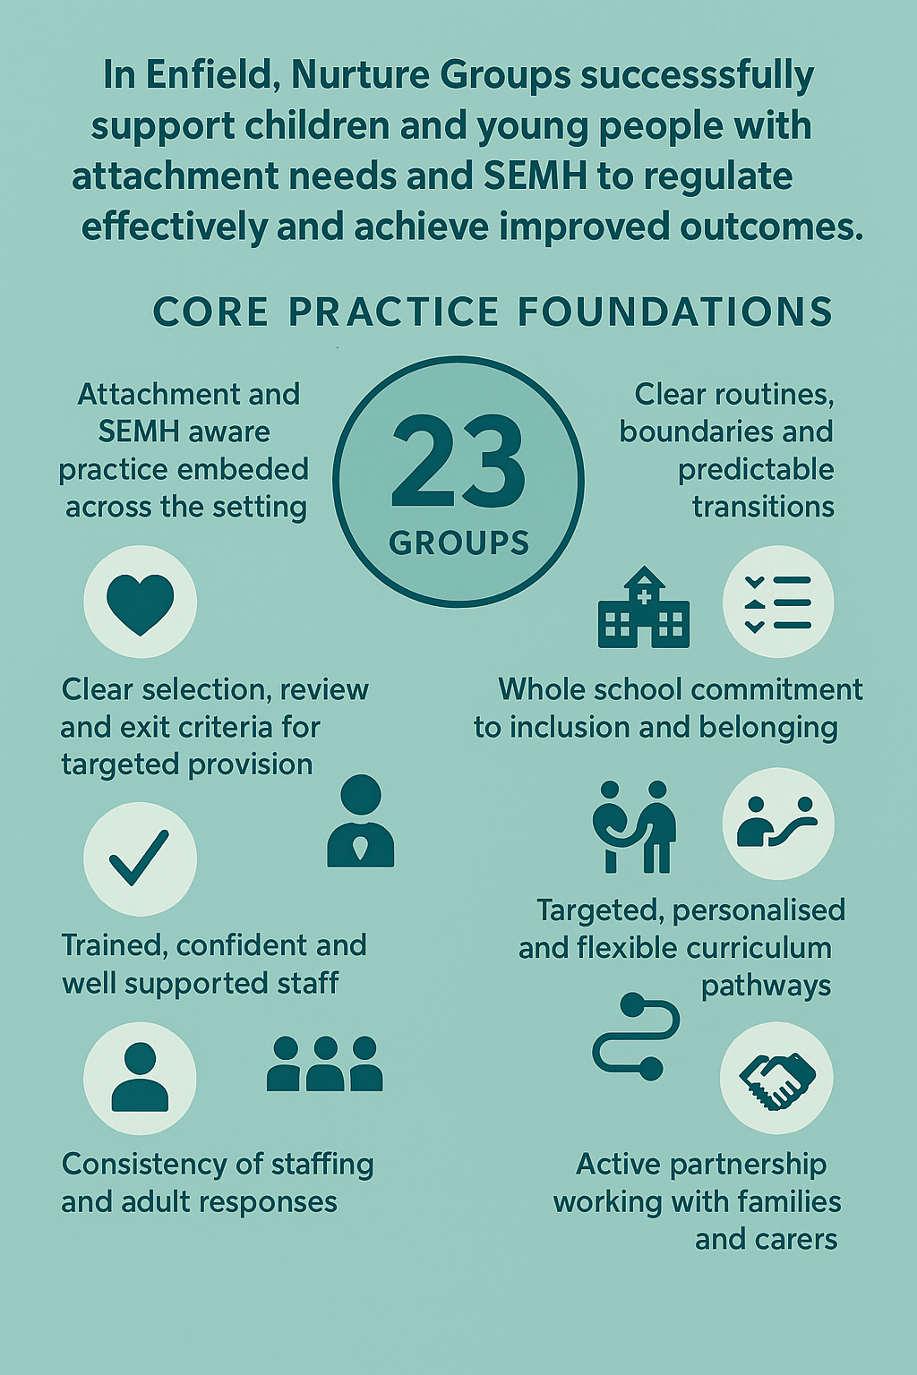
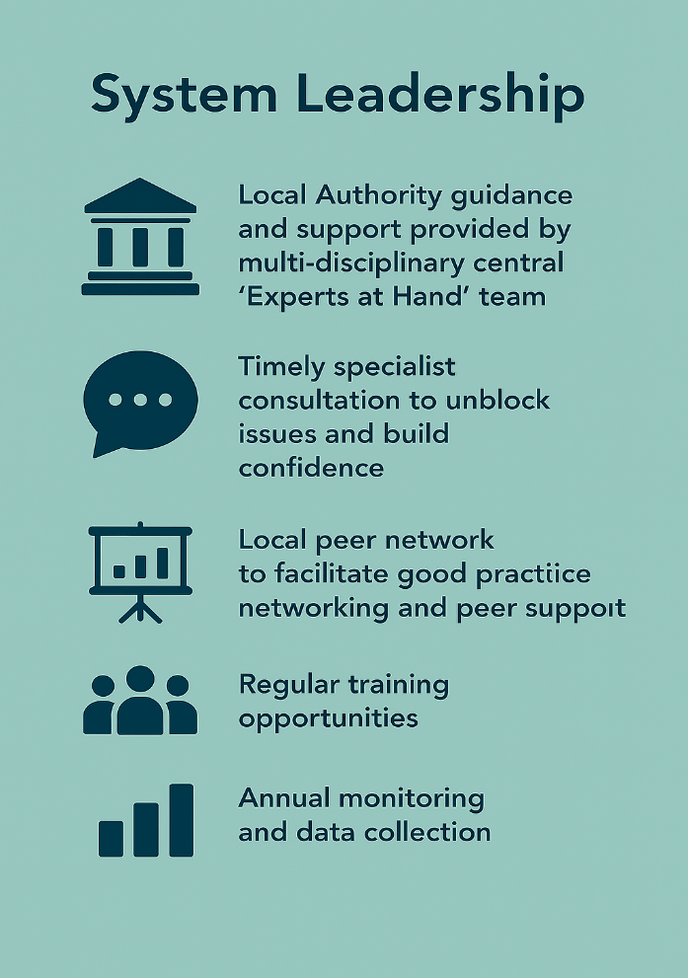
Nurture Groups and System Leadership in Enfield

Slide 40
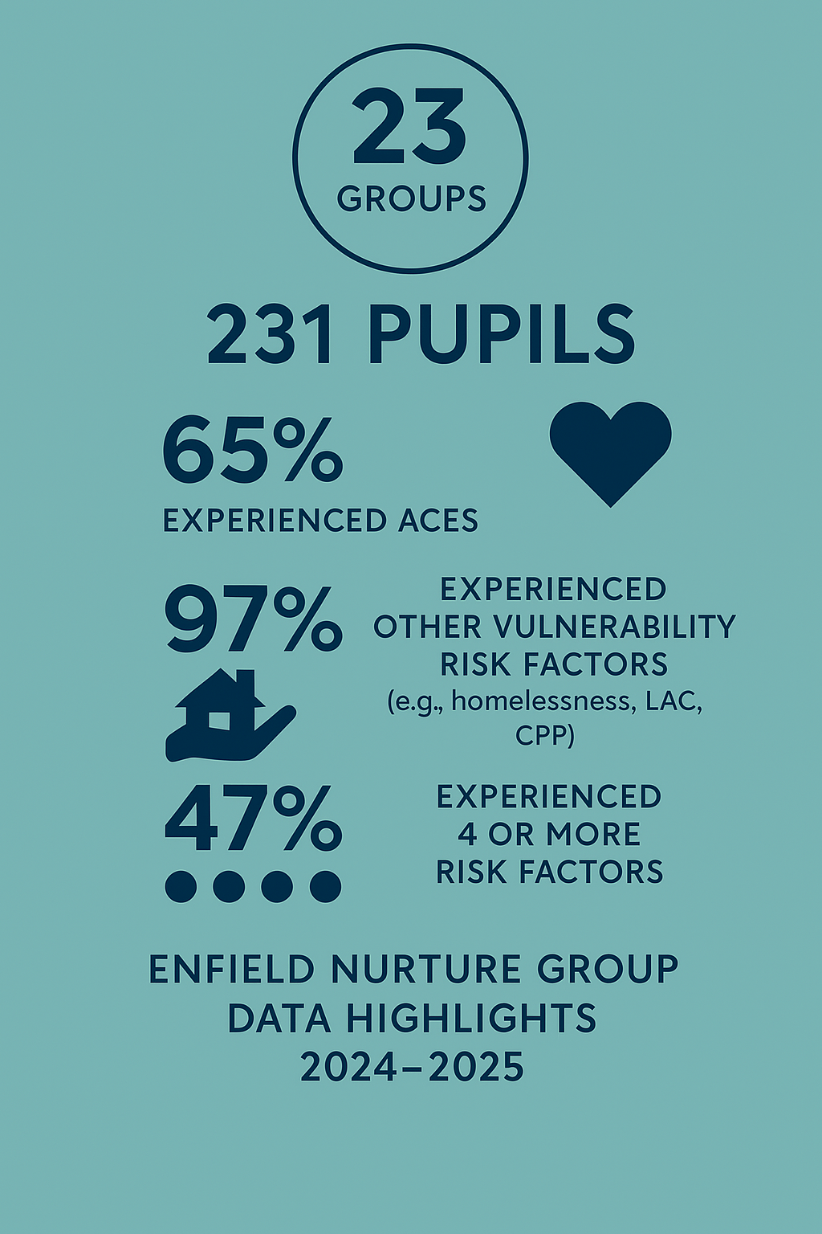
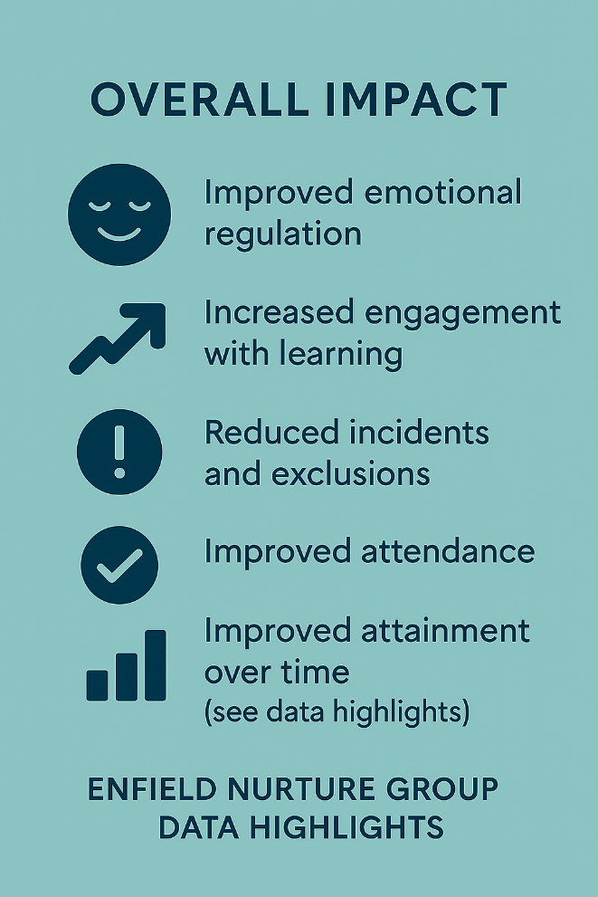
Vulnerability and Impact

Slide 41
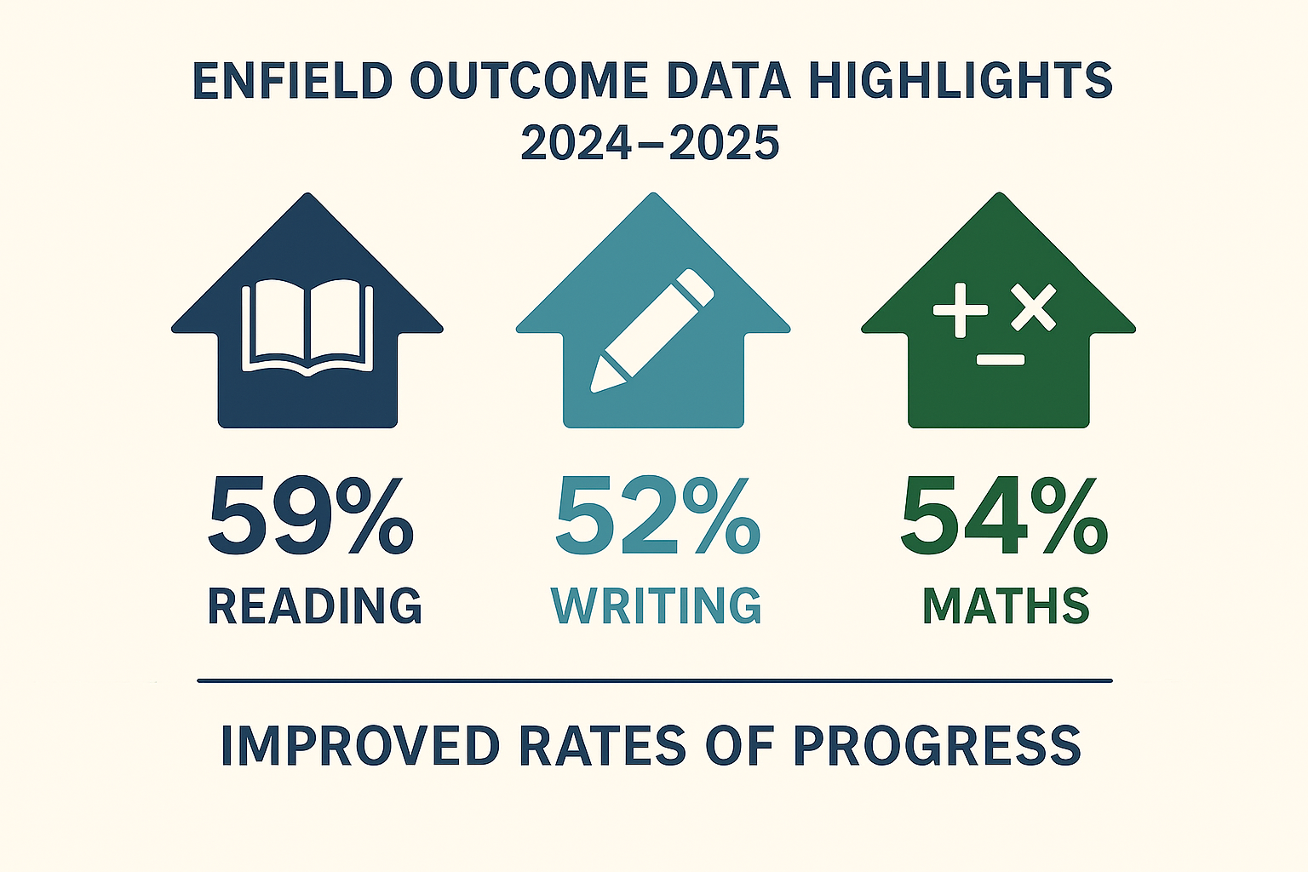
Effectiveness

Slide 42
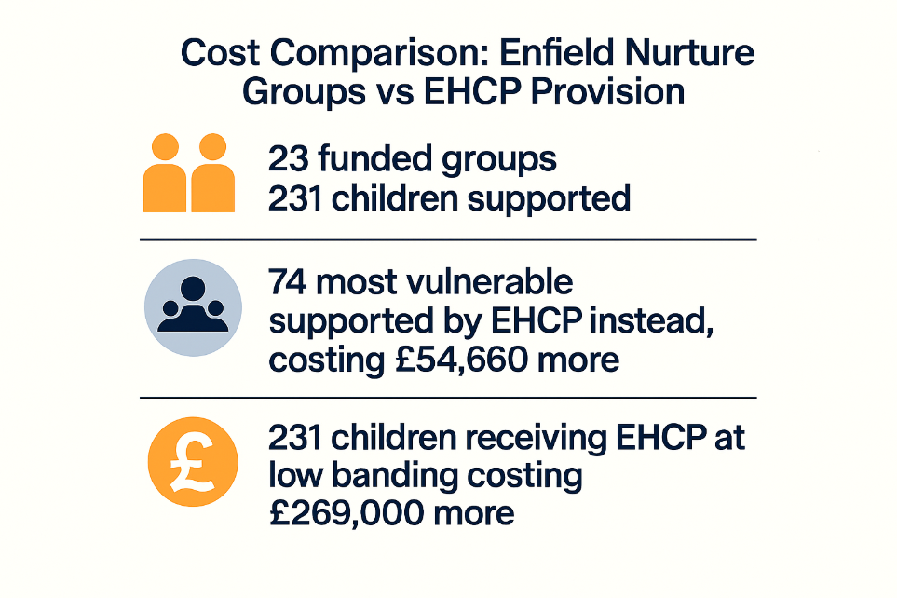
Efficiency

Slide 43


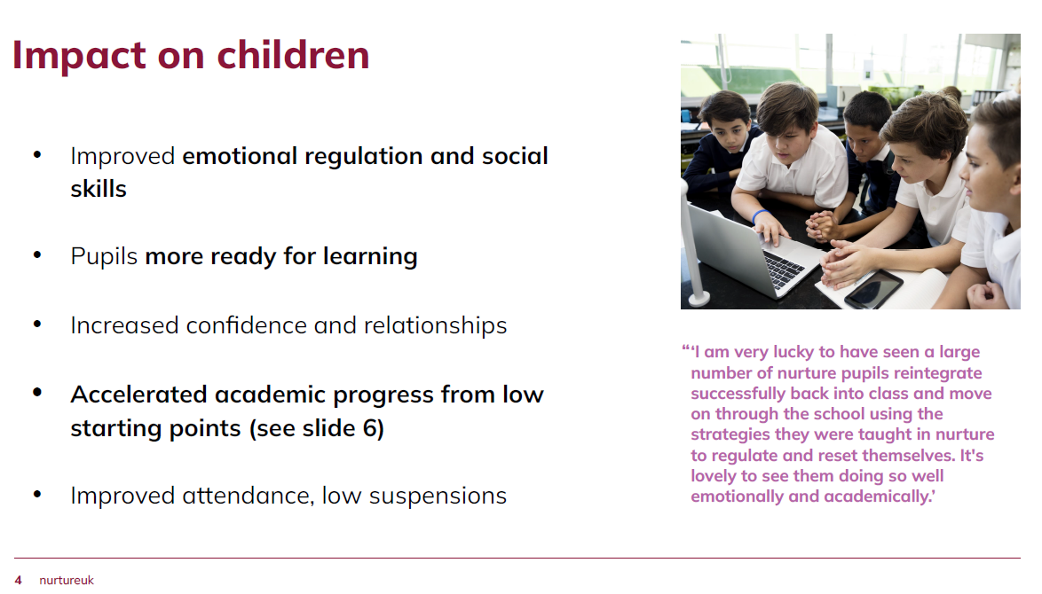
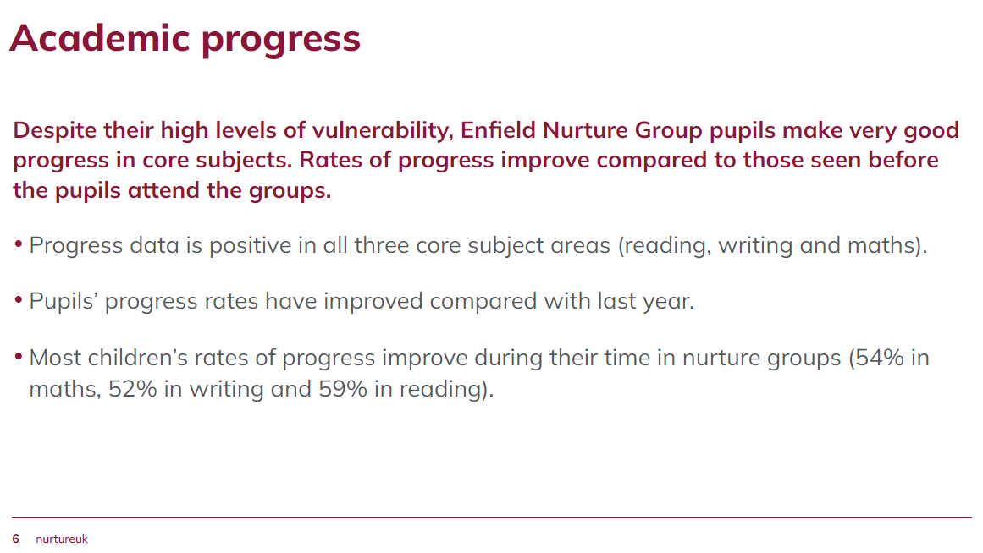

Slide 44
Learn from effective local models and cross-UK good practice For example, Enfield Council has funded and supported a network of nurture groups across the borough, providing early intervention and relational support at scale. The provision has been found to be an effective, high-value early intervention that delivers strong educational and economic returns.
SEND Reforms consultation response

Slide 45


The Inclusive and Relational Approaches Working Group
Who are we?
The inclusive and relational approaches working group is made up of educators, charity leaders and sector experts. We have come together to raise awareness of the need for inclusive, relational approaches as they relate to belonging in education, with the government, policymakers and the wider sector. We aim to share evidence and best practice on facilitating inclusion, relational approaches and a sense of belonging for children in school.

Slide 46
Future NG
Year 3 of the funding cycle 2026-27, new bids to begin in late Autumn 2026. All Primaries will be contacted.
How can we support children before and after Nurture Group, or in schools with no Nurture Group?
Next year marks 25 years of EY SEND Team (formerly EYSI) working in Enfield schools – time to celebrate!

Slide 47
TRANSITIONS 2025-26
KEY OUTCOMES
450 TSPs completed, covering over 11% of the Year 6 cohort in 2025.
100% of secondary schools received and used TSPs, enabling proactive planning.
97% of pupils receiving the ‘Language for Behaviour and Emotions intervention’ reported improved social skills.
Early evidence showed 1.2% higher attendance for Year 7 pupils with a TSP.

Slide 48
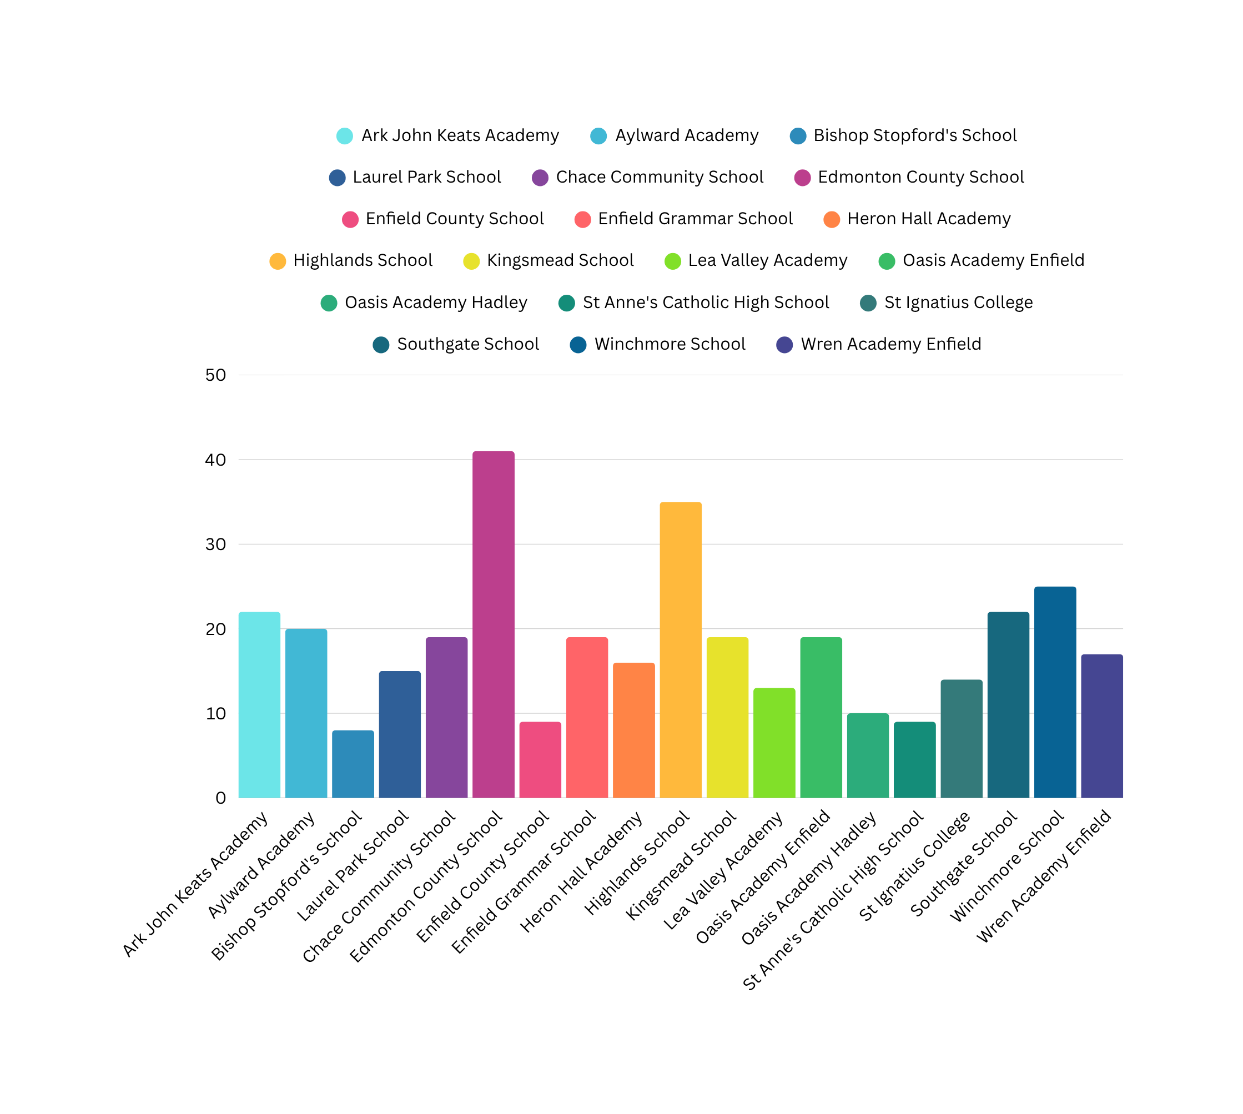
451 Transition Support Plans

Slide 49
TRANSITIONS 2026-27
ENGAGEMENT
Nearly 100 staff/services signed up to the last Transitions event and CPD on 25th March
Transition Support Plans due by 1 June
95% of Secondary Schools signed up to attending Information Sharing Event on 20th May
87% of Primary Schools signed up/ engaged

Slide 50

TRANSITION RESOURCES: PSHCE
Verbo
Language for Behaviour and Emotions
The Anna Freud Centre
Asking for Help
Problem Solving
Making Friends
Organisation
Talking about Feelings
Bringing it all Together

Slide 51

PEER MENTORING
SESSION
PILOT
September 2026
Years 6, 8 and 10
7 trial Primary Schools
7 trial Secondary Schools

Slide 52

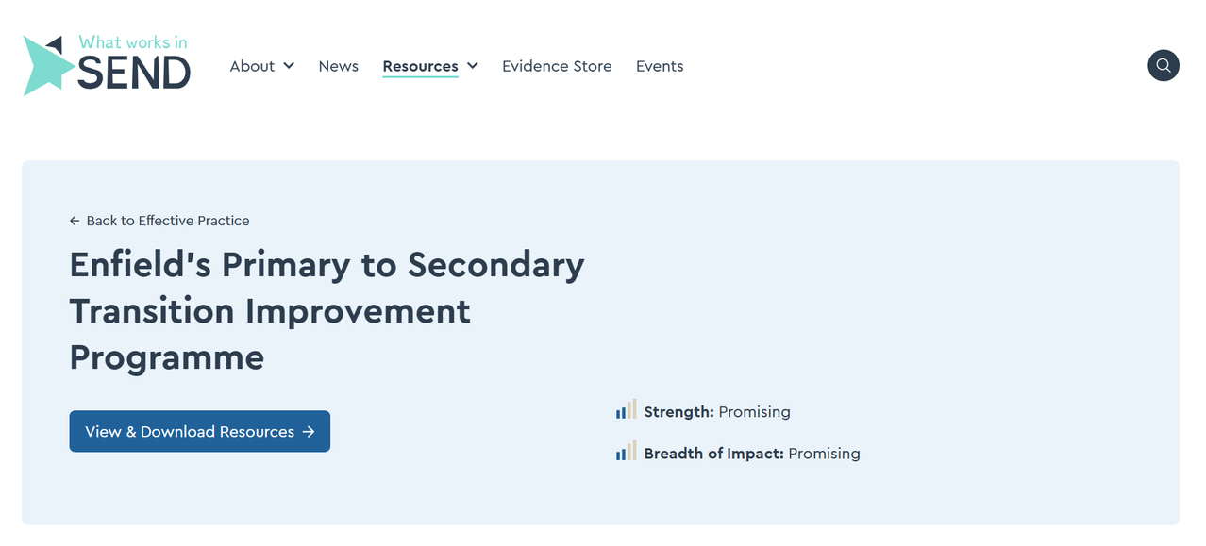
NATIONAL CASE STUDY

Slide 53

Enfield Trauma Informed Practice in Schools and Settings (ETIPSS)
Dr Leylla Mulisa (Specialist Senior Educational Psychologist Emotional Wellbeing & Mental Health)
www.enfield.gov.uk

Slide 54

What is E-TIPSS?
Builds on years of existing & good practice that has developed across Enfield services and partnerships including:
Educational Psychology Service – provides leadership & co-ordination
SWERRL
EASA
MYME
ECASS
SALT service
Youth Justice Service
School & Early Years Improvement Service
Cheviots Children’s Disability Service
Early Years Partners and providers
Virtual School for Looked After Children/CiN & CP
Our Voice Parent/Carer Forum
Early Help
Kati Taunt
(ARC TIPS Consultant)

Slide 55

What is E-TIPSS Film
Enfield E-TIPSS Oct 25 2min v02 | Videos & Movies on Vimeo
Notes:
Enfield E-TIPSS Oct 25 v09 on Vimeo

Slide 56
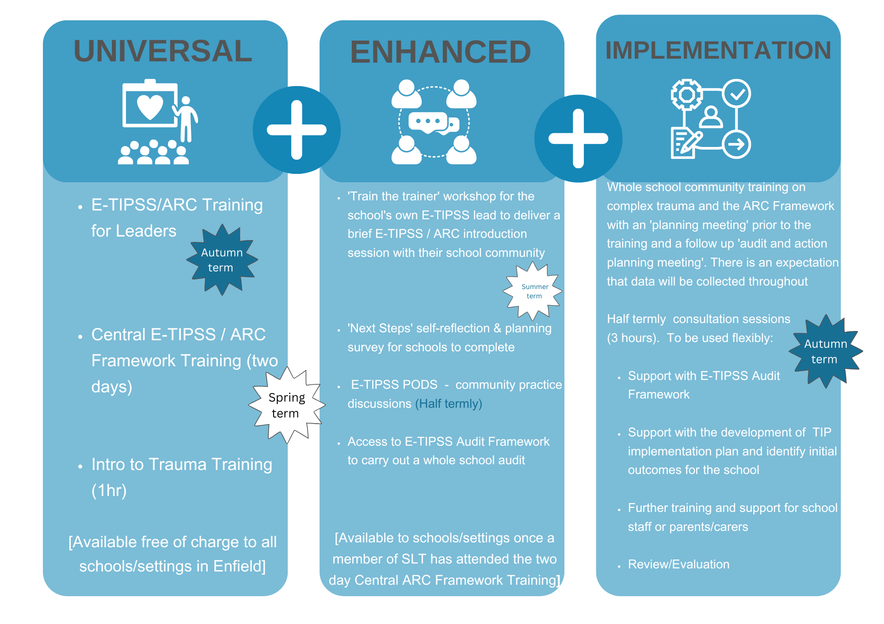
E-TIPSS offer for leaders | Educational Psychology Service
Enfield Trauma Informed Practice in Schools and Settings | Educational Psychology Service
Enfield Trauma Informed Practice in Schools and Settings | Educational Psychology Service

Slide 57
Further details about the event and a link to register can be found here Enfield Trauma Informed Practice in Schools and Settings | Educational Psychology Service
Please register (via the MS Form) to attend if you are able to make it.
ETIPSS Summer Event Registration

Slide 59


MeLSA Mediated Learning Support Approach
Information Session Summer 2026
Educational Psychology Service
Striving for excellence
www.enfield.gov.uk

Slide 60


Introductions

Slide 61

What is MeLSA?
MeLSA is a six day training and supervision programme that builds capacity of schools to support the learning needs of their pupils.
MeLSA delivers the psychology of learning and implementation science so schools can select, deliver and evaluate the right interventions and classroom-based learning support, so children make progress.
MeLSAs gain the skills to assist a child or young person to be a more skilled and independent learner.

Slide 62
Are MeLSAs like ELSAs?
Yes! As with the ELSA training programme, the aim of the MeLSA programme is to skill up specific members of staff who can deliver support.
You can identify Mediated Learning Support Assistants who take a specific role in school, providing individual and group interventions for children with C&L needs. Their knowledge and skills can also be utilised in the classroom.

Slide 63



Essential qualities of MeLSAs
Building relationships
Being creative
Interested in continuing own learning journey

Slide 64
Why MeLSA?
Capacity building for your staff team- knowledge, skill and enthusiasm are contagious!
MeLSA training provides school staff with the skills to:
Carry out clear baseline assessments
Deliver interventions effectively to consolidate learning
Monitor, trouble-short and evaluate the impact of interventions

Slide 65
What is the impact of MeLSA training? A school’s experience:
At the time that MeLSA was introduced, we had identified a group of children within our school who were still struggling to access the curriculum despite many years of repeated interventions. We found that the same strategies were not working, and that we need further professional development to better understand exactly what their challenges were … specifically, why some children appeared unable to retain information and recall it when needed, and why they were not able to reach their goals in reading, writing, and maths.
MeLSA helped us to understand the psychology of learning and made us more confident in adapting teaching and learning approaches to meet the needs of these pupils. After attending the training, we introduced an intervention programme for identified pupils using the techniques we had learned.
The intervention is delivered daily, with up to 12 children withdrawn from class each morning to receive focused teaching in maths, literacy, reading, and phonics. Alongside these lessons, the children take part in daily memory games, movement breaks, mindfulness activities, fine motor skill development, and precision teaching of high-frequency words. The majority of the children involved are from Year 3, as we identified that this is where the attainment gap begins to widen.
The intervention has now been running for two and a half years and has been very successful. The children are more confident and have developed the foundational skills they need to become active learners when they are back in their classrooms. They describe learning as fun!

Slide 66
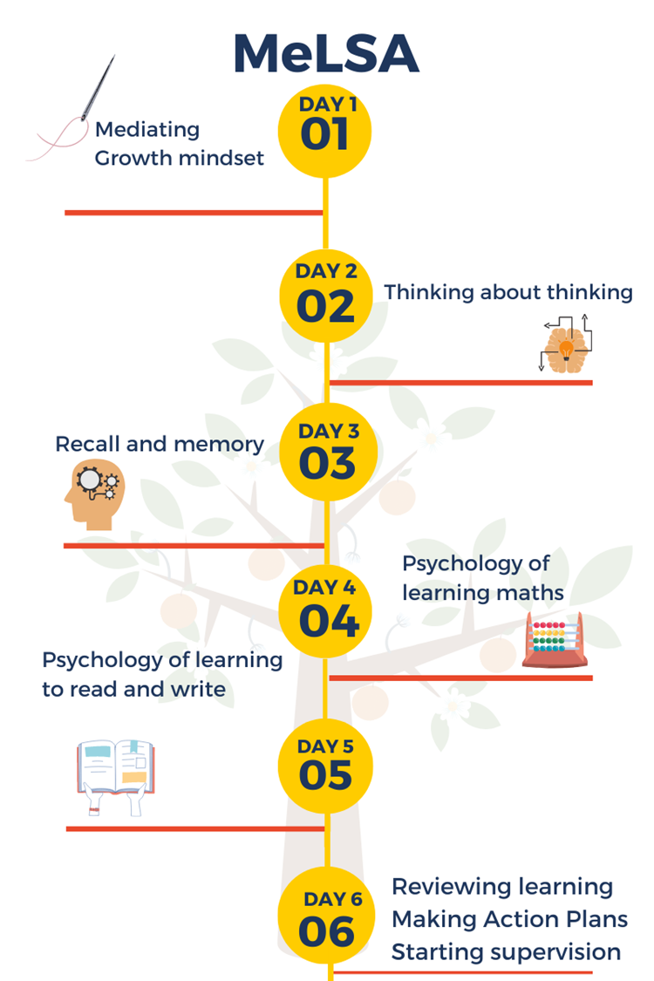
What’s covered?

Slide 67
Training course information
Co-delivered by two EPs.
Six Tuesdays in the autumn term, 9.30-3.30pm.
Face to face at the Civic Centre.
SENCos/SLT are asked to attend half of the first and last days.
For schools trading with EPS there is a £50 cost per participant for workbooks.
£600 charge for non-trading schools.

Slide 68
Beyond the training course: CPD package
Annual membership package to support you to embed the skills and develop whole-school MeLSA practice:
Half termly group supervision (online)
Termly MeLSA community of practice sessions for CPD and sharing good practice (online)
Cost for 26/27 is £120 per term per person. Initial commitment is for the spring term only.

Slide 69
Autumn term dates 2026
Day 1
Day 2
Day 3
Day 4
Day 5
Day 6
29th September
6th October
13th October
20th October
10th November
17th November

Slide 70
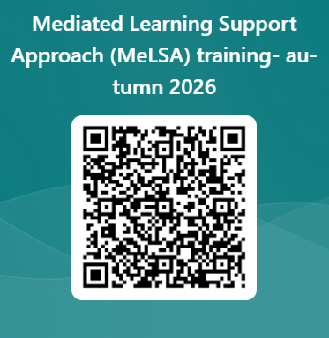
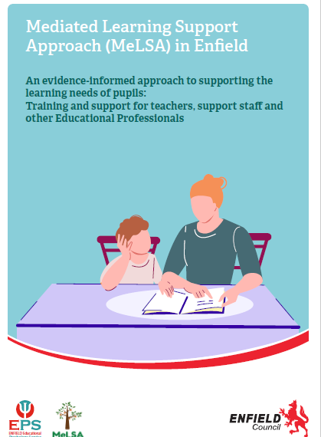
How do I sign up?
or click here

Slide 71

Further information sessions: 11.00-11.30am Tuesday 16th June 4.00-4.30pm Tuesday 23rd June Please sign up using QR code or click here:
Any questions, please contact Rachel Friend:
Rachel.Friend@enfield.gov.uk

Slide 72

Seeking Secondary School Leaders for Research Participation
Exploring changes in thinking and professional language about SEMH needs following engagement with training on trauma informed practice or relational approaches
About the Study
Why Participate?
• 40-minute semi-structured interview online
• Focus on leadership perspectives and SEMH
• Explores trauma-informed thinking and language
• Flexible scheduling available
• Ethically approved and fully confidential
✓ Contribute to Enfield-wide SEMH practice development
✓ Share leadership experiences and perspectives
✓ Support understanding of trauma-informed practice
✓ Help shape future training and implementation
✓ Achieve your silver or gold E-TIPSS certificate
Interested in taking part? Contact: Gemma Benson Gemma.Benson@enfield.gov.uk

Slide 73



KS2 Moderation
2026 Beatrix Simpson Moderation Manager SIA
Striving for excellence
www.enfield.gov.uk

Slide 74
Moderation Overview for 2026
ARRANGEMENTS
Moderation teams include Lead Moderators, Senior Practitioners, Pool Moderators, and members of the School Standards Service.
A protocol defining the role of the LA on behalf of STA in undertaking moderation and monitoring visits is included in the Handbook.
An appeals process for the reconsideration of the end of Key Stage 2 writing assessment, after the moderation, has been established.
Moderation Handbook was e mailed to HTs and Literacy Leaders in January 2026

Slide 75
Selecting Schools to be moderated
The LA is required to ensure that all schools are moderated at least once in a four-year cycle.
STA requires LAs to moderate a minimum of 25% of schools and 25% of academies each year and this could include those moderated in previous years.
Some schools are moderated more frequently depending on individual circumstances. Triggers for external moderation may include:
new teaching staff
new senior leadership team
school with a year 6 cohort for the first time
Ofsted concerns
Unusual patterns of attainment
Date and / or outcome of last external moderation visit
Concern relating to the 2025 assessment cycle, including maladministration

Slide 76
Dates
Those schools selected for an LA external moderation visit will be notified on or after Friday 15th May 2026.
Teams meeting for schools to be moderated on 21st May 3.45-4.30
Selected schools will receive an LA external moderation visit between Thursday 4th June 2026 and Tuesday 23th June 2026.
Re-moderation will take place on 24 June 2026 at the Civic Centre
Deadline for schools to submit the data on NCA, 26th June

Slide 77
Monitoring Visits SATS and PHONICS
Minimum 10% of schools –SATS ( before, during SATS and after )
2026 key stage 2 tests: monitoring visits guidance - GOV.UK
Minimum 10% of Schools –Phonics ( before, during and after)
2026 phonics screening check: monitoring visits guidance - GOV.UK

Slide 78


Postgraduate teacher apprenticeships (PGTA)​
Laura Ng
ITE Partnership Development Manager​

Slide 79
PGTA (Postgraduate Teaching Apprenticeship)
Full-time salaried programme that leads to Qualified Teacher Status and a PGCE.
Level 6 apprenticeship.
Masters accredited (60 credits).
Starts in September and is 1 academic year.
It is suitable for someone already working in a school who has classroom experience – TA/LSA or HLTA
Primary courses: 3-7, 5-11, 7-11, SEND 5-11

Slide 80
The PGTA programme at London Met
Route established in 2018.
Worked with over 70 schools in London.
Strong partnerships with alliances and federations including Hackney Teaching & Schools’ Alliance, Viridis Schools Partnership and Primary Advantage.
The vast majority of our apprentices since 2018 are still working in local schools.
Apprentice End Point Assessment 95% have gained Distinctions.
Notes:
Laura

Slide 81
Routes into teaching
Applicants must have GCSE English, Maths, Science - C/4 or above or equivalency e.g. A-star
Postgraduate – 1 year
Apprenticeship PGCE in Primary with QTS
Age 3-7, 5-11, 7-11, 5-11 SEND
Employment based – salaried UQT
Levy pays for the training
Core route – PGCE Primary with QTS
Age 3-7, 5-11, 7-11, 5-11 SEND
Self-funded
University based
120 days on placement
Degree?
Yes
or
No
Undergraduate – 2 years
Apprenticeship PGCE in Primary with QTS
Age 3-7, 5-11, 7-11, 5-11 SEND
Employment based – salaried UQT
Levy pays for the training
Core route – PGCE Primary with QTS
Age 3-7, 5-11, 7-11, 5-11 SEND
Self-funded
University based
120 days on placement
BA (Hons) Primary Education
Accelerated degree – 2 years
Part time
Self-funded
or
Notes:
Laura

Slide 82
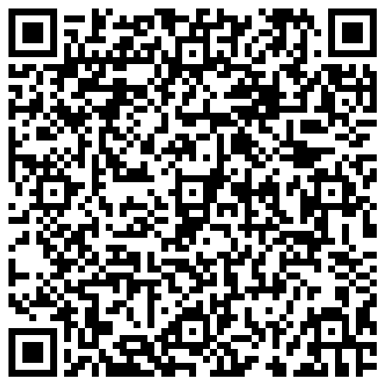
Funding
Levy Paying organisations:
Funds are taken from the Apprenticeship Service account and paid directly to London Met University (£9,000)
As long as levy funds remain above the required level, the school does not need to contribute to training costs
In many cases, the levy-paying organisation is the local authority
From April 2026, if there are insufficient funds in a levy-paying employer’s account during an apprenticeship, the employer will be required to contribute 25% of the funding shortfall.
Non-levy paying employer options:
Funding is available through government–employer co-investment
From 1 Aug 2026: Non-levy employers pay 5% co-investment for apprentices aged 25+.
From 1 Aug 2026: Non-levy employers pay 0% (fully funded) for apprentices aged 16–24
Notes:
USEFUL LINKS​
https://www.gov.uk/employing-an-apprentice/get-funding​
https://www.gov.uk/government/publications/apprenticeship-funding/apprenticeship-funding​
https://www.gov.uk/government/publications/apprenticeship-funding/apprenticeship-funding-for-employers-who-do-not-pay-the-apprenticeship-levy​
https://transfers.manage-apprenticeships.service.gov.uk/

Slide 83
Other financial considerations
Apprentices must be employed on the Unqualified Teacher Scale
Enfield 2025-26 UQT is £26,788
Trainees are not eligible for student finance

Slide 84
The course structure
20% off‑the‑job training, delivered at uni and/or OTJ activity in school (1 day a week plus ppa).
Second placement in Spring 1 (alternative Key Stage).
SEND trainees complete an extended mainstream placement (minimum 10 weeks) covering KS1 and KS2
Trainees remain paid by their main employing school during placements.
End Point Assessment (EPA) completed at the end of the academic year.

Slide 85
What are the advantages for schools?
It provides a progression pathway for graduate teaching support staff and allows schools to develop their own future teachers.
It gives an opportunity to utilise the apprenticeship levy effectively.
It supports the whole school workforce planning.
It can help to reduce recruitment costs.
Several former trainees have gone on to become successful middle leaders, and one is now a valued member of our Senior Leadership Team.
The “grow your own” approach means our trainees grow accustomed to our pedagogy, standards and expectations from the start.
Played a vital role in improving teacher retention, with all teachers trained through the programme remaining with us to complete at least their two ECT years.

Slide 86
What is expected from the school
Each apprentice must have a designated mentor in school that provides1.5 hours mentor support each week:
Observing and feeding back on teaching
Setting clear targets against the Initial Teacher Training and Early Career Framework
Support with planning
Engaging in mentor training
Apprentices work alongside teachers building up to teaching 80%
Working with groups
Team teaching
Developing their practice
They progress to lead whole classes
They shouldn't be used as cover teachers

Slide 87
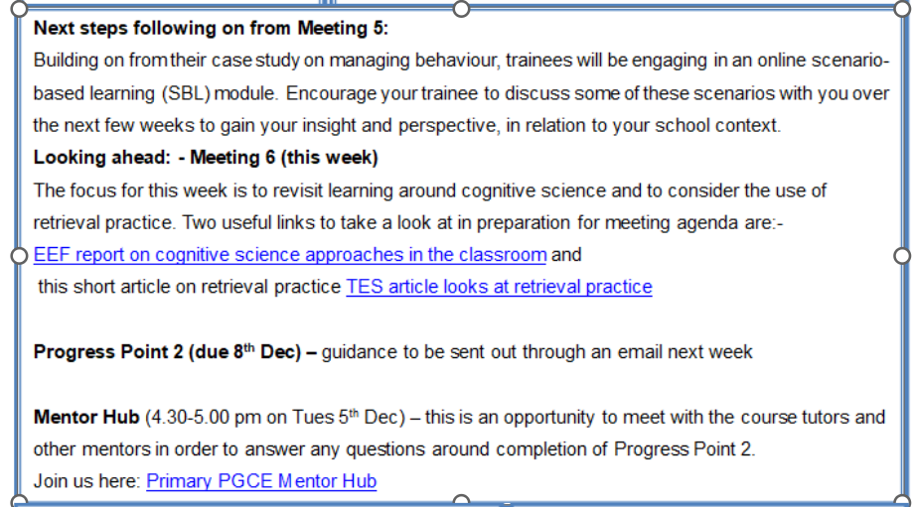

What the school can expect from London Met
A Link tutor from the university works closely with the trainee and the school.
Regular Mentor Bulletin: Triangulation of university-based learning and school experience
Links with curriculum during the university days
Next steps for your dialogue with trainees
Links with current research
Mentoring training update
Notes:
Alex

Slide 88
Application process
Candidate applies via the DfE portal
Primary 3-7
Primary 5-11
Primary 7-11
Primary (SEND)
The school interviews candidate to assess suitability for the programme
Application reviewed by university and interview held
If successful at interview, an offer is issued
Onboarding paperwork is sent to schools and offer holders

Slide 89

Find out more
FAQ apprenticeships LMU.pdf
Teacher Education Partnerships
Mentor Resource Hub
Routes into teaching at London Met

Slide 90
Contact details
Alex New Principal Lecturer Primary PGCE Lead
a.new@londonmet.ac.uk
Fiona Carretas Apprentice Lead Senior Lecturer Primary PGCE
f.carretas@londonmet.ac.uk
Laura Ng ITE Partnership Development Manager
l.ng@londonmet.ac.uk

