Slide 1

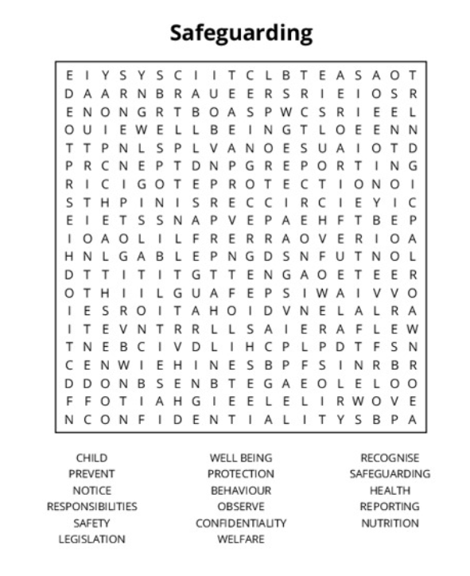


Samantha.Hill@Enfield.gov.uk
DSL Network
7th July 2026
SEYIS
Schools and Early Years Improvement Service
Striving for excellence
www.enfield.gov.uk

Slide 3
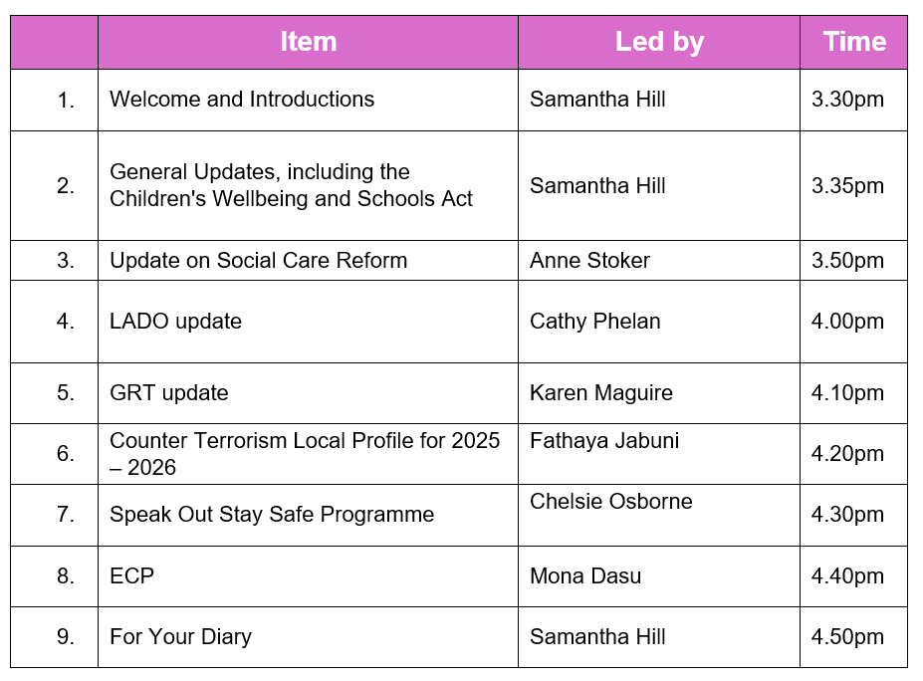

Slide 4
New Guidance to Prevent Deaths from Choking and Allergies
-Updates to the EYFS statutory framework place specific requirements on schools and early years settings to minimise choking risk through:
STAFF PRESENCE. A Paediatric First Aider must be present in the room when children are eating
SEATING ARRANGEMENTS. Children must be seated appropriately when eating
CHOKING PREVENTION. Staff are required to be aware of choking hazards and to take steps to minimise these, such as encouraging children to chew food well
RECORD KEEPING. Staff must record and choking incidents that require intervention and inform parents/carers
-Additionally, new allergy guidelines come in to force in September, with schools expected to have robust allergy policies, spare adrenaline auto-injectors and trained staff.

Slide 5
Children’s Wellbeing and Schools Act 2026
Children’s Wellbeing and Schools Act 2026
Children’s Wellbeing and Schools Act 2026 - Parliamentary Bills - UK Parliament
THIS HAS NOW BEEN PASSED INTO LAW
The Act has a staggered implementation timeline. Some provisions need further legislation or guidance to be formed before they become statutory.
Brief summary:
The Act integrates safeguarding, social care and educational support, emphasising children’s welfare, equitable access to school resources and multi-agency collaboration. It contains clear responsibilities for schools, local authorities and care providers.
This includes (but is not limited to):
Duty to report safeguarding information to ‘scope organisations’
Expectation that attendance will be seen through a wellbeing and safeguarding lens
Additional support and provision for young people in care and care leavers
Free breakfast clubs, rules on uniforms, extended eligibility for free school meals
Allergy safety policies
Provision for oversight of attendance, inspections and teacher misconduct
Funding and policy oversight for things like income from extended services
Bans on mobile phones in schools
Legal framework in place for potential future ban on social media for under 16s
…and more

Slide 6
KCSIE 2026
Keeping children safe in education: proposed revisions 2026 - GOV.UK
The draft/consultation version of KCSIE 26 is available, with final document expected to be published any day (but possibly all the way until September 1st). We will be publishing our borough model policy for 2026 once the final version is confirmed, as well as updating our audit tools and other documents.
There are lots of proposed changes, including:
Gender questioning students: schools should take a ‘very careful’ approach and single sex facilities should be maintained
‘Serious violence’ (weapons): early intervention, ‘teachable moments’ and the need for assessing risk and taking action
Mental health: ‘can sometimes develop into safeguarding concerns’, e.g. self harm and suicide risk
Child on child abuse: updated to include technological advances and other changes in the law, e.g. ‘deep fakes’, ‘upskirting’, misogyny, harmful sexual behaviours and sexual violence
Operation Encompass: domestic violence reporting duty made statutory
Mobile phone free schools: this should be the default
Safer Recruitment and managing allegations against staff: Guidance strengthened
And more!

Slide 7
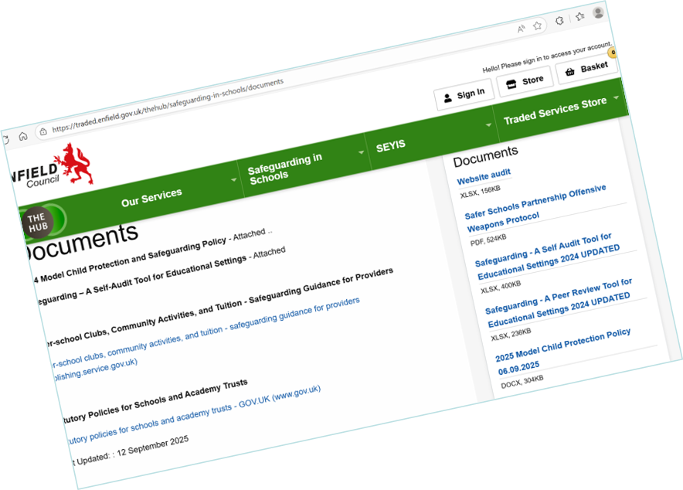
Safeguarding Self-Audit
You MUST return your school’s self audit for 2025/26
This includes academies, APs and independent schools
You can use our format or your own. You can find ours here:
Welcome to The Hub | Enfield Council
Please return to seyis@enfield.gov.uk

Slide 8


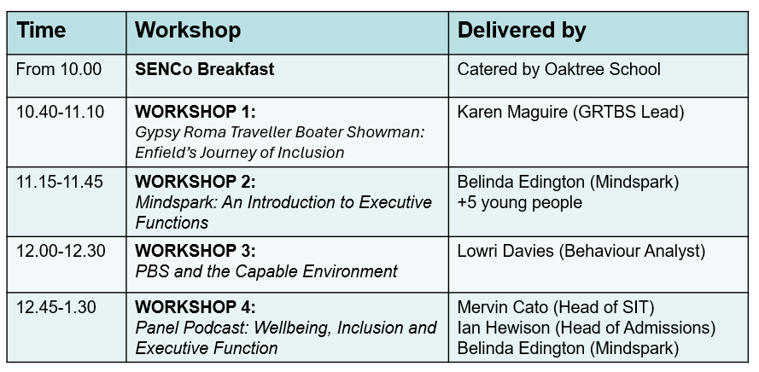
The Enfield
Inclusion Exhibition
You are invited to
Wednesday 8th July 2026 | Park Suite, Houndsfield School, N9 7RA
FEATURING:
THE ENFIELD INCLUSION CHARTER | SEYIS | SEN | CAMHS | EARLY YEARS | UNICEF | VRU | LONDON INCLUSION CHARTER | EPS | ECASS | EASA | RUSSET SCHOOL | WAVERLEY | MINDSPARK | DURANTS | OAKTREE | NEXUS | SWERRL | CHACE | HOUNDSFIELD | GRT | ATTENDANCE | GOVERNOR SERVICES | DBV | NIP IN THE BUD | NESSY | OUR VOICE | FOSTERING | THE VIRTUAL SCHOOL | FUSION OF HEARTS | MARKET AND BOOK STALLS | FOOD AND COFFEE
AND MORE
Workshops
Enfield Inclusion Charter Poster (8).pdf
School tours
Details of available tours have been circulated separately.
Contact the schools directly to book a place

Slide 9
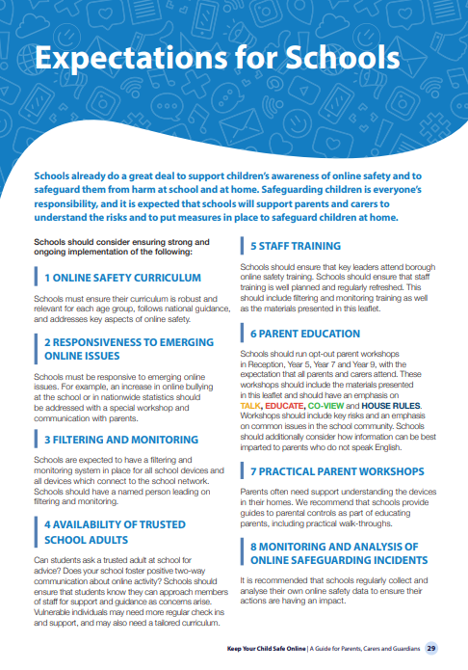

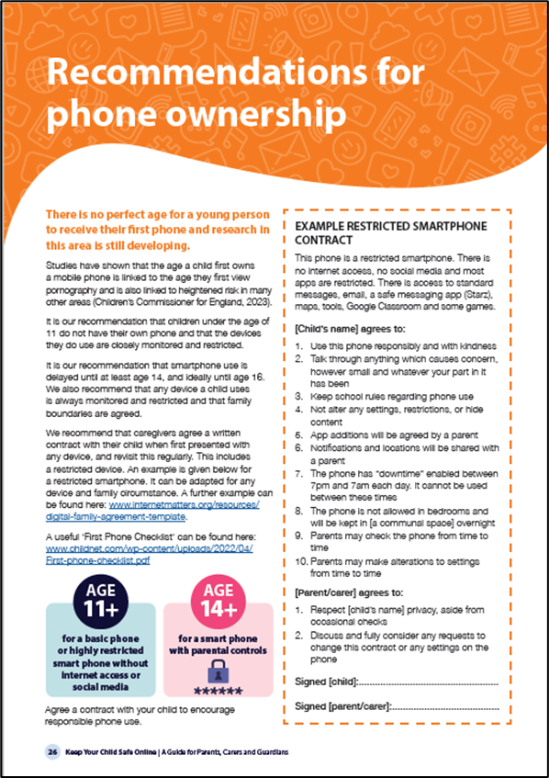
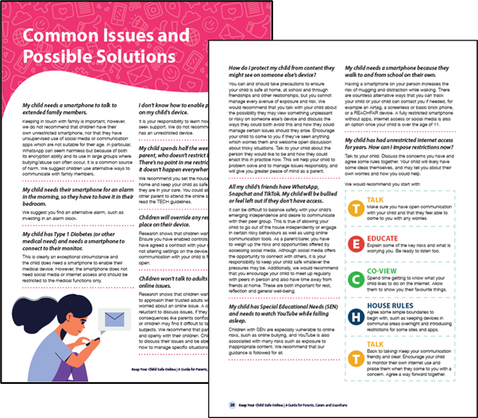
Online Safety | Enfield Council
Our Keep Your Child Safe Online guidance is currently being revised. We intend to make the following amendments and would appreciate your thoughts on what might be needed:
Updates in line with new government guidance and laws
Updated statistics and key risks
A more pictorial summary poster
A pictorial summary of all the guidance
Further information about SEND
Much more information about AI and any other emerging technology
…and more!

Slide 10
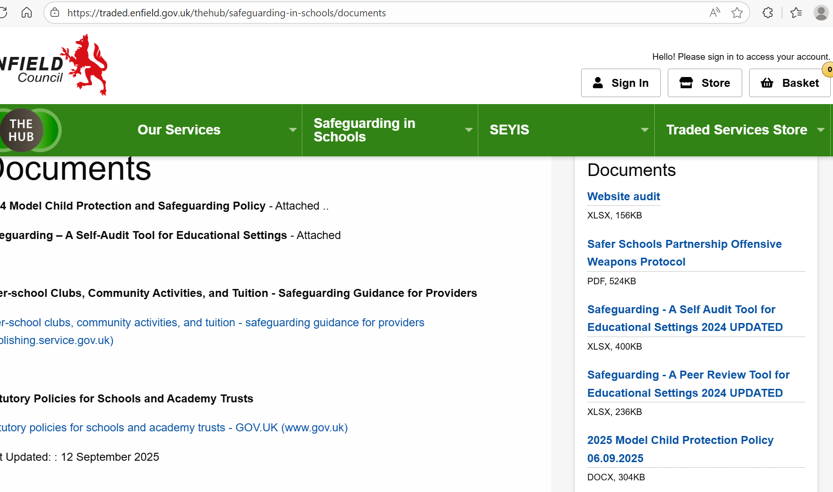
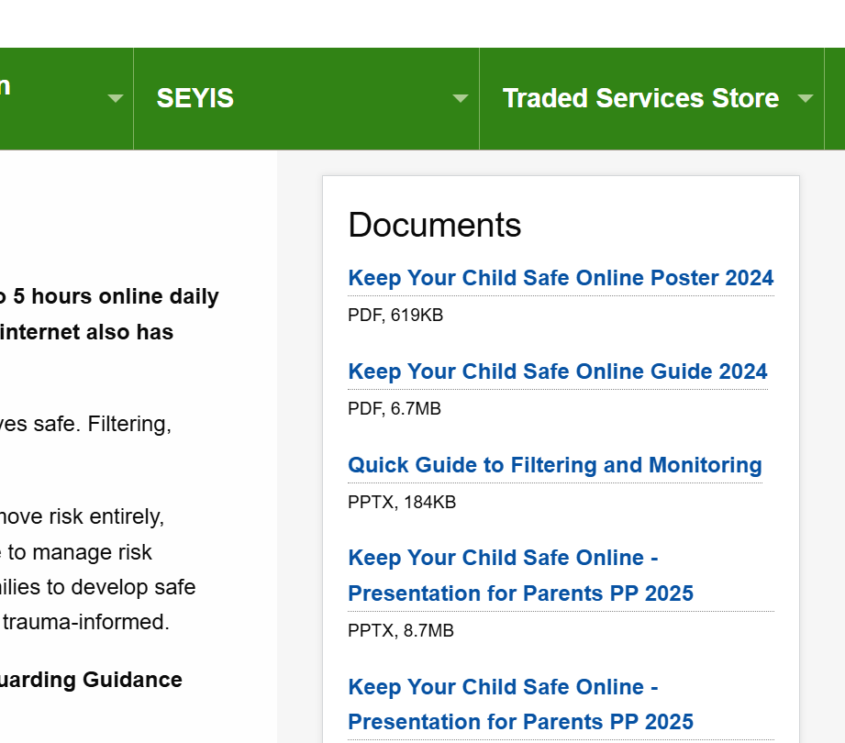
The Hub (Enfield Traded Services)
https://traded.enfield.gov.uk/thehub/safeguarding-in-schools
-Model policies
-Safeguarding self audit
-Website audit
-RoundUp Newsletters
-Whirlwind Guides
-Online safety materials
-LGBTQ+ guidance
-Signposting
-and more!

Slide 11
A Quick Reference Guide
Safeguarding RoundUp | A weekly newsletter which gives an overview of updates, training and general information about safeguarding. Many schools share this with their entire staff body. Sign up: seyis@enfield.gov.uk
DSL Network Meetings | A half termly Teams meeting for DSLs and senior leaders, attended by most DSLs in the borough. Range of guest speakers and important updates. Dates and Teams links published in the Safeguarding RoundUp. Contact seyis@enfield.gov.uk.
The Hub | Lots of tools, documents and information to support your work in your school, including safeguarding audits, website audits, inclusion audits, online safety tools, signposting and model policies. Welcome to The Hub | Enfield Council
Safeguarding Enfield | Training, information and resources. Safeguarding Enfield
Safeguarding Self Audit | Your school is expected to return a self-audit annually, using either our own Safeguarding Self-Audit Tool (available from The Hub or by emailing Samantha.Hill@enfield.gov.uk) or another format. It is recommended as part of your Autumn Term calendar. Email your document as a PDF to seyis@enfield.gov.uk
Ofsted/DfE/other official safeguarding complaints | These will be investigated either by the LADO or by SEYIS (Samantha Hill). We will contact you to explain the complaint and will request some relevant information from you, including the school’s narrative. A response is usually expected within a week.
Online Safety | Materials can be found here: Online Safety | Enfield Council.
Safeguarding Reviews | Contact Samantha.Hill@enfield.gov.uk if you are interested in commissioning a full Safeguarding Review. We also offer SEND and curriculum reviews.
Advice and support | Contact me any time for reasons big or small. Always happy to help or point you in the direction of someone who can: Samantha.Hill@enfield.gov.uk

Slide 12
Useful People, Useful Links
KCSIE 2025 | Keeping children safe in education - GOV.UK (www.gov.uk)
The Hub | Welcome to The Hub | Enfield Council
Safeguarding Enfield webpage | Safeguarding Enfield
Professional Learning Portal | https://traded.enfield.gov.uk/thehub/professional-learning-portal/safeguarding
Mind in Enfield | 0208 906 7505 mindinenfield.org.uk
Prevent Education Officer | Fathaya.Jabuni@enfield.gov.uk
HEART Team for Looked After Children and Post Adopted CYP | Suzanne.Rowson@enfield.gov.uk
MASH Service Manager | Natalie.Rollock@enfield.gov.uk
MASH Consultation Line | 02038556241
LADO (Cathy Phelan) | safeguardingservice@enfield.gov.uk
Enfield Educational Psychology Service | eps@enfield.gov.uk
CAMHS Crisis Line 24/7 | 24/7 Crisisline 0800 1510023
Samantha Hill Senior School Improvement Advisor for Safeguarding and Inclusion | Samantha.Hill@enfield.gov.uk 07764801827

