Slide 1

Gypsy Roma Traveller Pledge
One Pledge, One vision.
Better outcomes for every child
www.enfield.gov.uk

Slide 2
Turning Enfield’s vision into everyday practice
Strategic Alignment –
The Pledges complements Enfield's 'One Enfield' vision by helping schools work together to improve outcomes, reduce exclusions, strengthen inclusion, and ensure every child can thrive.

Slide 3
A simple Pledge. A lasting Impact
Adopting the GRTBS Pledge provides a practical framework for delivering Enfield's ambitions for excellent, inclusive education.
The Pledge gives you access to materials to support families, pupils and staff
The Pledge also provides opportunities for cultural awareness training
Learning materials/resources for key commemorative GRT dates in the Calendar Year

Slide 4
Building Schools Where Every Child Thrives
Builds a culture of respect and belonging
Supports inclusive practice and positive behaviour
Encourages attendance and engagement
Strengthens relationships with families
Helps schools deliver consistent expectations
Contributes to school improvement and pupil wellbeing

Slide 5
The GRTBS Pledge – Framework for Lasting School Improvement
How the pledge can support your school over time-
  Promotes respect, responsibility and belonging
  Creates safe, inclusive learning environments
  Reinforces consistent behaviour expectations

Slide 6
GRTBS Pledge- A shared commitment to Exellence, Inclusion & Success
G – Growth: Raises attainment, aspiration and lifelong learning.
R – Respect: Supports inclusion, belonging and positive behaviour.
T – Teamwork: Strengthens collaboration between schools, families and communities.
B – Belonging: Promotes pupil wellbeing, attendance and engagement.
S – Success: Helps every learner achieve their potential through high expectations.
Overall Impact: The GRTBS Pledge provides a practical framework for delivering Enfield's priorities of inclusion, excellence, wellbeing, partnership and improved outcomes for every child.

Slide 7
Making Enfield’s Educational Ambitions a Reality
Enfield's education partnership focuses on:
Raising attainment for all learners
Inclusive education and SEND support
Reducing suspensions and improving behaviour
Improving wellbeing and attendance
Strong partnerships between schools, families and the council
High-quality education in every school

Slide 8
The GRTBS Service
Support GRT families, pupils and school staff.
Coordinate ODET and ACERT referrals.
Promote GRT History Month, cultural training and peer-led engagement.
Help with attendance, behaviour, learning and wider support needs.
Improve GRT data and create apprenticeship pathways.

Slide 9

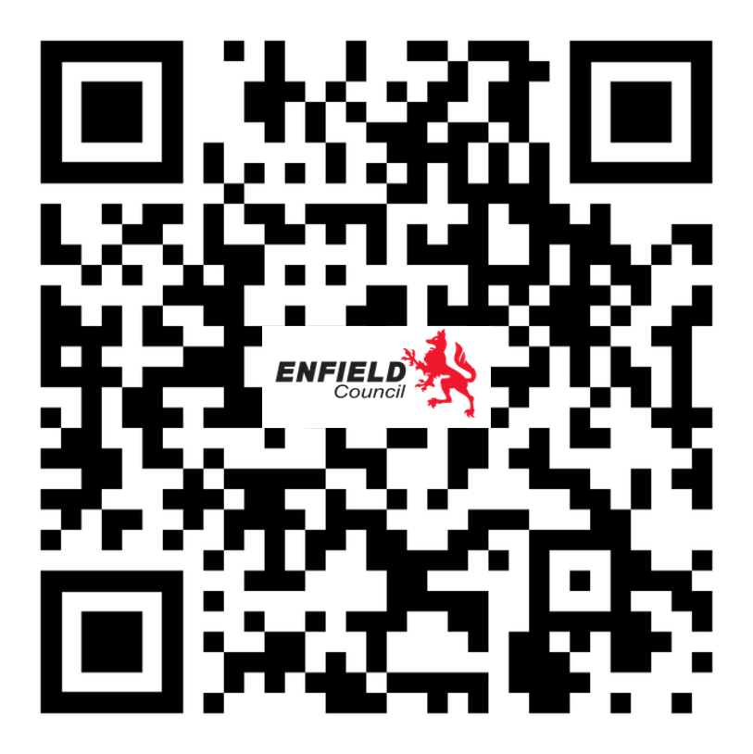

Any questions ? Thank you
Contact details-
grt@enfield.gov.uk

Slide 10
From Vision to Action
The GRTBS pledge is more than a behaviour initiative – it is a strategic framework that helps Enfield Schools deliver the Borough’s Vision of inclusive, ambitious, and high-quality education by embedding shared values into everyday practice

