Slide 1
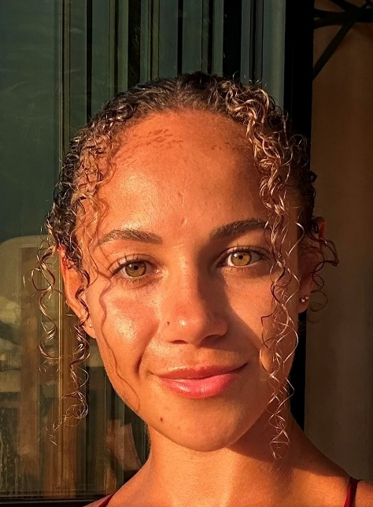

Hello! I’m Chelsie Osborne, Schools Coordinator for Enfield
My role is to:
Serve as your single point of contact for all NSPCC Schools Services such as Speak out, Stay safe (SOSS), Talk PANTS and Talk Relationships.
Share our free safeguarding resources tailored for parents, carers, DSLs, educators, and school staff.
Deliver our educational programmes to schools to support safeguarding education, and children and young people’s wellbeing.
Support schools with educational materials, guidance and support.
My contact details: Chelsie.Osborne@nspcc.org.uk - 07889158936

Slide 2
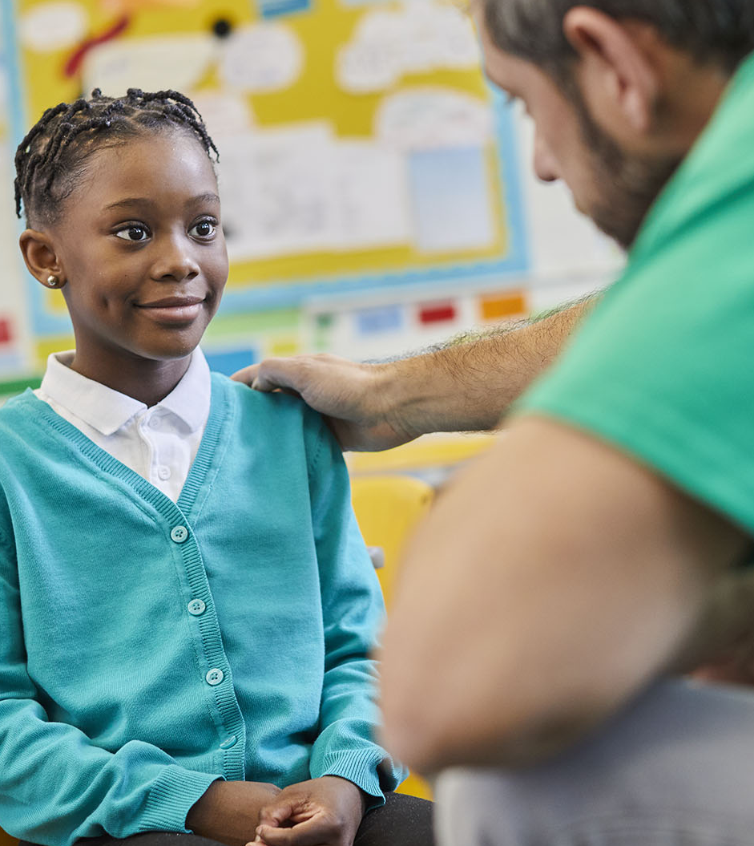

Speak out
Stay safe
Speak out Stay safe is our free safeguarding programme for 5–11-year-olds
It’s available to all primary schools across the south-east and nationally.
The programme is fully funded for ALL schools
We run a combination of assemblies, workshops and lesson plans
Find out more: Speak out Stay safe programme | NSPCC Learning
SOSS SEND also available
Notes:
Speak out Stay safe is our free, age-appropriate safeguarding programme
intended for children aged 5 to 11 and is designed to empower children and help them understand abuse in all its forms. It will help reinforce key messages about abuse and neglect, as part of your school’s teaching on healthy relationships in an age sensitive way while assisting you to meet your safeguarding obligations, all while being aligned with the curriculum.
In the programme we focus on:
how to recognise the signs of abuse,
understand that its is never a child’s fault
and they have the right to be kept safe,
how to get help if they need it.
We're often asked if the use of the programme is suitable for year R and we always advise that this is at your discretion. If you have a particularly young cohort you may wish to use the assemblies as a class lesson instead so that you can take things at a slower pace or answer any questions that may come up from younger learners. Ideally it would be best to carry out the programme towards the end of their first year so that most of the children are 5.
The main goal of the programme is to assist children in identifying the sources of help available to them, including our Childline services.
Speak out Stay safe is FREE - There is no obligation to fundraise. (Feedback I've been given has indicated that some people thought that the programme was a paid programme, but it is in fact completely free.)
The Programme uses our mascot BUDDY who is a speech bubble representing children’s rights.

Slide 3







Speak out Stay safe
Alternative Provisions - Practitioner Toolkit
Developed for practitioners in alternative provision settings
For children aged 5-11
Flexible, interactive resources & practitioner support materials
Adaptable for individuals or small groups
Empowers children to speak out & understand their rights
Covers types of abuse
Notes:
The Practitioner Toolkit is a new resource developed for those working in alternative provision settings, for example:
Pupil Referral Units/EOTAS (or Education Other Than At School Settings)
Secure units
Hospital schools
Online schools
LA specialist practitioners/teams
The resources within the toolkit convey the same Speak out Stay safe messages that children in school settings receive but offers a variety of activities for professionals to use as needed, instead of an assembly, workshop and lesson plans.
The toolkit is designed for use with children aged 5 to 11 and includes flexible, interactive resources that can be adapted for use with children either individually or in small groups; the resources can be selected and used based on what is most suitable for the child or children involved, and they can be adapted as necessary.
It uses hands-on activities, discussions and videos and covers the different types of abuse in an age-appropriate way. It includes activities that help children understand their rights and to feel empowered to speak out if something is wrong. Supporting the practitioner is also a key part of the toolkit, with resources included to help guide and facilitate delivery.

Slide 4

Speak out Stay safe
Home Education Resource Pack
Developed to support children aged 5-11 at home
To be used by parents and carers and/or home educators
Simple to run activities with video briefs and scripts to guide facilitation
Covers key topics like feelings and emotions, worries, children’s rights, and safe adults
Includes signposting for self-help and NSPCC resources for further support
Notes:
The Home Education Resource Pack is designed to support children and young people at home, particularly those who do not have access to our Speak out Stay safe programme through an education provider.
It is freely available via our NSPCC Learning platform and aimed at being used by parents and carers and/or home educators. It includes a range of engaging and age-appropriate activities, resources and videos for use with children aged 5-11.
All activities within the pack are easy to run and utilise resources that can be readily found at home. There are introductory materials to support with facilitation of the activities, including video briefs and scripts. The resources cover a range of topics including feelings, worries, safe adults, children's rights and an online safety Childline scavenger hunt. There is also signposting for self-help and further support, and to additional NSPCC resources.

Slide 5

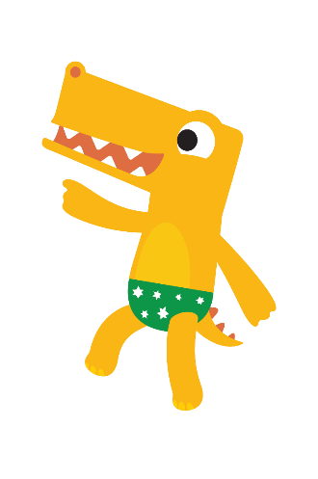


Talk PANTS
Recently updated – now aimed at all primary aged children (aged 4-11)
Talk PANTS is a simple conversation to help keep children safe from sexual abuse.
Webpage for parents with 5 PANTS rules: www.nspcc.org.uk/pants
Webpage for professionals with lesson plans, PowerPoint, template letter for parents and school display pack: PANTS resources for schools and teachers | NSPCC Learning
Storybook - Pantosaurus and the Power of PANTS!
Pantosaurus song – available on YouTube: https://youtu.be/-lL07JOGU5o?si=-dsBjpn4LX5eTnxp
Notes:
Talking PANTS with your children
Talk PANTS is a simple conversation using our mascot Pantosaurus, to help keep your child safe from sexual abuse. You can find out more and download the free resources on our website. Penguin and Ladybird have also partnered with the NSPCC to create a brand new Pantosaurus book aimed at children ages 4 - 8.
The pantosaurus resources were previously intended for early years but due to its popularity has been updated and expanded this year to support the messages in the soss programme and now has lesson plans for ages up to 11.
The goal was to provide another useful re-enforcement tool that the children are familiar with and we often find schools use talk Pants with children who are transitioning from EYFS settings, or by alternating the new programme with SOSS.
www.nspcc.org.uk/pants
Links:
https://learning.nspcc.org.uk/research-resources/schools/pants-teaching
https://www.youtube.com/watch?v=-lL07JOGU5o
Here’s a look at Pantasuarus – Video auto plays next slide

Slide 6
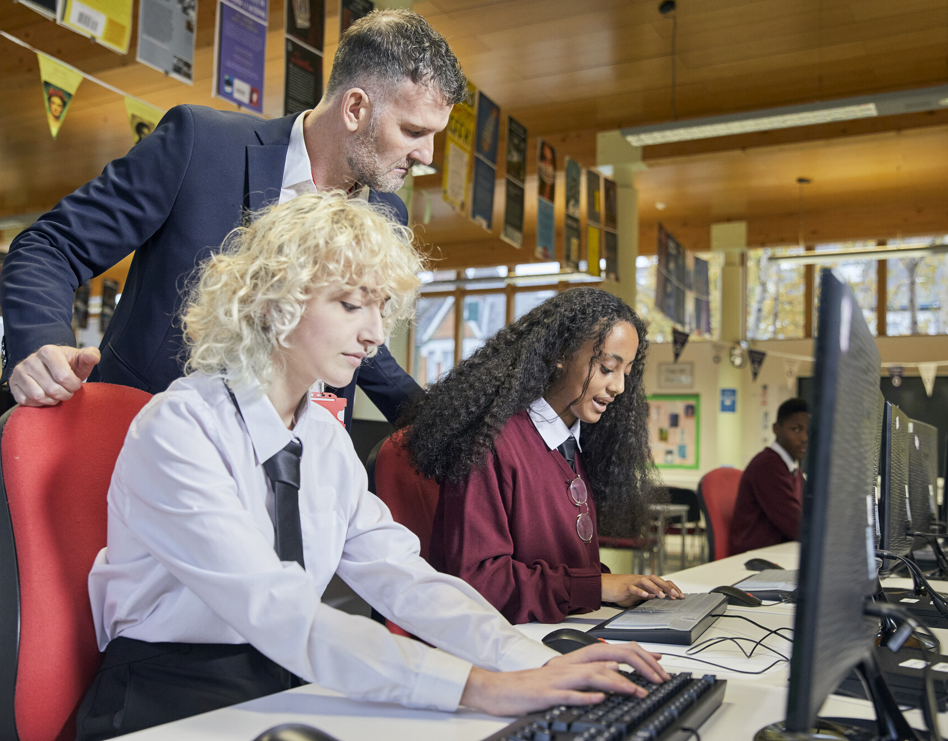
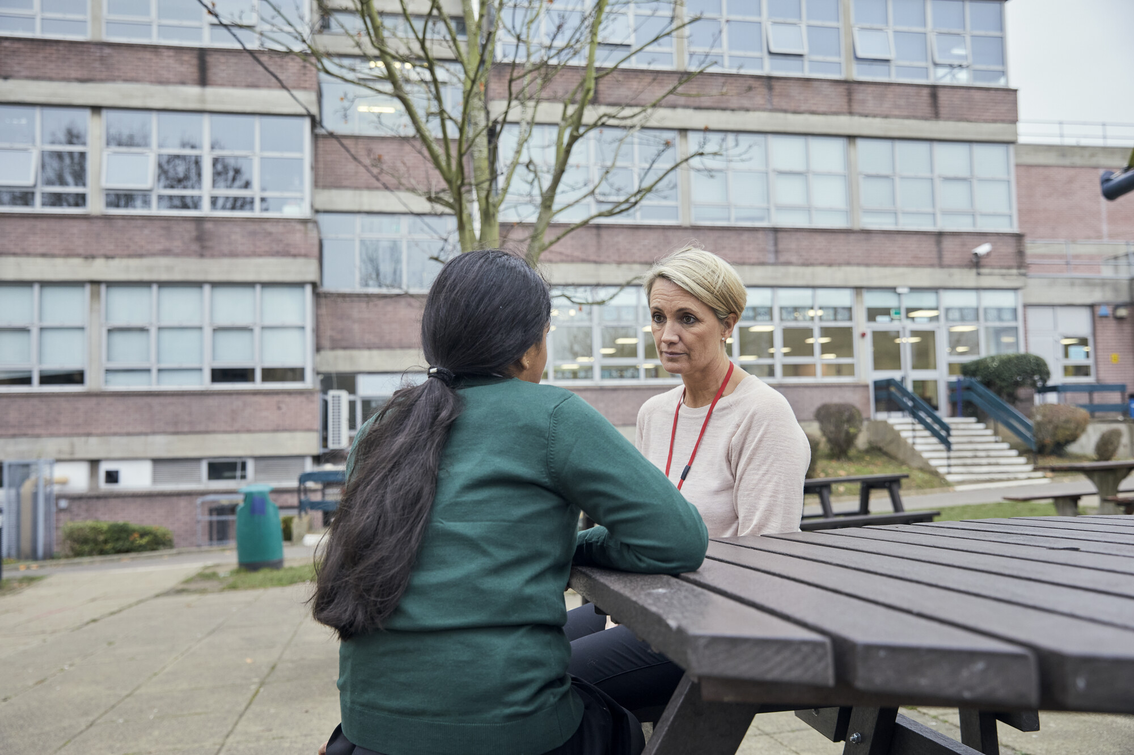



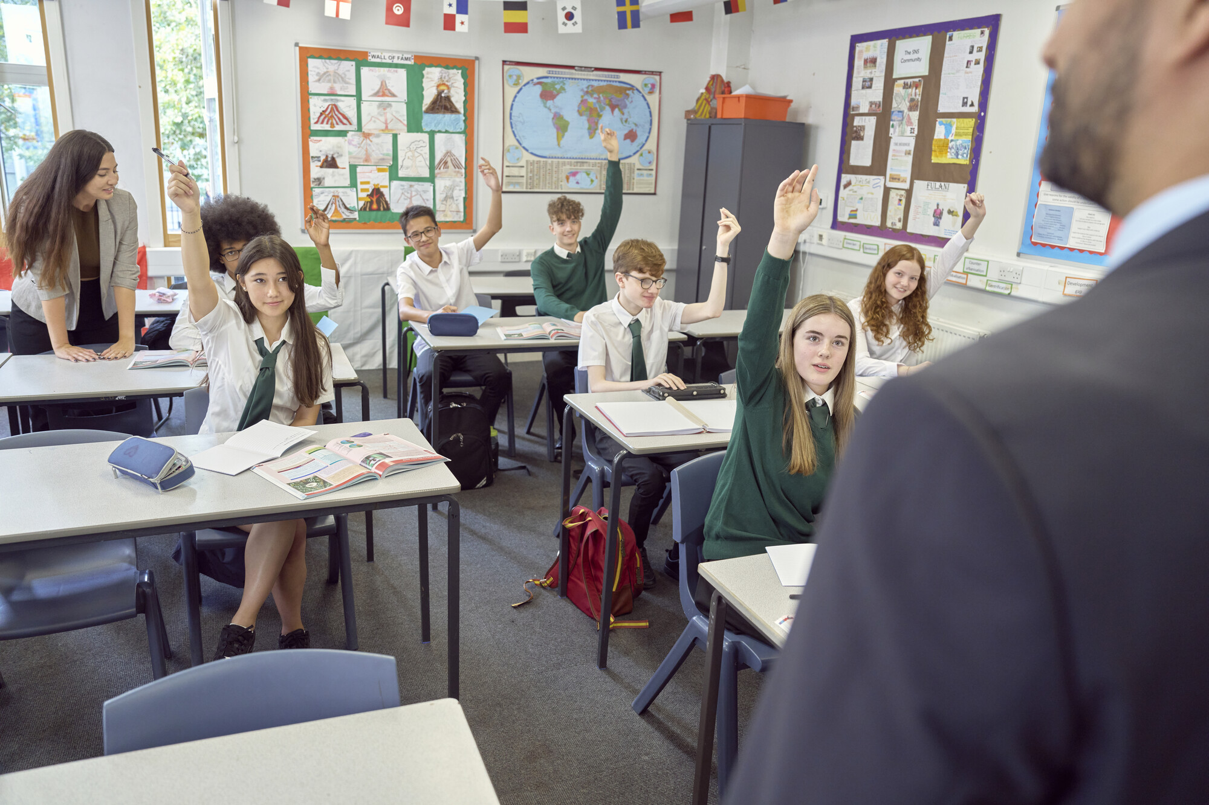
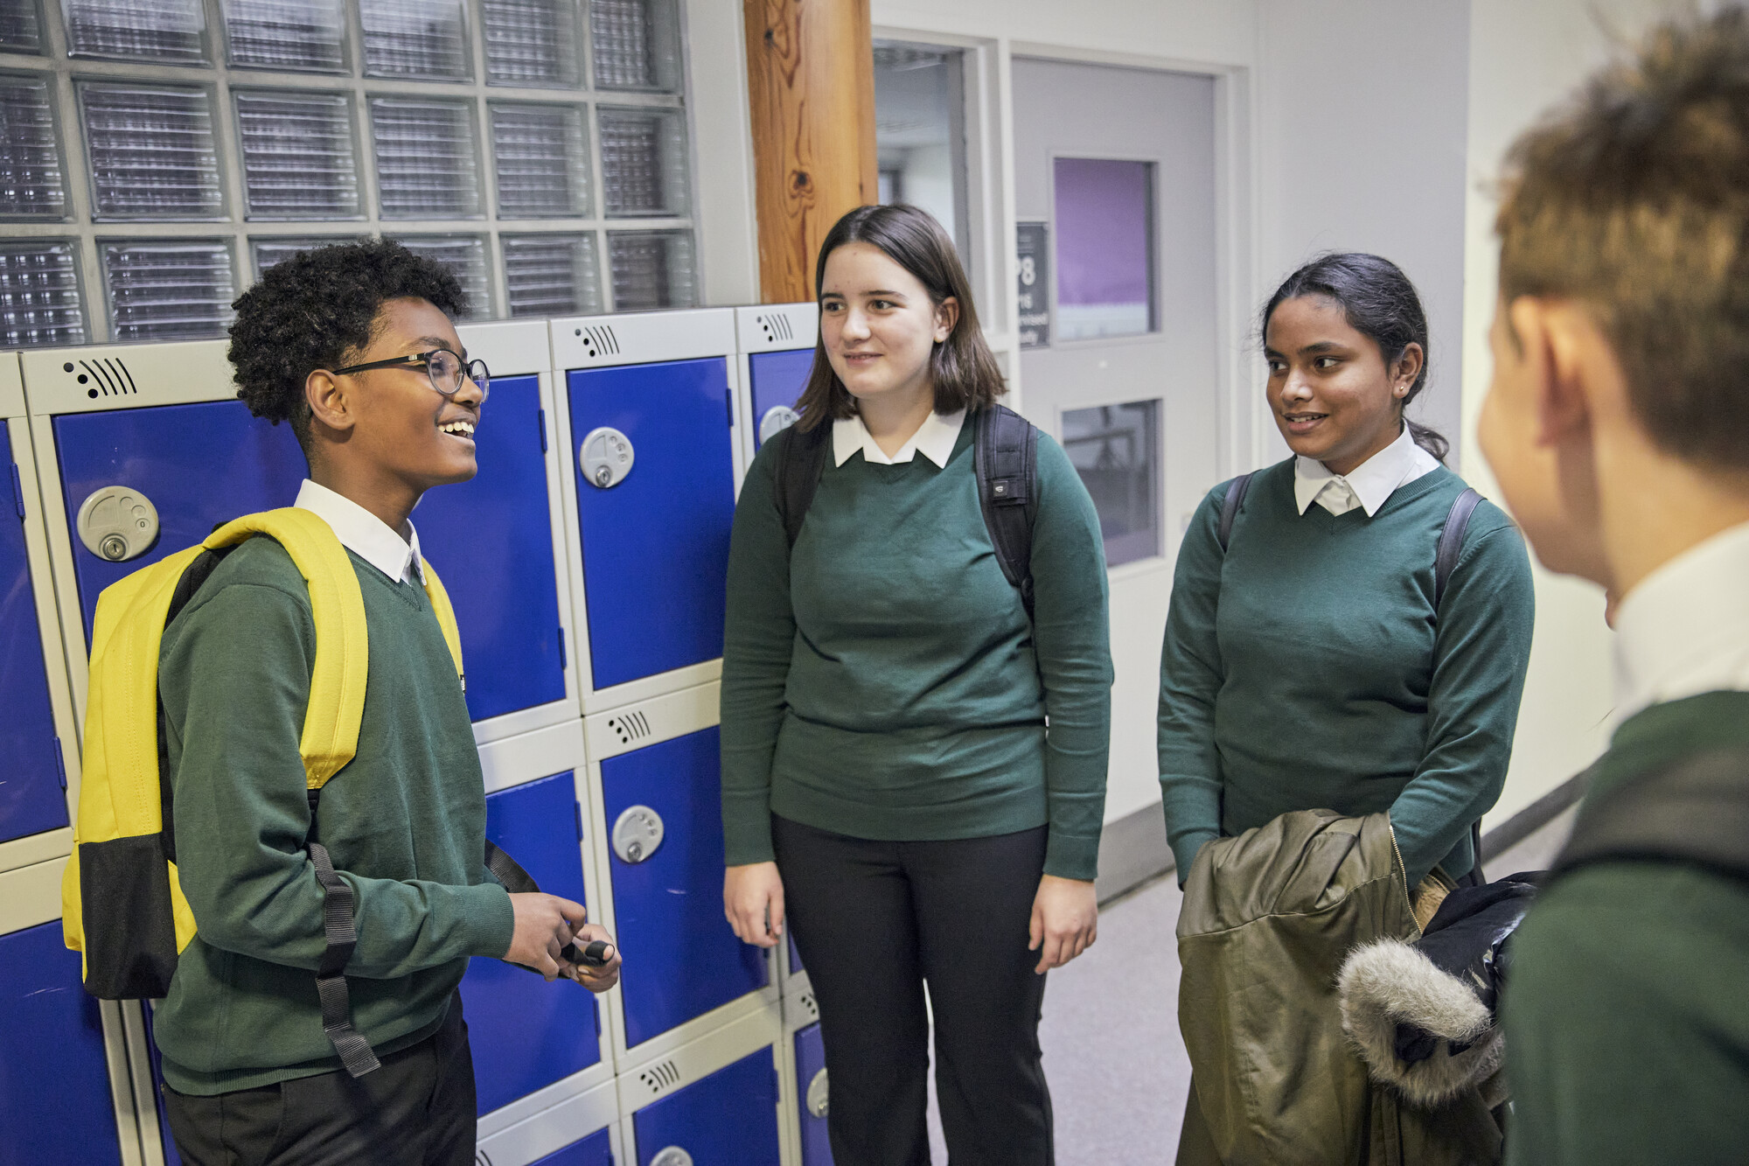

Talk Relationships
A whole school approach to support secondary school teachers & leaders to confidently deliver inclusive sex & relationships education with a year 6 into year 7 transition lesson available to primary schools
nspcc.org.uk/talkrelationships
Notes:
Talk Relationships is our new programme supporting secondary school settings to confidently deliver sex and relationships education.
It consists of a suite of resources that schools can use to deliver high quality RSE teaching in their settings.
We want all young people to understand healthy behaviours in relationships and recognise their right to be safe, heard and respected. And we want them to know how to get help from a safe adult if they need it.

Slide 7

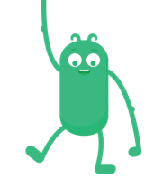
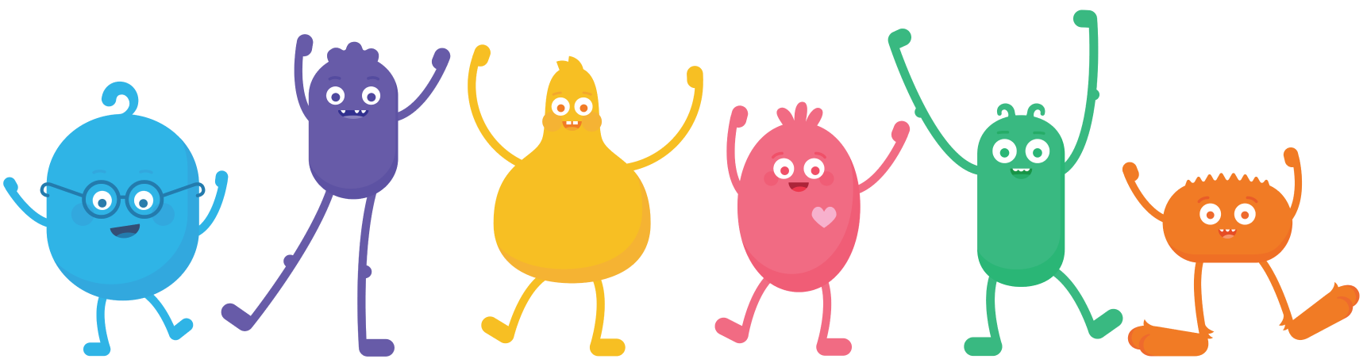


Digital Citizenship Resources
by
Common Sense Media
Media balance & wellbeing
Digital footprint & identity
Cyberbullying, digital drama & hate speech
News & media literacy
Relationships & communication
Privacy & Security
https://www.commonsense.org/education/uk/about-digital-citizenship
Notes:
The NSPCC are working in partnership with a charity called Common Sense, the aim of this partnership is to help us ensure that every child is safe online.
Common Sense is a charity registered in England and Wales, (SCOTLAND - the Scottish Government are recommending CSE resources to schools, and are working on aligning it to the curriculum​/ NORTHERN IRELAND - very early stages of a strategic partnership to share the Common Sense resources​) Common Sense HQ is in San Francisco, USA., So resources can be quite Americanised but there are links to UK resources to for each lesson.
Common Sense Media’s free Digital Citizenship education resources are used and trusted by more than 1 million users worldwide.
The resources engage learners to think critically, participate responsibly and take ownership of their digital lives.
They help build online resilience with easy-to-use lessons, which include videos, exercises and activities that empower young people with responsible real-world practices as they participate online. Materials are included for parents and carers within every lesson.
What are the Digital Citizenship Resources?
​Essentially it a suite of resources for schools to use. They help build online resilience with easy-to-use lessons, which include videos, exercises and activities that empower young people with responsible real-world practices as they participate online. Materials are also included for parents and carers within every lesson. ​
The resources engage young people to become a responsible digital citizen
But what is a digital citizen? A Digital citizen is a learner who can think critically, participate responsibly and take ownership of their digital life and the resources offered support children to do this.

