Slide 1






Enfield’s Journey
How we created opportunities for our
Gypsy, Roma and Traveller residents
www.enfield.gov.uk
In partnership with

Slide 2
Enfield is transforming GRT inclusion
Not as a standalone project, but as a core commitment embedded across every area of council life.
£1.95m saved in enforcement costs
Since 2018, our Negotiated Stopping model, now shared with other Local Authorities and recognised by the GLA, has transformed our relationship with travelling communities and delivered measurable financial savings.
A national model, not just a local one
Enfield's approach is now being actively shared with other Local Authorities. We are building infrastructure — a new Shared Community Hub, two permanent Traveller sites in planning — that will endure long after individual projects end.
Nothing for GRT without GRT
Eight dedicated working groups spanning health, education, employment, heritage and more, all with community representatives who shape decisions from the outset, not after the fact.
Embedded across the whole council
GRT inclusion is written into the Fairer Enfield Strategy and the Equality & Diversity Policy. This is not a project that can be cut, it is woven into how the council operates across all departments.
Notes:
✅ 全市嵌入式領導：GRT inclusion 寫進 Fairer Enfield Strategy，不是獨立計畫
✅ 共同設計而非單方決策：8 個工作組都有社區代表參與
✅ 可量化的系統性成果：700 次 GP 登記、£50K 以上費用節省、1,700 Library 訪客
✅ 創造模式可複製：Negotiated Stopping 模式與其他 Local Authorities 分享
£1.95m saved · National model · Community co-design · System-wide

Slide 3
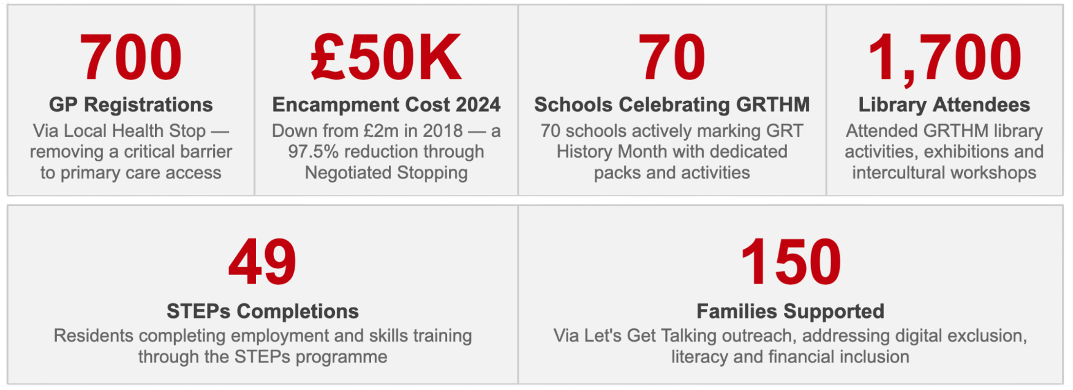
Snapshot key achievements 2025
A year of significant milestones across every workstream, demonstrating the breadth and depth of Enfield's commitment to GRT inclusion.
Notes:
✅ 全市嵌入式領導：GRT inclusion 寫進 Fairer Enfield Strategy，不是獨立計畫
✅ 共同設計而非單方決策：8 個工作組都有社區代表參與
✅ 可量化的系統性成果：700 次 GP 登記、£50K 以上費用節省、1,700 Library 訪客
✅ 創造模式可複製：Negotiated Stopping 模式與其他 Local Authorities 分享

Slide 4
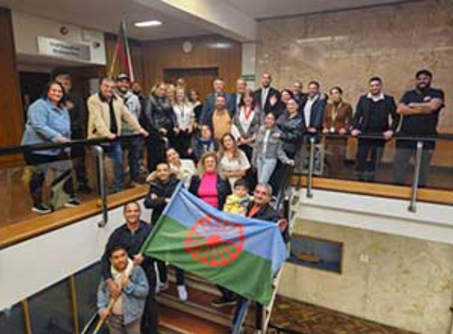
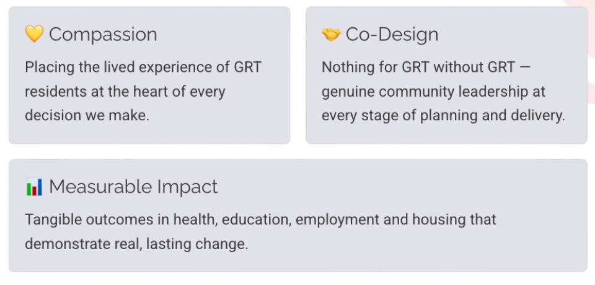
3 reasons why Enfield is leading the way
Enfield is transforming inclusion and setting a benchmark for local government excellence in GRT inclusion. Our approach is built on three foundational pillars.

Slide 5
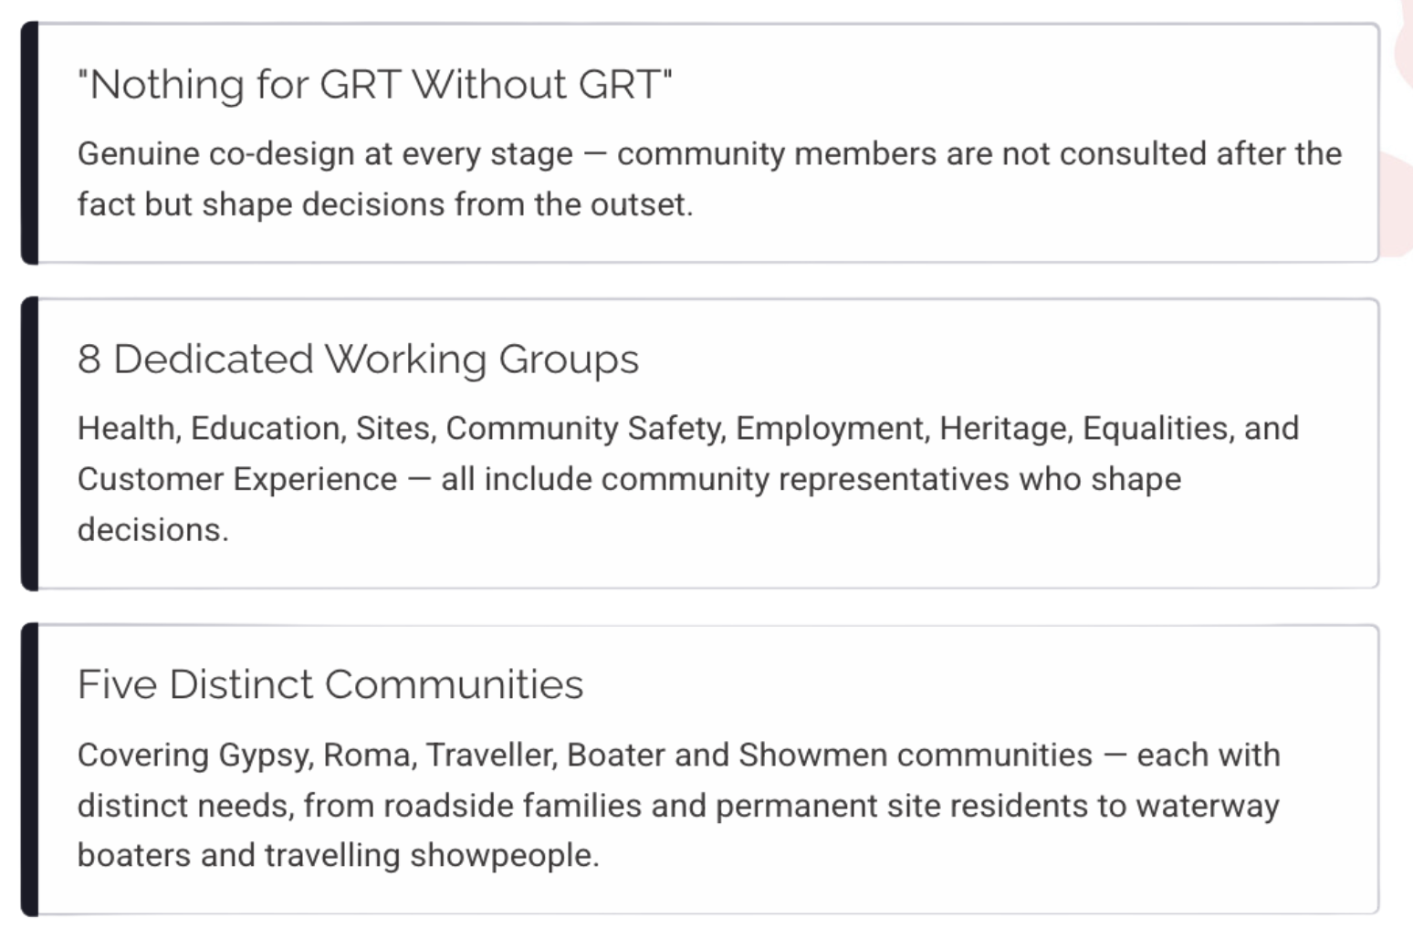
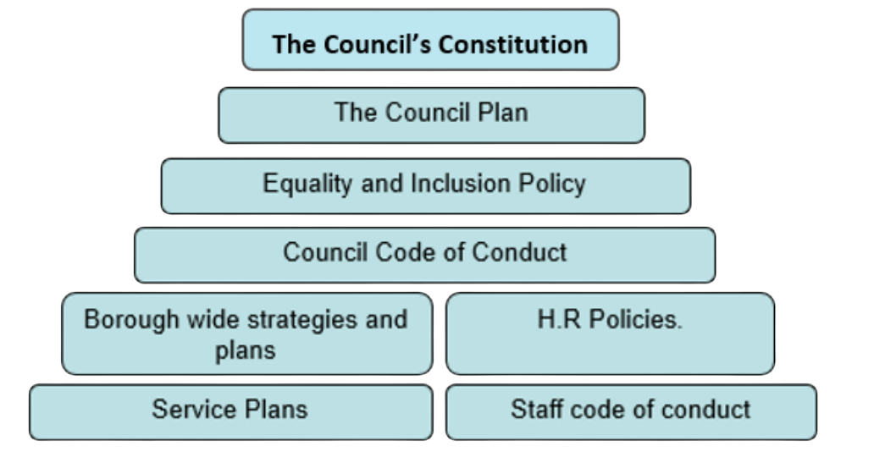
Integrated, Inclusive Leadership
GRT inclusion is embedded at every organisational level in Enfield — written into the Fairer Enfield Strategy and Equality & Diversity Policy. This is a core council commitment across all departments, not a standalone project.

Slide 6
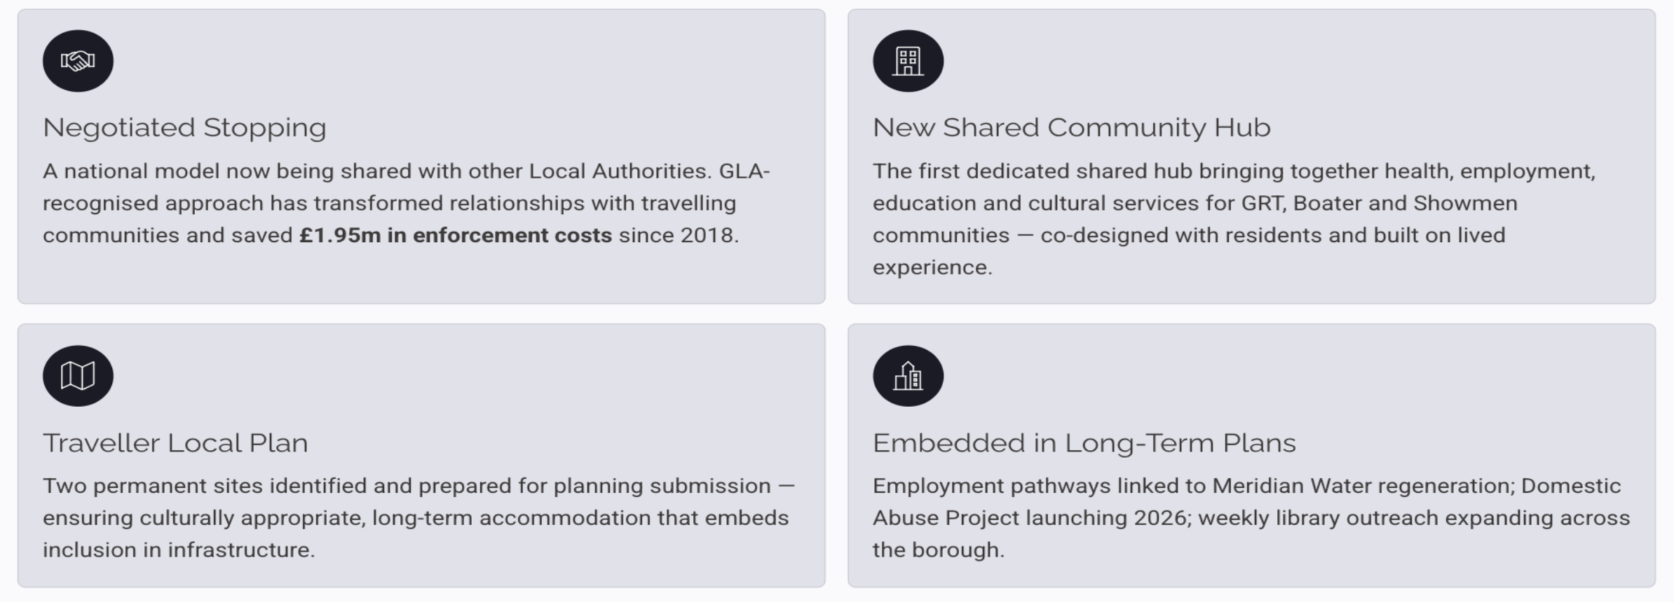
Bold, Sustainable Change
Enfield's most significant achievements represent systemic transformation — creating national models, lasting infrastructure and embedded inclusion that will endure long after individual projects end.

Slide 7
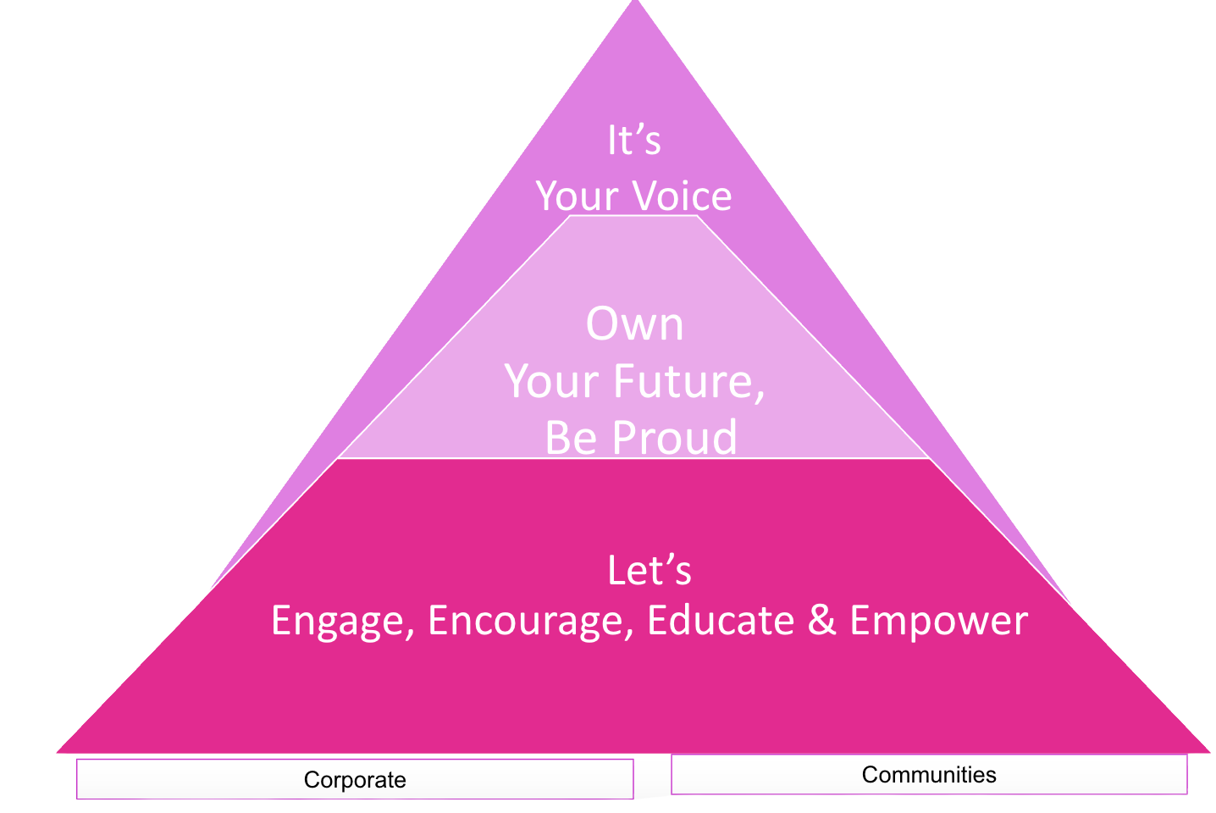
Our Customer Experience: How We Work With Communities
Everything Enfield does for GRT communities is built around one principle: genuine empowerment, not passive service delivery. This framework guides how we engage, how we deliver, and how we measure success.

Slide 8
GRTBS Project Board
Health and Wellbeing
Education
Community Engagement
Site Delivery
Ensuring Enfield's strategic approach to Gypsy, Roma & Traveller communities embedding inclusion across every area of council activity.
Financial Inclusion & Employment
Community Safety
Customer Experience & Journey
Equalities Monitoring
Heritage & Culture

Slide 9
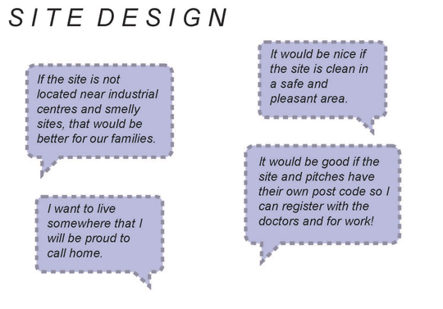
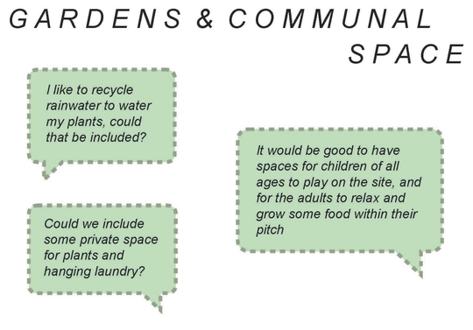
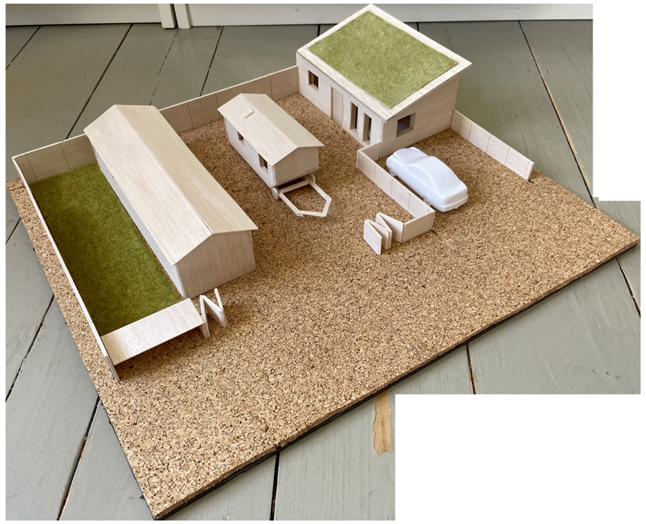
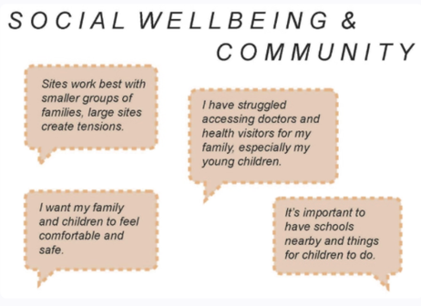
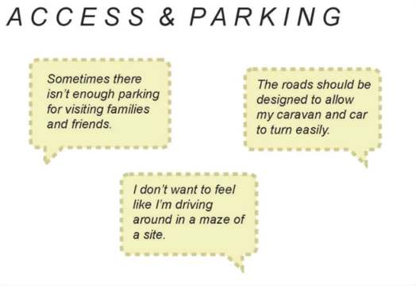
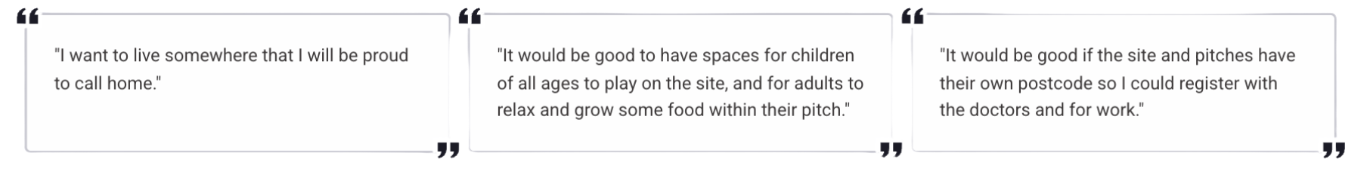
Site Delivery – We actively listened
Enfield's approach to site design is rooted in genuine community co-design. Through structured engagement, residents shaped the vision for new permanent sites — ensuring culturally appropriate, safe and welcoming spaces.

Slide 10
Education — No Child Left Behind
GRT Education Action Plan 2021-2026: cultural awareness training for school staff, inclusion charter guidance
Peer groups established for GRT families and school staff - sharing cultural knowledge and competency
Roadside education: 16 cases enrolled; rapid response for newly arrived families
70 schools actively celebrating GRT History Month with dedicated packs and activities
Commitment to GRTBS Pledge & Mistow Pledge

Slide 11
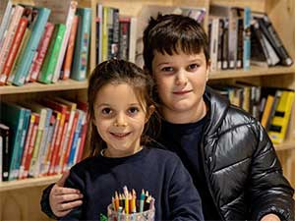
Case Study — Exclusion to Belonging
“Every student deserves the chance to dream, achieve and feel safe in education.”
Enfield's education inclusion approach ensures that GRT pupils are never left behind. By preventing Elective Home Education in cases where digital exclusion and literacy challenges may be prevalent, the council actively safeguards children's long-term life chances and social connections.
What Changed:
  A GRT family faced the risk of their child being permanently excluded from school
  Working with the family, Head of Inclusion and Headteacher, we built an understanding of GRT culture
  A managed move was avoided — belonging replaced exclusion
  The school now actively celebrates GRT culture through regular events
  The student completed their GCSEs; younger siblings now attend the same school
Early Support
Identifying at-risk pupils before crisis point — cultural awareness training for school staff is central to this work.
Family Partnerships
Building trust with GRT families so that schools feel safe, welcoming and respectful of cultural identity.
Targeted Interventions
One-to-one tutoring, managed moves avoided, and tailored plans that address learning gaps without stigma.
The Intervention: We partnered with The Traveller Movement to provide access to an online training and development programme, offering one-to-one tutoring and addressing learning gaps, helping the student re-engage and rebuild confidence.

Slide 12
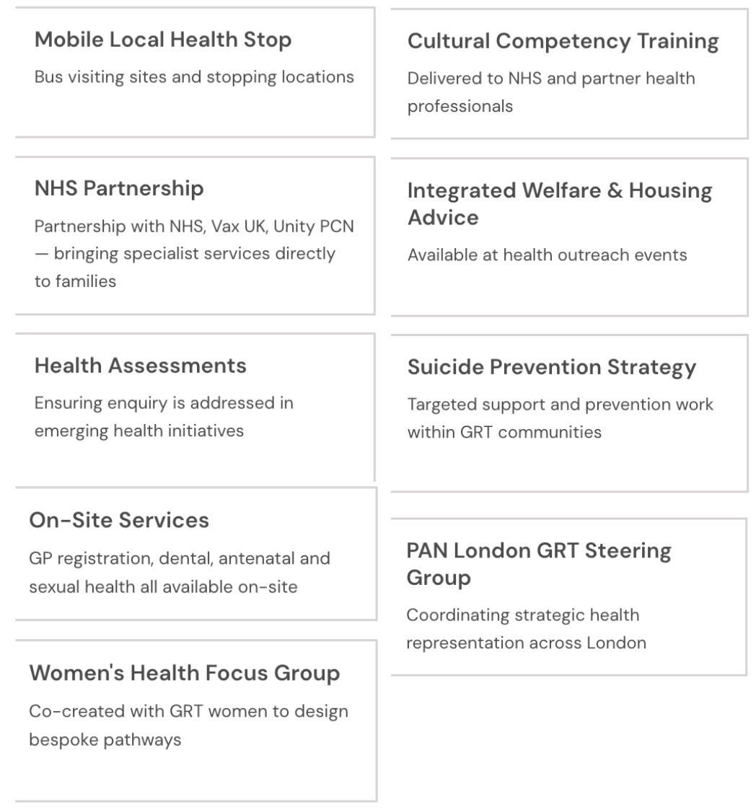
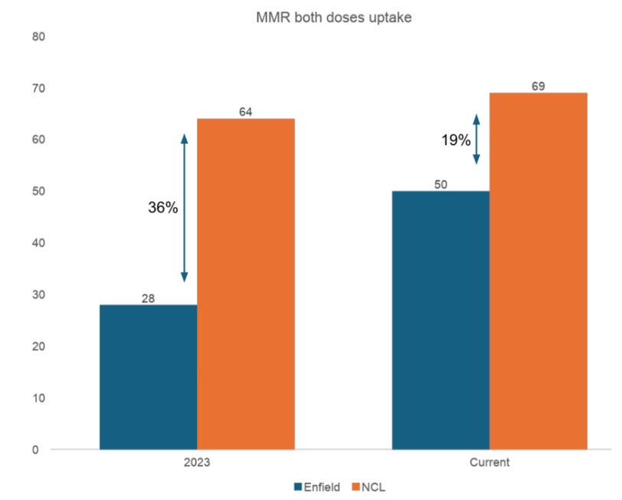


Health & Wellbeing — 'Your Local Health Bus Stop'
Increases in vaccination uptake: 2023 to date

Slide 13
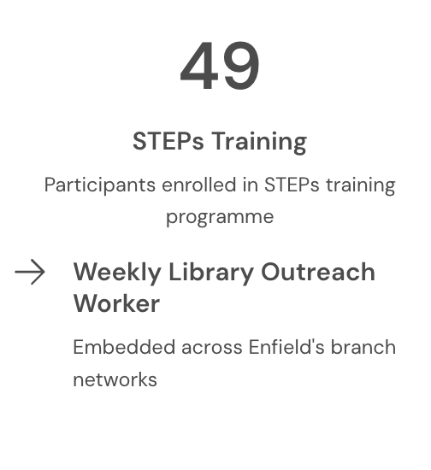
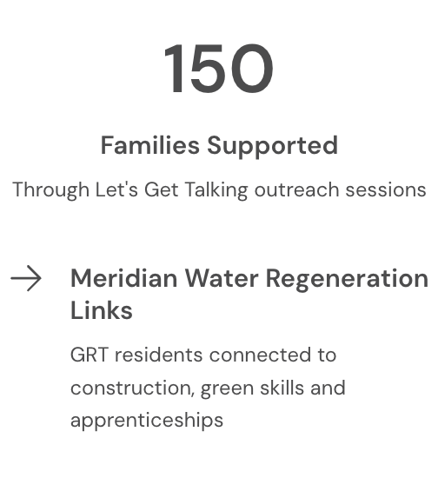
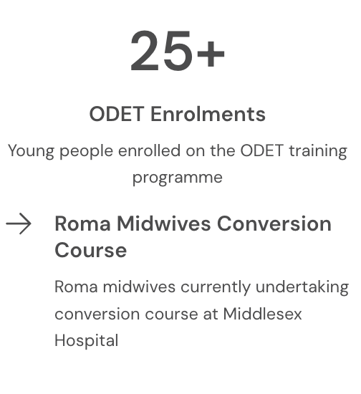
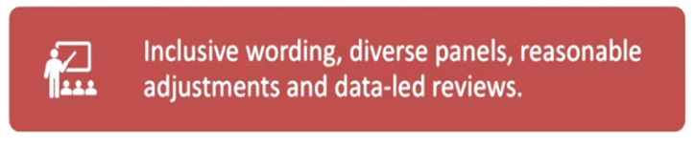
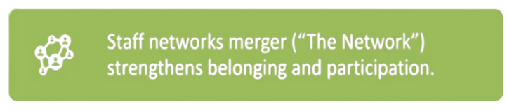

Employment - Equity & Equality Matters
Inclusive recruitment & workforce culture

Slide 14

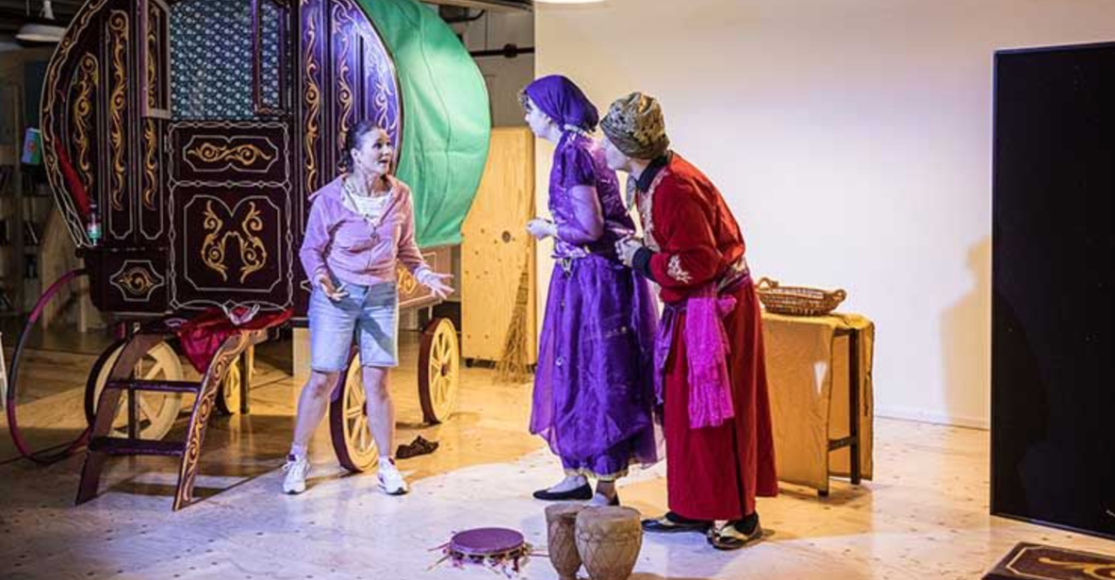
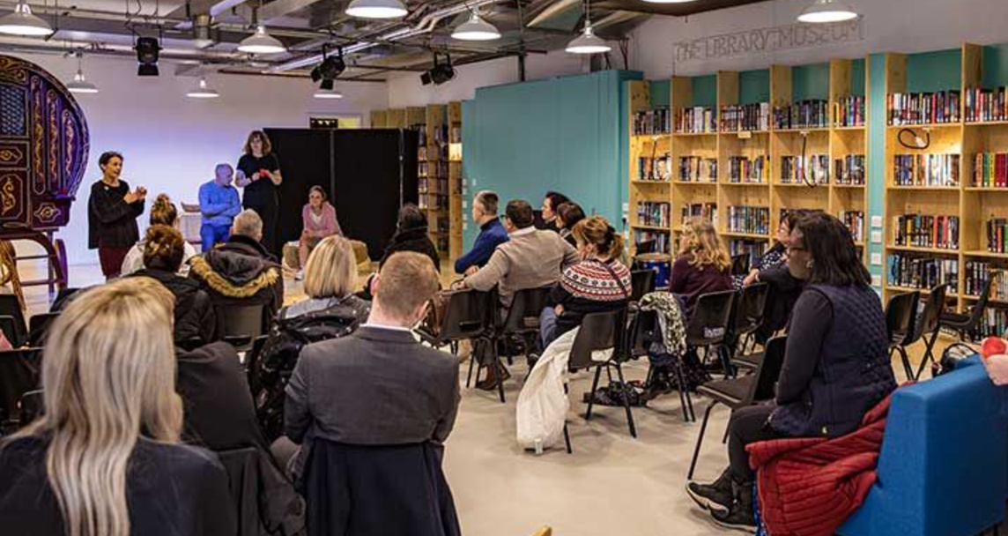
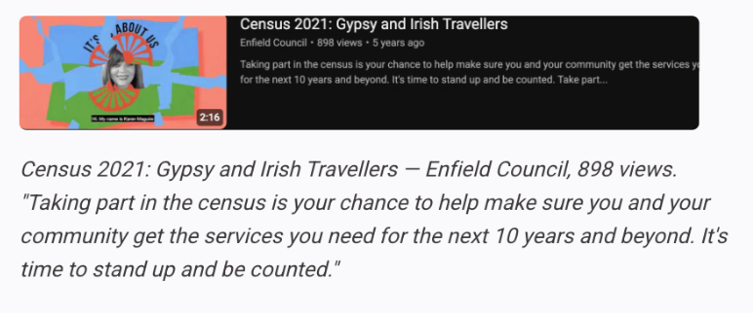
Heritage & Culture: Working in Collaboration
Enfield Council has worked in partnership with communities and national bodies to ensure GRT residents are heard, counted and celebrated. Below are examples of community-facing campaigns that have shaped participation and inclusion.
Community Celebrations
  Celebrating significant dates for our communities in Enfield
  Flying Roma Flag at Civic Buildings
  Roma Celebration – 200 attended Civic event
  Crystal's Vardo performances
Libraries & Learning
  Storytelling and Nursery Rhymes with young Mums
  GRTHM library activities, exhibitions and intercultural workshops
  Ensuring our Libraries have reading materials and activities that resonate with our communities

Slide 15
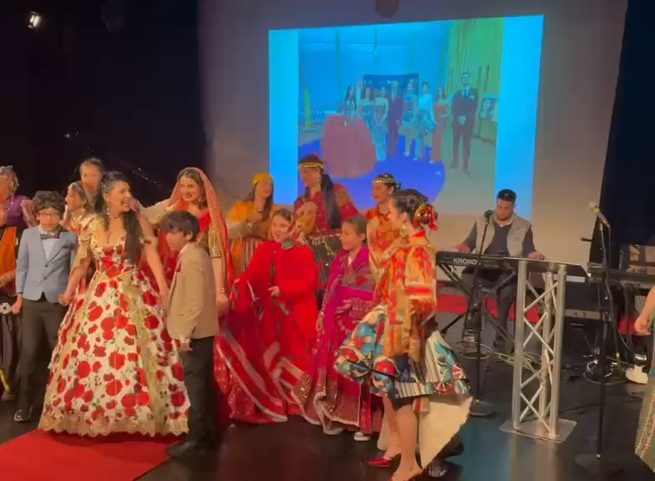
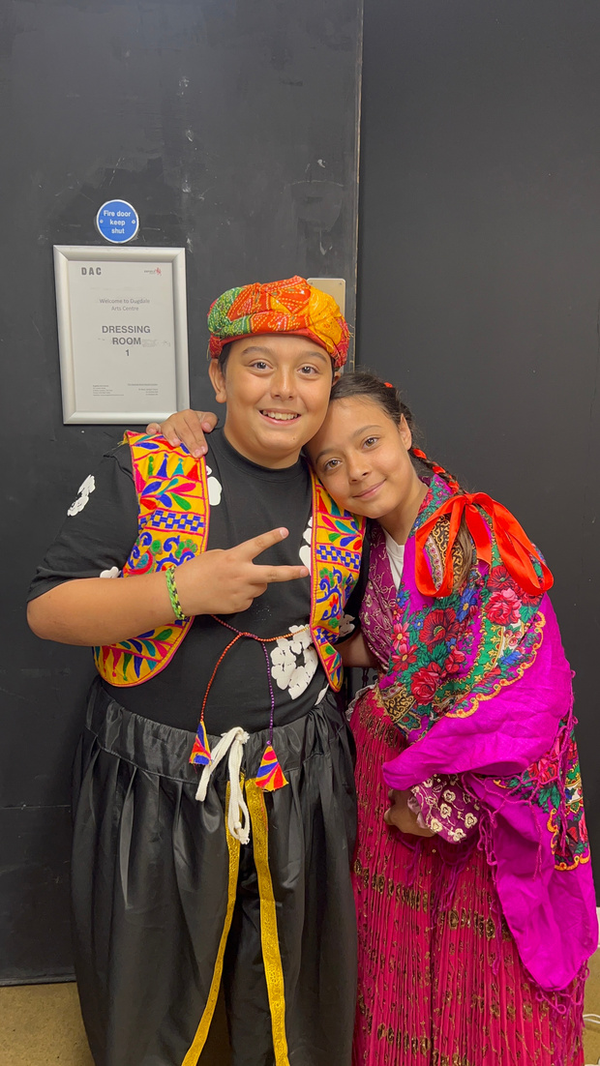
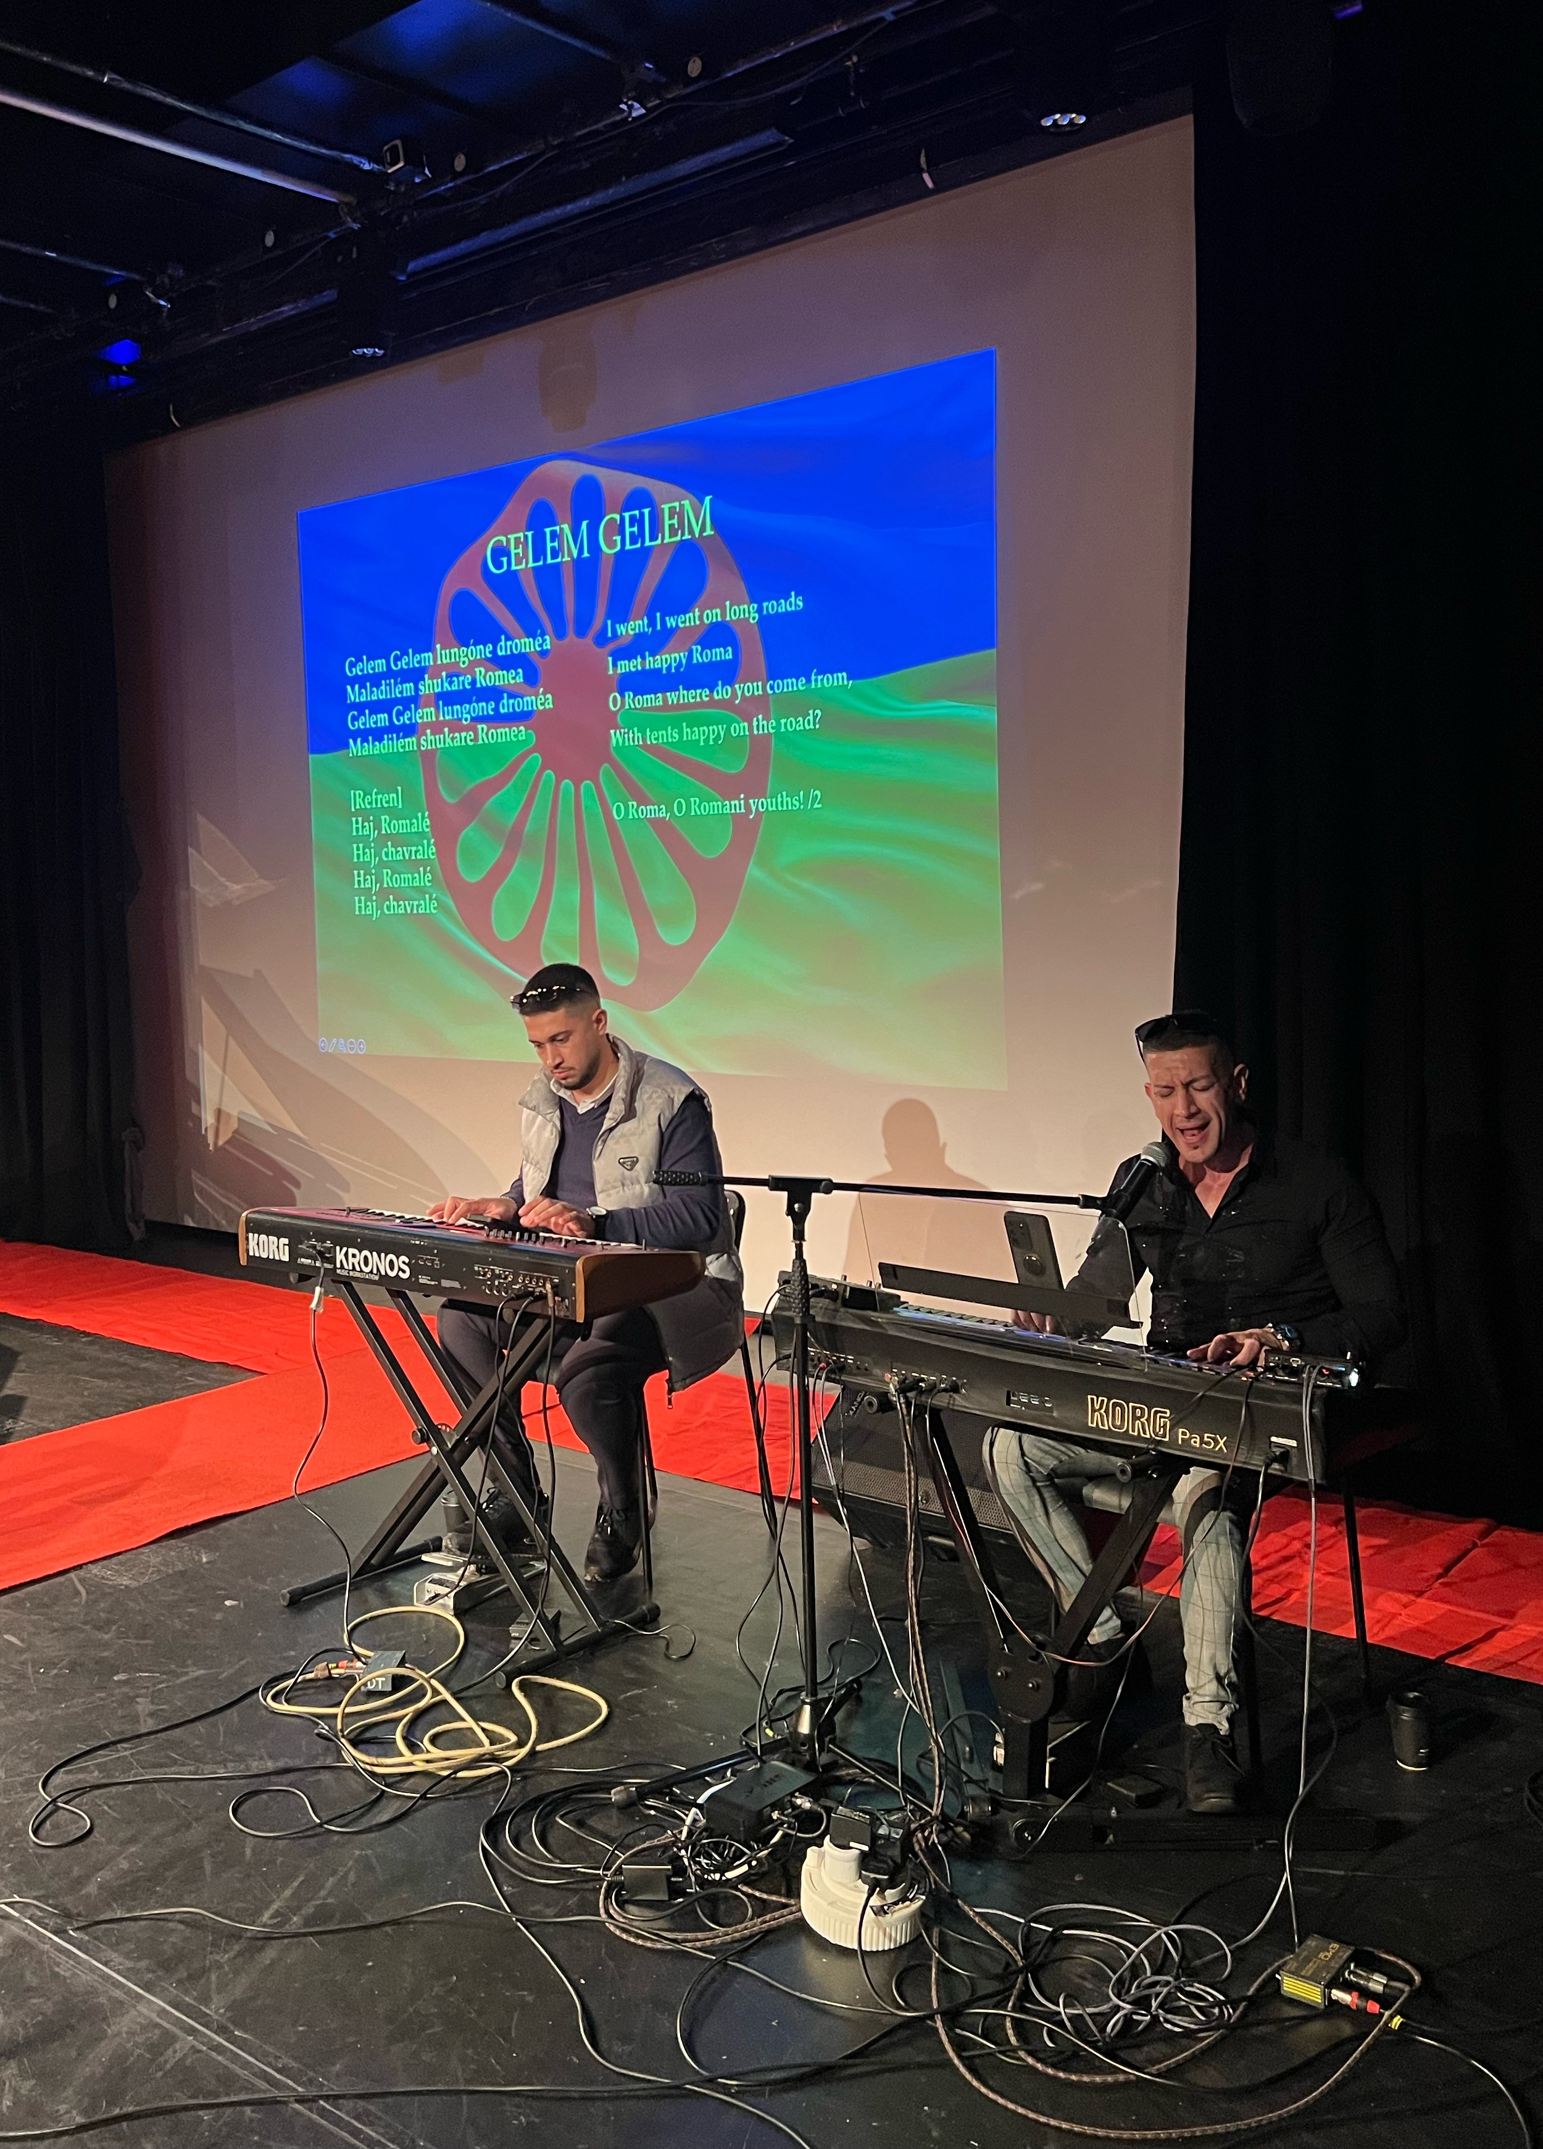
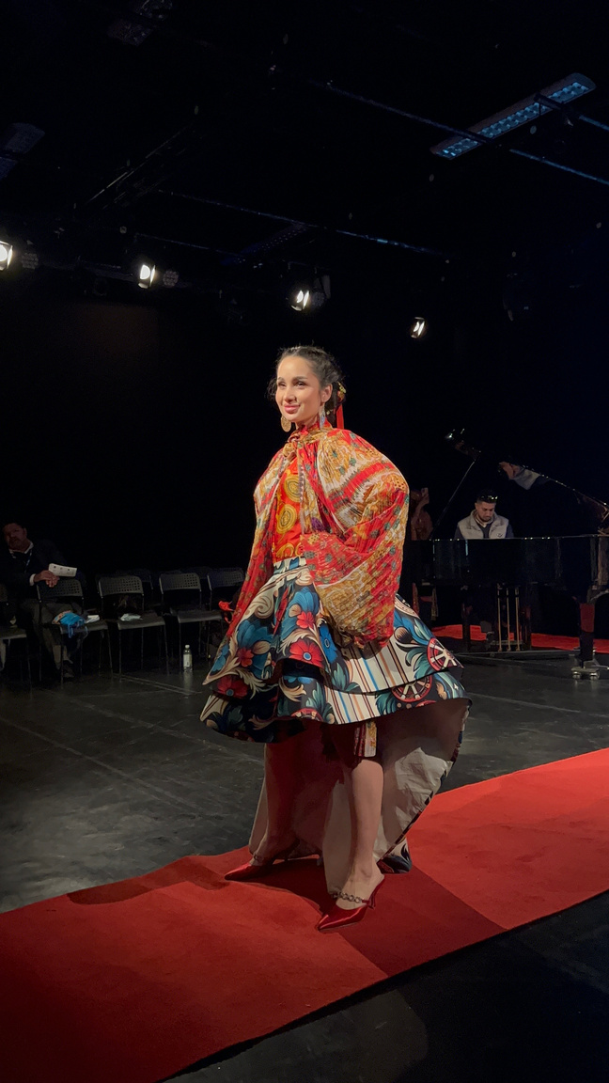
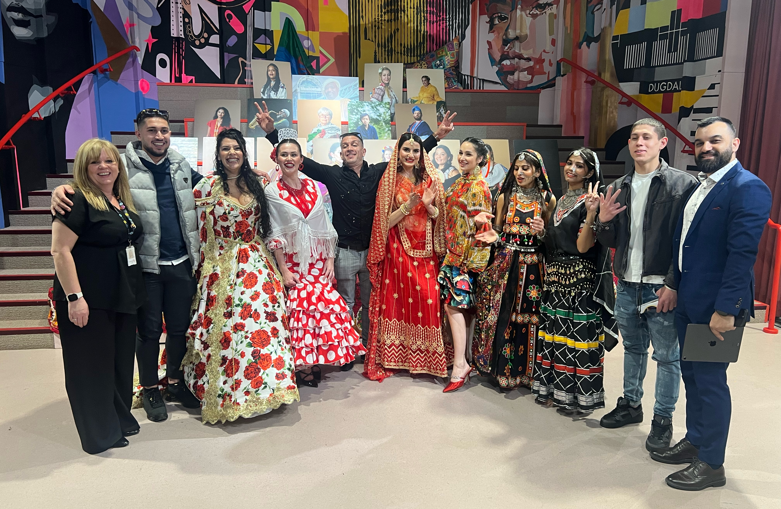
8th April International Roma Day
Enfield celebrated International Roma Day on 8th April at the Dugdale Centre, to recognise and honour the history, culture and contributions of our Roma Communities in Enfield. It was a celebration to acknowledge our community’s rich heritage and the challenges they face. We stand united together, promoting understanding, acceptance and equality.

Slide 16














Systemic Change
Enfield's achievements are only possible through deep, sustained partnership. Our network spans community organisations, health bodies, strategic regional partners and specialist support services — all united by a shared commitment to GRT inclusion.
GRT Community Organisations
Health Partners
Regional & Strategic Bodies
Specialist Support
Elected Members & Councillors
Enfield Wider Community
How we work together: Monthly drop-in sessions co-hosted with partners · Bi-weekly housing meetings with London Gypsy Travellers · Cultural awareness events and joint training · Shared representation on GRTBS Project Board · Joint outreach presence in the communities

Slide 17
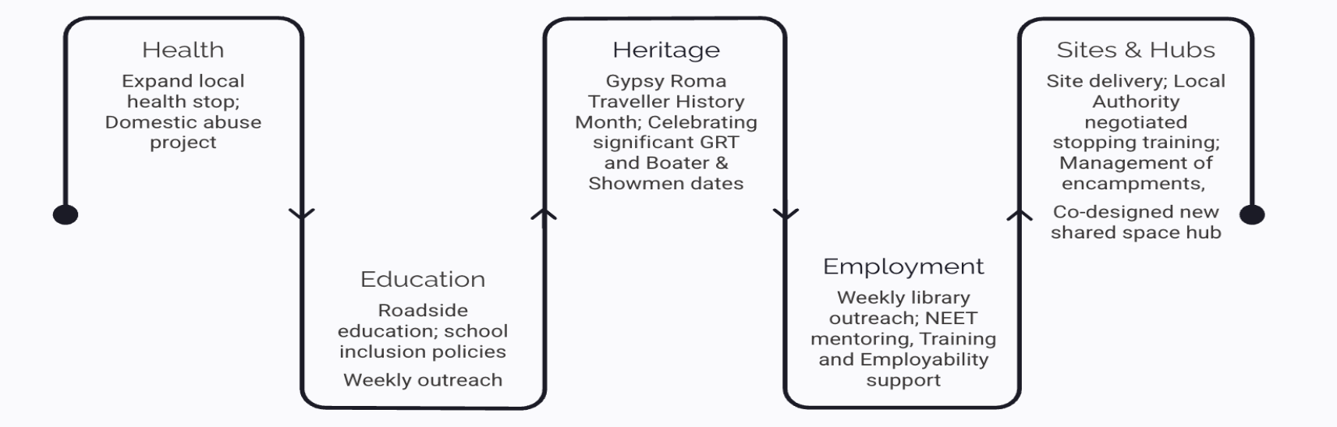
Road Map for 2026
A clear and committed programme of action for the year ahead, spanning all six strategic workstreams.
Every strand of this road map has been shaped with community input — ensuring Enfield's ambitions for 2026 reflect the priorities of GRT, Boater and Showmen residents themselves.

Slide 18
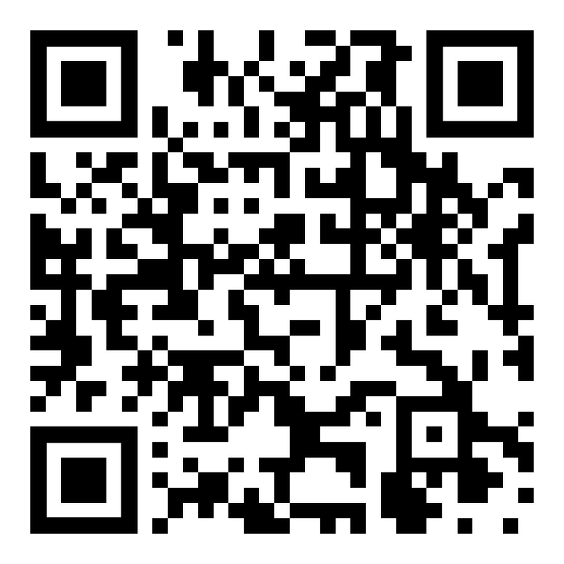

Follow our Journey
February 2026: Your Local Health Stop (Enfield Case study) | The Traveller Movement
Beyond Basics: Empowering Roma Traveller Adult Learners - Meet Kolyo
Gypsy, Roma and Travellers in Enfield | Enfield Council
https://www.enfield.gov.uk/services/your-council/grt

Slide 19


Any questions?
Thank you
Email
grt@enfield.gov.uk
Phone
020 8132 0958

